Slide 1
The Kubos Project
Nick, Jacob, Matthew

Slide 2

kubos
Using FreeRTOS and Docker, KubOS implements communication to microcontrollers
http://www.kubos.co/kubos/
http://docs.kubos.co/0.1.4/index.html

Slide 3
Freertos
KubOS is a layer of abstraction
Allows an easy user interface for programmers to use FreeRTOS
http://www.freertos.org/

Slide 4

Docker
Docker uses containers to contain anything needed for software (code, libraries, system functions)
Docker has a container for FreeRTOS which KubOS uses to implement functions from the OS
https://www.docker.com/

Slide 5
Microcontrollers
KubOS main purpose is to make programming boards easier for developers
The following is the microcontrollers currently supported by KubOS:
STM32F4 Discovery Board
MSP430 Launchpad

Slide 6
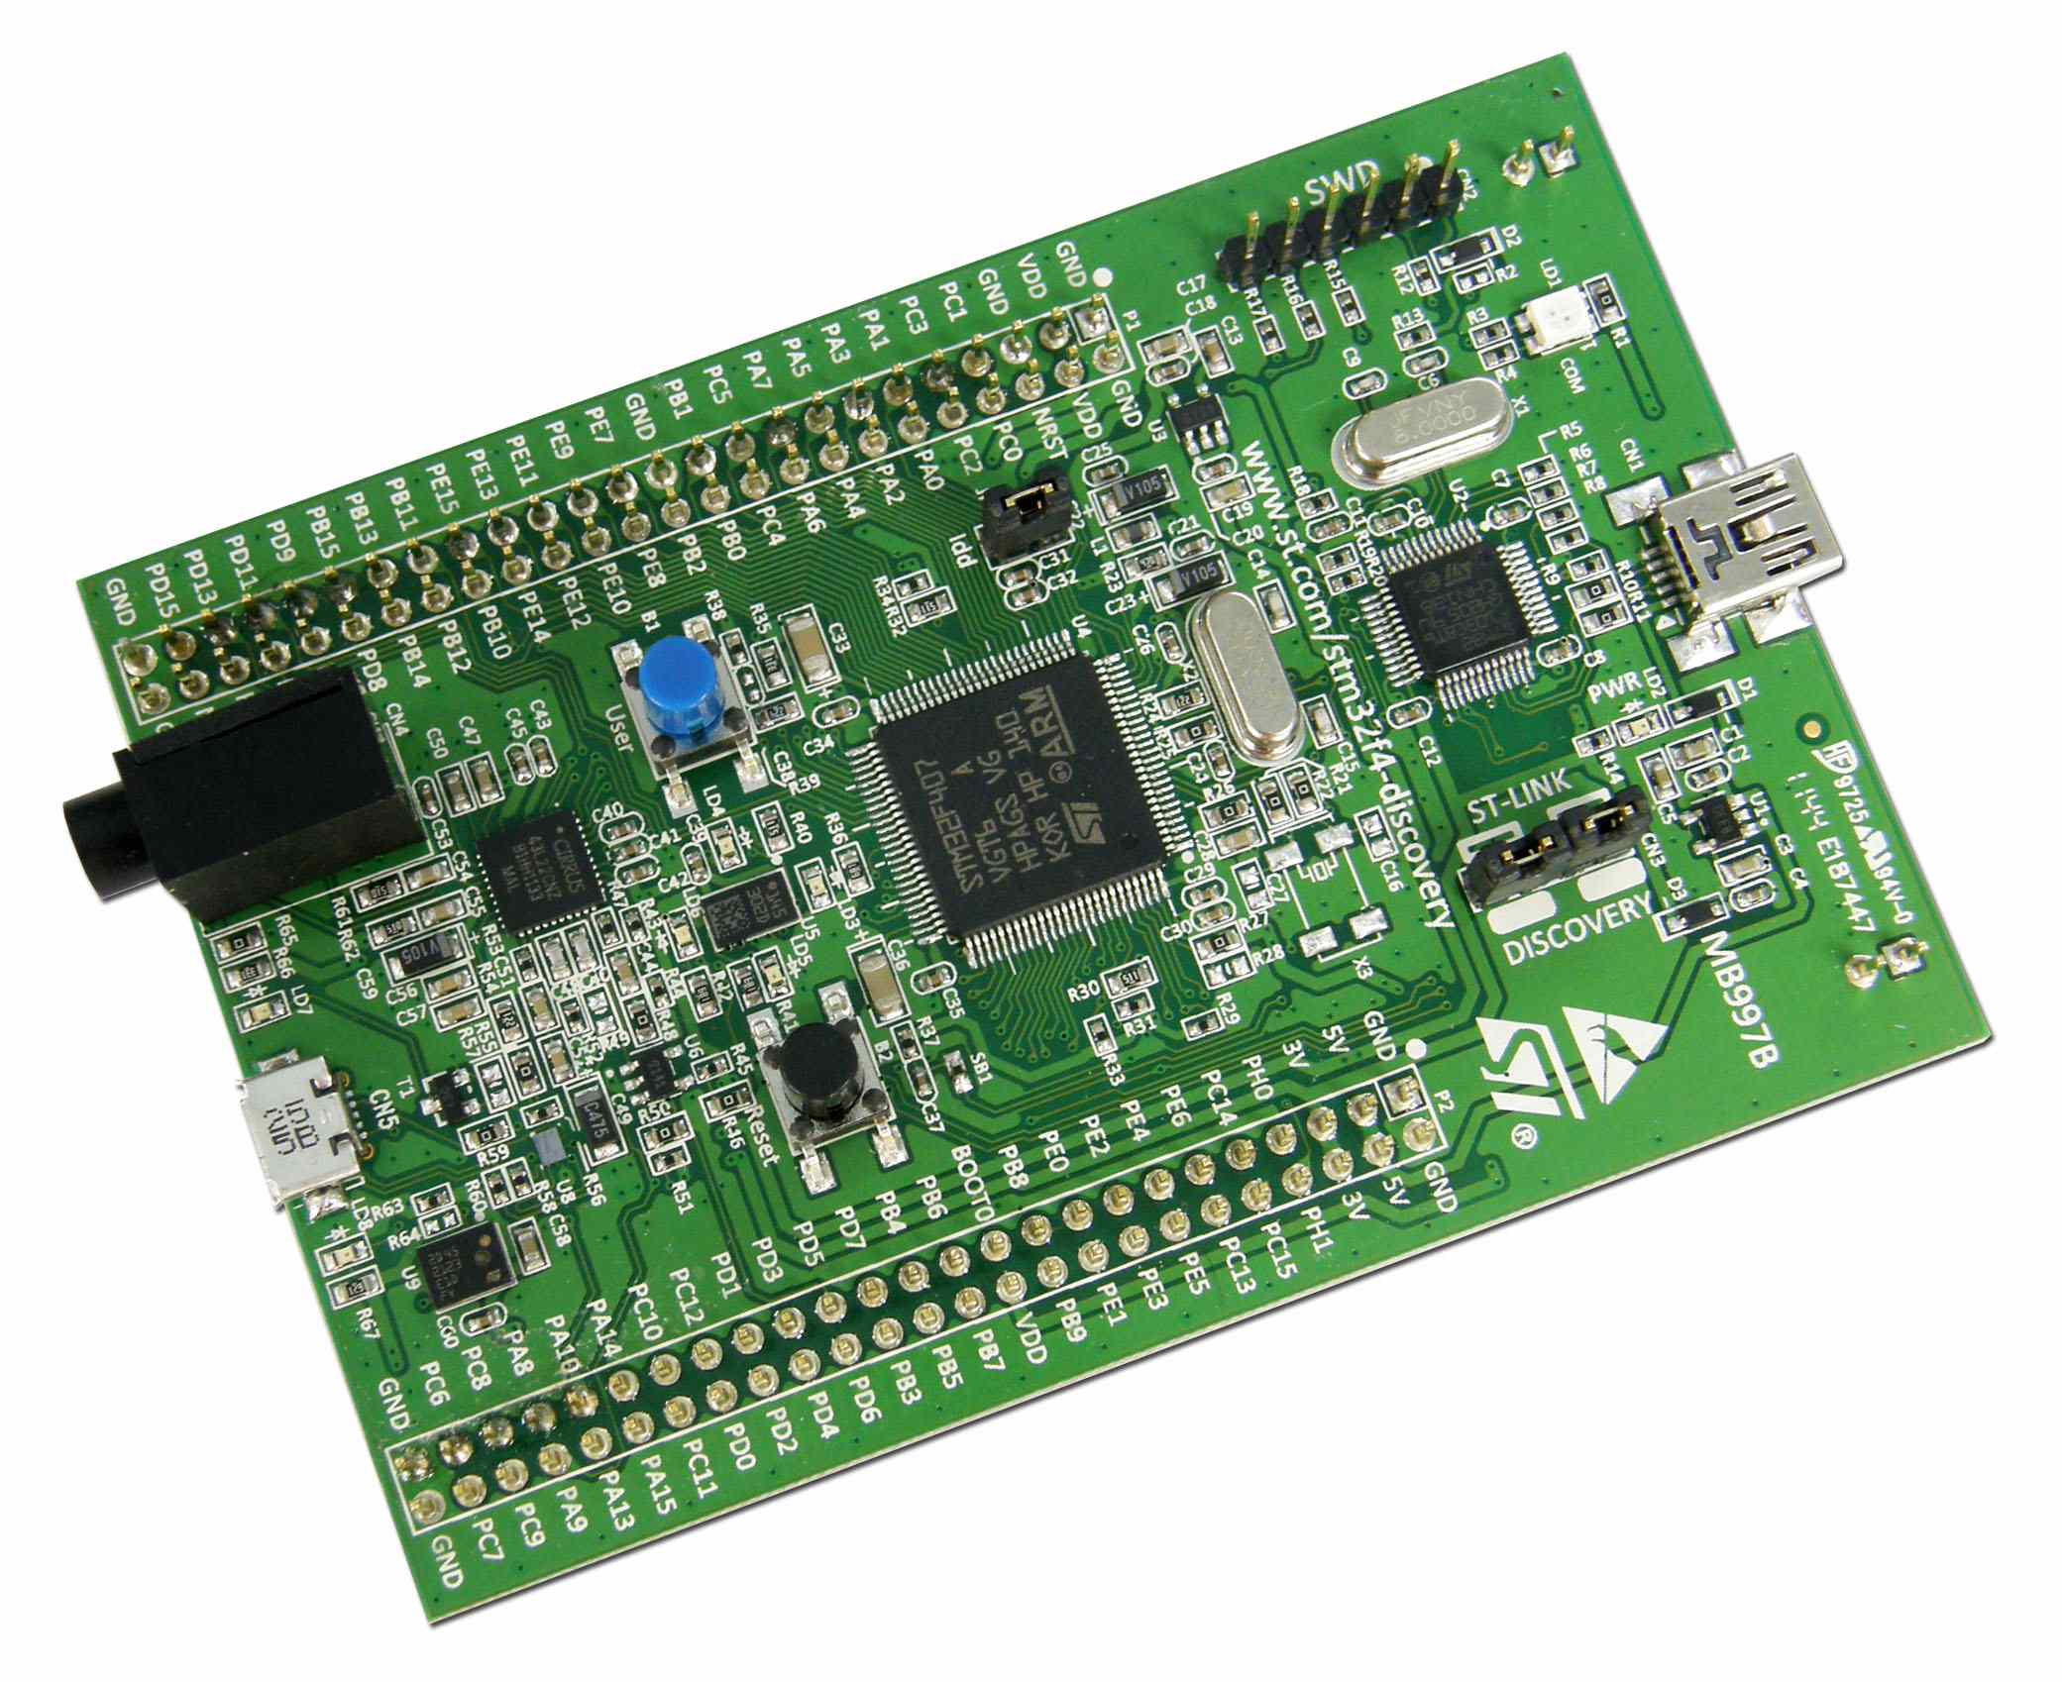
Stm32f4 Discovery board
Not much success using this board
Mainly supported by Windows
KubOS is used in Unix environments (Mac, Linux)
http://docs.kubos.co/0.1.4/md_docs_STM32F4-discovery-board-guide.html

Slide 7
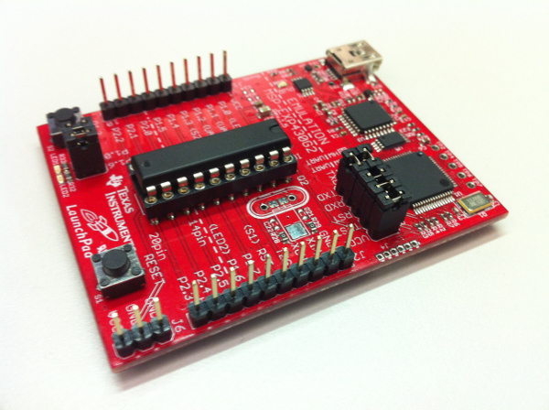
MSP430 Launchpad
Supports communication such as UART, SPI, and I^2C
Mainly using this board for development
http://docs.kubos.co/0.1.4/md_docs_MSP430-launchpad-guide.html

Slide 8
Tasks to accomplish
The tasks we want to implement is for the board we are using to communicate information back to us
Using KubOS and MSP430, we will run a task and have it communicate back to us
Communication methods available are I^2C, UART, and SPI

Slide 9
Communication Protocols
I^2C (Inter-Integrated Circuit)
UART (Universal asynchronous receiver/transmitter)
SPI (Serial Peripheral Interface)

Slide 10
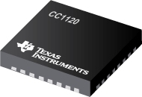
CC1120
This is the transceiver used in communication
It uses SPI protocols for communication
These need to be changed to functions that KubOS can use

Slide 11
SPI Protocol functions
SPI.begin(); //Initialize SPI
SPI.beginTransaction(); //Begin an SPI communication
SPI.transfer(); //Communicate information
SPI.endTransaction(); //End an SPI communication

Slide 12
Using SPI
void strobe ( uint8_t strobe ){
SPI.beginTransaction(s);
digitalWrite(cs_cc1120, LOW);
status.val = SPI.transfer( READ_BIT | strobe );
digitalWrite(cs_cc1120, HIGH);
SPI.endTransaction();
}

Slide 13
Converting spi to functions usable to kubos
We need to convert SPI function to able to communicate to KubOS
The following are functions used by KubOS when communicating to the board:
k_gpio_write();
k_spi_write_read();

Slide 14
Communicating back to the board
void strobe(uint8_t strobe){
uint8_t tx = READ_BIT | strobe;
volatile uint8_t rx = 0;
k_gpio_write(FAKE_CS, 0);
k_spi_write_read(SPI_BUS, &tx, &rx, 1);
status.val = rx;
k_gpio_write(FAKE_CS, 1);
}

Slide 15
Thank you!
Questions?
Comments?

