Slide 1


Slide 2

Autolab
Jacob Hochstetler
2018-09-17
Platform Development Kit progress

Slide 3
Research Areas
NVIDIA DRIVE™ Foundation
Hypervisor Architecture
The Linux Foundation
Open Container Initiative
Layers of Isolation (Sandboxing)
Machine-level virtualization
Rule-based execution
Modified shim kernel

Slide 4
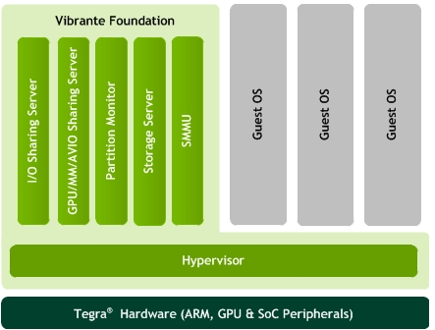
NVIDIA DRIVE™ Foundation

Slide 5
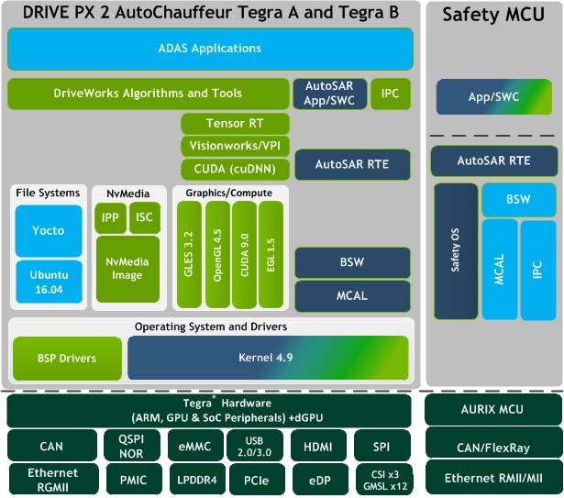
DRIVE™ PX2 AutoChauffeur

Slide 6
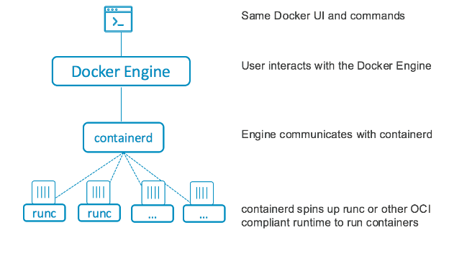
Open Container Initiative

Slide 7
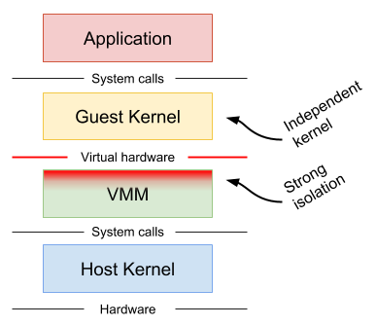
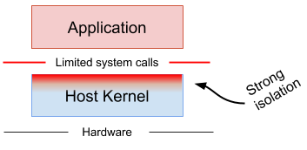
Layers of Isolation (Sandboxing)
Machine-level (hypervisor/virtual machine)
Rule-based (SELinux, AppArmor)

Slide 8
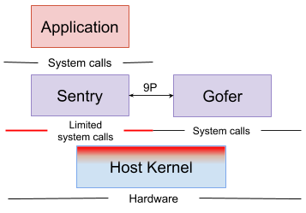
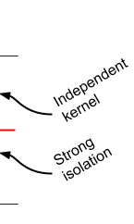
Layers of Isolation (Sandboxing)
Modified shim kernel
Provides:
Call filtering
Filesystem proxying
Network isolation (at a data-link layer)

Slide 9

Questions/Discussion?
State of the University

