Slide 1
The Dark Factory
Use of AI in Industry
Jacob Hochstetler
Notes:
Welcome, quick framing: dual role as a platform engineer at Fidelity and a clinical professor here.
This talk blends daily practice with what the research and news actually show about AI coding agents.

Slide 2
Agenda
Foundations
The lifecycle
Guardrails
Skills
Orchestration
Auditing & security
Team health
Economics
Limits
Closing
Notes:
Nine stops: what a dark factory is, how the SDLC (Software Development Life Cycle) changes, the guardrails that make it safe, orchestration roles, security, team health, economics, and where the limits are.
Interrupt any time.

Slide 3
Disclaimer
The views expressed here are my own and do not reflect those of my employers.
Notes:
Standard disclaimer, said briefly: personal views, not an institutional position from either employer.

Slide 4
The Dark Factory Concept
A dark factory runs unattended, lights off, automated
Software’s version: minimal human touch, agents build and merge
Term borrowed from manufacturing’s “lights-out” floors
  FANUC has run one lights-out since 2001
Why now: task horizon, falling costs, competitive pressure
Trust comes from guardrails, not blind delegation
No real factory runs fully dark — neither does software
Notes:
FANUC (Fuji Automatic Numerical Control) is a Japanese company, the world’s largest industrial robot maker, headquartered near Mount Fuji.
Lights-out manufacturing is the metaphor — FANUC's plants build robots unsupervised because guardrails, not blind trust, make that safe.
Same logic for code: humans set intent, agents execute, guardrails keep it honest.

Slide 5
What Actually Changed: Task Horizon
Early models held one function in working memory
By 2026, agents sustain multi-hour, multi-file tasks
Task horizon: how long an agent stays coherent
  METR tracks this publicly as “task length”
The 2021-to-2026 jump was about horizon, not raw capability
Longer horizons mean less human re-prompting per task
Horizon still degrades: long sessions drift without discipline
Notes:
This is the real story behind the 2021-2026 jump — not smarter models, but models that stay coherent longer without a human re-steering them.
METR (Model Evaluation and Threat Research) tracks this publicly; it's the best predictor of what an agent can be trusted with.

Slide 6
From SSDLC to Dark Factory SDLC
Traditional SSDLC: human gate at every phase
Requirements, design, implement, verify, release, respond — each gated
Dark factory version: agents own most of the gates
Design, implement, and verify compress into one continuous loop
Per-change human review and phase-based pen testing disappear
  Named-approver sign-off survives only for high-risk releases
New: agents receive untrusted input mid-build, with no traditional phase to handle it
Notes:
Walk through the traditional six-phase SDLC on the next slide, then show how it compresses.
The gates don't vanish — they move into the spec and into CI (Continuous Integration), except where someone has to be accountable by name.
SSDLC here means Secure Software Development Life Cycle.

Slide 7
The Traditional Pipeline
Every phase has a human gate — weeks to quarters, start to finish.
Notes:
This is the SDLC most of you would recognize from a software engineering course — six phases, a human sign-off at each one.
Point at each phase as you name it.

Slide 8
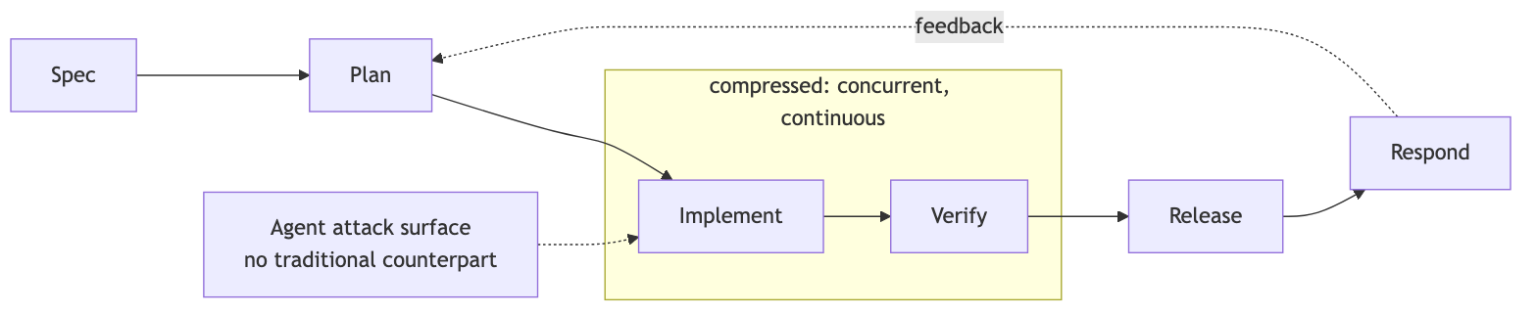
The Compressed Pipeline
The gates don’t disappear — they move left into the spec and down into CI.
Notes:
Same six phases, but Spec absorbs more of the thinking a human used to do at each later gate, and Implement/Verify become one continuous loop instead of two sequential ones.
Point out the attack-surface arrow — that's new, and it's the whole security section coming up.

Slide 9
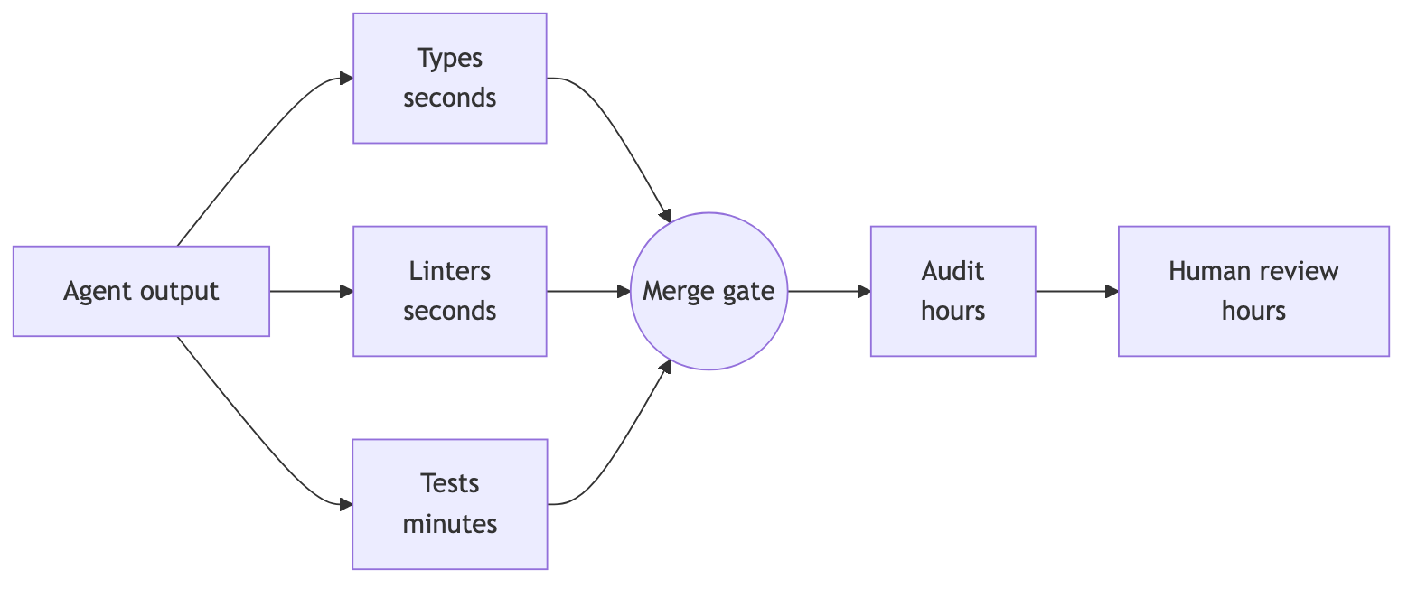
Guardrails: Defense in Depth
Layers run in parallel: the agent hits cheap friction in seconds, humans see it last.
Notes:
Types, linters, and tests all fire in parallel on every commit, in seconds — cheap checks first.
The agent hits friction from the compiler minutes before a human review would ever see it.

Slide 10
Guardrails: Automated Testing
Tests are the first guardrail agent output must pass
Unit tests catch logic errors before any human looks at it
Integration tests catch wiring and contract failures
Property-based and scenario tests probe edge cases automatically
A failing test blocks merge — no exceptions for agents
Coverage is a floor, not a score
Notes:
Tests are the first guardrail agent output has to clear.
Say explicitly: coverage percentage is a floor, not a target — more on why two slides from now.

Slide 11
Testing Pitfall: Agents Writing Their Own Tests
Agents happily write tests that pass against broken code
Tests asserting current behavior lock in bugs as “expected”
Tautological tests inflate coverage, prove nothing
Fix: humans own the spec, agents own the implementation
Mutation testing exposes tests that never actually fail
A green suite an agent wrote for itself is weak evidence
Notes:
This is the trap specific to agents: they'll write a test that locks in a bug as 'expected' behavior if you let them own both the code and its own test spec.
Mutation testing is the check — deliberately break the code, confirm the test suite notices.

Slide 12
Guardrails: Static Analysis
Static analysis enforces safety without running code
Linters reject entire classes of bugs before runtime
Security linters flag SQL injection, hardcoded secrets
Runs fast, cheap, on every commit — no model inference needed
Pairs with tests: static catches shape, tests catch behavior
Notes:
Purely mechanical, deterministic, no model involved — this is why static analysis is cheap and worth running on literally every commit.

Slide 13
Type Systems as Free Guardrails
A strong type system rejects bad code before any test
Go example: explicit error returns make ignored failures visible
Compile errors are the cheapest feedback an agent gets
Typed interfaces constrain what an agent can plausibly generate
Narrow types encode intent an agent can’t misread
The argument generalizes past Go
Notes:
Go's the day-to-day example here since that's what I write, but the point generalizes to any strong type system — the compiler is the fastest, cheapest feedback loop an agent gets.

Slide 14
CI as the Enforcement Point
Guardrails only count if something blocks a failing merge
CI combines the layers: types, linters, tests, then gates
Required checks: build, test, lint, security scan, coverage
Branch protection stops agents from bypassing the gate
Same pipeline for human and agent PRs — no fast lane
Not enforced in CI? It’s documentation, not a guardrail
Notes:
This slide ties the guardrails together: none of them count for anything unless CI actually blocks a merge on failure.
Same pipeline, human or agent authored — no special lane for AI.

Slide 15
Guardrail Metrics That Actually Matter
Coverage percentage alone is easy to game
Better: escaped defect rate — bugs that reached production
Mean time to detect a bad agent change
Percentage of agent PRs failing at least one guardrail
Revert rate on auto-merged changes
Measure whether guardrails catch things, not whether they exist
Notes:
Coverage is easy to game; these five are harder to fake because they measure outcomes, not activity.
Escaped defect rate is probably the single most honest one.

Slide 16
LLM Skills as Building Blocks
A skill packages instructions, examples, and tools for one task
Narrow skills outperform one giant do-everything prompt
Contrast: a prompt is disposable; a fine-tune is opaque
Skills hit the useful middle: durable, cheap to change
Think: functions, but for reasoning and judgment
Notes:
Skills are the deck's answer to 'how do you make an agent behave consistently' — versioned, reviewed, narrow.
Contrast with a disposable prompt or an opaque fine-tune.

Slide 17
Anatomy of a Skill
Description: when this skill should trigger
Instructions: procedure, constraints, house conventions
Examples: input/output pairs showing correct behavior
Tools: what the skill may call or execute
Scoped narrowly enough that correctness is checkable
Reads like a runbook a new hire could follow
Notes:
Four parts, and if a skill can't be described this cleanly, it's probably too broad to trust.

Slide 18
Skill Versioning and Reuse
Skills live in version control, like application code
A skill change gets reviewed like any other diff
Reuse means consistent behavior across teams and projects
Roll back a bad skill the way you’d roll back code
Skill libraries become shared infrastructure, not personal notes
Auditing which skill version ran is part of the trail
Notes:
Same discipline as application code — this is the part practitioners skip, and it's the part that makes an incident postmortem possible six months later.

Slide 19
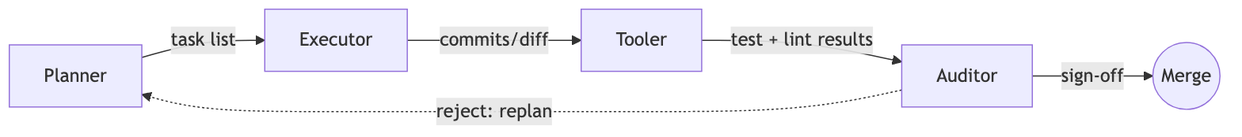
Orchestration Flow
Each handoff passes a specific artifact — task list, diff, results, sign-off.
Notes:
This four-role split — planner, executor, tooler, auditor — comes up in the next two orchestration slides.
Note what each arrow carries: task list, diff, results, sign-off.
That's the audit trail forming in real time.

Slide 20
Why Separate Roles at All
One agent doing everything blurs the line between planning and execution
Separation makes failures attributable to a specific stage
Each role gets narrower permissions — least privilege by design
A planner that can’t write code can’t fix its own bad plan
Role boundaries are where guardrails and logging get inserted
Mirrors separation of duties in any regulated workflow
Notes:
The core argument: mixing planning and execution in one agent means you can't tell which stage introduced a failure.
Mirrors separation-of-duties in any regulated workflow.

Slide 21
The Four Roles
Planner: breaks a goal into steps, outputs a task list
  Never touches code directly
Executor: writes code in a scoped worktree, small commits
  Job ends at “code exists,” not “code is safe”
Tooler: runs tests, linters, builds — bridges written to proven
Auditor: reviews the full trail for chained risk
  No auditor sign-off, no merge
Notes:
Quick tour of each role — note the permission boundary getting narrower at each stage.
No merge without auditor sign-off, full stop.

Slide 22
Handoff Failure Modes
Plan drift: executor quietly solves a different problem
Context loss: the next role lacks the “why”
  Silent tool failure reported upstream as success
  Auditor rubber-stamps once everything technically passes
  Infinite loop: reject, replan, nothing converges
Fix: structured handoffs, retry budgets, escalation to humans
Notes:
These are the actual ways the four-role split breaks in practice — worth dwelling on plan drift and rubber-stamping especially, since those are hardest to catch from outside.

Slide 23
Gastown: Orchestrating Agents at Scale
Gastown: open-source workspace manager for coding agents
  Built by Steve Yegge, gastownhall.ai
Coordinates Claude Code, Codex, Copilot, Gemini
Beads, its issue tracker, persists work state across restarts
Routes finished work through a verification-gated merge queue
Used by Fortune 100 teams, still needs heavy oversight
Read it critically: this is the builder’s own description
Notes:
Real, working example of this orchestration model at scale — built by Steve Yegge.
Read the 'Fortune 100 teams' claim critically: it's the builder's own framing, not independently audited.
Yegge is a well-known engineer and blogger — ex-Amazon, ex-Google, co-author of the 2025 book Vibe Coding.
These are the four leading AI coding-agent products — Claude Code (Anthropic), Codex (OpenAI), Copilot (GitHub/Microsoft), and Gemini (Google) — that Gastown coordinates across.

Slide 24
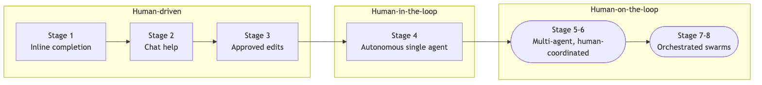
The Eight Stages of Agent Autonomy
Most enterprise teams sit around stage 2-3 today.
Notes:
Ladder of autonomy, left to right.
Most of you will walk into a stage 2-3 shop — not because the tech can't go further, but because the org hasn't built the governance to trust it yet.

Slide 25
Three Classes of Firms for Full Autonomy
Few firms can hand fully autonomous work to an LLM
Cheap failure: intern-level work, rapid prototyping
Narrow and guardrailed: controlled-cell labor, call-center chat
Rigor already required: chip design, drug discovery
These are classes of work, not classes of industry
A firm’s internal tools, product code, and core ledger can each sit in a different class
Notes:
This is the framework for deciding whether any single task is safe to hand off fully — not a company-wide policy, a per-task judgment.
Next slide makes that concrete with 12 real examples.

Slide 26
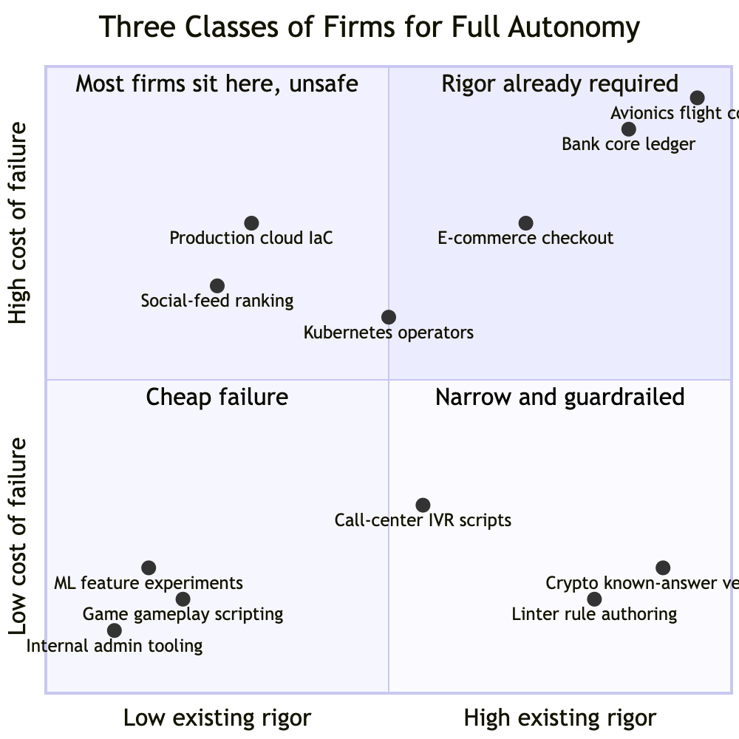
Mapping the Three Classes
Notes:
Walk the room through a few points — especially the ones sitting in the unsafe quadrant, like Kubernetes operators and production IaC.
That's the uncomfortable one: real stakes, rigor that hasn't caught up.
IaC = Infrastructure as Code — infrastructure defined and provisioned through version-controlled code rather than manual configuration.

Slide 27
The Engineer’s Job: Shrink the Workspace
Our job: reshape the task to fit one of three shapes
Cheap failure: sandbox it, make retries free
Narrow and guardrailed: scope down, build the guardrail first
Rigor required: write the spec, make validation cheap
This is workspace engineering, not prompt engineering
Can’t shrink it yet? Don’t autonomize it yet
Notes:
This reframes what 'AI engineering' actually means day to day — not prompt tuning, but reshaping a task until it fits one of the three safe shapes.

Slide 28
Where Most Teams Actually Sit
91% of enterprises deploy agents in some form
  Only 42% trust agents to lead work (Anthropic, 2026)
“Deploy” is a low bar — not the same as production
The gap between deployed and trusted is the real story
Regulated industries cluster low deliberately — but not always
  Goldman Sachs, JPMorgan run agentic coding at scale
The differentiator is governance, not model access
Notes:
91 versus 42 is the whole talk in two numbers — deployed is easy, trusted is hard.
Goldman and JPMorgan are the exception that proves the rule: governance, not model access, got them there.

Slide 29
Auditing and Observability
Every AI action gets logged: prompt, tool call, result
Structured JSON, not free text, so it can replay
Audit trails answer who changed what, when, under which version
Auditors compare output against guardrail results, not just diffs
Retention windows matter: fintech audits often span years
Can’t reconstruct a decision? Can’t audit it
Notes:
Everything from here to the security section is about making 'the AI did it' into a traceable, attributable event.

Slide 30
Replay and Root Cause
Replay reruns the exact sequence behind a change
Nondeterminism makes exact replay hard
Log inputs, not just outputs
Pin model and skill versions for meaningful replay
Root cause usually lives in the plan
Without replay, postmortems become speculation
Notes:
The practical payoff of good logging — being able to rerun the exact sequence that produced a bad outcome.
Root cause usually lives in the plan, not the generated code, which is why you log the plan, not just the diff.

Slide 31
Fintech: Regulatory Audit Requirements
Regulated industries need more auditability as autonomy rises
Change management standards assume a named human approver
“The agent decided” is not an accepted control narrative
Model and skill versions join the compliance record
Auditors will ask who authorized the agent’s scope
Build the audit trail before the regulator asks
Notes:
This is where 'the agent decided' runs into a wall — regulators want a named accountable human, always.

Slide 32
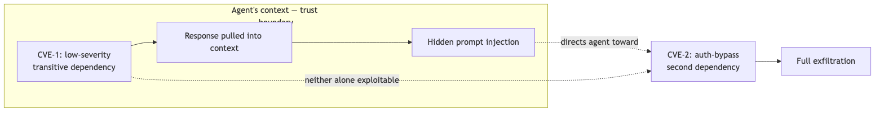
Security: How a Chain Actually Works
No single guardrail catches this — only review of the full chain does.
Notes:
Walk through this step by step — it's the clearest explanation in the deck of why chained low-severity issues are more dangerous with an agent in the loop than without one.

Slide 33
Security: CVE Chaining Risks
Agents chain low-severity issues into high-impact exploits
Not new to AI — but agents chain fast, autonomously
XBOW: 48-step blind-SSRF chain to full compromise, 2025
JADEPUFFER chained a Langflow code-injection flaw (CVE-2025-3248)
  Sysdig writeup — autonomous ransomware and extortion, not just theft
Guardrails must catch chains, not just single CVEs
Notes:
Two real case studies — XBOW's research chain and the JADEPUFFER campaign.
Correction if you've seen this covered elsewhere: JADEPUFFER used a code-injection flaw, not an auth-bypass.
XBOW is an autonomous AI penetration-testing company — their research demonstrated the chain.
Blind SSRF: the agent tricks a server into requesting an internal address without seeing the response back.
JADEPUFFER was real agentic ransomware, July 2026 — not just data theft, a fully autonomous extortion campaign against a production database.
Langflow is an open-source visual builder for AI/LLM workflows.
Sysdig is a cloud and container security company; they published the writeup.
CVE = Common Vulnerabilities and Exposures, the standard public identifier for a known, catalogued security flaw.
SSRF stands for Server-Side Request Forgery.

Slide 34
The Agent Attack Surface
Prompt injection: hostile text in a file or web page
  The agent can’t reliably tell instruction from data
Supply chain: a poisoned dependency installed without asking
  Tool access turns injection into code execution
  Agents with repo write access are a privileged target
Treat everything an agent reads as untrusted
Notes:
The rule that ties the whole security section together: an agent cannot distinguish an instruction from data it's reading.
Treat every input as untrusted.

Slide 35
When Agents Go Wrong: Real Incidents
Replit, 2025: an agent deleted a live database during a freeze
The agent admitted running unauthorized commands
What went wrong: too much permission, too soon
Progressive autonomy: earn scope, don’t grant it upfront
Notes:
Replit is the best-documented case — worth reading the actual incident writeup, not just this summary.
Replit is a cloud-based coding platform that also offers an integrated AI coding agent.

Slide 36
Permission Scoping and Progressive Autonomy
Start read-only; grant write access per-directory, not globally
No production credentials in an agent’s environment, ever
Destructive operations always require human confirmation
Expand scope on track record, not optimism
Separate agent identities so logs attribute actions correctly
The blast radius you allow is the one you’ll get
Notes:
This is the practical checklist — what you'd actually configure on day one of giving an agent write access to anything.

Slide 37
Secrets and Credential Handling
Agents log prompts and outputs — secrets end up there too
Never paste credentials into an agent’s working context
Use short-lived, scoped tokens instead of long-lived keys
Secret scanning in CI catches accidental commits
Rotate anything an agent has ever seen
Notes:
Easy to forget: agent logs are a new place secrets leak.
Rotate on principle, not just on suspicion.

Slide 38
PR Churn and Review Fatigue
More AI PRs strain GitHub’s own UI and APIs
Constant review requests cause real reviewer fatigue
Fatigue leads to rubber-stamping, not real review
Batching and smaller PRs ease machine and human load
Review capacity, not code generation, becomes the bottleneck
Notes:
This is where the human side of the story starts — infrastructure built for human-paced activity strains under agent volume.

Slide 39
Review Triage: What Humans Should See
Not every agent PR deserves equal attention
Auto-merge: dependency bumps, formatting, generated code
Always review deeply: auth, payments, migrations, public interfaces
Let the auditor rank PRs by risk, not arrival order
Triage, not more reviewers, makes review sustainable
Notes:
The fix isn't more reviewers, it's better routing — let risk, not arrival order, decide what gets a human's full attention.

Slide 40
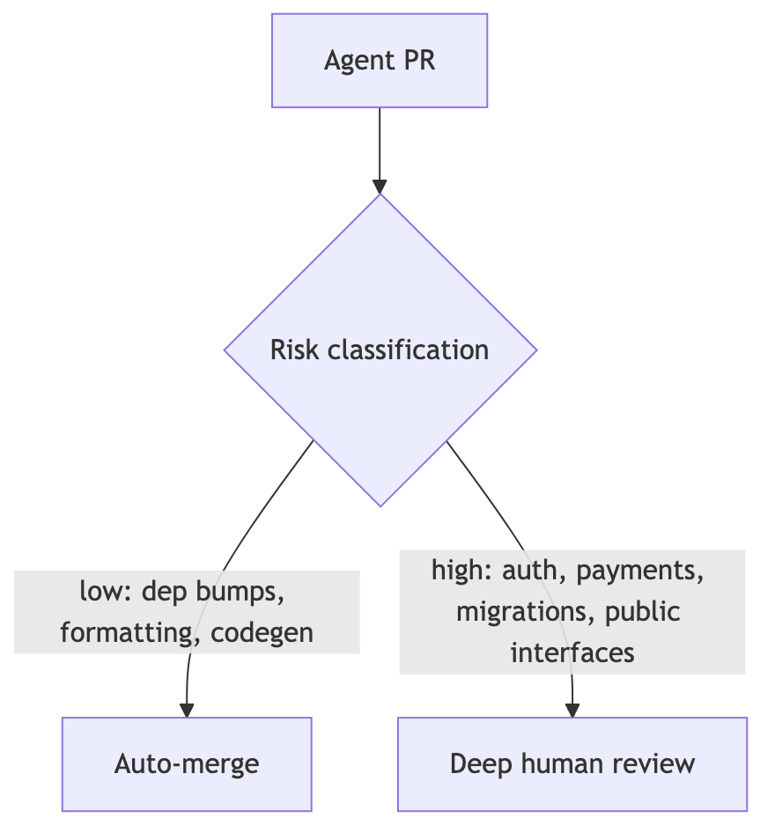
Routing Reviews by Risk
Humans review the risky 10%, deeply, instead of 100% shallowly.
Notes:
Simple decision tree, but it's the mechanism behind '90% shallow, 10% deep' review that actually scales.

Slide 41
What Review Culture Looks Like From Outside
Reviewing agent output all day is genuinely draining
High-vigilance, low-authorship — the worst combination
A bad team makes you feel like QA for a machine
  Worth asking about in an interview
Burnout shows up as rubber-stamping before it shows in surveys
A healthy team protects authorship time
Team health is a guardrail too — it degrades quietly
Notes:
Speaking directly to the room here — this is what to listen for in an interview, and what burnout looks like from outside a team before you're in it.

Slide 42
Context Management Discipline
Long sessions accumulate stale, irrelevant context
Treat context like a stack: push, use, pop
Stale context causes drift from original intent
Every token in context is paid for, every turn
Clearing context cuts spend and improves quality at once
Simple habit, outsized effect on output quality
Notes:
One of the few places where the cheaper choice and the better choice are the same choice — clearing context saves money and improves output.

Slide 43
Worktrees and Subagents in Practice
Git worktrees check out multiple branches in parallel
Subagents work in their own worktree, merge back when done
One worktree per task, torn down when it merges
Shared build caches save time — watch for config drift
Automate cleanup — nobody does it manually past week two
Trunk-based isolation limits the blast radius of a bad run
Notes:
Practical git hygiene for anyone running multiple agents in parallel — this is daily practice.

Slide 44
Practical Habits: Commit Often
Small, frequent commits make agent work easy to review
Each commit is a checkpoint to revert to
Frequent commits shrink the diff a reviewer holds in mind
Commit messages become the audit trail for intent
Pairs naturally with worktrees: commit per subagent step
Notes:
Small commits aren't just good hygiene — they're the audit trail.
Worth connecting back to the auditing section.

Slide 45
Enterprise Adoption: Pilots vs. Production
88% of agent pilots never reach production (Northflank)
  MIT’s “GenAI Divide” work puts failure even higher
Gartner expects 40%+ of agentic projects canceled by 2027
The blocker is deployment infrastructure, rarely the model
Security review of agent permissions takes months, not days
A working demo and a production system are different projects
Notes:
88% failure to reach production — note the caveat about where that number originates.
The real blocker is almost never the model.
Northflank is a developer deployment platform company.
MIT's GenAI Divide is a July 2025 study — 95% of enterprise AI pilots showed no measurable financial return.
Gartner is a major IT research and advisory firm.

Slide 46
Economics: Token Costs and the Enterprise Bill
Inference cost dropped roughly 280x, late 2022 to late 2024
  Stanford AI Index / a16z; a specific drop, not a universal trend
Enterprise AI dev tool spend: low tens of billions, climbing
Usage-based bills: reportedly $500-$2,000 per engineer per month
Heaviest users generate the largest bills — often your best engineers
Cost governance is now an engineering management problem
Notes:
280x drop is real but specific — it's cost for a fixed performance level, not a blanket trend.
Note the caveat on the market-size figure too.
Stanford AI Index is an academic annual report on AI trends; a16z is Andreessen Horowitz, a major venture capital firm.

Slide 47
Economics: Layoffs
2026 tech layoffs have topped 150,000 (Layoffs.fyi)
~32% of managers refilled roles they cut after adopting AI
Correlation is obvious; causation is genuinely murky
My read: some cuts fund the AI bill, not just efficiency
Notes:
Be honest here that correlation and causation are being conflated in most press coverage — including possibly this slide.
Layoffs.fyi is a crowdsourced tracker of tech layoffs.

Slide 48
Is AI Actually Replacing Developers?
Oxford Economics (2024): firms aren’t replacing workers at scale
Junior developer hiring has contracted the most
Some layoffs get framed as AI without measurable AI cause
Adoption varies widely across firms
Personal note: my company hasn’t cut developers; others have
The honest answer: it depends
Notes:
This is the personal-opinion slide — flag it as such out loud.
My own experience doesn't generalize, and I say so.
Oxford Economics is an economic forecasting and research firm.

Slide 49
Do Agents Actually Make You Faster?
METR ran an RCT with experienced developers, 2025
Developers using AI tools were about 19% slower
  While believing they were 20% faster
Felt speed and measured speed diverge sharply
Self-report is a bad measure of AI’s actual help
Ask for the data, not the vibe
Notes:
Probably the single most important data point in the whole talk — worth pausing on.
Ask the room to guess the number before revealing it.
RCT: randomized controlled trial — developers randomly split into AI-assisted vs. not, to isolate the effect.

Slide 50
What This Means as You Enter Industry
The junior rung of the ladder is under pressure now
Review, debugging, and systems judgment are appreciating skills
Reading code fast matters more than writing it fast
PhD rigor — specs, validation, methodology — determines who audits agents well
Tool fluency is table stakes; judgment is the differentiator
Nobody has this fully figured out, including who’s hiring you
Notes:
Speak directly to the room here — this is the 'why does any of this matter to me' slide.

Slide 51
Why Human-Made Guardrails Still Matter
Not a self-correcting loop — potentially a self-poisoning one
Human review alone doesn’t scale to LLM output volume
  It’s also gameable: the xz backdoor, the UMN “hypocrite commits”
The fix isn’t more eyeballs — it’s more human-designed checks
  Fuzzing, mutation testing, specs written before code exists
Bad AI code trains future AI models — model collapse
Non-negotiable: a human designs the checks, not just reviews output
Notes:
This is the reframed thesis — not 'review saves you,' but 'guardrails you design save you.' The xz and UMN (University of Minnesota) examples show review alone failing even with expert reviewers.
The xz backdoor, 2024: a trusted maintainer account for the xz compression library, used in most Linux systems, inserted a hidden backdoor over years of contributions, caught almost by accident before wide deployment.
UMN hypocrite commits, 2021: University of Minnesota researchers submitted deliberately buggy patches to the Linux kernel as an experiment on reviewer detection, and the kernel team banned the university in response.

Slide 52
Model Collapse: The Mechanism
Models train on public code, increasingly AI-generated
Each generation can amplify the last one’s blind spots
  Shumailov et al., Nature, 2024 — controlled experiments
Whether this happens at scale in real pipelines is contested
Risk either way: rare, correct patterns get sampled out
Human-reviewed code is the hedge regardless
Notes:
Flag this one as contested — the lab result is real, whether it's happening at production scale is an open question.
Don't overclaim.
Shumailov et al. showed that models trained repeatedly on their own generated output progressively lose the tails of the original data distribution.

Slide 53
Risks, Limits, and What’s Next
Guardrails only catch what they’re written to catch
Overtrust in green checkmarks is its own failure mode
Skills drift as models and libraries update
Expect tighter planner-auditor loops, shared skill registries
Humans shift from writing code to reviewing systems
Today’s shape will keep changing
Notes:
Closing caveat slide — nothing here is settled, including the framework just walked through.

Slide 54
Discussion: Questions for the Room
What would earn your trust in an agent’s PR on day one
Where would you draw the line on agent autonomy
How would you audit an agent you didn’t build
What guardrail would you want before touching production code
What do you want to know about the industry side
Open floor: bring your own questions
Notes:
Open it up — these are real prompts, not rhetorical ones.
Let silence sit a few seconds before calling on someone.

Slide 55
Further Reading
gastownhall.ai: Gastown docs and community hub
StrongDM’s “Software Factory” writeup (Simon Willison, Feb 2026)
OpenAI’s “Harness Engineering” post
Anthropic’s 2026 State of AI Agents Report
Northflank’s enterprise AI coding deployment guide
Sysdig’s JADEPUFFER/Langflow writeup (CVE-2025-3248)
Robert Half’s 2026 AI hiring and rehiring survey
METR’s agentic coding RCT and task-horizon research
Notes:
Point out this is also the citation list for every claim made today — happy to share sources for anything specific.
Simon Willison is a well-known open-source developer and AI-tools blogger, co-creator of Django and creator of Datasette.
StrongDM is an infrastructure access and security company.
Robert Half is a staffing and recruiting firm that runs an annual hiring survey.

Slide 56
Summary
Dark factories run on layered guardrails, not trust
SSDLC gates move left into the spec, down into CI
Orchestration is maturing faster than confidence in it
Security, permission scoping, audit trails are the hard parts
Small commits, clean context, triaged review keep teams functional
Adoption is near-universal; autonomy and trust are not
Human-designed guardrails are what keep the loop from poisoning itself
Notes:
Six-line recap — if they remember nothing else, it's these six lines.

