Slide 1


Slide 2

Docker Wharf Sharing Docker Images in a Distributed File System
Presented by Jacob Hochstetler
DCS Lab
November 21st 2018
https://doi.org/10.1145/3267809.3267836

Slide 3
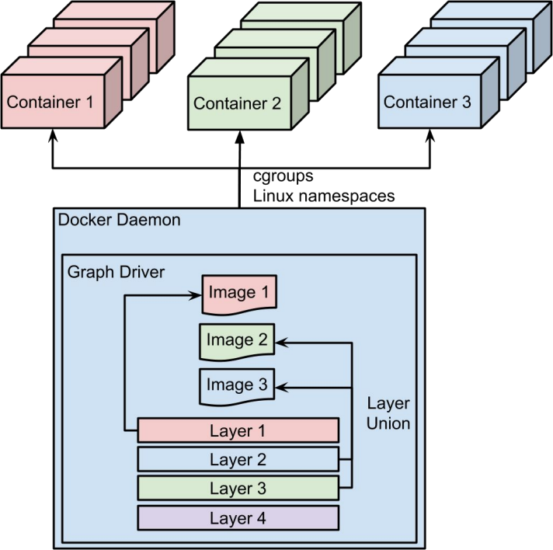
Docker Container Runtime
Container Image & Layer
Multiple read-only layers and one writable layer
Different images may share layers
All changes are stored in writable layer (COW)
Graph Driver
Overlay drivers: AUFS, OverlayFS/2
Specialized drivers: Devicemapper, btrfs

Slide 4
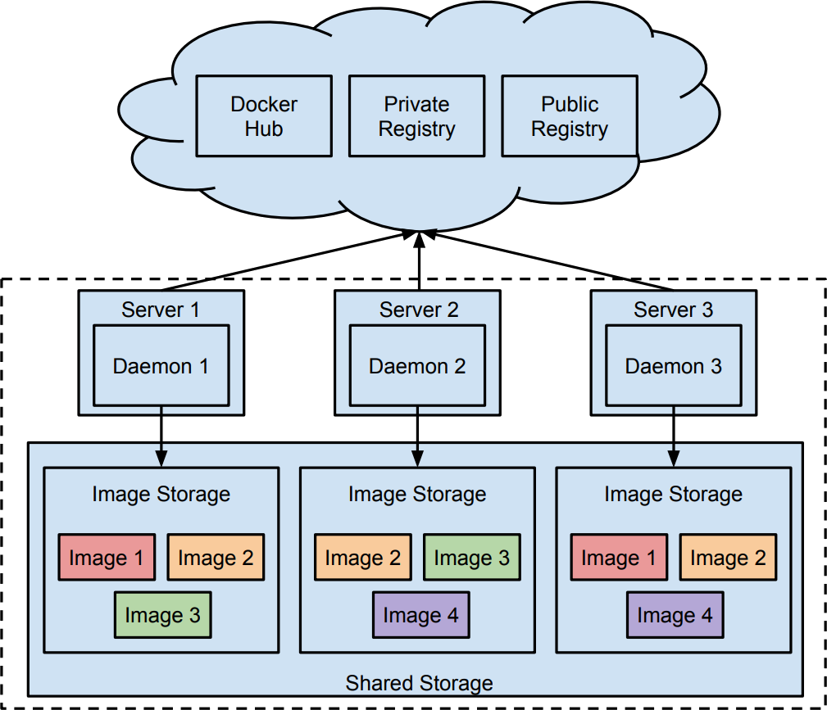
Naïve Solution
High Network Overheads
Waste Disk Space
Longer Workload Startup Time

Slide 5
Challenges
Keep consistency between daemons
Avoid potential performance degradation
Avoid remote access to shared storage

Slide 6
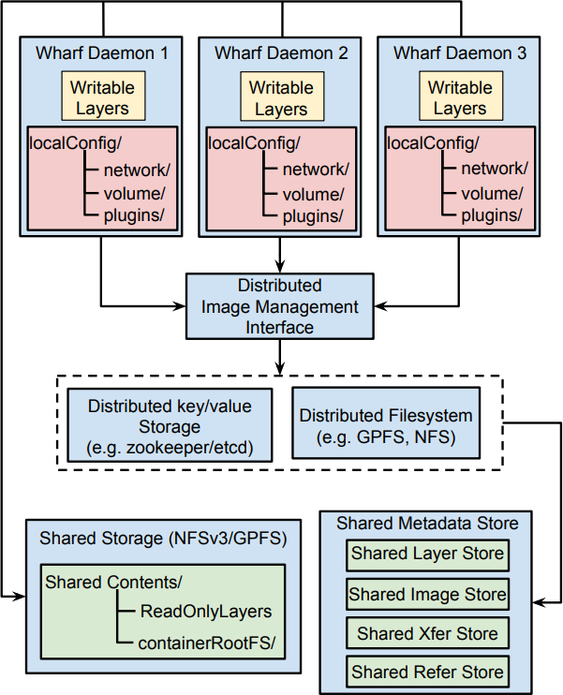
Wharf Architecture
Global/Local State
Global State
Shared Data Store: image and layer data
Shared Metadata Store: layer, image, and xfering metadata
Local State
Metadata: network, volume, container plugins, etc.
Container Data: container writable layers
Read/Write Operations
All operations will access the shared metadata store, before the shared data store
Read: read the global state. eg. list images
Write: update the global state. eg. pull images

Slide 7
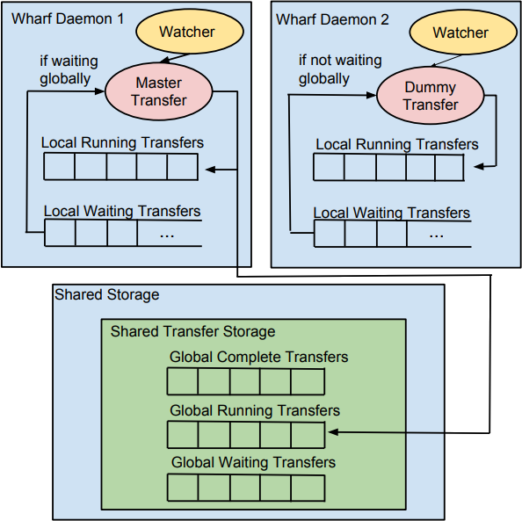
Wharf Concurrent Layer Pulling (granular locking)
Lock small portion of global state
Only lock the metadata related to the operation (list images, pull layer, etc…)
Operation can only be started after successfully accessing the metadata store
Concurrent Read, Exclusive Write
Extend the parallel model of Docker
Use watcher to watch the pulling of layers
Use dummy transfer to imitate real transfer

Slide 8
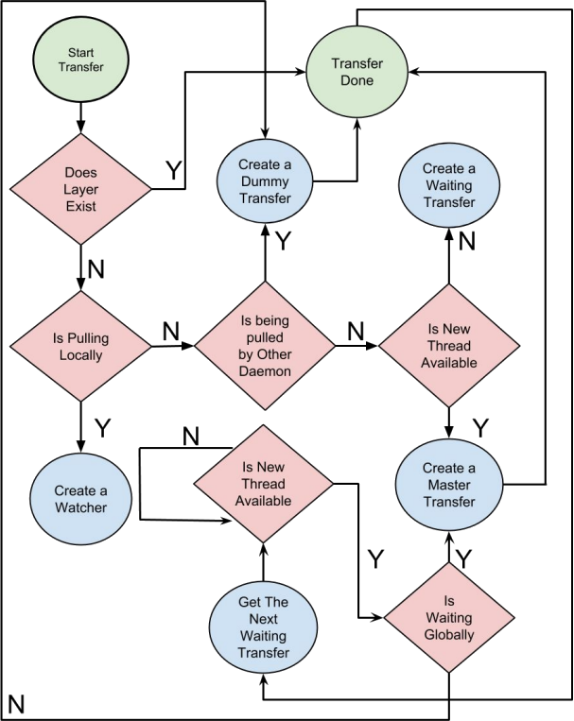
Wharf Workflow

Slide 9
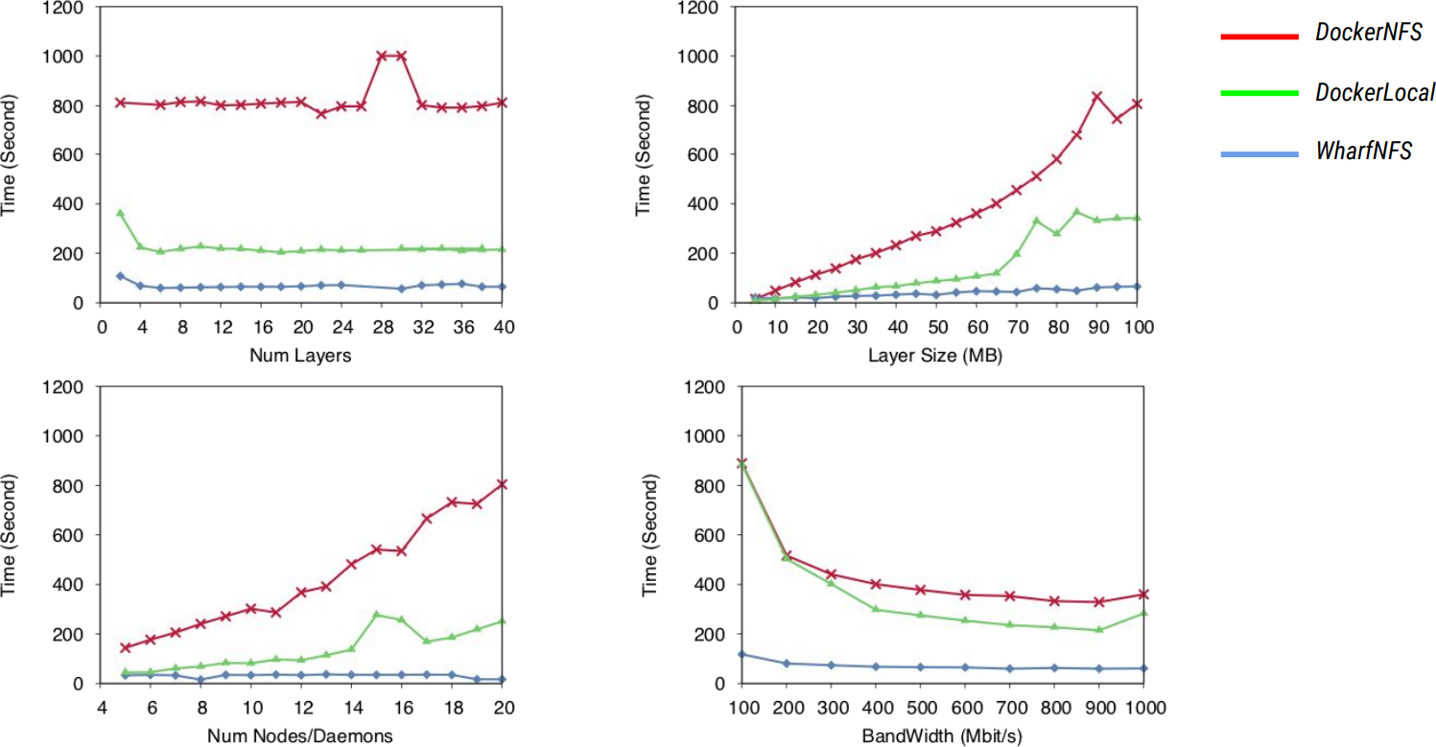
Wharf Evaluation

Slide 10
Wharf Summary
12x faster pulling
9.1x less data pulled, stored
2.6-4.7% runtime degradation

Slide 11

Questions?
State of the University

