Slide 1
Capstone – Cyclistic Bike
7/20/2022

Slide 2
Ride Data Analysis Between Casual Riders and Cyclistic Members
Problem:
Lack of incentive for Casual Riders to join Cyclistic Membership program
Do not know the differentiation of Cyclistic bikes usage habit between Casual Riders and Cyclistic Members
Solutions:
Identify the differentiation of Cyclistic bikes usage habit between Casual Riders and Cyclistic Members.
This allows the business is understand the following:
How Casual Riders and Cyclistic Members are differ,?
What causes the different?
How to close this usage gap between Casual Riders and Cyclistic Members?
Helps the business’s marketing department to design an effective market strategy to promote Cyclistic Membership and convert Casual Riders into annual members.

Slide 3
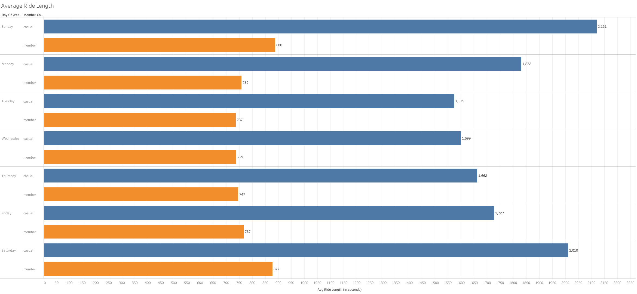
Ride Data Analysis Between Casual Riders and Cyclistic Members
The average ride duration (in seconds), Cyclistic Members are relatively constant.
However, for Casual Riders, the ridership dipped during the weekdays period.
That said, the graph depicts that Casual Riders spent longer time riding than Cyclistic Members.
We can derive a hypothesis that Cyclistic Members are using the Cyclistic bikes for their daily commute as duration is shorter.
On the other hand, Casual Riders tended to travel longer and stop more frequent to rest-up or sightseeing for leisure purpose.

Slide 4
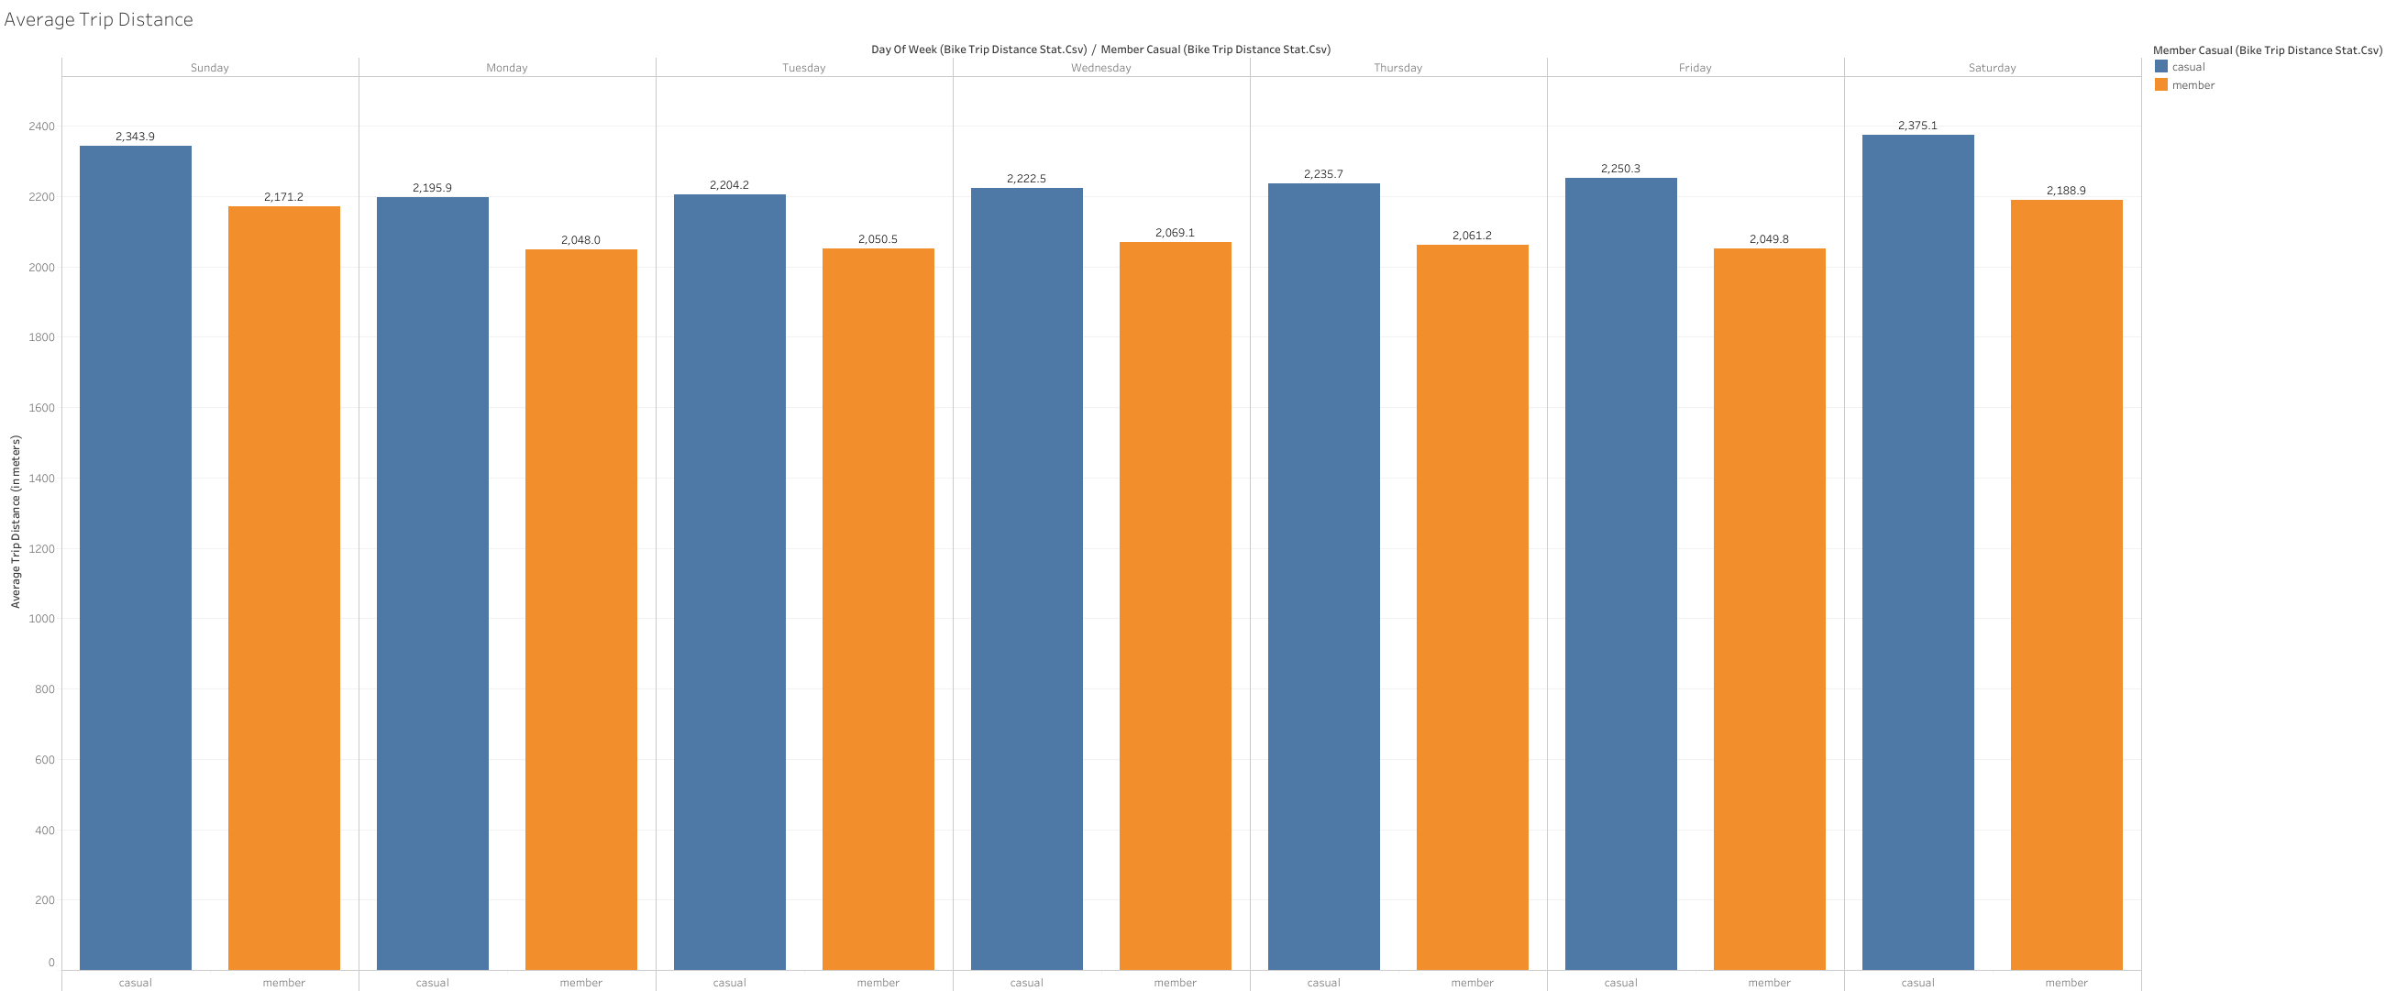
Ride Data Analysis Between Casual Riders and Cyclistic Members
The average trip distance(in meters)
Casual Riders travel, on average, longer distance than Cyclistic Members
Cyclistic Members are using the Cyclistic bikes for their daily commute to school or work, which usually in closer proximity.
On the other hand, for Casual Riders, they traveled longer distance, this might indicates that they tended to travel to further area for leisure purpose

Slide 5
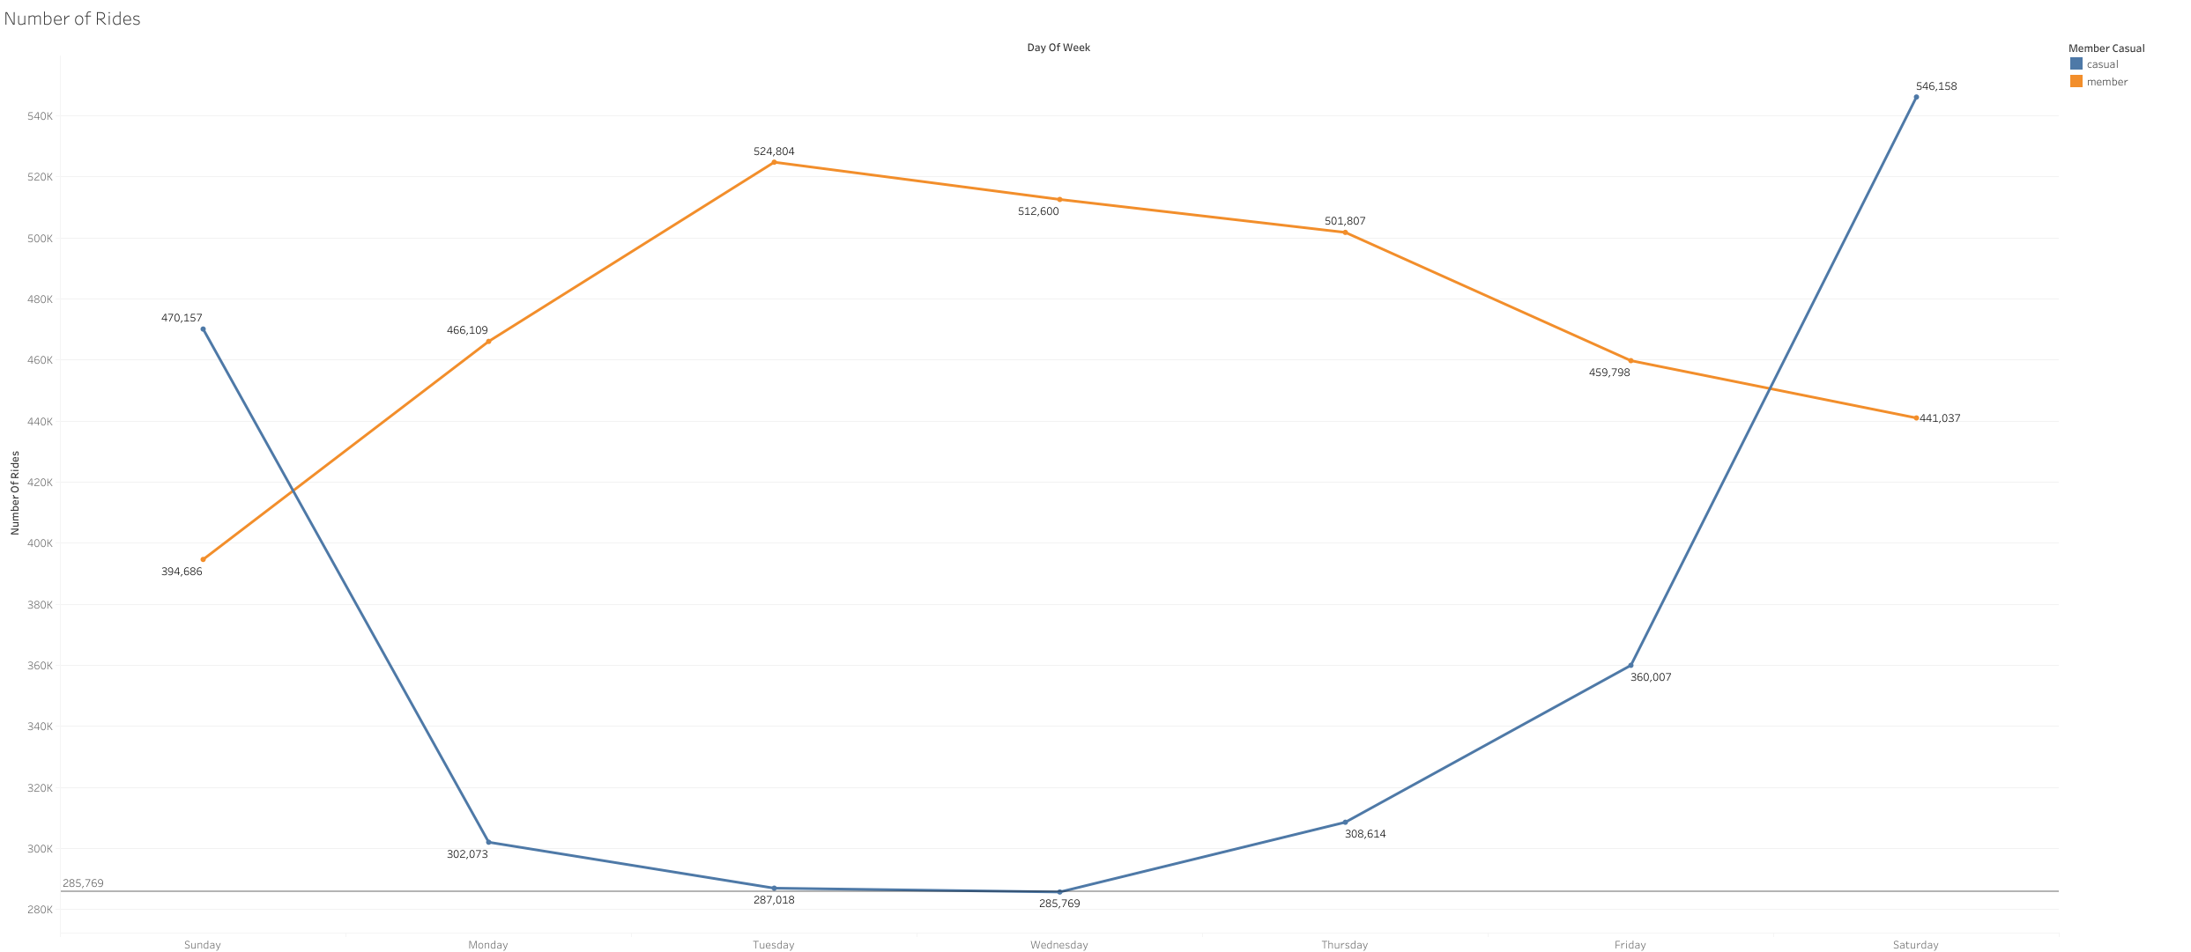
Ride Data Analysis Between Casual Riders and Cyclistic Members
During weekdays, Cyclistic Members have higher ridership than Casual Riders group.
However, the ridership of Casual Riders increased significantly during each weekends throughout the 12 months period.
This represents the following:
Cyclistic Members are using the Cyclistic bikes for their daily commute in close proximity
Casual Riders are using the bikes to travel to further for leisure.

Slide 6
Recommendations
Encourage Casual Riders to use bikes for their daily commutes by providing membership discount for the first 3 months of joining
3 months discount membership for Casual Riders with electric bike and classic bike to be used with no extra charge/fee
Promote regular bike riding as health improving exercise by giving before and after heart rate and blood pressure checks and a 3 months discount membership trial

