Slide 1
Impact of Higher Tier 1 Capital Ratio on Return on Equity of Global and Domestic Systemic Important Banks in Canada
Jinghan Xu
March 31, 2025

Slide 2
Agenda
Introduction Background
Motivation
Contribution
Study Design Institutional Setting
Data Sources
Empirical Strategy
Discussion Results
Interpretations
Policy Implications

Slide 3
Agenda
Introduction Background
Motivation
Contribution
Study Design Institutional Setting
Data Sources
Empirical Strategy
Discussion Results
Interpretations
Policy Implications

Slide 4
Background
Introduction
Tier 1 Capital: core equity assets
Tier 1 Capital Ratio: Tier 1 capital/ risk-weighted assets
Global systemically Important Banks (G-SIBs): top 40 banks (overall score > 86) according to the Basel Committee on Banking Supervision (BCBS)
Significant disruption on a global scale if failed
Domestic systemically Important Banks (D-SIBs):
Disruption on a nation scale if failed
Notes:
Tier 1 capital represents the core equity assets of a bank or financial institution. It has two components: Common Equity Tier 1 (CET1) and Additional Tier 1 capital (AT1). -- perpetual contingent convertible capital instruments
The Tier 1 capital ratio compares a bank’s equity capital with its total risk-weighted assets (RWAs), the higher this value is, the more resonant a bank can be when facing some risks

Slide 5
Motivation
Introduction
Ongoing Policy Change
Resilient Performance
Economic Theory
An updated version of the accord, BASEL III Reform (IV), began implementation in January 2023
Canadian Banks Perform nice during the Finance Crisis in 2007-2008
Almost done the transformation from Basel III to Basel III Reform
Stricter capital rules increase banks equity and decrease lending activities to reduce risk-weighted assets. Both lower ROE
Notes:
The policy change in this study was announced in 2010, but a reformed version was out in 2023 on top of that. So understanding what has been happening helps to find what is happening.
Canadian banks acted resilient during the financial crisis, and it has been a pionner to the new policy change. Understding this effect of canidna banks performance can give some reference to the rest of the world
The economic theory has been

Slide 6
Contribution
Introduction
Previous:
Stricter capital rules improved bank stability but had a negative effects on short term profitability among Africa banks
stricter capital ratios do not significantly improve bank profitability for Australian banks
This study:
Lack of study focus on Canadian banks
Provide reference for further study on new policy change in Canada as an early adopter

Slide 7
Agenda
Introduction Background
Motivation
Contribution
Study Design Institutional Setting
Data Sources
Empirical Strategy
Discussion Results
Interpretations
Policy Implications

Slide 8
Institutional Settings
Study Design
What has been changed?
Tier 1 capital ratio requirement: 4% (Basel II Accord) -> 6% (Basel III accord)
Why it happened?
Response to the 2007-2008 Financial Crisis
Timeline:
Introduced in Dec 2010
Implemented: 2014Q1 in Canada; 2018Q1 in US
Notes:
Basel III was created in response to the weaknesses revealed during the global financial crisis, aiming to prevent future crises and ensure a more resilient banking system.

Slide 9
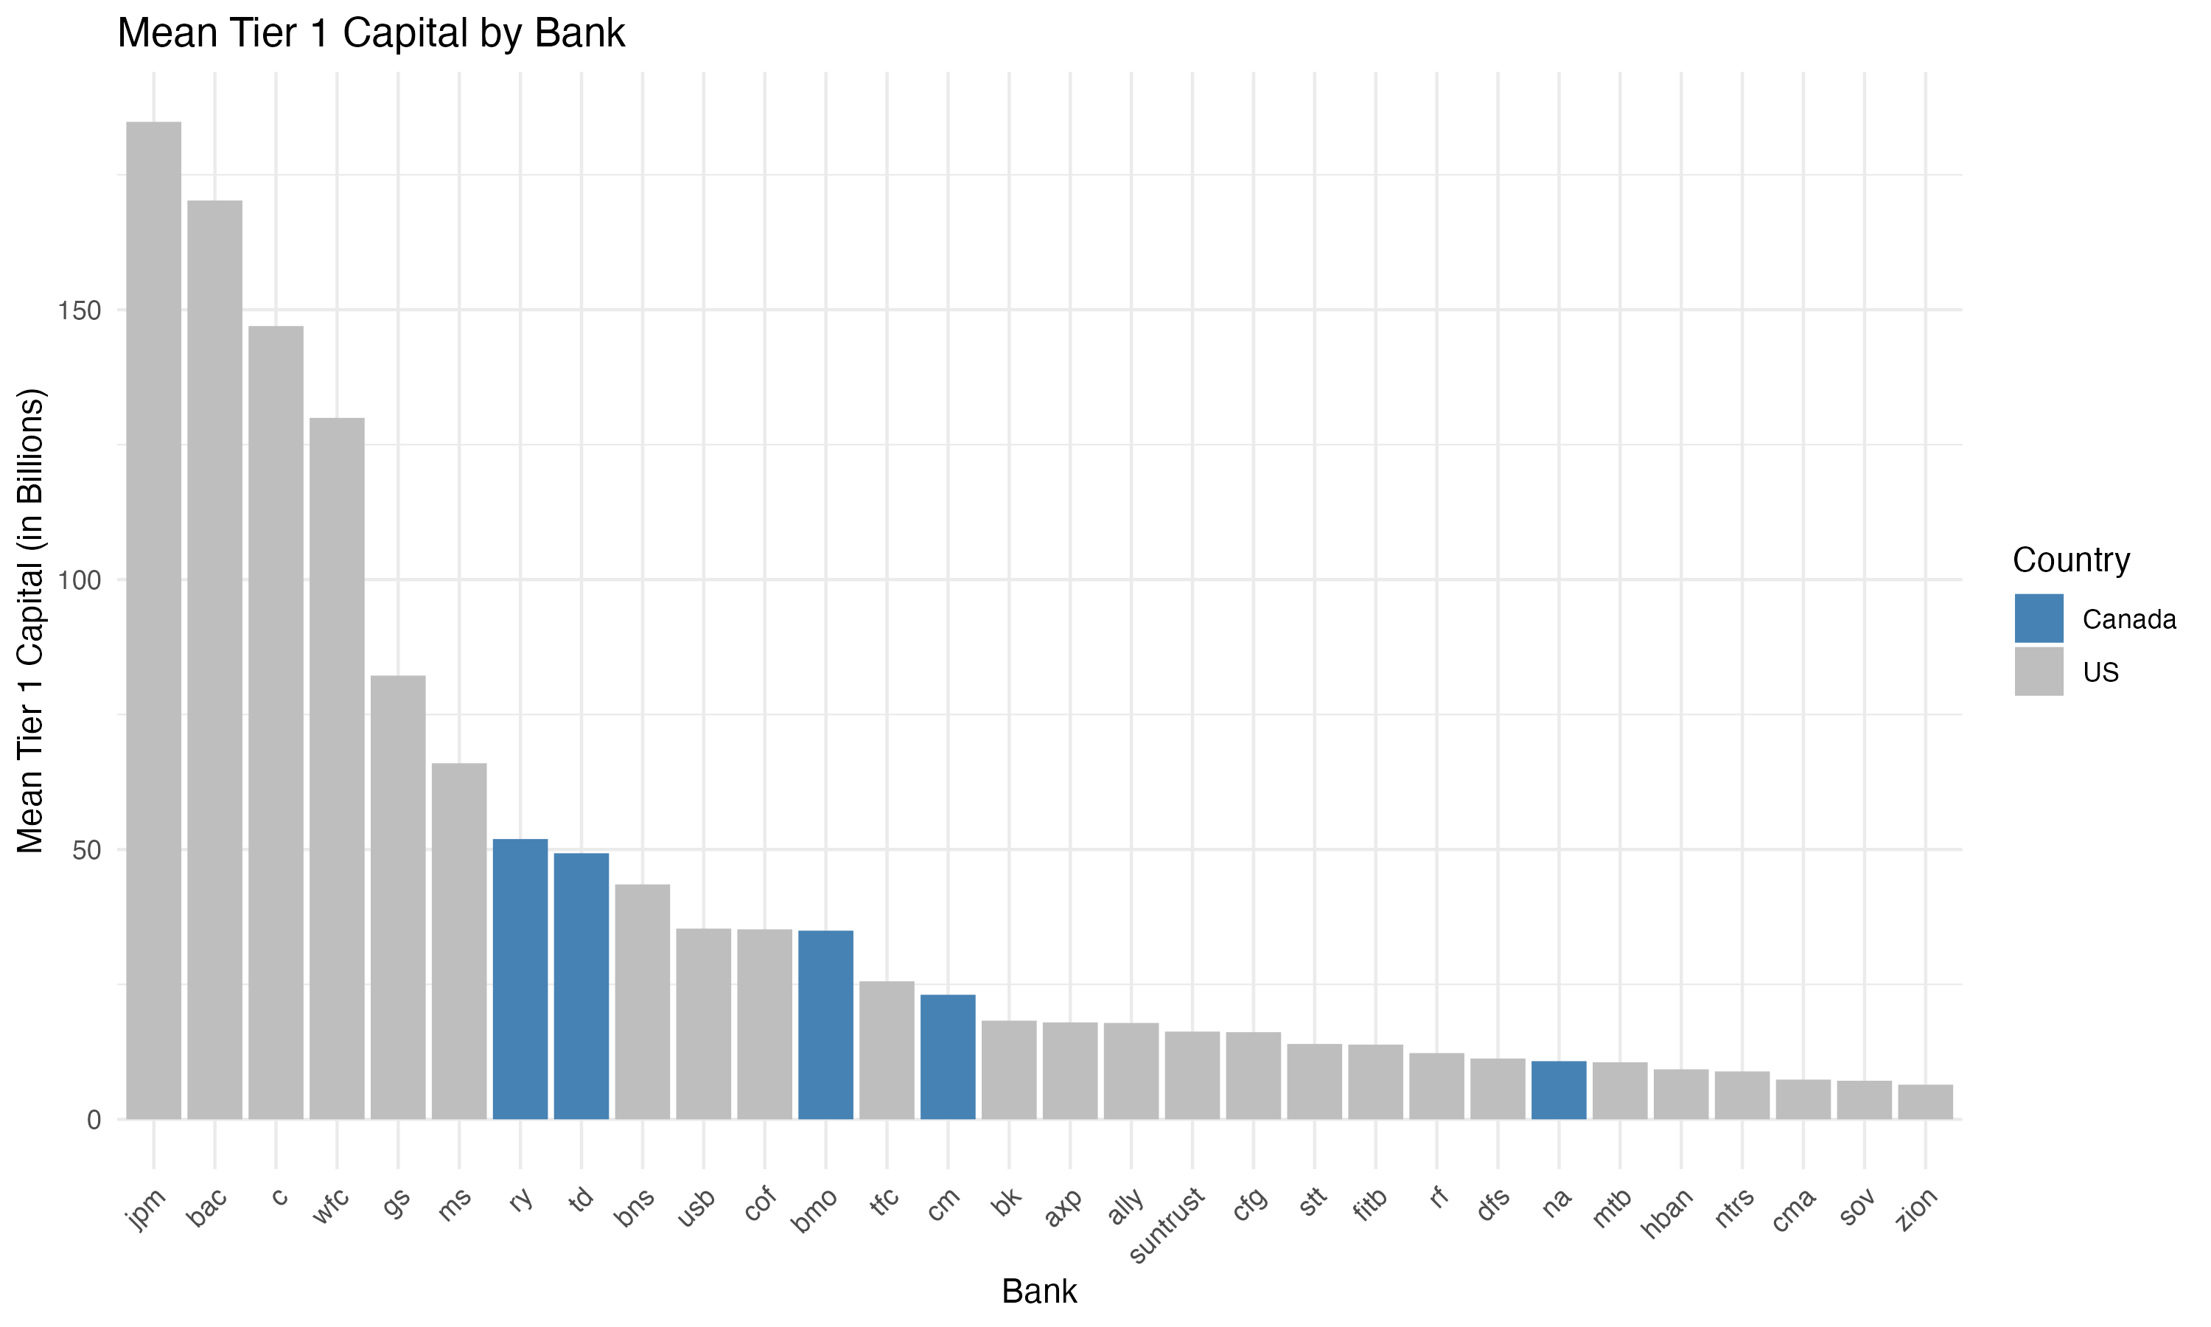
Institutional Settings (Cont’d)
Study Design
Treatment Group: Canada G-SIBs and D-SIBs
Control Group: US G-SIBs and D-SIBS
Pre-policy change: 2011-2013
Post- policy change: 2014-2017
Notes:
Global systemically Important Banks (G-SIBs): top 40 banks (overall score > 86) according to the Basel Committee on Banking Supervision (BCBS).
significant disruption globally if failed
Domestic systemically Important Banks (D-SIBs):
Disruption on a nation scale if failed

Slide 10
Data Sources
Study Design
Bloomberg – Financial Report
R Package ‘WDI’– World Bank
Bank wise data (quarterly):
Return on equity (ROE): net income / shareholders’ equity
Tier 1 capital ratio (T1CR)
Tier 1 capital
Adjusted EBITDA: earnings before interest, taxes, depreciation, and amortization
Macro economic data (annual):
Gross domestic product (GDP)
Consumer price index (CPI)
Real interest rate (RIR)
Notes:
The data in our study comes form 2 sources

Slide 11
Empirical Strategy
Study Design
Data transformation:
Add `Group`: “Large” if Tier 1 Capital > 50 Billion; “Small” otherwise
Difference-in-Difference model with fixed effects:
Absorb year-quarter fixed effects to eliminate time-based omitted variable bias
Cluster standard error at the bank level to allow the errors to be correlated within each bank but assume independence between banks
Notes:
Fixed Effects (α_i)
Controls for time-invariant factors at the Group level (e.g., industry-wide trends).
Removes unobserved heterogeneity among different banks.
Clustered Standard Errors (vce(cluster bank))
Accounts for correlation within each bank’s observations over time.
Helps address heteroskedasticity and autocorrelation issues.

Slide 12
Empirical Strategy (Cont’d)
Study Design
Difference-in-Difference model with year-quarter fixed effects, clusters standard errors at bank level
ROE_{it} = β₀ + β₁ TP + β₂ T + β₃ P +
β₄ adj_ebitda_{it} + β₅ Group_{i} + β₆ GDP_{it} + β₇ CPI_{it} + β₈ RIR_{it} + α_{i} + ε_{it}
where i represents the bank and t represents time
ROE_{it}: Return on Equity for bank i at time t
TP: Treatment effect after the policy change
α_{i}: Fixed effects for year-quarter
ε_{it}: Error term, clustered at the bank level
Notes:
β1​ on TP measures the causal impact of the policy change on ROE for the treated group compared to the control group, after accounting for covariates and time fixed effects
Fixed Effects: absorb(yr_qtr) Absorbs fixed effects for year-quarter, controlling for time-varying unobserved heterogeneity.
Robust Standard Errors vce(cluster bank): Clusters the standard errors at the bank level to account for correlation within each bank over time.

Slide 13
Agenda
Introduction Background
Motivation
Contribution
Study Design Institutional Setting
Data Sources
Empirical Strategy
Discussion Results
Interpretations
Policy Implications

Slide 14
Results
Discussions
TP -1.486**
T 15.780*
P 0.000
adj_ebitda 0.000*
Group -5.345
GDP 0.001
CPI -0.028
RIR 0.106
Constant -23.034
------------------------------------
Standard errors clustered at bank level.
*** p<0.01, ** p<0.05, * p<0.10
ROE_{it} = β₀ + β₁ TP + β₂ T + β₃ P + β₄ adj_ebitda_{it} + β₅ Group_{i}
+ β₆ GDP_{it} + β₇ CPI_{it} + β₈ RIR_{it} + α_{i} + ε_{it}
Notes:
If alpha>0, large banks (Group = 1) tend to have higher ROE than smaller banks, after controlling for capital requirements, macroeconomic conditions, and other factors.

Slide 15
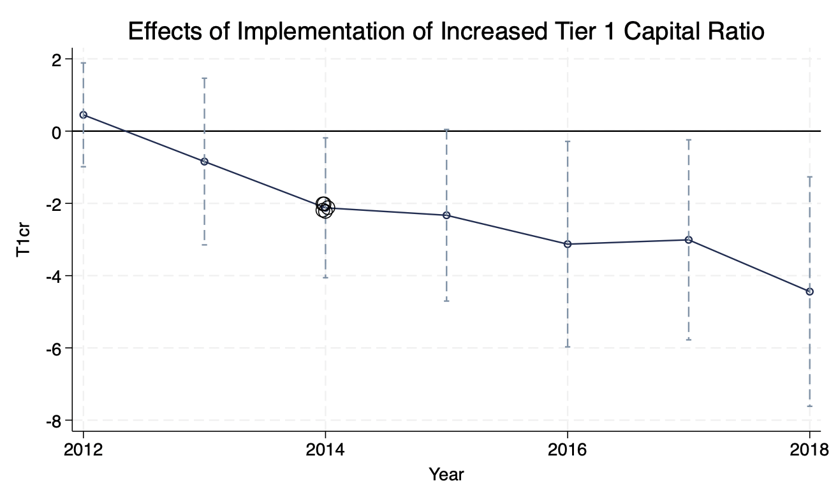
Results (Cont’d)
Discussions

Slide 16
Interpretations
Discussions
DID Estimator: - 1.486, statistically significant at 95% confidence level
Reject H₀ --- the increased capital requirements lower the ROE of Canadian banks after the policy change by 1.486 percentage points compared to the US banks
All the macroeconomic indexes are not statistical significance
DID Model Captures the Main Effect of the Tier 1 Capital Ratio increase, making macroeconomic variables redundant
The macroeconomic factors does not have a strong impact on the ROE of GSIB and DSIB banks, while bank-specific characteristics are more important

Slide 17
Interpretations (Cont’d)
Discussions
Bias from Parallel Trends Assumption Violation
US banks are still in the recovery progress from Financial Crisis
Not implemented officially but started to work on the new rules
(Mean Reversion)
It overestimates the negative effect of the policy

Slide 18
Policy Implications
Discussions
Negatively affects the banks performance
Trade-off between banks profitability and resilience
Problem to be solved in future researches:
Small sample size in Canada -> lose statistical power
Notes:
Harder to detect small but meaningful effects in Canada

Slide 19
Thank you

Slide 20
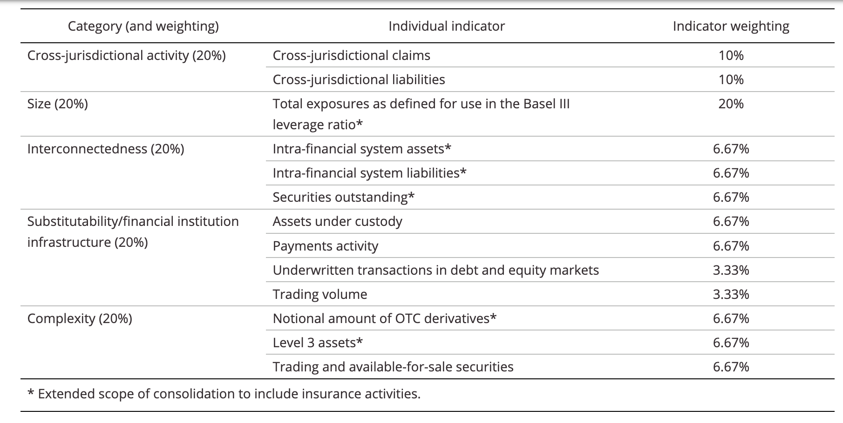
Assessment for Global systemically Important Banks
Appendix

Slide 21
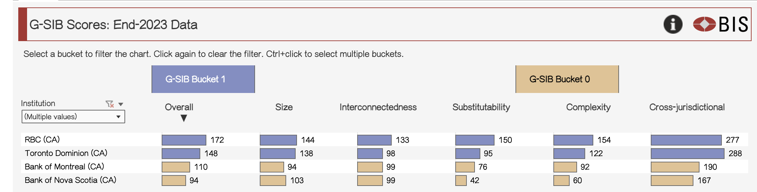
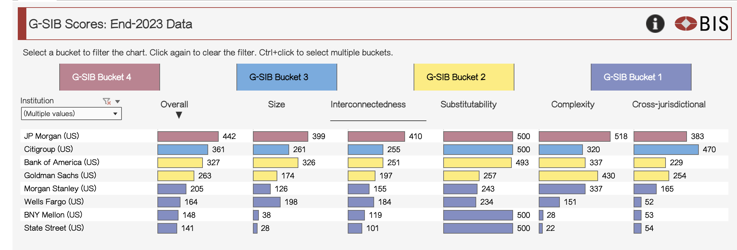
G-SIB List in Canada and US
Appendix

Slide 22
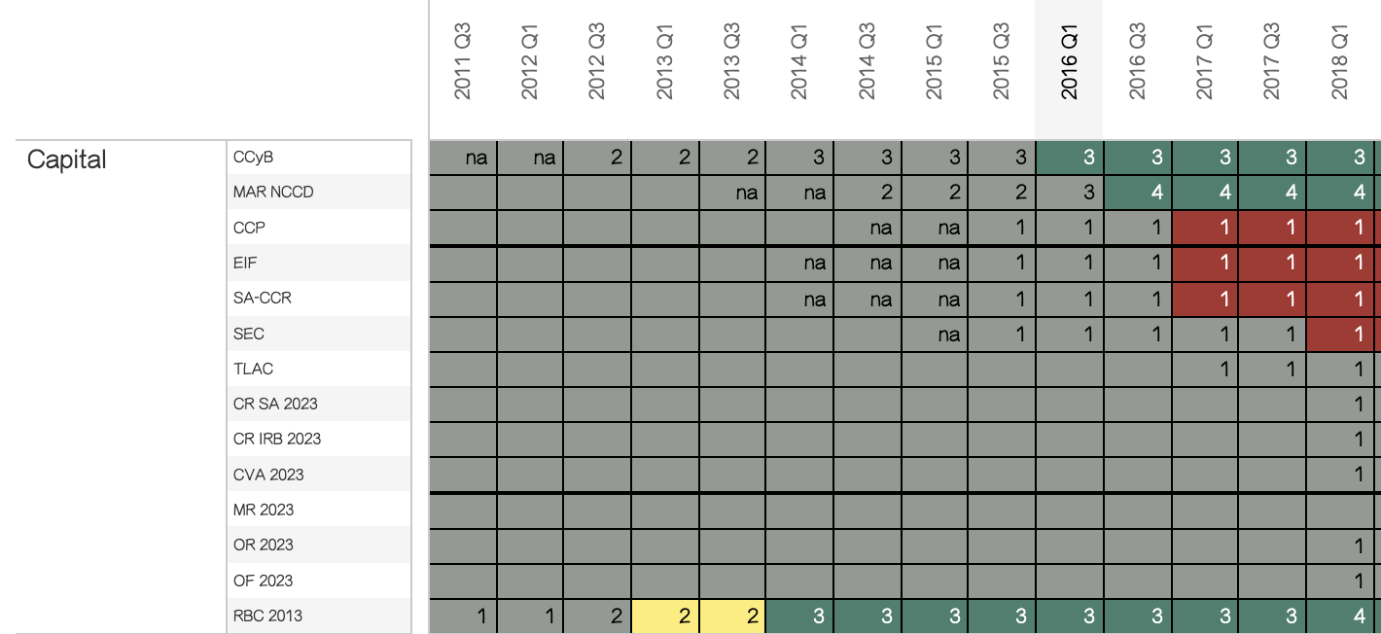
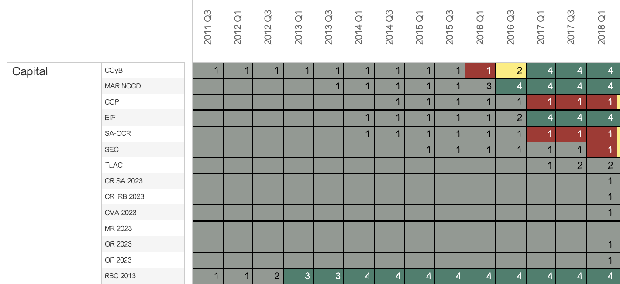
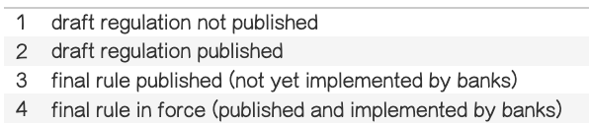
Basel III adoption progress for in Canada and US
Appendix
Canada
US

