Slide 1

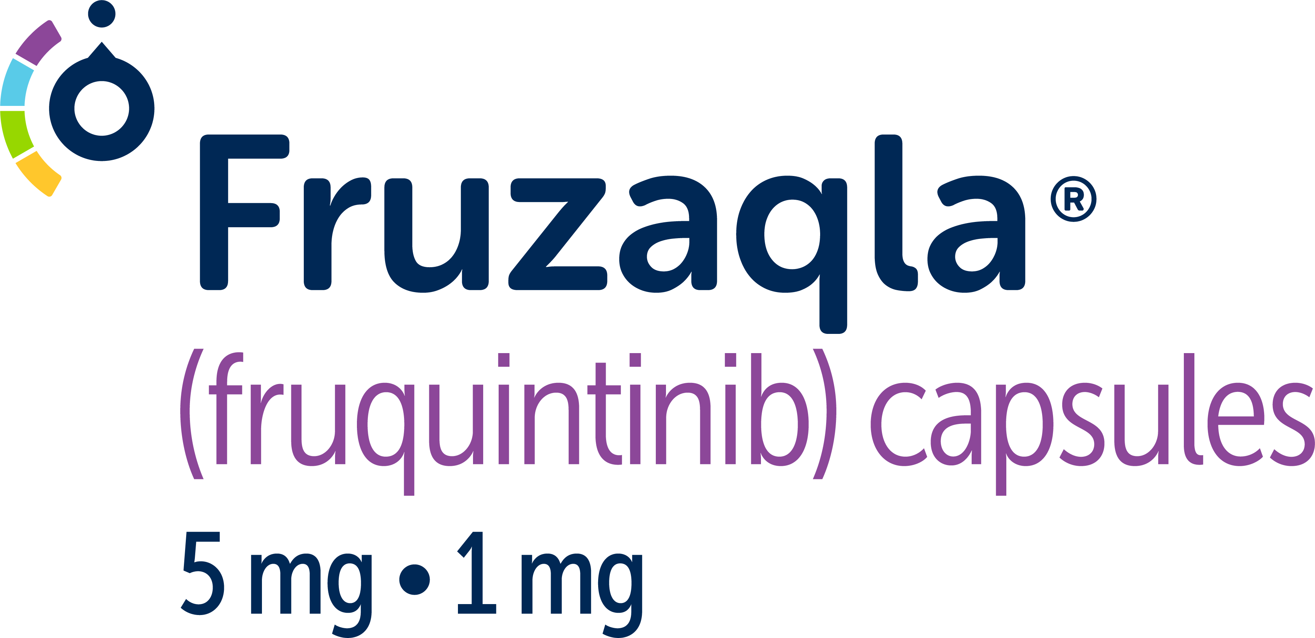

FRESCO Study
IMPORTANT SAFETY INFORMATION (continued)
WARNINGS AND PRECAUTIONS (continued)
Impaired Wound Healing. In 911 patients with mCRC treated with FRUZAQLA, 1 patient experienced a Grade 2 event of wound dehiscence. Do not administer FRUZAQLA for at least 2 weeks prior to major surgery. Do not administer FRUZAQLA for at least 2 weeks after major surgery and until adequate wound healing. The safety of resumption of FRUZAQLA after resolution of wound healing complications has not been established.
Please see additional Important Safety Information throughout, full Important Safety Information, and full Prescribing Information for FRUZAQLA.
UNMET
NEED/MOA
FRESCO-2
EFFICACY:
OS
EFFICACY:
PFS
SAFETY
FRESCO
EFFICACY:
OS
EFFICACY:
PFS
SAFETY
QOL/
DOSING
ASSIST/
ISI
ISI/
REFERENCES

