Slide 1
PureC-Mamba on Genesys2-eb [ Internal Use ]
University of ulsan
Electronical, Electronic and Computer Engineering
Jaehyeok Cho

Slide 2
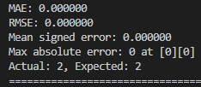
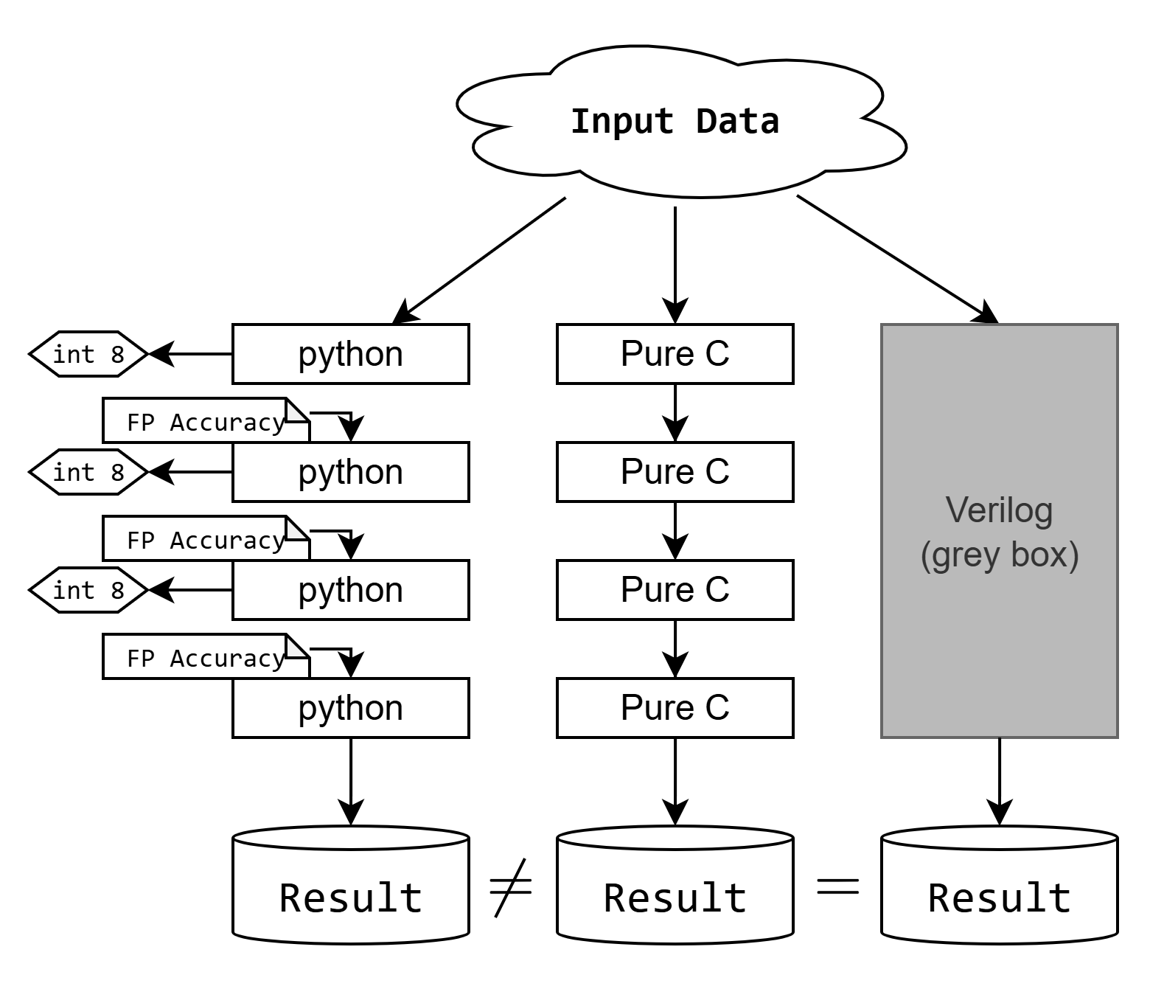
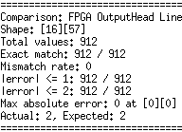
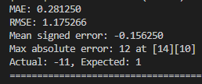
C-Mamba
C-Mamba showed errors against Layer-wise Py.Sim, as it uses FP-quant. Ref. inputs.
C-Mamba cascades int8 outputs by layers, and it accumulates Error across the network.
Under the same cascaded int8 condition of RTL log, the final output matched 100%
The verified C-Mamba was successfully ported to Genesys2-EB
It is named PureC-Mamba.
Fakefile read is used twice.
Input loading
Final output comparison
Result comparison with Verilog LOG On Desktop Ubuntu
Result comparison with Verilog LOG On Genesys2-EB
Result comparison with Py.Sim.

Slide 3
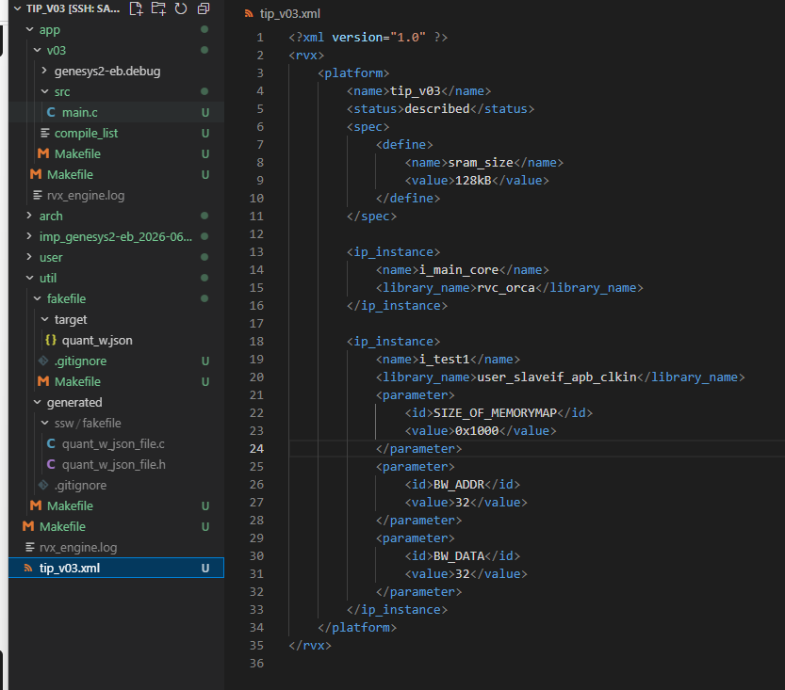
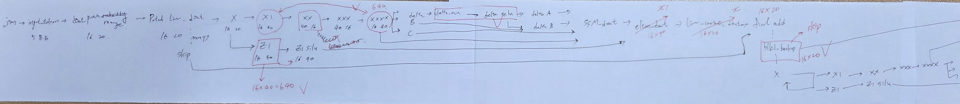
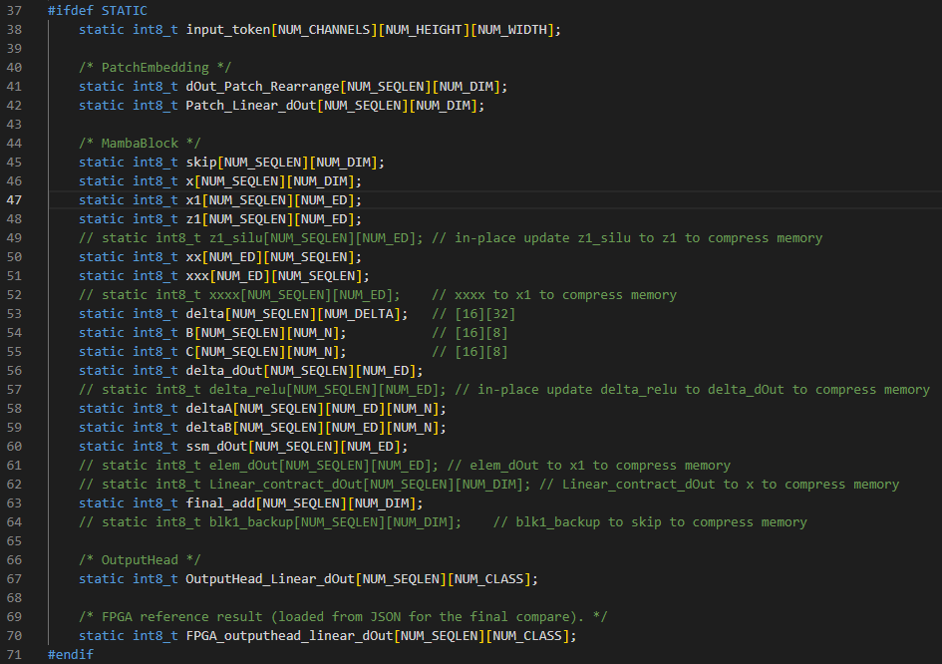
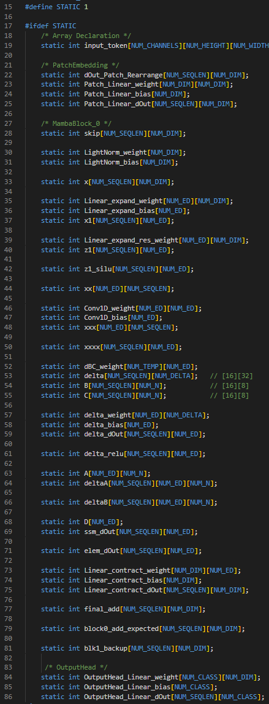
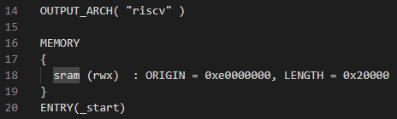
Porting PureC-Mamba from C-Mamba
It uses .bss memory space due to static buffer implementation.
Total memory usage: about 400KB → It exceeds Genesys2-EB SRAM 128KiB
I adapt two methods to optimized memory usage.
I reused memory space several times and applied in-place updates(Data Dependence).
I leveraged on-the-fly computation instead of array buffer (no middle buffers).
Manually checked Data Dependence
Reduced int8_t arrays
Ported int arrays
Memory Limitation

Slide 4
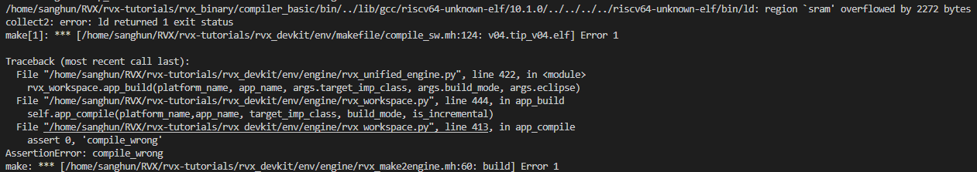
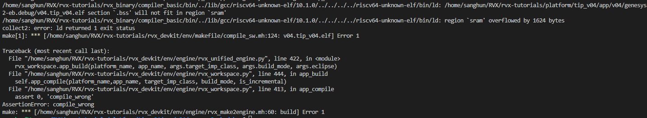
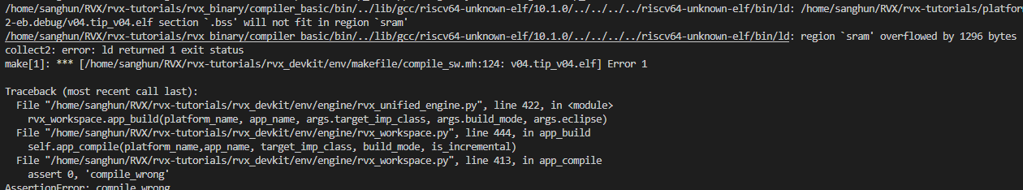
- 648 Byte
xxx → xx
- 328
Byte
blk1_backup → skip
- 648
Byte
z1_silu → z1

Slide 5
PureC-Mamba
Memory Usage of Final Version: 129,244B / 131,072B
SRAM Free Space: 1.8KB
It works well on Genesys2-EB with limited SRAM.
However, the size of single input takes about 9KiB, we cannot upload multiple input at once.
It requires additional capacity optimization or storage off-loading.
SRAM Capacity [0x20_000] = 131,072B Memory Usage = 129,244B Free Space = 131,072 - 129,244 = 1,828 Byte
quant_input_1_json_file_raw [0x23d9] = 9,177 bytes ≈ 8.96 KiB FPGA_result_1029_3_json_file_raw [0x3f71] = 16,241 bytes ≈ 15.86 KiB

Slide 6
PureC-Mamba on Genesys2-eb [ External Use ]
University of ulsan
Electronical, Electronic and Computer Engineering
Jaehyeok Cho

Slide 7
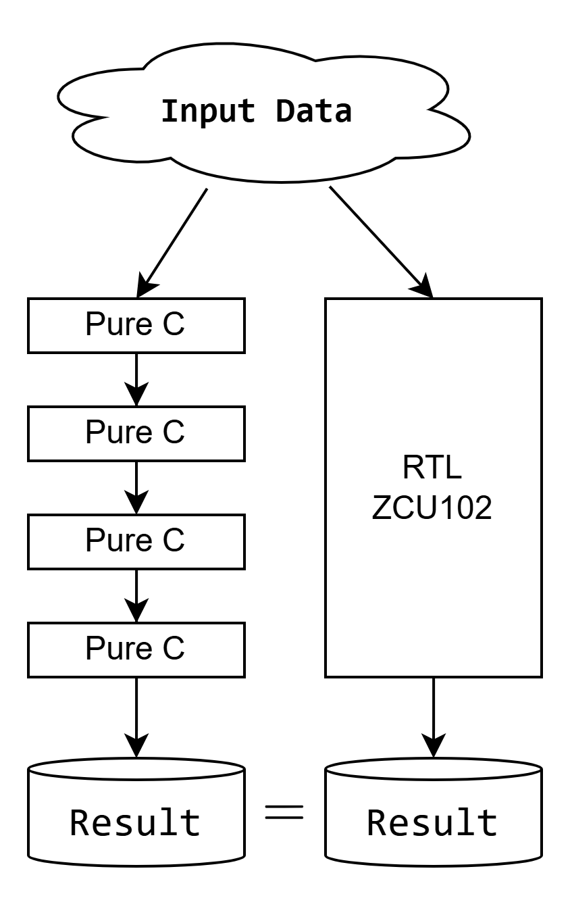
PureC-Mamba
RTL 결과와 일치하도록 Genesys2-EB에 포팅하여 정상 동작 확인
PureC-Mamba.
Fakefile read는 2번 사용
input 로딩
결과 비교 평가를 위한 RTL-ZCU102의 최종 결과 로딩
Flow Diagram
Genesys2-EB 출력 결과

Slide 8
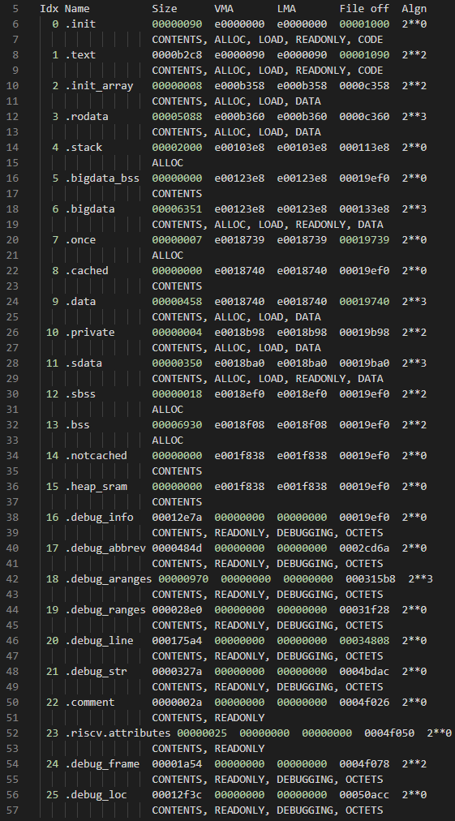
Porting PureC-Mamba
최종 메모리 사용량: 129,244B / 131,072B
SRAM 잔여 공간: 1.8KB, 정상 동작 확인
input 1개가 약 9KiB: 내부 로직 최적화 / 외부 로딩 방식 필요
SRAM Capacity [0x20_000] = 131,072 Byte Memory Usage = 129,244 Byte Free Space = 1,828 Byte
quant_input_1_json_file_raw [0x23d9] ≈ 8.96 KiB FPGA_result_1029_3_json_file_raw [0x3f71] ≈ 15.86 KiB
Genesys2-eb memory tree
objdump ELF file

Slide 9
Tutorial
University of ulsan
Electronical, Electronic and Computer Engineering
Jaehyeok Cho

Slide 10
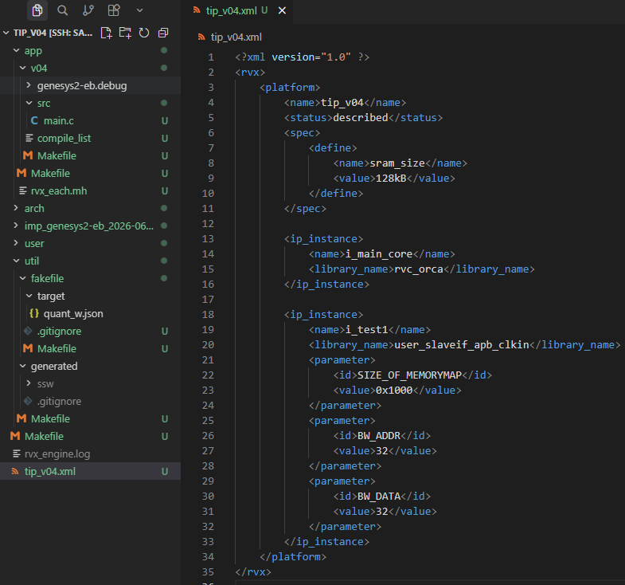

Platform & App 만들기
1.
construct my own system memory tree. Copy from original hello file.
2.

Slide 11
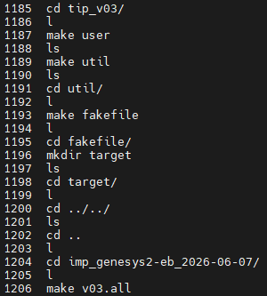
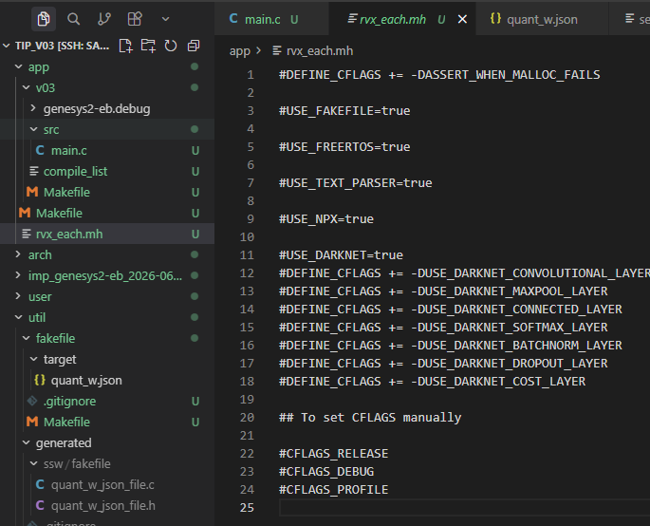

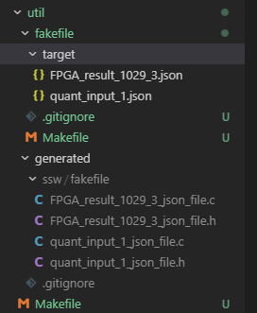
Fakefile 만들기
What we want to make
1.
3.
Paste your source text/json file here.
2.
Un-comment (주석 제거)

Slide 12
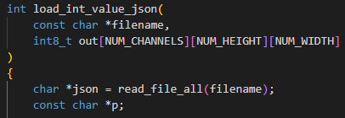
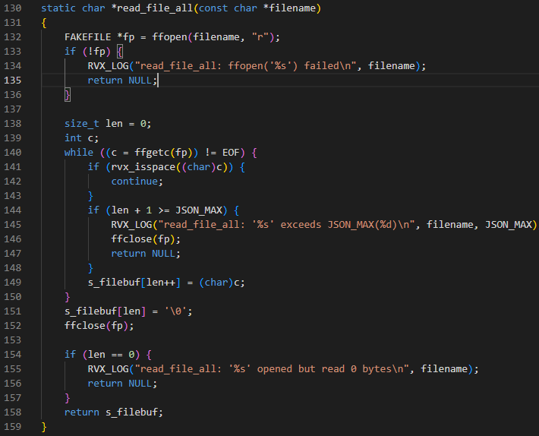
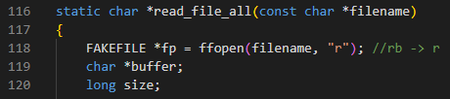

Fakefile 읽기
Error shooting

Slide 13
elf file

