Slide 1

British Airlines
Reviews Sentiment Analysis

Slide 2
Key Insights:
Positive Reviews: 46.60%
Negative Reviews: 51.50%
Neutral Reviews: 1.90%

Slide 3
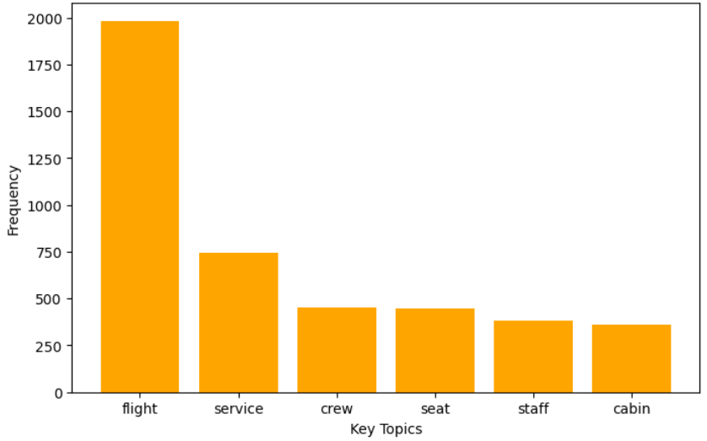
Key Topics in Reviews:

