Slide 1
Adult_Census_Salary
File created on: 2/22/2020 11:36:09 AM

Slide 2
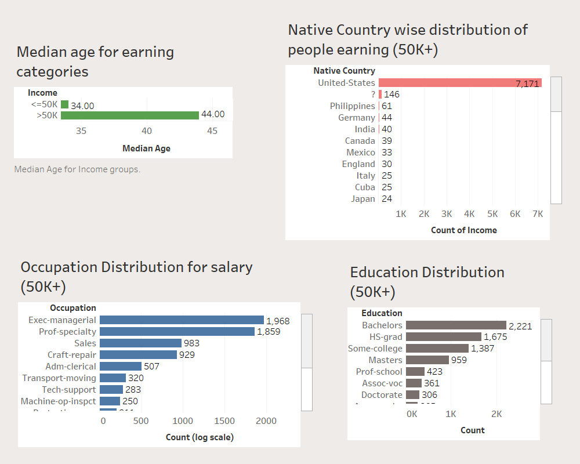

Slide 3
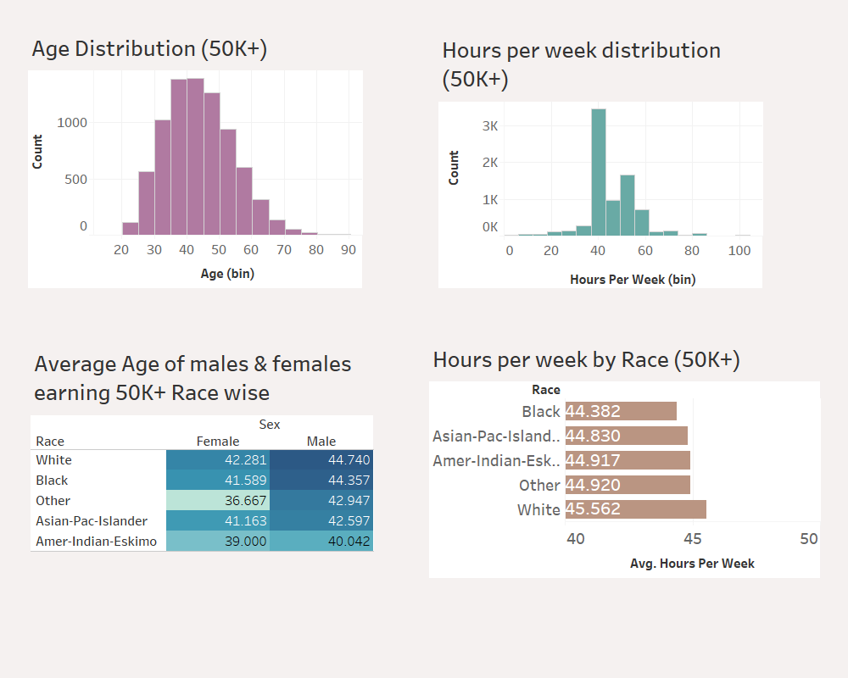

Slide 4
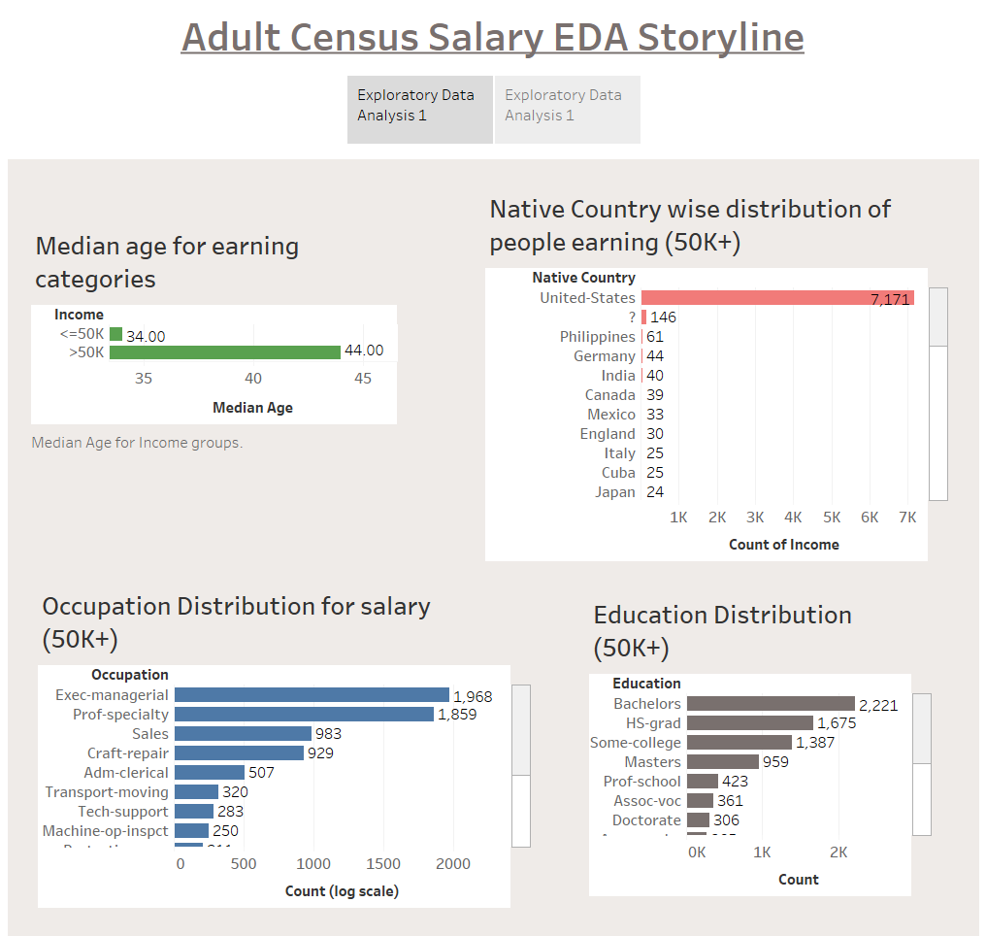

Slide 5
