Slide 1
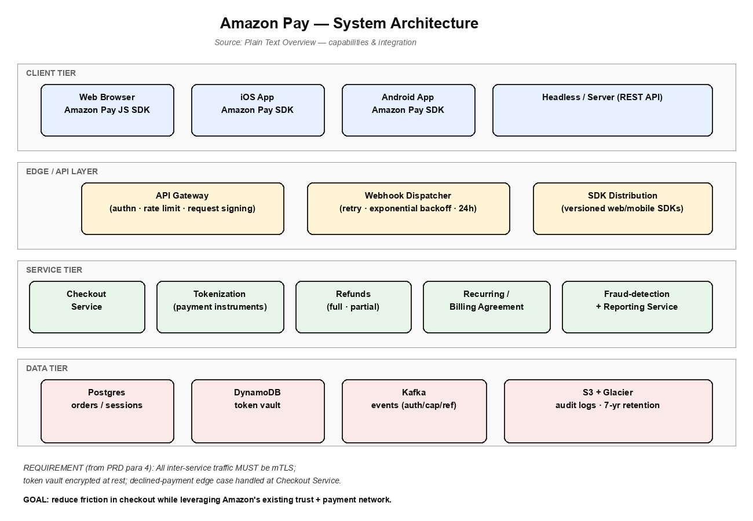
Amazon Pay - Architecture Overview
Tiered architecture
- Client tier: Web, iOS, Android, server SDKs
- Edge: API Gateway, webhook dispatcher
- Service: checkout, refunds, fraud detection
- Data: Postgres, DynamoDB, Kafka, S3
All inter-service traffic uses mTLS;
token vault is encrypted at rest.

Slide 2
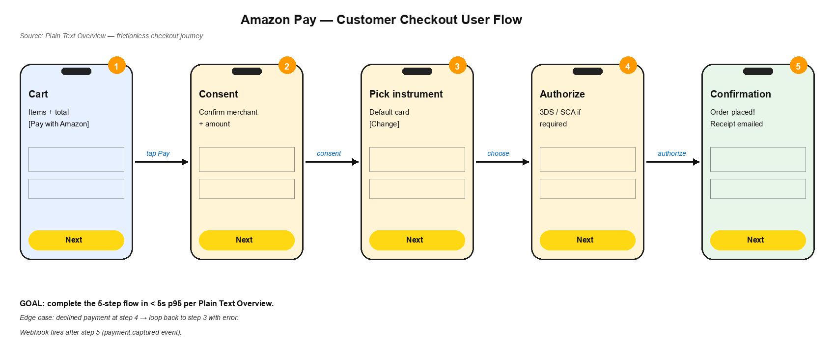
User Checkout Flow
5-step flow: Cart -> Consent -> Pick Instrument -> Authorize -> Confirmation. Target: < 5s p95.

