Slide 2
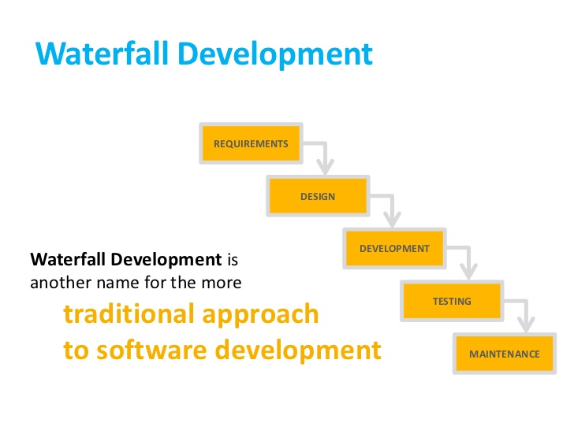

Slide 3
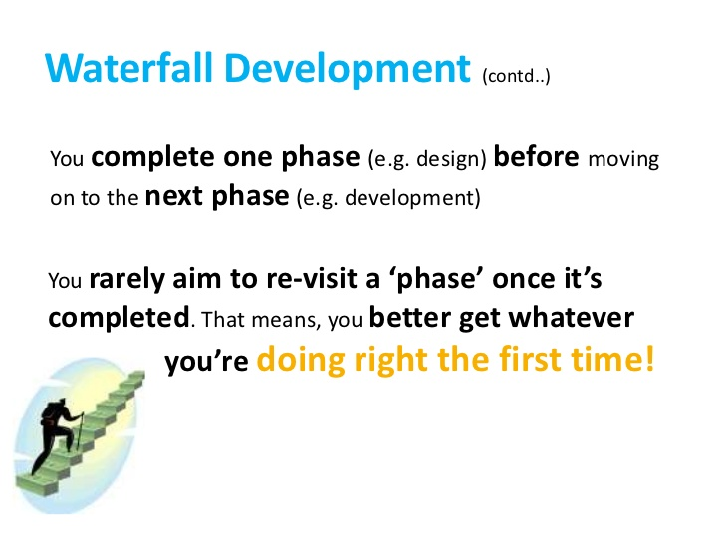

Slide 4
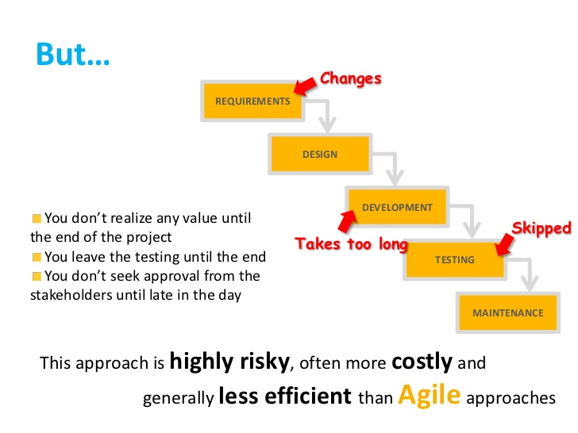

Slide 5
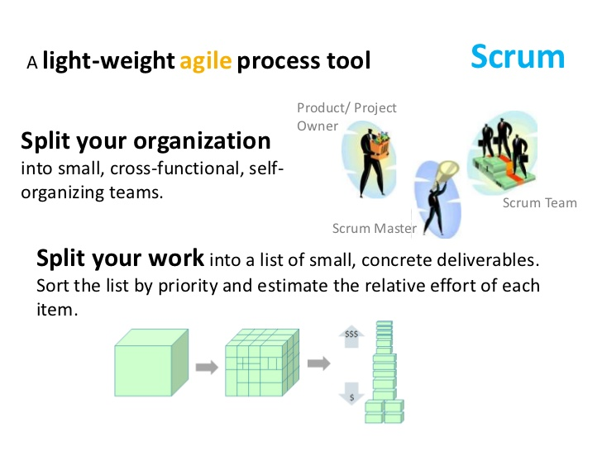

Slide 6
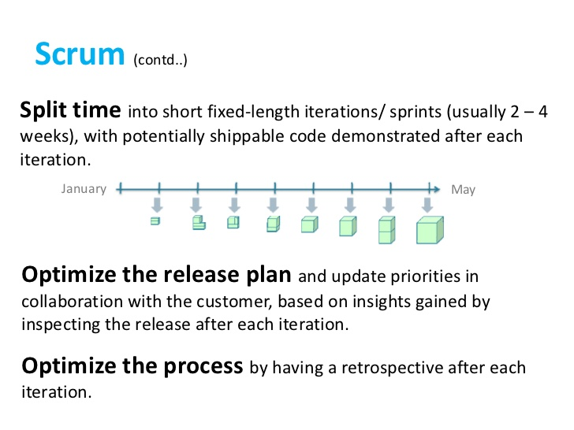

Slide 7
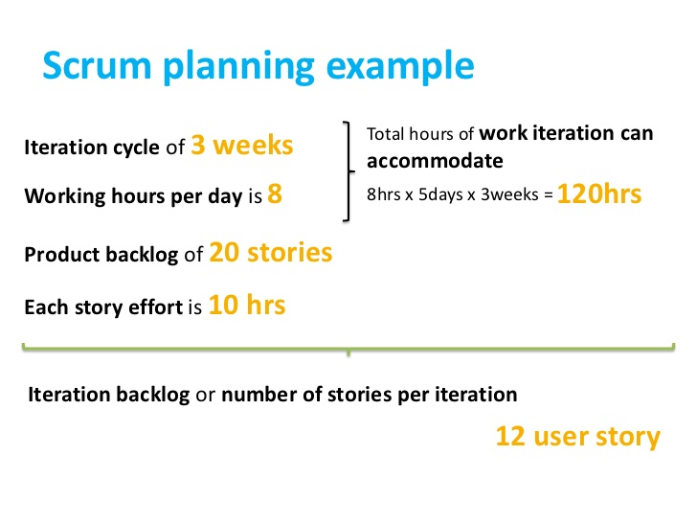

Slide 8
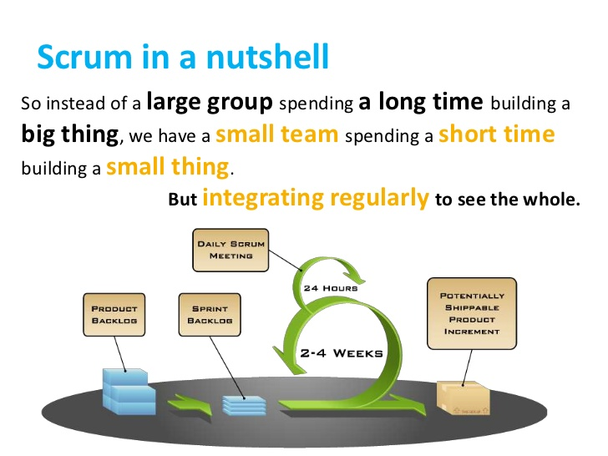

Slide 9
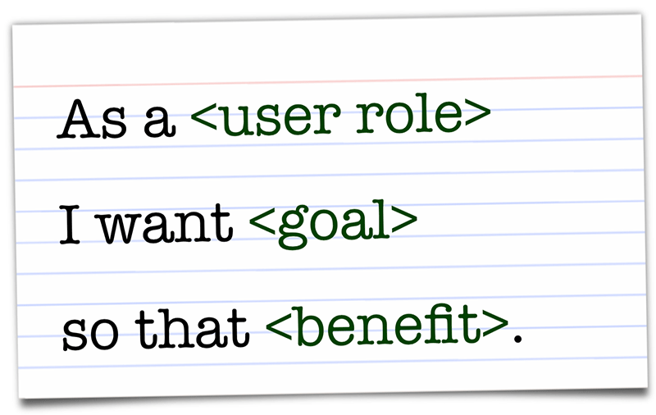
User Story
A user story is a tool used in Agile software development to capture a description of a software feature from an end-user perspective. The user story describes the type of user, what they want and why. A user story helps to create a simplified description of a requirement.

Slide 10
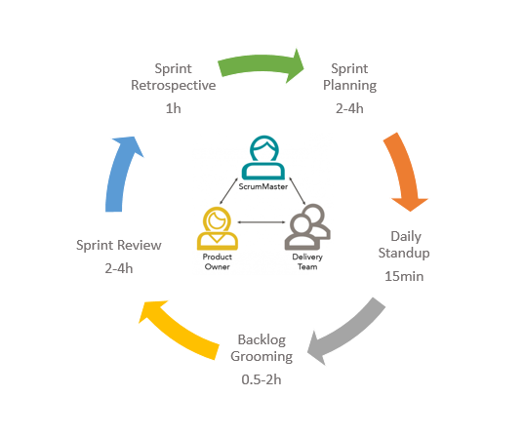
Sprint Client
To involve your client when using Scrum, you'll need to make sure they are monitoring the product backlog. This is a key element in the Scrum methodology process and the client is responsible for making entries or adjustments to the project throughout the project process. While the client is responsible for the upkeep of the product backlog, your team is responsible for developing the client's requests.

Slide 11
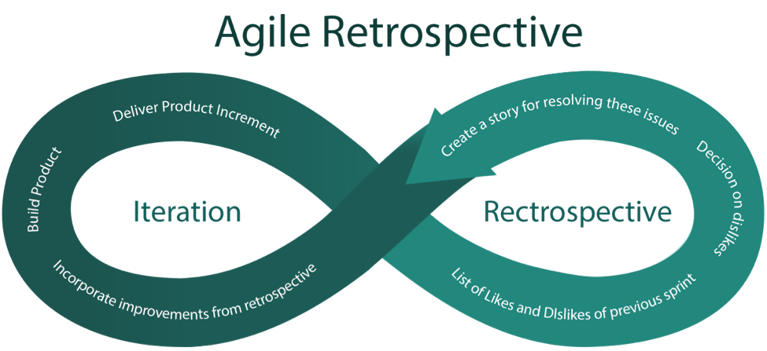
Agile retrospective
An Agile retrospective is a meeting that's held at the end of an iteration in Agile software development (ASD). During the retrospective, the team reflects on what happened in the iteration and identifies actions for improvement going forward.
General questions asked are:-
1. What worked well for us?
2.What did not work well for us?
3.What actions can we take to improve our process going forward?

Slide 12
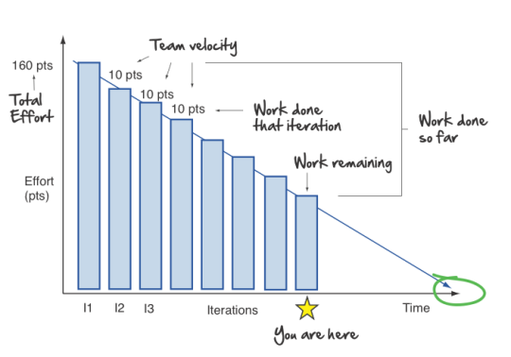
Burn Down Chart
A burn down chart is a graphical representation of work left to do versus time. The outstanding work (or backlog) is often on the vertical axis, with time along the horizontal. That is, it is a run chart of outstanding work. It is useful for predicting when all of the work will be completed. It is often used in agile software development methodologies such as Scrum. However, burn down charts can be applied to any project containing measurable progress over time. Outstanding work can be represented in terms of either time or story points

Slide 13
Scrum product owner
The Product Owner is the sole person responsible for managing the Product Backlog. Product Backlog management includes:
Clearly expressing Product Backlog items.
Ordering the items in the Product Backlog to best achieve goals and missions.
Optimizing the value of the work the Development Team performs.
Ensuring the Development Team understands items in the Product Backlog to the level needed

Slide 14
Velocity
Velocity is a metric that predicts how much work an Agile software development team can successfully complete within a two-week sprint
Velocity is a key feedback mechanism for the Team.
Velocity is a useful planning tool for estimating how fast work can be completed.
Generally, velocity remains somewhat constant during a development project
By knowing Velocity, a product owner can figure out how many Sprints it will take the Team to achieve a desired level of functionality.

Slide 15
Spring Backlog
The Sprint Backlog is the set of Product Backlog items selected for the Sprint.
The Sprint Backlog is a forecast by the Development Team about what functionality will be in the next Increment and the work needed to deliver that functionality.
The Team determines how best to work through the Sprint Backlog.
The Sprint Backlog is a plan with enough detail that changes in progress can be understood in the Daily Scrum.

