Slide 1

A3-PS003-TC520 · Chauraha Sync
Federated Traffic-Flow Prediction
with Communication-Cost Evaluation
STUDENT TEAM
Aryan Jha · Team Lead
aryanjha.ad26@bmsce.ac.in
Apeksha Benneshiroor
apekshabenneshiroor.ec26@bmsce.ac.in
FACULTY MENTOR
Dr. Monika Puttaramaiah
monika.mel@bmsce.ac.in
BMS College of Engineering
Bengaluru, India
GitHub: github.com/jhaaryan7580-dev/A3-PS003-TC520
LinkedIn: linkedin.com/in/aryan-jha-785a29343
AIORI Hackathon 3 · Smart Cities
AI-assisted cross-checks · October 19, 2026
A. Jha · A3-PS003-TC520 · Prepared October 19, 2026
1 / 11

Slide 2
AIORI 3 Abstract
Problem Description
Can local traffic forecasting retain accuracy while reducing accounted data exchange?
Measure centralised, local-only and FedAvg training under random IID-style and quiet-to-busy non-IID sensor groups.
5 clients · 34 sensors/client · 3 seeds
15 primary learned runs; 6 extended-round diagnostic runs.
Public PEMS08 data; next five-minute forecast. No live cameras or city deployment.
AI-assisted checks — primary results
Centralised MAE: 13.862 ± 0.013
IID FedAvg: 13.964 ± 0.014 (+0.73%)
Non-IID FedAvg: 14.209 ± 0.066 (+2.50%)
Common-group relative-error gap: 2.404 → 2.919 percentage points for IID versus non-IID FedAvg.
Quietest group: non-IID FedAvg MAE 10.42% worse than matched local-only. H4 is refuted.
Mean ± sample SD over three seeds. Primary: 30 central/local epochs; 30 FedAvg rounds × 1 local epoch.
Counts and figures derive from frozen JSONs, not the superseded Level 1 results.
A. Jha · A3-PS003-TC520 · Prepared October 19, 2026
2 / 11

Slide 3
AIORI 3 Background
Background
Public benchmark, not Bengaluru deployment
PEMS08 tensor: 17,856 × 170 × 3.
Five-minute steps; channel 0 is flow.
California freeway sensors, grouped into five simulated clients. [2, 3]
Quality and modelling assumption
NaN = 0; Inf = 0.
Zero flow: 10,560 entries · 0.348%.
Treat exact zero as missing; drop a window if any of its 13 flow values is zero.
Leakage-safe chronological protocol
Train/validation/test: 70/15/15%.
Eligible windows: 2,098,136 / 448,263 / 448,533.
Train-only scaling; no cross-boundary windows. Validation selects checkpoints.
Measured heterogeneity
IID-style sensor-mean W1, seeds 0/1/2:
28.407 / 30.085 / 30.793.
Quiet-to-busy non-IID: 127.867.
Primary statistic: pairwise W1 on sensor means.
Zero handling is an explicit assumption, not proof about every zero. W1 uses valid training values only.
A. Jha · A3-PS003-TC520 · Prepared October 19, 2026
3 / 11

Slide 4
AIORI 3 Literature & RFC Review
Literature & RFC Review
[1] McMahan et al., 2017 — FedAvg
Iterative averaging of locally trained model parameters. We implement sample-weighted aggregation with all five clients; the local optimiser is Adam.
[2, 3] Caltrans PeMS and the ASTGNN benchmark package
Public California traffic measurements and the exact PEMS08 tensor. We use the dataset, not ASTGNN's graph model; our forecaster has only 513 parameters.
[4] AIORI PS-003 — measurable comparison, not a new algorithm
Contribution: matched local-only references, identical evaluation groups, validation-selected checkpoints, three-seed reporting and explicit 30-versus-100-round payload trade-offs.
No governing FedAvg RFC is claimed. No differential privacy, secure aggregation or transport-layer bandwidth measurement is implemented.
A. Jha · A3-PS003-TC520 · Prepared October 19, 2026
4 / 11

Slide 5
AIORI 3 Proposed Solution
Proposed Solution
Frozen NumPy scientific core
12 flow lags + sin/cos of global index mod 288.
14 → 32 ReLU → 1; 513 parameters.
MSE; Adam, LR 0.001; batch 1,024.
FedAvg + matched comparisons
5 clients; sample-weighted parameter average.
Local Adam state resets each round.
Central/local: 30 epochs; FedAvg: 30 rounds × 1 local epoch. Seeds 0, 1, 2.
Minimum validation MAE selects checkpoints.
Working demonstration prototype
Local PEMS08 file → eligible held-out sensor window → real saved-weight forecast.
Recorded truth + persistence comparison.
Browser SHA checks; NumPy parity tolerance 0.001 flow units. No retraining in this view.
Inspect the evidence and cost
Three-seed metrics; common-group errors; verified validation-history replay.
2,052 B/model; 20,520 B/round.
Training-flow reference: 8,499,320 B.
Browser replay is not training; fresh NumPy smoke commands write separate outputs. No city deployment or privacy guarantee.
Shared train-derived scaling is a simulation assumption. Equal sample passes are not equal optimiser trajectories.
Payload excludes wire/serialization overhead; zero model exchange does not mean zero total system cost.
A. Jha · A3-PS003-TC520 · Prepared October 19, 2026
5 / 11

Slide 6
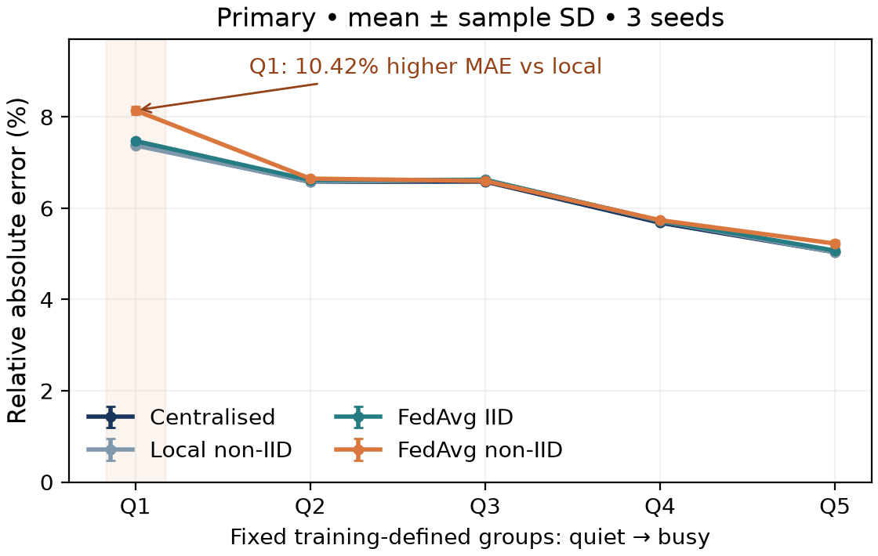
AIORI 3 Solution Optimization
Optimization Proposed — Accuracy & Client Cost
Primary: 30 central/local epochs; 30 FedAvg rounds. Test means ± sample SD, seeds 0/1/2.
Method | Test MAE | Test RMSE
Persistence | 16.078 | 24.451
Daily / sensor | 34.776 | 51.078
Centralised | 13.862 ± 0.013 | 21.074 ± 0.008
Local IID | 13.992 ± 0.031 | 21.221 ± 0.048
Local non-IID | 13.898 ± 0.005 | 21.096 ± 0.012
FedAvg IID | 13.964 ± 0.014 | 21.211 ± 0.031
FedAvg non-IID | 14.209 ± 0.066 | 21.373 ± 0.079
FedAvg: 615,600 model-payload B/run.
Local-only: 0 model-exchange B, not total cost.
Separate diagnostic: 30 → 100 rounds
IID MAE | 13.964 → 13.873 ± 0.010
Non-IID MAE | 14.209 → 14.064 ± 0.043
2,052,000 B/run · 3.33× payload; no plateau claim.
Q1: 7.983 vs 7.230 MAE; H4 refuted. Scarcity benefit remains untested.
Relative error = group MAE / group mean flow, not MAPE.
A. Jha · A3-PS003-TC520 · Prepared October 19, 2026
6 / 11

Slide 7
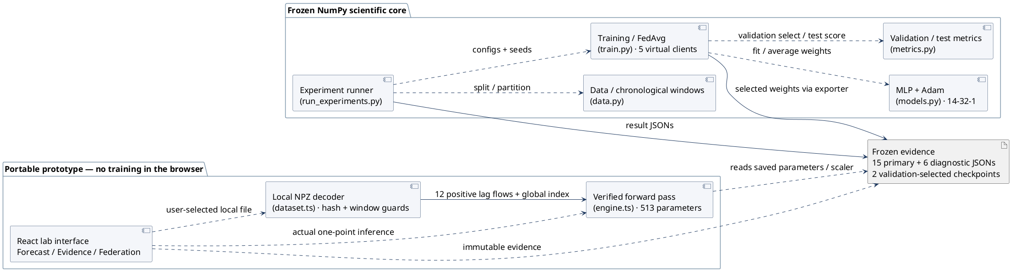
AIORI 3 Architecture Design (UML Diagram)
Solution Architecture & Design
Actual module dependencies: frozen NumPy simulator + a portable, checksum-verified browser inference view.
Dashed arrows: module dependencies. Solid arrows: result/model artifacts and validated input flow.
Browser playback is not training. Local file input is not an app upload; no deployed city or formal privacy claimed.
A. Jha · A3-PS003-TC520 · Prepared October 19, 2026
7 / 11

Slide 8
AIORI 3 Data Flow Diagram
Data Flow Diagram
No test-driven selection. Local training uses training windows; validation is evaluated after aggregation.
Public PEMS08
Channel 0 flow
SHA-256 verification
Chronological split
Train-only scaler
12-lag valid windows
Training partition
IID / non-IID
5 groups × 34 sensors
Local training
Receive global weights
1 epoch / round
2,052 B
upload/client
2,052 B
download/client
Result JSONs
15 main + 6 diagnostic
Tables and figures
Final test scoring
448,533 windows
MAE / RMSE / gaps
Validation
Minimum MAE
selects checkpoint
FedAvg server
Sample-weighted model
Count payload bytes
Rounds to validation target, seeds 0 / 1 / 2: IID 3 / 2 / 3; non-IID 9 / 6 / 4.
Target = 1.05 × each seed’s best centralised validation MAE; descriptive, not a stopping rule.
Five clients × two directions × 2,052 B = 20,520 B/round.
Figure: simulation data flow; no production network or formal privacy claim.
A. Jha · A3-PS003-TC520 · Prepared October 19, 2026
8 / 11

Slide 9
AIORI 3 Deployment Timeline
Deployment Timeline — Technical Release & Review
Technical artifacts prepared October 19. Deployment here means the local simulator release, not a city installation.
Date / status | Milestone | Evidence / exit check
Oct 19 · complete | Dataset, chronological windows and baselines | Hashed data; training-only statistics
Oct 19 · complete | Primary matrix and separate extended diagnostic | 15 + 6 JSONs; three seeds
Oct 19 · complete | Actual inference, reports and evidence figures | 2 verified saved checkpoints; runnable predictor
Oct 19 · complete | Release verification and AIORI-format presentation | 55 tests; 41 preserved entries; PDF/PPTX
Oct 19–30 · review | Team reproduction, mentor walkthrough, publication | Record actual checks and feedback; team uploads
Oct 31 · window end | Official Level 2 submission window closes | Confirm final repository access and artifacts
Mentoring dates will follow organiser confirmation; session dates and feedback will be logged when held.
October 30 is our buffer target. Later review/publication dates are not claimed as new experiment dates.
A. Jha · A3-PS003-TC520 · Prepared October 19, 2026
9 / 11

Slide 10
AIORI 3 Bibliography
Bibliography
[1] McMahan, B., Moore, E., Ramage, D., Hampson, S. and Agüera y Arcas, B. (2017). Communication-Efficient Learning of Deep Networks from Decentralized Data. AISTATS, PMLR 54:1273–1282.
proceedings.mlr.press/v54/mcmahan17a.html
[2] California Department of Transportation. Performance Measurement System (PeMS) Data Source.
dot.ca.gov/programs/traffic-operations/mpr/pems-source
[3] Guo et al. ASTGNN code and benchmark data repository. Exact PEMS08 tensor independently hashed for this study.
github.com/guoshnBJTU/ASTGNN
[4] AIORI-3. Official PS-003 brief, presentation template and hackathon guideline.
portal.aiori.in/aiori-3/hackathon-guideline/
[4] Supplied PDFs are preserved in docs/PS-003_official.pdf and docs/Proposed-structure-hackathon.pdf.
The URL links the public guideline, not those PDFs. URLs checked October 19; metrics come from preserved JSONs.
Public availability is not treated as a dataset redistribution licence; obtain the benchmark from its source.
A. Jha · A3-PS003-TC520 · Prepared October 19, 2026
10 / 11

Slide 11

AIORI 3 Team & Contact
Thank You for Your Attention!
Point of contact — Aryan Jha · Team Lead
aryanjha.ad26@bmsce.ac.in
Apeksha Benneshiroor · apekshabenneshiroor.ec26@bmsce.ac.in
Dr. Monika Puttaramaiah · monika.mel@bmsce.ac.in
Repository
github.com/jhaaryan7580-dev/A3-PS003-TC520
Introduction video
youtube.com/watch?v=jJh9rvyaiUA
LinkedIn: linkedin.com/in/aryan-jha-785a29343
Repository QR
Private access may require login.
Mentor/evaluator access must be checked.
Reproducible evidence, honest limitations and mentor feedback guide the final submission.
A. Jha · A3-PS003-TC520 · Prepared October 19, 2026
11 / 11

