Slide 1
Classification via
Linear Discriminant Analysis
Oscar Garcia Fernandez
Jannik Haas

Slide 2
Classification Applications
Bank Loan Prediction
Image/Video/Sound Classification
Text Classification
Glass Classification
Forensic Sciences

Slide 3
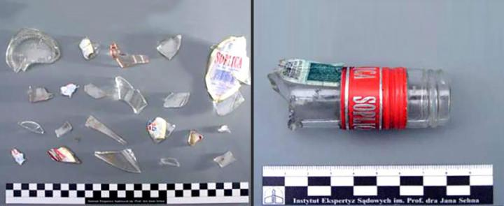
Application Importance
General Classification
Glass Classification
Be able to classify items based on their features.
Forensic Evidence

Slide 4
Other Methods used
Support Vector Machine:
http://rexa.info/paper/81ad8e5b8306aee758f09fd5c1caa8a23c63c2d6
Neural Networks:
http://rexa.info/paper/abe4b819b1c9858440502f14d418706d2446c387
Genetic Algorithms:
http://rexa.info/paper/0a882383e36d72c5890e2d191326433e23e53c9b

Slide 5
Linear Discriminant Analysis
Advantages
Disadvantages
Easy to implement
Low computational cost
Good input for other algorithms
Good standard for other more complex classifiers
AI methods will generally outperform it
Performance can be affected if its assumptions are not met:
Normally distributed data
Equal covariances among classes
Independent features

Slide 6
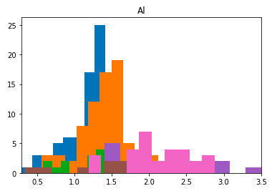
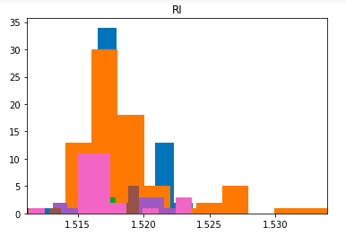
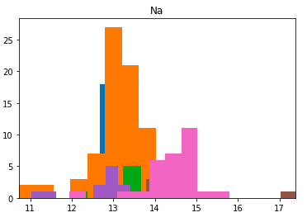
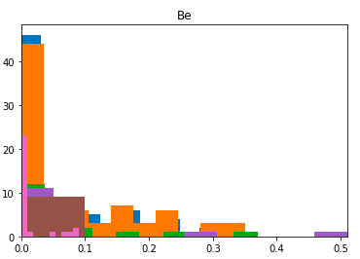
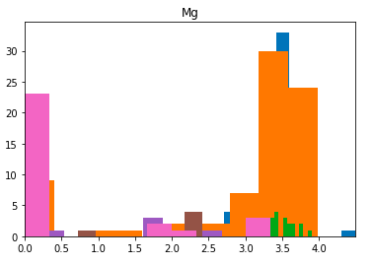
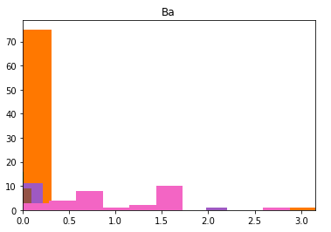
Glass Classification via LDA- Data Exploration

Slide 7
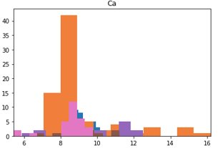
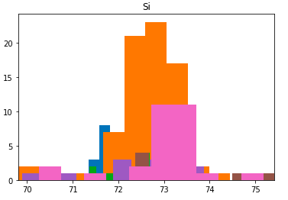
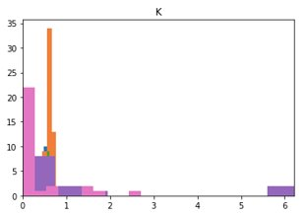
Glass Classification via LDA- Data Exploration

Slide 8
Glass Classification via LDA- Types of Glass
Building Windows Float Processed
Building Windows Non Float Processed
Vehicle Windows Float Processed
Vehicle Windows Non Float Processed (none in this database)
Containers
Tableware
Headlamps

Slide 9
Glass Classification via LDA- Implementation
Split data into training and testing
80% training
20% testing
Train SKLearn LDA Model using training data
Test LDA Model on testing data
Results:
83.7% Accuracy

Slide 10
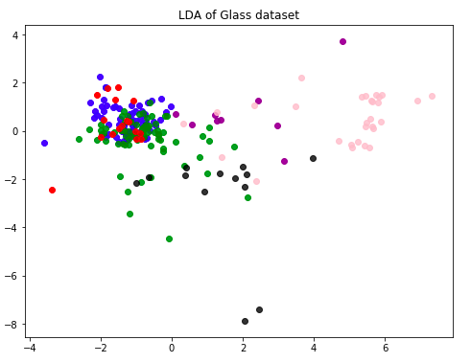
Glass Classification via LDA- Results

Slide 11
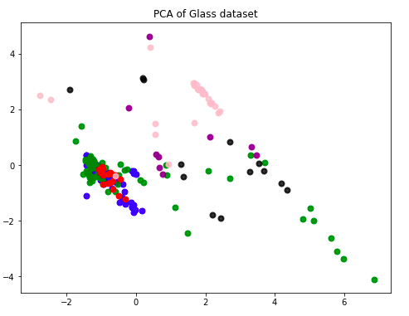
LDA vs. PCA

Slide 12
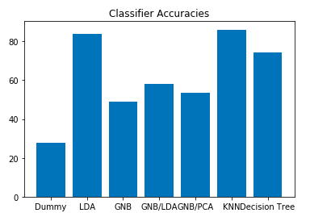
LDA Performance vs. Other Simple Classifiers

Slide 13


