Slide 1

Text as Data:
A brief introduction
TextXD, Dec. 3, 2019
Jaren Haber
UC Berkeley
Special thanks to Ben Gebre-Medhin, Laura Nelson,
Geoff Bacon, and Caroline Le Pennec-Caldichoury
Slides: http://bit.ly/repo-textxd19

Slide 2
Introductions
Instructor
Participants
Name
Affiliation
Any immediate projects or use cases? (Briefly)
Familiarity with Python or R? (Beginner, Intermediate, Advanced)
- If you do have immediate projects, bring them in!

Slide 3

Goals of this workshop
Provide a general roadmap of computational text analysis (CTA)
Build intuitions about using text as data
Build enthusiasm!
Practice preprocessing and more
Understand at a high-level
how a few primary CTA methods work
what kinds of questions they answer
how to design and implement a CTA project

Slide 4
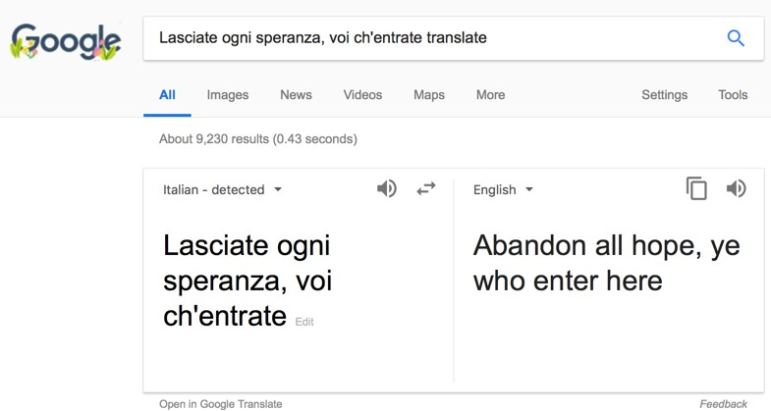
Machine translation
Notes:
Slide borrowed from David Bamman’s INFO 256 course: http://people.ischool.berkeley.edu/~dbamman/info256.html

Slide 5
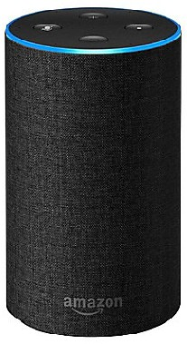
Speech Recognition
“Alexa, how many cups are in a quart?”
Notes:
Slide borrowed from David Bamman’s INFO 256 course: http://people.ischool.berkeley.edu/~dbamman/info256.html

Slide 6
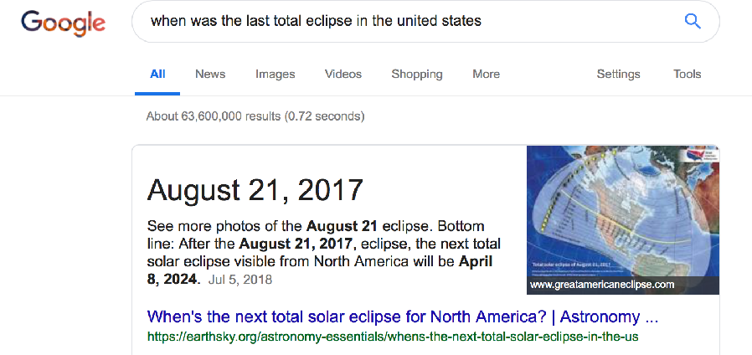
Question Answering
Notes:
Slide borrowed from David Bamman’s INFO 256 course: http://people.ischool.berkeley.edu/~dbamman/info256.html

Slide 7






Software/Libraries
NLTK
10
Notes:
Slide borrowed from David Bamman’s INFO 256 course: http://people.ischool.berkeley.edu/~dbamman/info256.html

Slide 8
NLP is interdisciplinary
•
Artificial intelligence
•
Machine learning (ca. 2000—today); statistical models, neural networks
•
Linguistics (representation of language)
•
Social sciences/humanities (models of language at use in culture/society)
Notes:
Slide borrowed from David Bamman’s INFO 256 course: http://people.ischool.berkeley.edu/~dbamman/info256.html

Slide 9
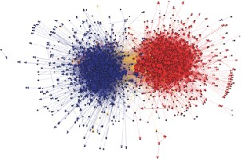
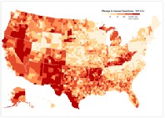
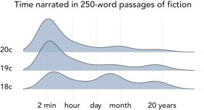
Computational Journalism
Computational Social Science
Adamic and Glance 2005
Change in insured Americans under the ACA, NY Times (Oct 29, 2014)
Computational Humanities
Underwood 2018
Notes:
Slide borrowed from David Bamman’s INFO 256 course: http://people.ischool.berkeley.edu/~dbamman/info256.html

Slide 10
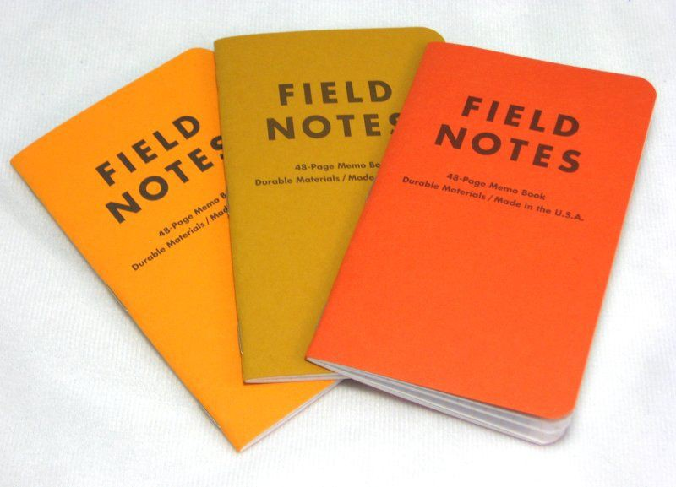
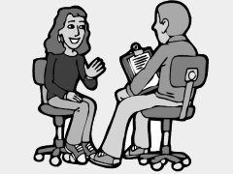

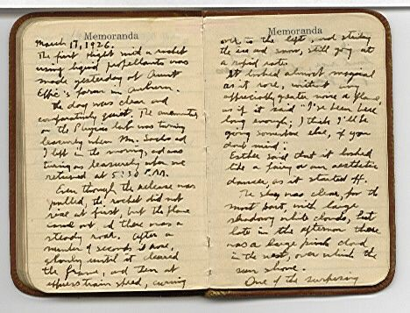


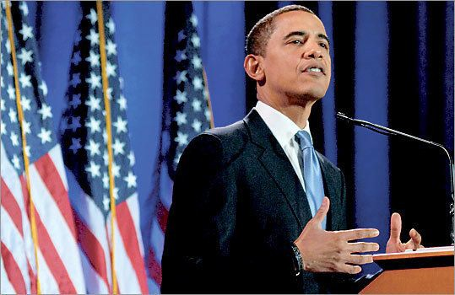
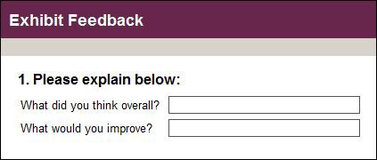
Text as data

Slide 11
Types of languages
Natural languages
Time flies like an arrow. Fruit flies like a banana.
Artificial languages
Y = f3₀ + f3₁ X₁ + f3₂ X₂ + f3₃ X₃ + . . . + f3_{n} X_{n} + E
import scipy
from scipy import sparse
n = 200000
matrix = scipy.sparse.rand(n, n, density=.001) print(matrix)

Slide 12

How do humans analyze texts?
We need to steer clear of this poverty of ambition, where people want to drive fancy cars and wear nice clothes and live in nice apartments but don't want to work hard to accomplish these things. Everyone should try to realize their full potential.
- Barack Obama
Close reading

Slide 13
The promise of distant reading
Scale/speed
Reproducibility
Does not have human biases
Has other (at times unknown) biases
Consistent

Slide 14
A simple representation of text
Corpus of documents
Objective: map raw text of each document i to some attribute v_{i}
The estimated attribute vˆ_{i} can then be used for
descriptive or causal analysis

Slide 15

Movie revenues
Input: text of movie review
Output: box office revenue
Joshi et al. (2010), "Movie Reviews and Revenues: An Experiment in Text Regression” (NAACL)
Notes:
Slide borrowed from David Bamman’s INFO 256 course: http://people.ischool.berkeley.edu/~dbamman/info256.html

Slide 16
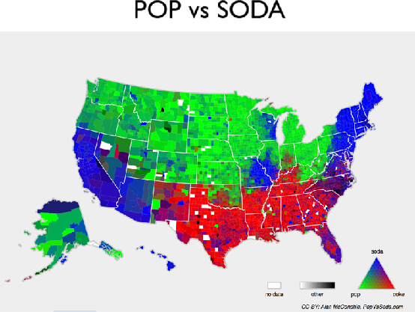
Geographical location
Input: tweet
Output: latitude, longitude
http://popvssoda.com
Wing and Baldridge (2011), “Simple supervised document geolocation with geodesic grids” (ACL)
Notes:
Slide borrowed from David Bamman’s INFO 256 course: http://people.ischool.berkeley.edu/~dbamman/info256.html

Slide 17

•
Data: Random acts of pizza (subreddit)
•
Response: Is a request successful in getting a pizza?
Althoff et al. (2014), "How to Ask for a Favor: A Case Study on the Success of Altruistic Requests” (ICWSM)
Notes:
Slide borrowed from David Bamman’s INFO 256 course: http://people.ischool.berkeley.edu/~dbamman/info256.html

Slide 18
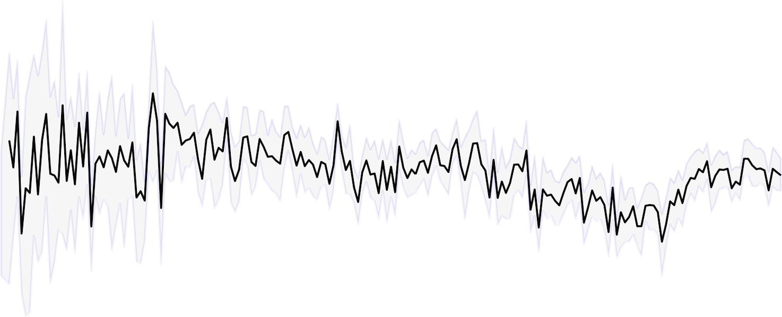
1.00
0.75
words about women
0.50
written by women
0.25
0.00
1820
1840
1860
1880
1900
1920
1940
1960
1980
2000
Fraction of words about female characters
Ted Underwood, David Bamman, and Sabrina Lee (2018), "The Transformation of Gender in English-Language Fiction,” (Cultural Analytics)
Notes:
Slide borrowed from David Bamman’s INFO 256 course: http://people.ischool.berkeley.edu/~dbamman/info256.html

Slide 19
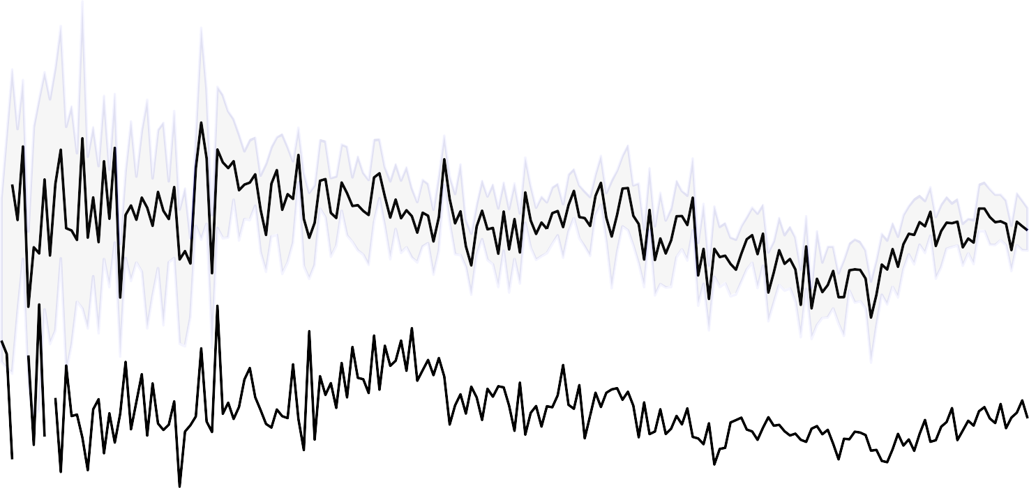
1.00
0.75
words about women
0.50
written by women
written by men
0.25
0.00
1820
1840
1860
1880
1900
1920
1940
1960
1980
2000
Fraction of words about female characters
Ted Underwood, David Bamman, and Sabrina Lee (2018), "The Transformation of Gender in English-Language Fiction,” (Cultural Analytics)
Notes:
Slide borrowed from David Bamman’s INFO 256 course: http://people.ischool.berkeley.edu/~dbamman/info256.html

Slide 20
CTA lifecycle

Slide 21
CTA lifecycle
Research question
Collect data
Preprocessing
Modeling
Interpret
- Cooking analogy

Slide 22
Research question
Research question
Domain specific
Possible answer is encoded in text
- E.g. What are the early warning symptoms of depression?
How did different European nations react to the election of Trump?
Do Twitter users react differently to mass shootings based on the ethnicity of the perpetrator?
What distinguishes different styles of hip-hop?
Have any of these essays been plagiarized?

Slide 23
Getting data
Collect data
What do we want?
- Plain, machine-readable text
How do we get it?
You (your collaborator or a stranger on the Internet) already have it*
Web scraping
API
OCR
- *Still important to know how the data was collected

Slide 24
What is preprocessing?
Preprocessing
Tokenization = separating running text into words
Sentence segmentation/tokenization = separating words into sentences
Text normalization = dealing with upper/lower case, spelling mistakes, removing special characters, replacing URLs, numbers, etc.
Remove “stop words”
Stemming/lemmatization = removing morphological affixes
POS tagging = assigning a part-of-speech category to each word
Syntactic parsing = assigning a (normally graph or tree) structure to a sentence
Chunking = shallow version of syntactic parsing
Named entity recognition = identifying the proper nouns in a text
- . . .

Slide 25
Why do we do preprocessing?
Preprocessing
Because later methods require preprocessed data as input
Counting words requires having already identified the words of a text
Knowing the POS of a word might help us in knowing whether it is important (modal can vs noun
can)
Because we gain intuition about our data
It forces us to look at the data
Often coupled with exploratory data analysis (EDA)
We might find out that all the reviews are exactly 500 characters long, which suggests some have been truncated.

Slide 26
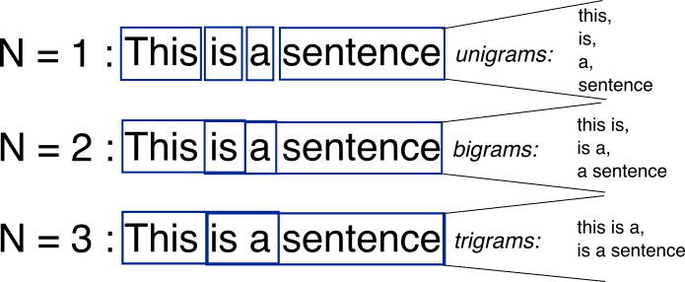
What are N-grams?
Notes:
Text = document, a single unit under study
Corpus = a collection of documents
Lexical ≈ fancy name for word
N-gram: sequences of adjacent words of length N
Bag of words

Slide 27
Document-term matrix
 | Hamlet | Macbeth | Romeo & Juliet | Richard III | Julius Caesar | Tempest | Othello | King Lear
knife | 1 | 1 | 4 | 2 |  | 2 |  | 2
dog | 2 |  | 6 | 6 |  | 2 |  | 12
sword | 17 | 2 | 7 | 12 |  | 2 |  | 17
love | 64 |  | 135 | 63 |  | 12 |  | 48
like | 75 | 38 | 34 | 36 | 34 | 41 | 27 | 44
Context = appearing in the same document.
Notes:
Document-Term Matrix (DTM)
Words are rows, documents are columns, entries are number of times word appears in document.
DTM: Vector representation that encodes information about the distribution of contexts a word appears in
Words that appear in similar contexts have similar representations (and similar meanings, by the distributional hypothesis).

Slide 28
Vector
Vector representation of the document; vector size = V
Hamlet
1
2
17
64
75
King Lear
2
12
17
48
44

Slide 29
Vectors
knife | 1 | 1 | 4 | 2 |  | 2 |  | 2
sword | 17 | 2 | 7 | 12 |  | 2 |  | 17
Vector representation of the term; vector size = number of documents

Slide 30
Inputs to modeling
Modeling
Topic modeling: input = many different texts, output = what each text is about
Newspaper articles
Emails
Classification: input = many different texts and hand-labeled categories, output = something that can take in unlabeled texts and predict the category.
Hand label a bunch of documents, train a computer to mimic your hand coding
Spam / ham
positive/negative reviews
The big difference is the need for labeled data (unsupervised vs supervised)
Text = document, could be a review, newspaper article, journal article, whole book, tweet, . . .

Slide 31
Notes:
Slide from Jurafsky & Manning’s online course onNLP

Slide 32
But there’s more out there
Modeling
Dictionary methods
Lists of positive/negative words
Term Frequency-Inverse Document Frequency (TF-IDF)
Modification of DTM
Entries are scaled by how common a word is across the whole corpus
Distinctive words
Through difference of proportions, Chi-square test, classification, etc.
Word Embeddings
Each word represented by numerical vector
Foundation for many advanced NLP tasks (e.g., transformers)
Clustering
Of DTM or TF-IDF, or of Word Embeddings

Slide 33
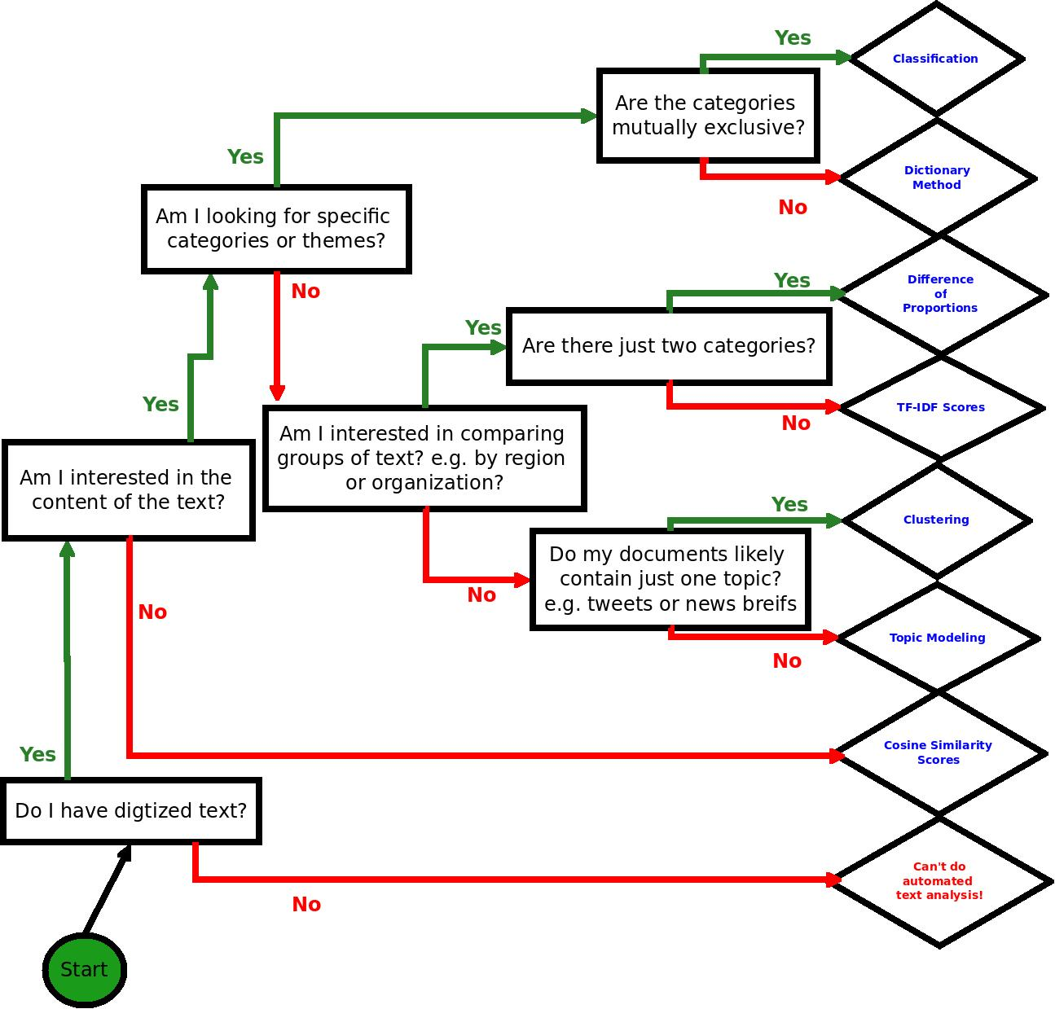
Thanks to Laura K Nelson
Notes:
Your first decision, can I do automated text analysis? It requires digitized text.
Cosine similarity just checks how similar the corpora are – useful for plagiarism checking. If the number is near zero, someone plagiarized
Second question, do I want to do deductive or inductive analysis?

Slide 34
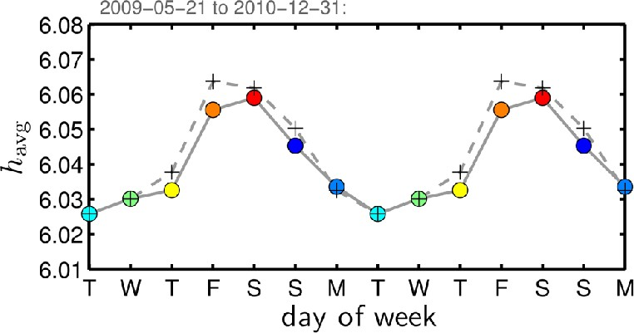
Dictionaries
Modeling
Dodds et al. (2011), "Temporal patterns of happiness and information in a global social network: Hedonometrics and Twitter" (PLoS One)

Slide 35
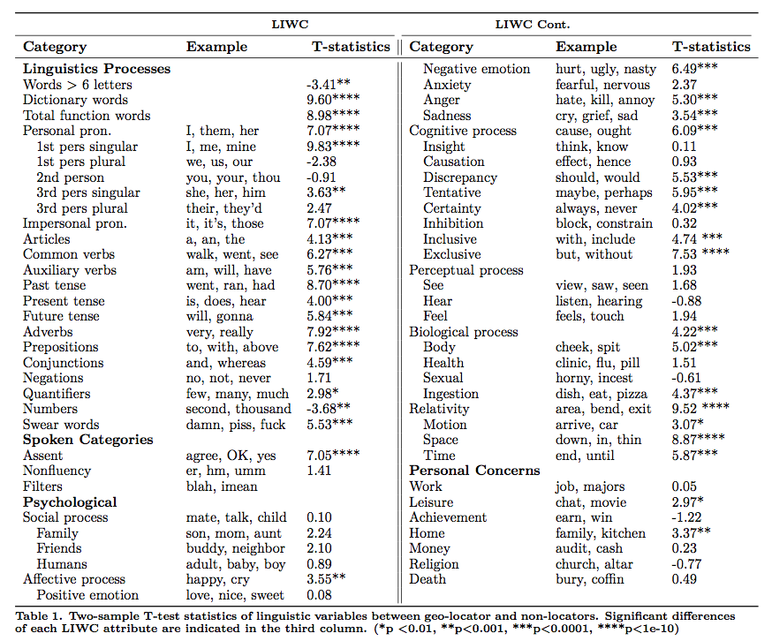
Modeling

Slide 36
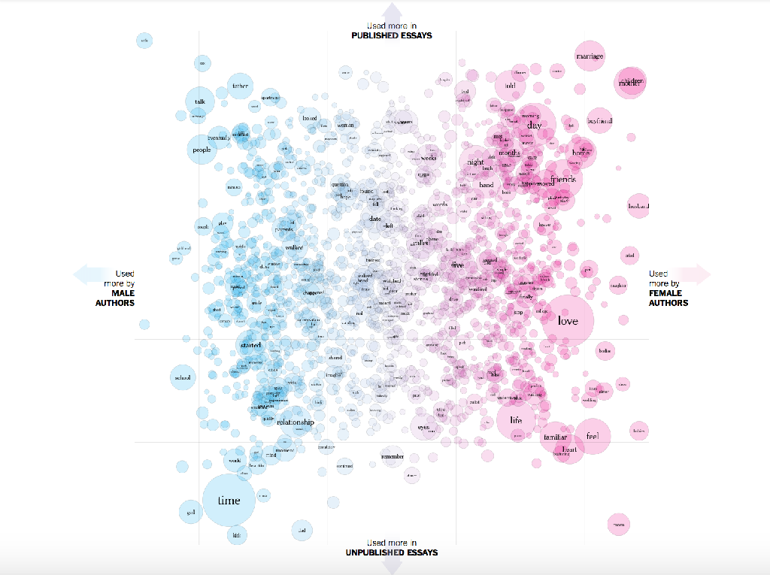
Modeling
Distinctive words
https://www.nytimes.com/interactive/ 2017/11/07/upshot/modern-love-what-we- write-when-we-write-about-love.html
Notes:
Finding distinctive terms is useful:
As a data exploration exercise to understand larger trends in individual word differences).
As a pre-processing step of feature selection.
When the two datasets are A and ¬A, these terms also provide insight into what A is about.
Many methods for finding these terms! (Developed in NLP, corpus linguistics, political science, etc.)
Slide borrowed from David Bamman’s INFO 256 course: http://people.ischool.berkeley.edu/~dbamman/info256.html

Slide 37
Now what?
Interpret
Use the insight from the preprocessing and modeling stage to understand the initial question
In classification, this could be looking at words with high coefficients.
E.g. People with depressive symptoms are more likely to talk about abstract concepts and use more negation.
In topic modeling, this could be qualitative inspection of the topics.
E.g. In Germany the main themes centered around taxes and immigration, while in France people were more concerned about racism.

Slide 38
CTA lifecycle
Research question
Collect data
Preprocessing
Modeling
Interpret

Slide 39

Questions?

Slide 40
Now to get our hands dirty
http://bit.ly/intro-textxd19
Notes:
Slide borrowed from David Bamman’s INFO 256 course: http://people.ischool.berkeley.edu/~dbamman/info256.html

Slide 41
Further resources
D-Lab: http://dlab.berkeley.edu/
Regular workshops on CTA, Python, R, etc.
Consulting
CTAWG: http://dlabctawg.github.io/
Lectures from Stanford's NLP class
Tutorials on NLTK and SpaCy
Jurafsky and Martin textbook

Slide 42
Further examples of CTA applications
Estimate political ideology from Twitter
Uncover government censorship
Relate the stock market to sentiment in the media
Study why particular papers get cited
Detect impending disease epidemics
Determine who actually wrote something
- . . .

