Slide 1
OpenCOR
Alan Garny

Slide 2
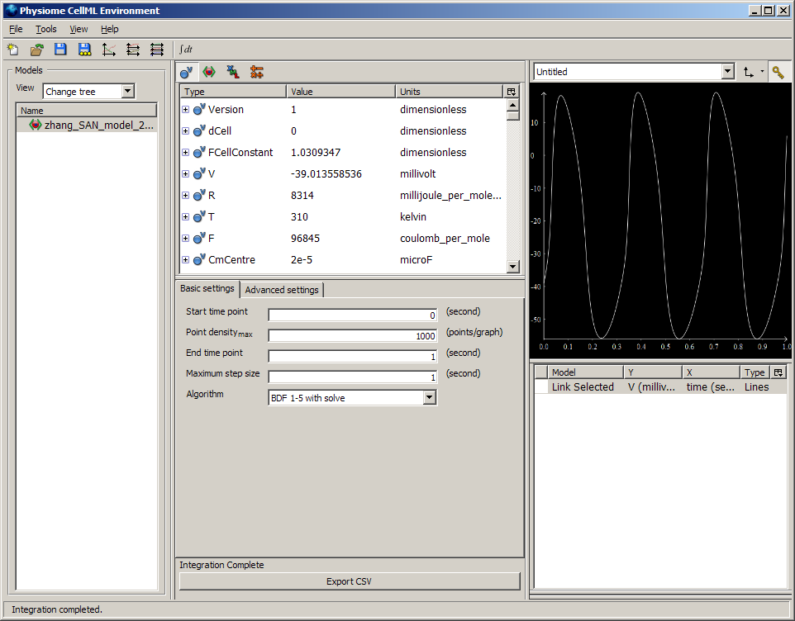
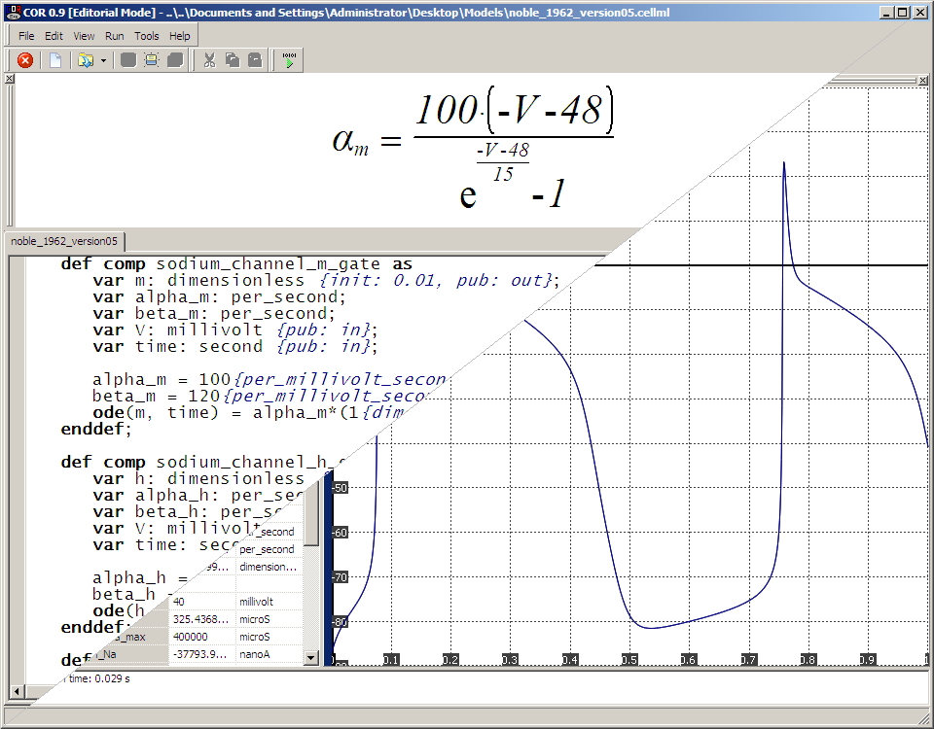
Background
The two main environments for editing and simulating CellML files are COR (http://cor.physiol.ox.ac.uk/) and OpenCell (http://www.opencell.org/).
Having very similar goals, their authors decided to work on a combined and improved environment: OpenCOR.

Slide 3
General Information
OpenCOR is an open source project.
No license yet, but it might have to be GPL (i.e. not business friendly).
A (very) simple website has been setup.
⇨ http://www.opencor.ws/ ⇦
The project is hosted on GitHub.
⇨ https://github.com/opencor/opencor/ ⇦
Currently being developed (using Qt), built, run and tested on:
Windows 7;
Ubuntu 11.04 (Natty Narwhal; both 32-bit and 64-bit); and
Mac OS X 10.7 (Lion).

Slide 4
General Philosophy
OpenCOR can be used either from the command line or through a graphical user interface (GUI).
Everything is available as a plugin. This means that:
Features can be enabled/disabled as the user sees fit; and that
New features can be easily added (e.g. support for SBML).
A four-step approach:
Organise CellML files (CellML Model Repository, File Browser and File Organiser plugins);
Edit CellML files using different (plugin) views (e.g. Raw, Raw CellML and CellML Annotation);
Simulate CellML files using the Single Cell (plugin) view; and
Analyse simulation data (pending).

Slide 5
Plugin Approach
OpenCOR currently offers the following interfaces:
Core: to initialise/finalise a plugin, as well as to load/save its settings;
File: to specify the file types supported by a plugin;
GUI: to customise OpenCOR’s GUI (i.e. menus, docking windows and views);
Internationalisation: to support the translation of a plugin; and
Solver: to specify the interface to a numerical solver and make it available to other plugins.
A plugin can have dependencies on other plugins.
A user can decide whether a plugin is to be loaded (e.g. the Raw CellML plugin) while other plugins will only be loaded if needed (e.g. the CellML plugin).

Slide 6
Organise CellML Files
CellML Model Repository plugin: an interface to PMR2 through Web services (REST/JSON).
This work is still in progress, so:
Currently: implemented a proof of technical feasibility by retrieving a list of CellML files (and allowing it to be searched and workspaces to be looked up); but
In the future: clone a workspace, create an exposure, etc.
File Browser plugin: to get access to physical files, be they CellML files or not.
File Organiser plugin: to virtually organise physical files.

Slide 7
Edit CellML Files
People work in different ways and there exist different approaches to modelling.
It should therefore be possible to edit a CellML file in more than just one way.
We therefore have different CellML editing views (e.g. a Raw CellML view, a COR-like view or a tree-like view).
Those CellML views are connected to a CellML File Manager to keep track of changes to a CellML file.
Note: a similar approach could be used to edit SBML files, SED-ML files, etc.

Slide 8
Simulate CellML Files (I)
When it comes to simulation, speed is paramount.
A CellML file should therefore be compiled. For example:
OpenCell generates some C code (using the CCGS service) which is then compiled (using gcc) into a shared library.
COR uses its own internal compiler to generate binary code.
However, to rely on gcc is not convenient and internal generation of binary code is tedious. So, OpenCOR:
Generates some C code (still using the CCGS service);
Parses that code to get an AST representation of the model;
Uses that AST rep. to generate some LLVM assembly code;
Asks LLVM to compile the assembly code into binary code; and
Executes the binary code using LLVM’s JIT execution engine.

Slide 9
Simulate CellML Files (II)
Two types of solvers are to be supported initially:
ODE solvers (done); and
DAE solvers (pending).
Plugins only know the following about a solver:
Its name;
Its type (i.e. ODE or DAE solver); and
Its parameter names and types (so it can be customised).
An instance of the solver can also be retrieved.
Forward Euler and CVODE are two ODE solvers which can currently be used.

Slide 10
Demonstration time!

Slide 11
Useful Links
OpenCOR:
Web site: http://www.opencor.ws/; and
GitHub repository: https://github.com/opencor/opencor/.
Other CellML environments:
OpenCell: http://www.opencell.org/; and
COR: http://cor.physiol.ox.ac.uk/.
Miscellaneous:
Qt: http://qt.nokia.com/;
CellML API: http://www.cellml.org/tools/api/;
LLVM: http://www.llvm.org/; and
SUNDIALS (e.g. CVODE and IDA): https://computation.llnl.gov/casc/sundials/main.html.

Slide 12







