Slide 1
딥러닝 실습 - 필기 숫자 인식 -
참고: 박해선 역 "머신 러닝 교과서 with 파이썬, 사이킷런, 텐서플로" 길벗 2019

Slide 2
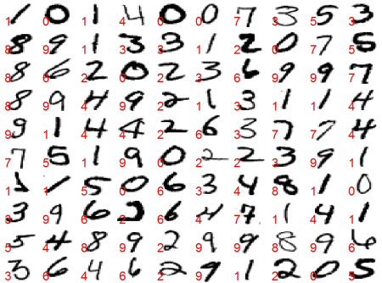
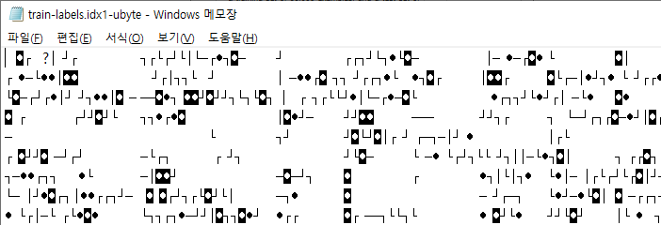
THE MNIST DATABASE of handwritten digits
http://yann.lecun.com/exdb/mnist/
a training set of 55,000 examples, and a test set of 10,000 examples
train-images-idx3-ubyte.gz: training set images (9M bytes)
train-labels-idx1-ubyte.gz: training set labels (28K bytes)
t10k-images-idx3-ubyte.gz: test set images (1M bytes)
t10k-labels-idx1-ubyte.gz: test set labels (4K bytes)

Slide 3
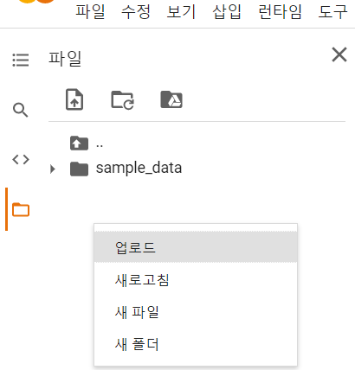
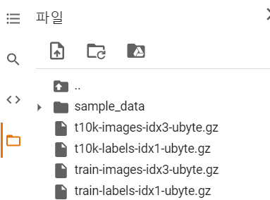
MNIST 데이터 다운로드
https://github.com/rickiepark/python-machine-learning-book-2nd-edition/raw/master/code/ch12/t10k-images-idx3-ubyte.gz
https://github.com/rickiepark/python-machine-learning-book-2nd-edition/raw/master/code/ch12/t10k-labels-idx1-ubyte.gz
https://github.com/rickiepark/python-machine-learning-book-2nd-edition/raw/master/code/ch12/train-images-idx3-ubyte.gz
https://github.com/rickiepark/python-machine-learning-book-2nd-edition/raw/master/code/ch12/train-labels-idx1-ubyte.gz

Slide 4
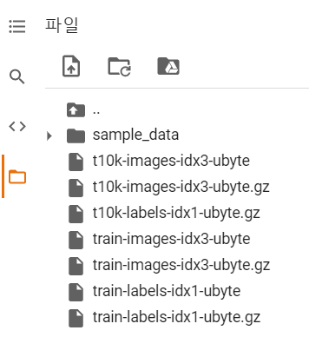
압축해제
import sys
import gzip
import shutil
import os
if (sys.version_info > (3, 0)):
writemode = 'wb'
else:
writemode = 'w'
zipped_mnist = [f for f in os.listdir('/content') if f.endswith('ubyte.gz')]
for z in zipped_mnist:
with gzip.GzipFile(z, mode='rb') as decompressed, open(z[:-3], writemode) as outfile:
outfile.write(decompressed.read())

Slide 5
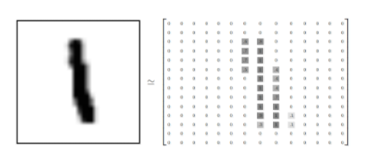
MNIST 데이터 로드
28
import os
import struct
import numpy as np
def load_mnist(path, kind='train'):
"""`path`에서 MNIST 데이터 불러오기"""
labels_path = os.path.join(path, '%s-labels-idx1-ubyte' % kind)
images_path = os.path.join(path, '%s-images-idx3-ubyte' % kind)
with open(labels_path, 'rb') as lbpath:
magic, n = struct.unpack('>II', lbpath.read(8))
labels = np.fromfile(lbpath, dtype=np.uint8)
with open(images_path, 'rb') as imgpath:
magic, num, rows, cols = struct.unpack(">IIII", imgpath.read(16))
images = np.fromfile(imgpath, dtype=np.uint8).reshape(len(labels), 784)
images = ((images / 255.) - .5) * 2
return images, labels
28
0~255인 픽셀값을 -1에서 1사이로 정규화

Slide 6
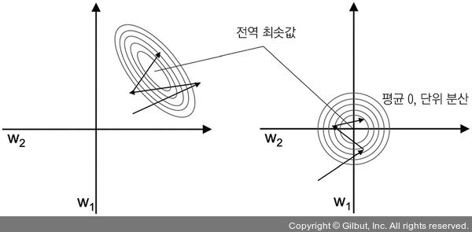
특성 스케일을 조정하여 경사 하강법 결과 향상

Slide 7
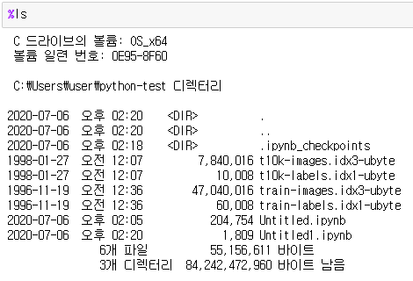
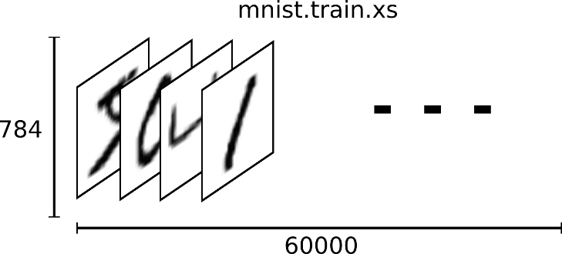
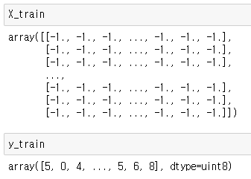
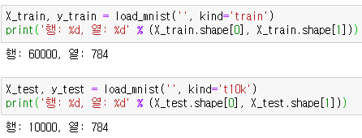
MINIST 데이터 정보
28
28
X_train, y_train = load_mnist('', kind='train')
print('행: %d, 열: %d' % (X_train.shape[0], X_train.shape[1]))
X_test, y_test = load_mnist('', kind='t10k')
print('행: %d, 열: %d' % (X_test.shape[0], X_test.shape[1]))

Slide 8
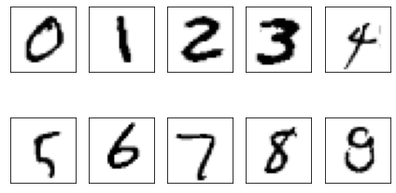
MINIST 데이터 시각화
각 숫자에 대한 샘플을 그립니다
import matplotlib.pyplot as plt
fig, ax = plt.subplots(nrows=2, ncols=5, sharex=True, sharey=True,)
ax = ax.flatten()
for i in range(10):
img = X_train[y_train == i][i].reshape(28, 28)
ax[i].imshow(img, cmap='Greys')
ax[0].set_xticks([])
ax[0].set_yticks([])
plt.tight_layout()
plt.show()
특정 숫자 샘플만 그릴 수 있는지?

Slide 9
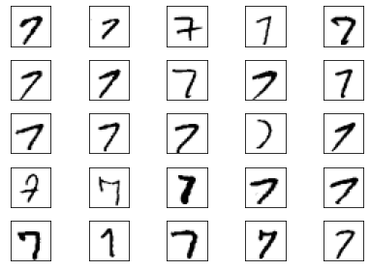
MINIST 데이터 시각화
숫자 7 샘플 25개를 그립니다
import matplotlib.pyplot as plt
fig, ax = plt.subplots(nrows=5, ncols=5, sharex=True, sharey=True,)
ax = ax.flatten()
for i in range(25):
img = X_train[y_train == 7][i].reshape(28, 28)
ax[i].imshow(img, cmap='Greys')
ax[0].set_xticks([])
ax[0].set_yticks([])
plt.tight_layout()
plt.show()

Slide 10
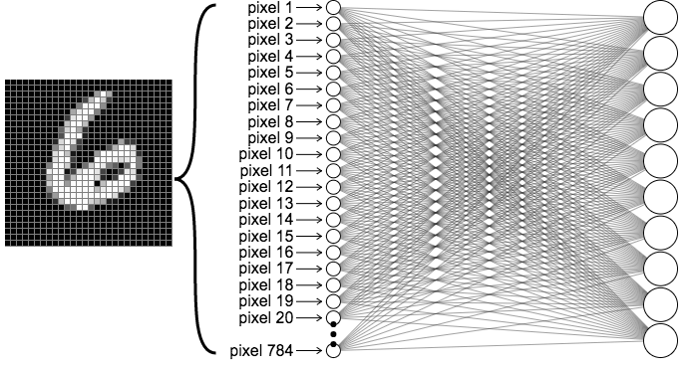
1-layer neural network for MNIST
https://ml4a.github.io/ml4a/looking_inside_neural_nets/

Slide 11
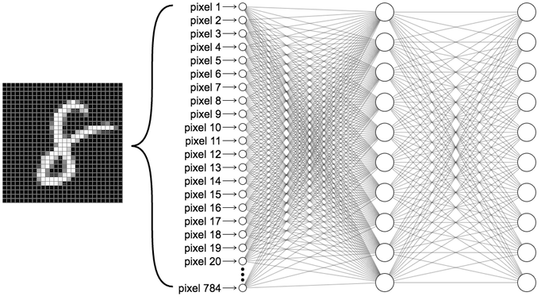
2-layer neural network for MNIST
https://ml4a.github.io/ml4a/looking_inside_neural_nets/

Slide 12
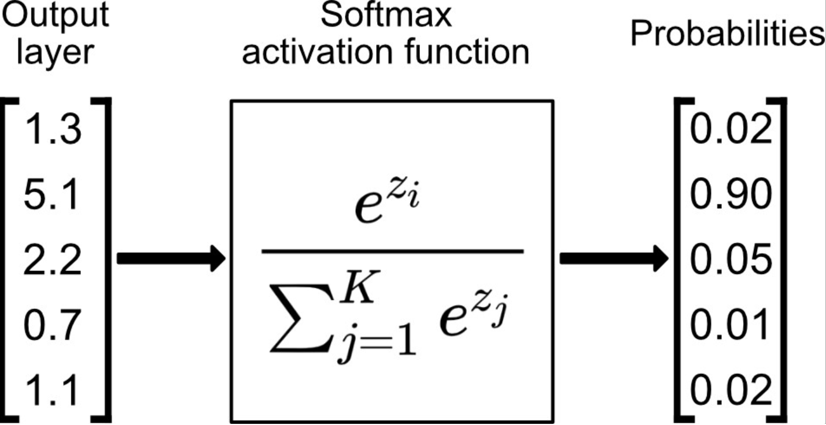
softmax
https://towardsdatascience.com/softmax-activation-function-explained-a7e1bc3ad60

Slide 13
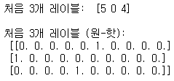
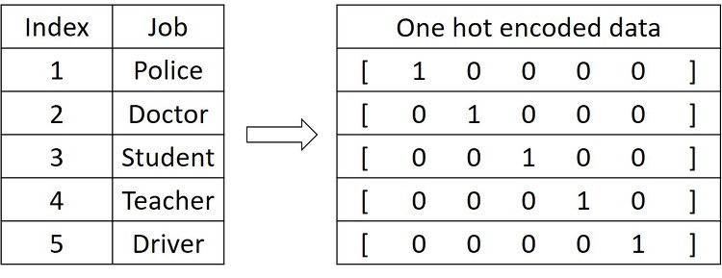
One-hot 인코딩
import tensorflow as tf
np.random.seed(123)
y_train_onehot = tf.keras.utils.to_categorical(y_train)
print('처음 3개 레이블: ', y_train[:3])
print('\n처음 3개 레이블 (원-핫):\n', y_train_onehot[:3])
http://hunkim.github.io/ml/

Slide 14
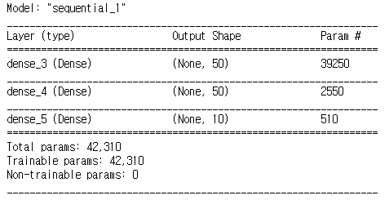
다층신경망 모델 생성
가중치의 개수는 어떻게 계산?
model = tf.keras.models.Sequential()
model.add(
tf.keras.layers.Dense(
units=50,
input_dim=X_train.shape[1],
kernel_initializer='glorot_uniform',
bias_initializer='zeros',
activation='tanh'))
model.add(
tf.keras.layers.Dense(
units=50,
input_dim=50,
kernel_initializer='glorot_uniform',
bias_initializer='zeros',
activation='tanh'))
model.add(
tf.keras.layers.Dense(
units=y_train_onehot.shape[1],
input_dim=50,
kernel_initializer='glorot_uniform',
bias_initializer='zeros',
activation='softmax'))
model.summary()
10개인 이유?
Notes:
784x50 + 50 = 39250
50 x 50 + 50 = 2550
50 x 10 + 10 = 510

Slide 15
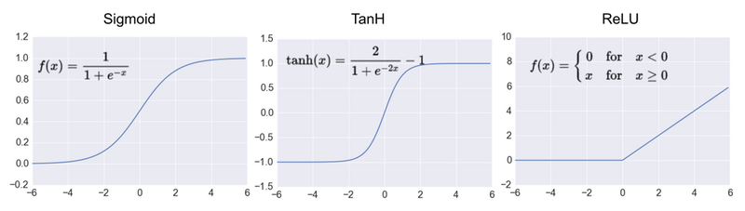
Activation Functions
https://developpaper.com/attention-mechanism-relu-activation-function-adaptive-parameterized-relu-activation-function/

Slide 16
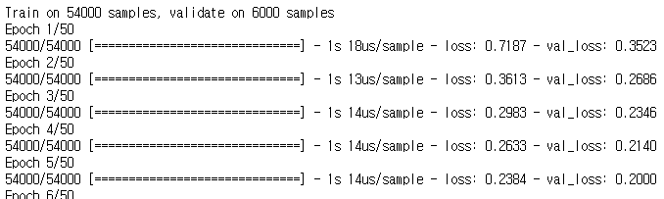

훈련
sgd_optimizer = tf.keras.optimizers.SGD(lr=0.001, decay=1e-7, momentum=.9)
model.compile(optimizer=sgd_optimizer, loss='categorical_crossentropy')
history = model.fit(X_train, y_train_onehot,
batch_size=64, epochs=50,
verbose=1,
validation_split=0.1)
훈련 데이터의 10%를 검증 데이터로 떼어 냄
***

Slide 17
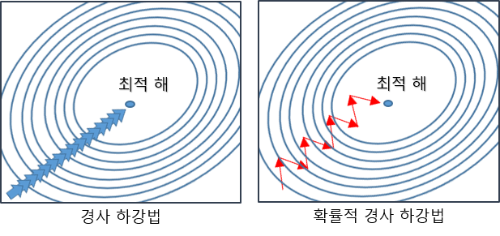
SGD(확률적 경사 하강법)
경사 하강법과 다르게 한번 학습할 때 모든 데이터에 대해 가중치를 조절하는 것이 아니라, 램덤하게 추출한 일부 데이터에 대해 가중치를 조절
https://twinw.tistory.com/247

Slide 18
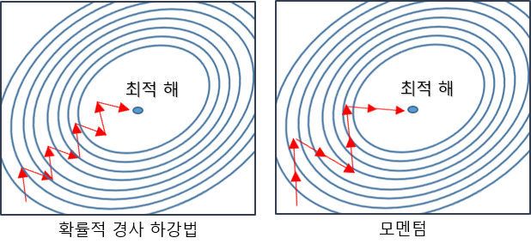
Momentum(모멘텀)
경사 하강법에 관성을 더해 줌
https://twinw.tistory.com/247

Slide 19
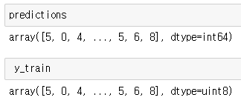

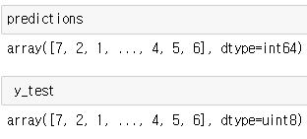

전체 데이터 예측
predictions = model.predict_classes(X_train, verbose=0)
correct_preds = np.sum(y_train == predictions, axis=0)
train_acc = correct_preds / y_train.shape[0]
print('처음 3개 예측: ', predictions[:3])
print('훈련 정확도: %.2f%%' % (train_acc * 100))
테스트 데이터에 대한 예측?
predictions = model.predict_classes(X_test, verbose=0)
correct_preds = np.sum(y_test == predictions, axis=0)
train_acc = correct_preds / y_test.shape[0]
print('처음 3개 예측: ', predictions[:3])
print('훈련 정확도: %.2f%%' % (train_acc * 100))
개별 이미지를 예측?

Slide 20

개별 이미지 예측 확인
predictions = model.predict(X_test, verbose=0)
print(predictions[0])
np.argmax(predictions[0])

Slide 21
예측결과를 시각화
def plot_image(i, predictions_array, true_label, img):
predictions_array, true_label, img = predictions_array[i], true_label[i], img[i]
plt.grid(False)
plt.xticks([])
plt.yticks([])
#plt.imshow(img, cmap=plt.cm.binary)
plt.imshow(img.reshape(28, 28), cmap='Greys')
predicted_label = np.argmax(predictions_array)
if predicted_label == true_label:
color = 'blue'
else:
color = 'red'
plt.xlabel("{} {:2.0f}% ({})".format(predicted_label,
100*np.max(predictions_array),
true_label),
color=color)
def plot_value_array(i, predictions_array, true_label):
predictions_array, true_label = predictions_array[i], true_label[i]
plt.grid(False)
plt.xticks([])
plt.yticks([])
thisplot = plt.bar(range(10), predictions_array, color="#777777")
plt.ylim([0, 1])
predicted_label = np.argmax(predictions_array)
thisplot[predicted_label].set_color('red')
thisplot[true_label].set_color('blue')

Slide 22
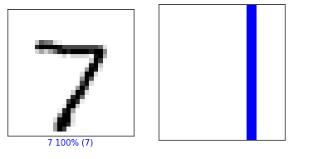
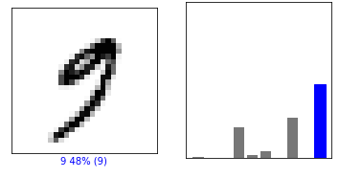
예측결과를 시각화
i = 0
plt.figure(figsize=(6,3))
plt.subplot(1,2,1)
plot_image(i, predictions, y_test, X_test)
plt.subplot(1,2,2)
plot_value_array(i, predictions, y_test)
plt.show()
0번째 이미지
2582번째 이미지

Slide 23
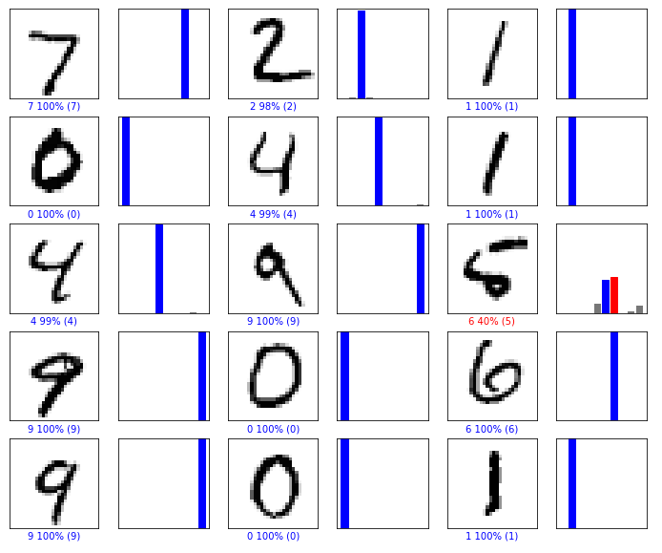
예측결과를 시각화
num_rows = 5
num_cols = 3
num_images = num_rows*num_cols
plt.figure(figsize=(2*2*num_cols, 2*num_rows))
for i in range(num_images):
plt.subplot(num_rows, 2*num_cols, 2*i+1)
plot_image(i, predictions, y_test, X_test)
plt.subplot(num_rows, 2*num_cols, 2*i+2)
plot_value_array(i, predictions, y_test)
plt.show()

Slide 24
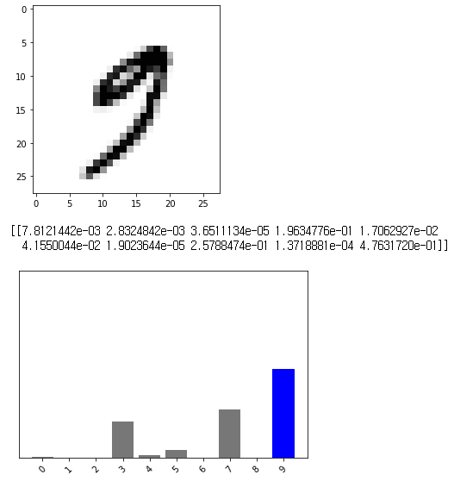
한 이미지에 대한 예측
img_index = 2582
img = X_test[img_index]
plt.imshow(img.reshape(28, 28), cmap='Greys')
plt.show()
img = (np.expand_dims(img,0))
predictions_single = model.predict(img)
print(predictions_single)
np.argmax(predictions_single)
plot_value_array2(img_index, predictions_single, y_test)
_ = plt.xticks(range(10), class_names, rotation=45)
plot_value_array 함수 수정?

Slide 25
한 이미지에 대한 예측
def plot_value_array2(i, predictions_array, true_label):
predictions_array, true_label = predictions_array[0], true_label[i]
plt.grid(False)
plt.xticks([])
plt.yticks([])
thisplot = plt.bar(range(10), predictions_array, color="#777777")
plt.ylim([0, 1])
predicted_label = np.argmax(predictions_array)
thisplot[predicted_label].set_color('red')
thisplot[true_label].set_color('blue'

Slide 26
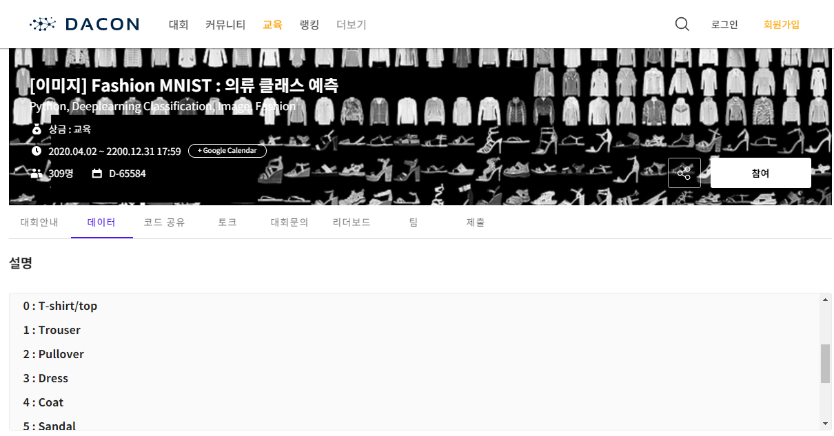
경진대회
https://www.kaggle.com/
https://dacon.io/

