Slide 1

I Have Seen the Future
Networking and Communication in the Internet of Things

Slide 2
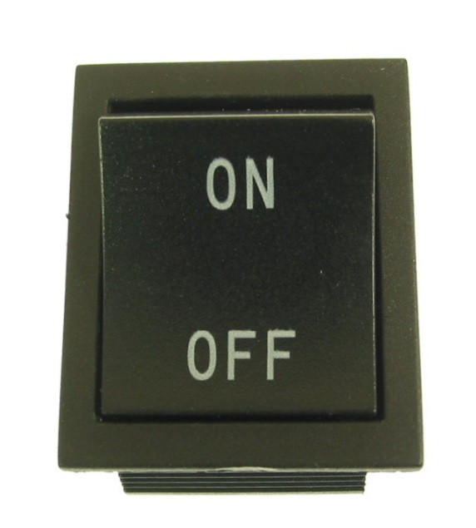
IoT
Simply put…
this is the concept of basically connecting any device with an on and off switch to the Internet & each other

Slide 3
IoT
This includes everything from cell phones, coffee makers, washing machines, headphones, lamps, wearable devices and almost anything else you can think of.

Slide 4

IoT
Gartner says that by 2020 there will be over 26 billion connected devices… could be upwards of 100 billion…
That is a lot, but…
Simple representation of IoT

Slide 5

IoT vs McDonalds
Still not as much as McDonalds…

Slide 6
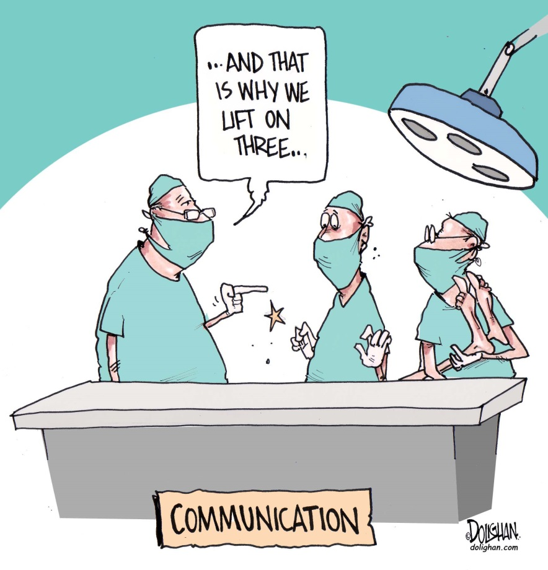
Devices are everywhere…
Sensors and devices are now everywhere
Question is how to make them communicate?
This has been the difficult problem up until now…

Slide 7



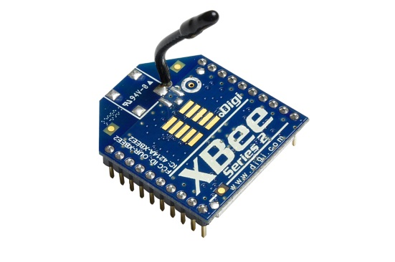

Current Standards
WiFi -> Easy to setup – low range (meters) – battery intensive
Cellular -> Hard to setup – large Range (miles) – battery Intensive
Xbee/Zigbee -> Hard to setup – Mesh network capable -- range (meters to miles) – battery friendly

Slide 8
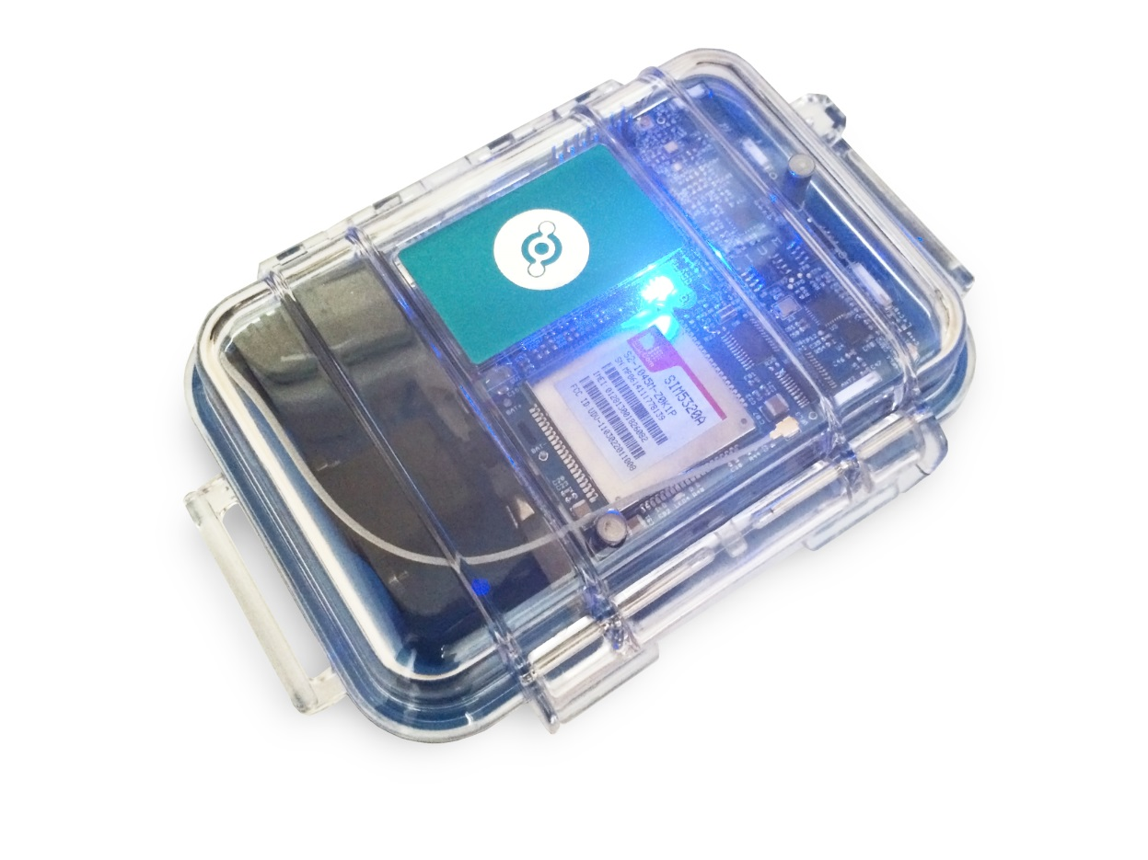
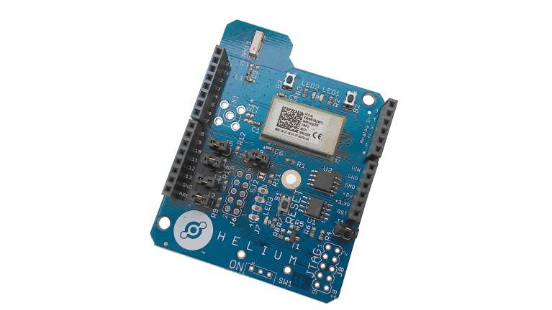
Introducing Helium.co
Helium.co -> Ease of WiFi – Battery usage of Xbee – Range of Cellular***

Slide 9
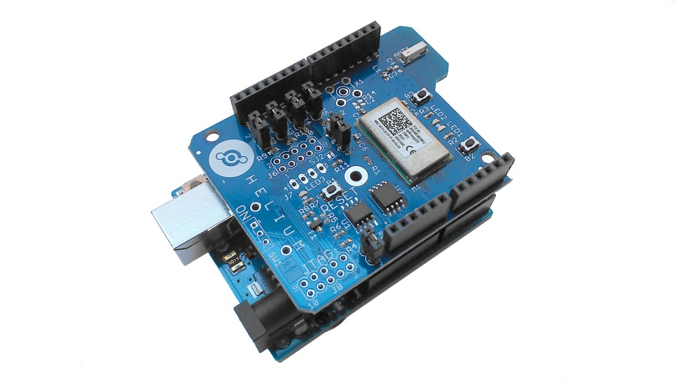
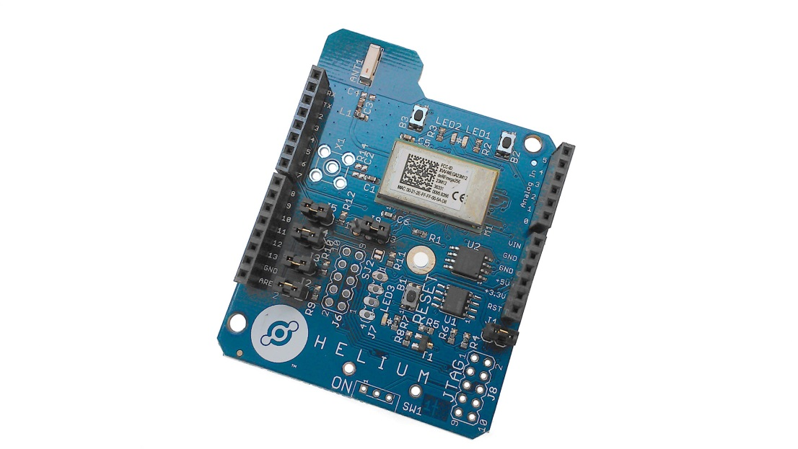
How they solve this…
Helium uses two components
Atom shield attached to an Arduino Shield

Slide 10

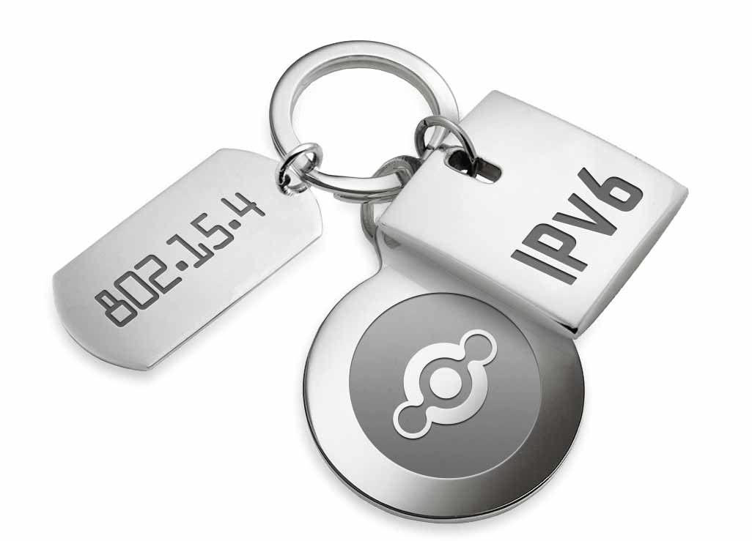
Atom shield
Helium Atom uses a customized 802.15.4 (xbee) protocol
Connects seamlessly to the Helium Element Bridge

Slide 11
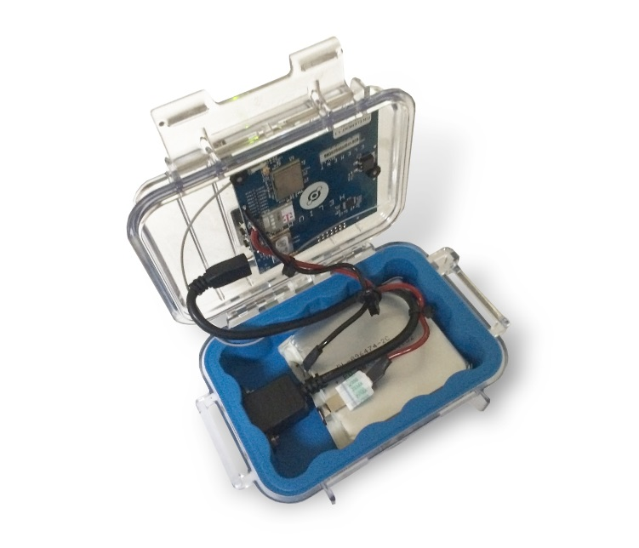
Helium Element bridge
The Element Bridge is powered via 5V power
Could be solar or wall power
Battery backed for uninterrupted usage
Element bridges have a backhaul
Could be cellular
Could be Ethernet

Slide 12
Our Bridges…
We graciously received one bridge and two Atom shields last week.
The Element Bridge is configured with a T-Mobile sim card that transfers data from the Atom shields up to Element Bridge…
And then…

Slide 13
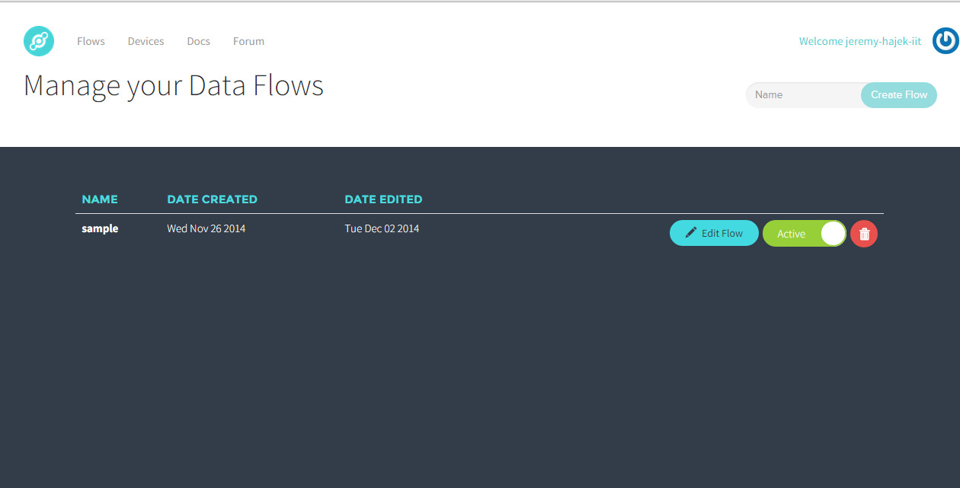
Fusion

Slide 14
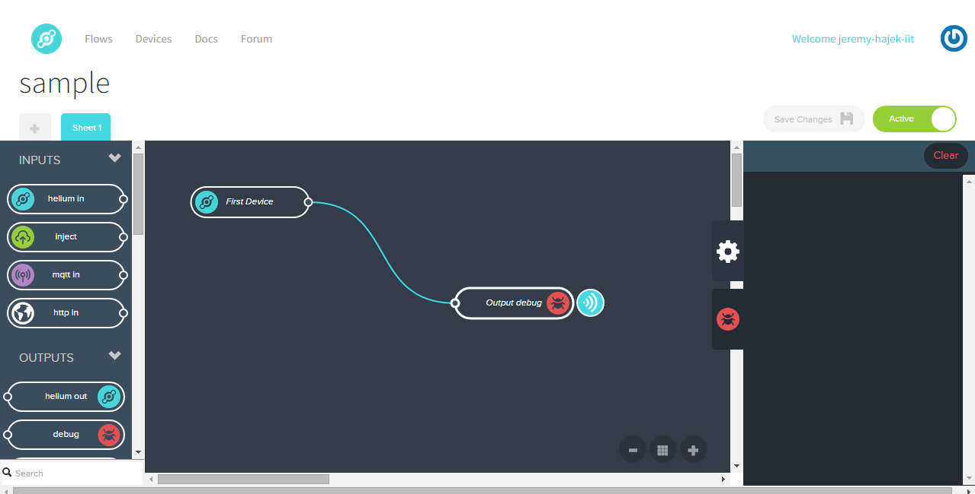
Fusion Flows

Slide 15
Fusion
Fusion is a central data logging platform
Eventually Helium will make this a pervasive data service (like a utility)
Charge per KB of data transferred in
It is extensible too!
You write your own code and application
Currently in Beta
Only supports C and Ruby at the moment
Linux and Mac OSX library support currently – Windows coming soon!

Slide 16

Use Case
Current Beta Units get ~200 feet of distance
This could be used to help retrofit an existing building
Using wall power or solar…
Creating a sensor platform that transmits data
Create our own application to read from Fusion data logging platform
Make loads of money

Slide 17
Future
Helium has hinted at more powerful area/campus based devices
Imagine if all of IIT Main Campus was enabled with the Helium protocol?
How would it effect your projects?
How could it help your department?
How could it further research in the field?
It is coming – hopefully this spring.

Slide 18
Questions
Thank you for your time
Any Questions?
Demo Time.

