Slide 1
ITMT 492 Embedded System Final Project
Clothing Based Proximity Sensors
for the Visually Impaired
Youjung Choi / Yelim Kim
Changyul Oh / Neil Okhandiar

Slide 2
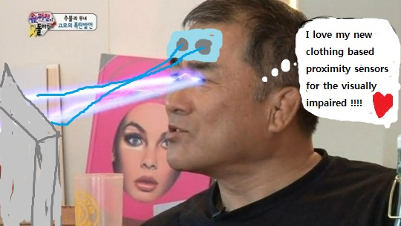
00
Intro
Look at the picture

Slide 3
Index
01
02
03
04
05
Purpose
Component
How it works
Result
Conclusion

Slide 4

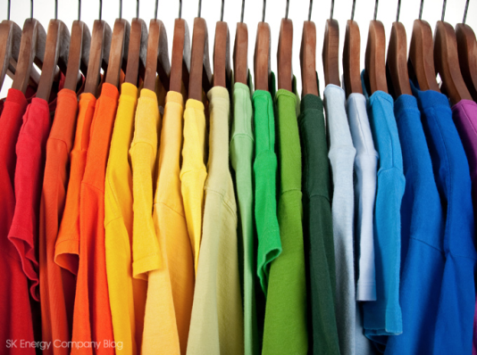

01
Purpose
Why did we develop that? .
WHO
WHAT
EXPECT
- Visually Impaired
- Wearable device
- Solution for social problem
- Detect obstacle
- Extend function for wearable device
- Avoid collision
- Environment(using solar energy)

Slide 5
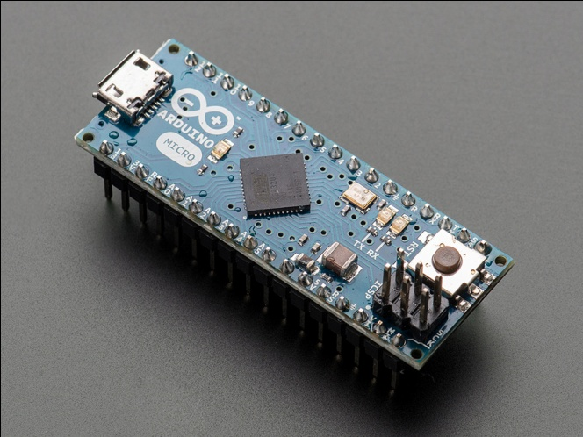
02
Component
Hardware
Small size / portable
8bit microcontroller / 32K of flash / 2.5K of Ram
Based of the ATmega32u4
Ardino Micro

Slide 6
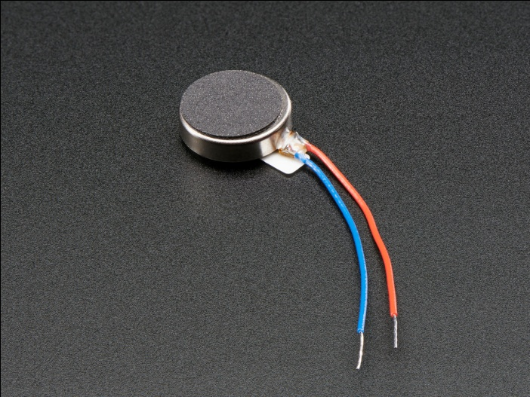
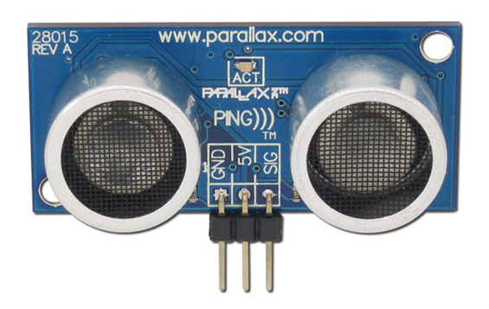
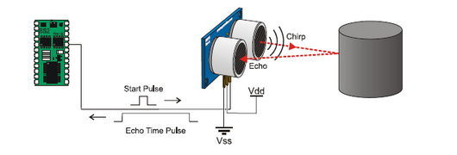
02
Component
Input / Output
Ping (Ultrasonic range detection sensor)
Vibrating mini motor disc

Slide 7
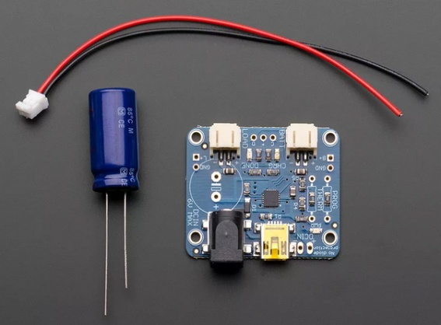
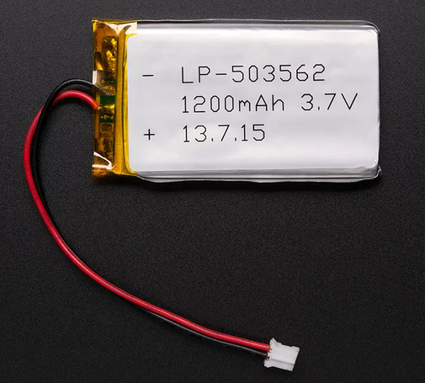
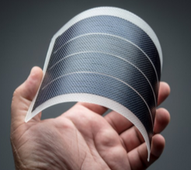
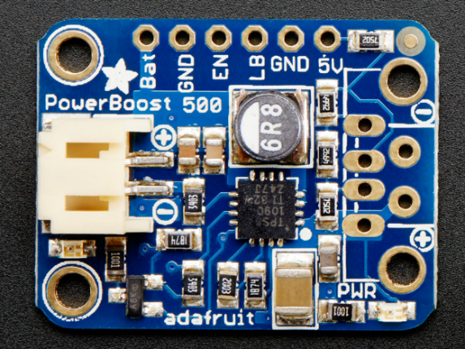
02
Component
Charging
Solar Lithium Ion/Polymer charger
5V Lithium Ion Polymer Battery
5V USB Boost, 500mA from 1.8V+
Flexible solar panel
Power Boost 500 Basic

Slide 8
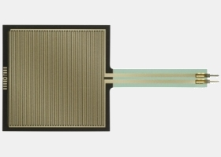
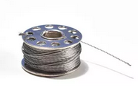
02
Component
ETC
- human touch control of electronic device
(Robot, Medical, Industrial)
Touch panel(FSR 406)
Stainless Conductive Thread

Slide 9






03
How it works
Map
Hardware
Arduino Micro
Detect
Alarm
Ping (Ultrasonic
range detection sensor)
Vibrating
PRODUCT
Connect
Charge
sewing
Solar panel/charger
/battery/Power Boost

Slide 10
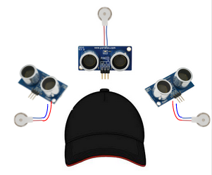
03
How it works
Cap

Slide 11

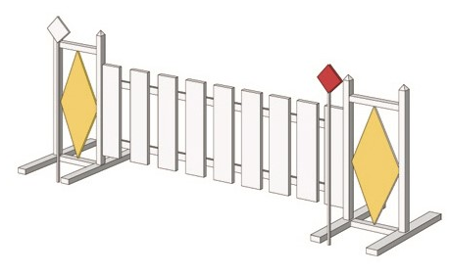


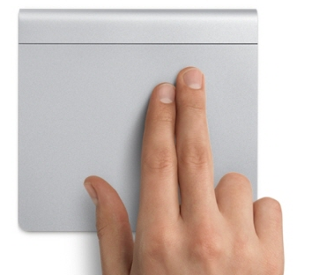
03
How it works
Cap
Vibrating(output)
Closer = Faster
Detect(input)
Touch panel
Stop vibrating

Slide 12
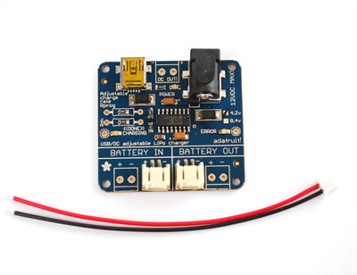
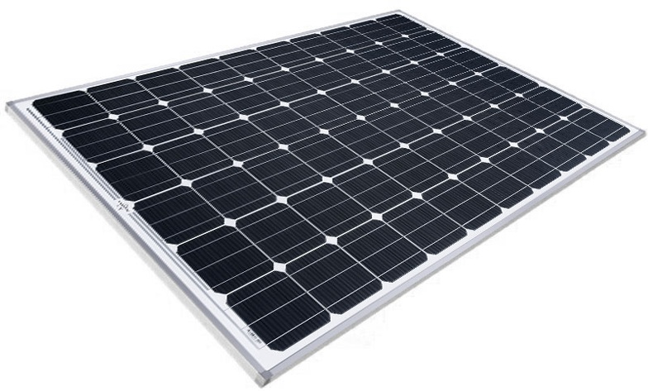
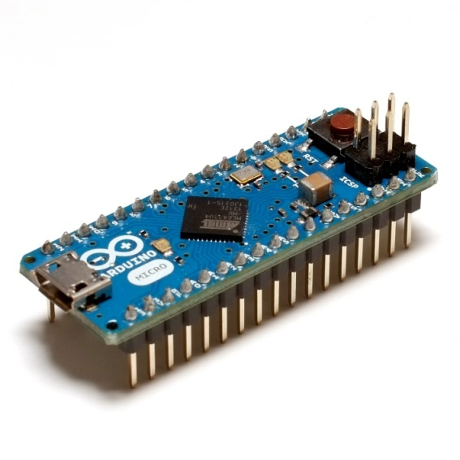
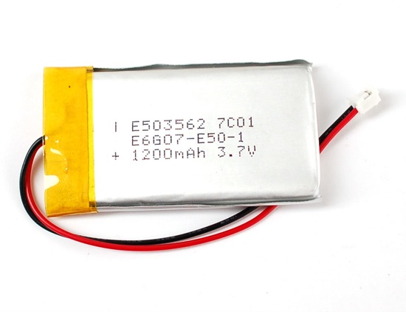

03
How it works
Battery

Slide 13
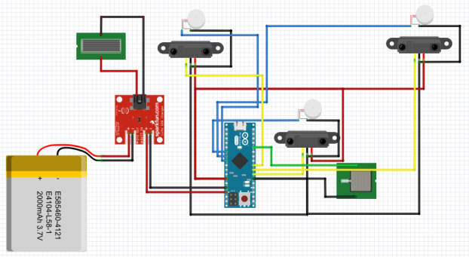
04
Result
Circuit

Slide 14
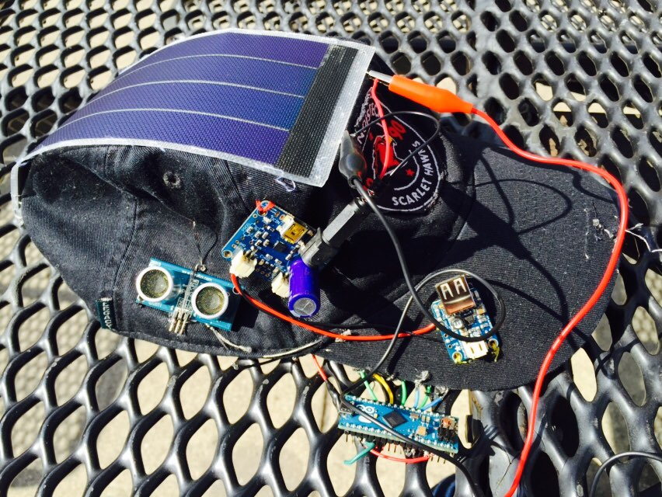

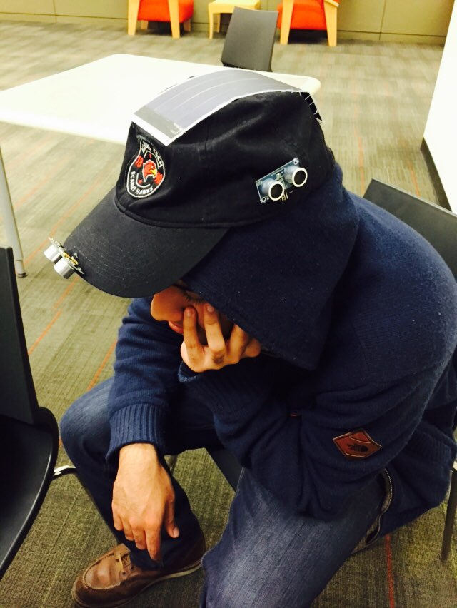
04
Result
Actual Feature

Slide 15

04
Result
Battery & Solar panel

Slide 16
04
Result
Demo

Slide 17
05
Conclusion
Pons and Cons
Pons
Idea(discuss to social problem and suggest a solution)
Solar energy(environment, technical)
Wearable(technical, compact size)
Cons
Price (expensive)
Sewing in Circuit(needs lots of time & complicated)

Slide 18
THANK YOU

