Slide 1
Predicting Stock Market Returns S&P 500
ABI Market Strategists:
Kushboo Jha
Notes:
Good evening and today, as ABI Market Strategists we will be forecasting the stock market return of S&P500

Slide 2

Outline
Background
Data
Trading Strategy
Predictors Used
Analysis
Conclusion

Slide 3


Our market predictions provide a competitive advantage over human inspection of data
Predictive
Algorithm
Subject understanding
Informed Trading Strategy
Notes:
The existence of an enormous amount of historical data suggests that data mining can provide a competitive advantage over human inspection of these data.
At the same time we need to also state that there are researchers claiming that the markets adapt so rapidly in terms of price adjustments that there is no space to obtain profits in a consistent way. This is usually known as the efficient markets hypothesis.
Markets are chaotic systems with complex dynamics, yet to a certain extent we can make valid stock market forecasts. Using these forecasts generated by cutting-edge predictive algorithms together with a careful risk management strategy may give a trader a significant competitive advantage. So in the short run intelligent estimates based on model and subject matter expertise could prove to be helpful.

Slide 4

Our goal is to maximize profit
Trade a single security market index
Maximize our profits by either selling, holding, or buying
Notes:
The long-term objective is to achieve as much profit as possible from these trading actions. Namely, we will only “trade” a single security, actually a market index. Given this security and an initial capital, we will try to maximize our profit over a future testing period by means of trading actions (Buy, Sell, Hold). Our trading strategy is based on results from a data mining process. Thus our prediction model will be incorporated in a trading system that generates its decisions based on the predictions of the model. Our overall evaluation criteria will be the performance of this trading system, that is, the profit/loss resulting from the actions of the system as well as some other statistics that are of interest to investors. This means that our main evaluation criteria will be the operational results of applying the knowledge discovered by our data mining process and not the predictive accuracy of the models developed during this process.

Slide 5
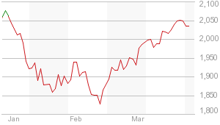
Data Used in Forecasting
January 1970
To
September 2009
S&P 500
Market index
Notes:
As our clients, you have asked us to forecast the S&P 500 market index.
The Standard & Poor's 500 Index (S&P 500) is an index of 500 stocks chosen for market size, liquidity and industry grouping, among other factors. The S&P 500 is designed to be a leading indicator of U.S. equities and is meant to reflect the risk/return characteristics of the large cap universe.
Companies included in the index are selected by the S&P Index Committee, a team of analysts and economists at Standard & Poor's. The S&P 500 is a market value weighted index - each stock's weight is proportionate to its market value.
And as we just stated, our goal is to have good forecasts of the future price of the S&P 500 index so that profitable orders can be placed on time.
This general goal should allow us to easily define what to predict with our models—it should resort to forecast the future values of the price time series.
(1) Which of the daily quotes? or (2) for which time in the future?
Answering these questions usually depends on how the predictions will be used for generating trading orders.
Daily data concerning the quotes of this security are freely available in many places such as Yahoo finance site.
GSPC is the ticker ID of S&P 500 at Yahoo finance from we obtained our quotes
The daily stock quotes data includes information regarding the following properties:
Date of the stock exchange session
Open price at the beginning of the session
Highest price during the session
Lowest price
Closing price of the session
Volume of transactions
Adjusted close price4

Slide 6

Data gives information about…
Our data looks like
Date of the stock exchange session
Open price at the beginning of the session
Highest price during the session
Lowest price
Closing price of the session
Volume of transactions
Adjusted close price

Slide 7
Dataset will be split into two separate sets
Data
Construct Trading System
Test Trading System
30 years of quotes
9 years of quotes
Notes:
In our approach to this application, we will split the available data into two separate sets: (1) one used for constructing the trading system; and (2) other to test it.
The first set will be formed by the first 30 years of quotes of S&P 500. We will leave the remaining data (around 9 years) for the final test of our trading system. In this context, we must leave this final test set out of this feature selection process to ensure unbiased results.

Slide 8


T Indicator
Average price for a given day
P
%k variation
V
T
Sum of variations in price
Notes:
The T indicator is any class of metrics whose value is derived from generic price activity in a stock or asset. Technical indicators look to predict the future price levels, or simply the general price direction, of a security by looking at past patterns.
Here let P be the average price for a given day
Let Vi be the set of k percentage variations of today’s close to the following k days average prices (often called arithmetic returns)
And T, our indicator variable is the total sum of the variations whose absolute value is above our target margin p%:

Slide 9

Trading strategies will allow us to make predictions and in turn take profitable action
Buy
Indicator within the next k days
High T Value
>P%
Calculate T
Current
Price
Low T Value
<P%
Signal k days with average daily price above target
Sell
Do not trade
Notes:
Based on the trading strategies we used, we will assume that we obtain a prediction of the tendency of the market in the next few days. Based on this prediction, we will place orders that will be profitable if the tendency is confirmed in the future.
Let us assume that if the prices vary more than p%, we consider this worthwhile in terms of trading (e.g., covering transaction costs). In this context, we want our prediction models to forecast whether this margin is attainable in the next k days.
Please note that within these k days we can actually observe prices both above and below this percentage. This means that predicting a particular quote for a specific future time t+k might not be the best idea.
In effect, what we want is to have a prediction of the overall dynamics of the price in the next k days, and this is not captured by a particular price at a specific time. For instance, the closing price at time t + k may represent a variation much lower than p%, but it could have been preceded by a period of prices representing variations much higher than p% within the window t · · · t+k.
So, what we want in effect is to have a good prediction of the overall tendency of the prices in the next k days.
indicator (a value) of the tendency in the next k days.
Value of this indicator should be related to the confidence we have that the target margin p will be attainable in the next k days.
it is important to note that when we mention a variation in p%, we mean above or below the current price.
The idea is that positive variations will lead us to buy, while negative variations will trigger sell actions. Positive for upward tendencies, and negative for downward price tendencies.
The general idea of the variable T is to signal k-days periods that have several days with average daily prices clearly above the target variation. High positive values of T mean that there are several average daily prices that are p% higher than today’s close. Such situations are good indications of potential opportunities to issue a buy order, as we have good expectations that the prices will rise.
On the other hand, highly negative values of T suggest sell actions, given the prices will probably decline. Values around zero can be caused by periods with “flat” prices or by conflicting positive and negative variations that cancel each other.

Slide 10
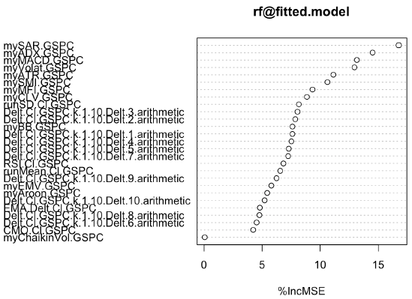
Through Random Forest, six predictor were used
Volatility
Average True Range (ATR)
Stochastic Oscillator
The Average Directional Index
Moving average convergence divergence (MACD)
Stop And Reverse(SAR)
Notes:
Random forests can be used to estimate the importance of the variables involved in a prediction task.
for selecting features, we will use the value of 10 as the threshold
6 features selected:
Volatility
Average True Range (ATR)
Stochastic Oscillator
The Average Directional Index
Moving average convergence divergence (MACD)
Stop And Reverse(SAR)

Slide 11
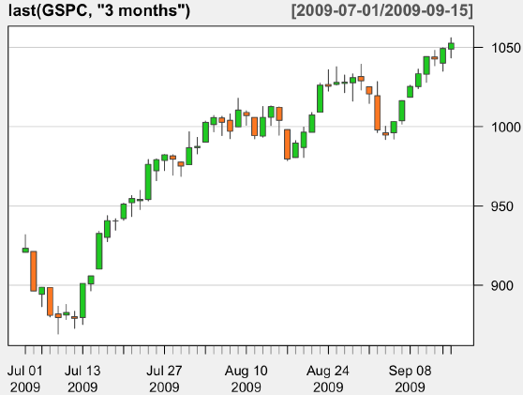
Candle Chart
Orange candle – closing on low
Green candle – closing on high
Notes:
Candle chart analysis
These graphs represent the daily quotes by a colored box and a vertical bar.
The bar represents the High and Low prices of the day, while the box represents the Open-Close amplitude.
The color of the box indicates if the top of the box is the Open or the Close price, that is, if the prices declined (orange) or rose (green) across the daily session.
added to the candlestick graph two indicators: the average price (on the same graph as the candlesticks) and our T indicator.
The correct trading signal at time t will be “buy” if the T score is higher than a certain threshold, and will be “sell” if the score is below another threshold. In all other cases, the correct signal will be do nothing (i.e., “hold”).

Slide 12
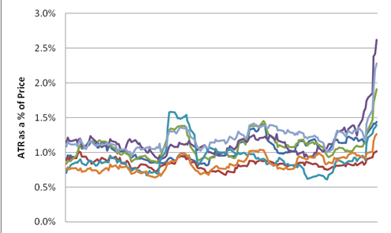
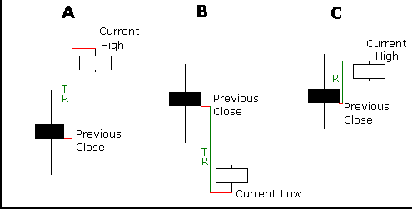
Predictors
Volatility
ATR
Source: https://www.dailyfx.com
Source: http://investopedia.com; http://stockcharts.com
Notes:
VOLAT: Volatility is a statistical measure of the dispersion of returns for a given security or market index. Volatility can either be measured by using the standard deviation or variance between returns from that same security or market index. Commonly, the higher the volatility, the riskier the security.
ATR: Average True Range (ATR) is an indicator that measures volatility. It is important to remember that ATR does not provide an indication of price direction, just volatility. The average true range is a moving average (generally 14-days) of the true ranges.
The true range indicator is the greatest of the following: -current high less the current low. -the absolute value of the current high less the previous close. -the absolute value of the current low less the previous close.
Absolute values are used to ensure positive numbers. If the current period's high is above the prior period's high and the low is below the prior period's low, then the current period's high-low range will be used as the True Range. This is an outside day that would use Method 1 to calculate the TR. This is pretty straight forward. Methods 2 and 3 are used when there is a gap or an inside day. A gap occurs when the previous close is greater than the current high (signaling a potential gap down or limit move) or the previous close is lower than the current low (signaling a potential gap up or limit move).
The image beside shows examples of when point # 2 and 3 are appropriate.
Example A: A small high/low range formed after a gap up. The TR equals the absolute value of the difference between the current high and the previous close.
Example B: A small high/low range formed after a gap down. The TR equals the absolute value of the difference between the current low and the previous close.
Example C: Even though the current close is within the previous high/low range, the current high/low range is quite small. In fact, it is smaller than the absolute value of the difference between the current high and the previous close, which is used to value the TR.

Slide 13
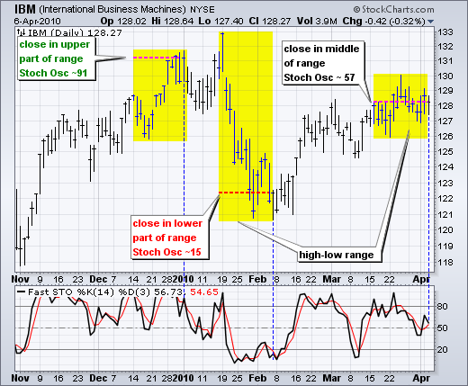
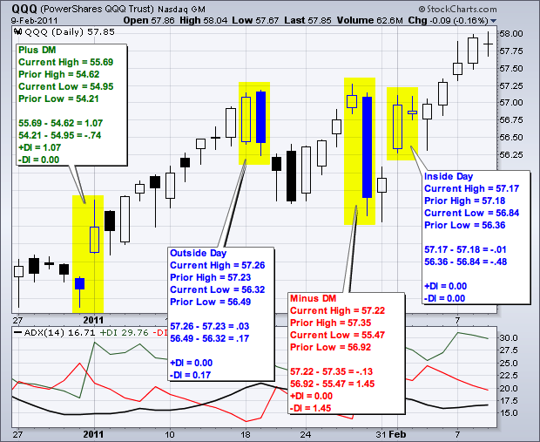
Predictors
Stochastic Oscillator
Average Directional Index
Source: http://investopedia.com; http://stockcharts.com
Source: http://investopedia.com; http://stockcharts.com
Notes:
Stochastic Oscillator: The Stochastic oscillator is a technical momentum indicator that compares a security's closing price to its price range over a given time period. The oscillator's sensitivity to market movements can be reduced by adjusting the time period or by taking a moving average of the result. This indicator is calculated with the following formula:
%K = 100[(C - L14)/(H14 - L14)] ; %D = 3-period moving average of %K (C = the most recent closing price, L14 = the low of the 14 previous trading sessions, H14 = the highest price during the same 14-day period.)
The Stochastic Oscillator measures the level of the close relative to the high-low range over a given period of time. The Stochastic Oscillator is above 50 when the close is in the upper half of the range and below 50 when the close is in the lower half. Low readings (below 20) indicate that price is near its low for the given time period. High readings (above 80) indicate that price is near its high for the given time period. The IBM example here shows three 14-day ranges (yellow areas) with the closing price at the end of the period (red dotted) line. The Stochastic Oscillator equals 91 when the close was at the top of the range. The Stochastic Oscillator equals 15 when the close was near the bottom of the range. The close equals 57 when the close was in the middle of the range.
ADX: The Average Directional Index (ADX) measures trend strength without regard to trend direction. The other two indicators, Plus Directional Indicator (+DI) and Minus Directional Indicator (-DI), complement ADX by defining trend direction. Used together, chartists can determine both the direction and strength of the trend
Directional movement is positive (plus) when the current high minus the prior high is greater than the prior low minus the current low. Directional movement is negative (minus) when the prior low minus the current low is greater than the current high minus the prior high. A negative value would simply be entered as zero.
The chart here shows four calculation examples for directional movement. The first pairing shows a big positive difference between the highs for a strong Plus Directional Movement (+DM). The second pairing shows an outside day with Minus Directional Movement (-DM) getting the edge. The third pairing shows a big difference between the lows for a strong Minus Directional Movement (-DM). The final pairing shows an inside day, which amounts to no directional movement (zero). Both Plus Directional Movement (+DM) and Minus Directional Movement (-DM) are negative and cancel out each other. Negative values revert to zero. All inside days will have zero directional movement.

Slide 14
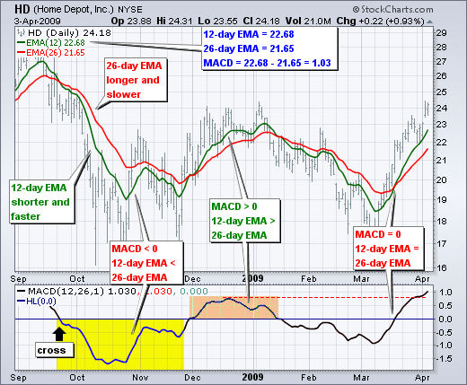
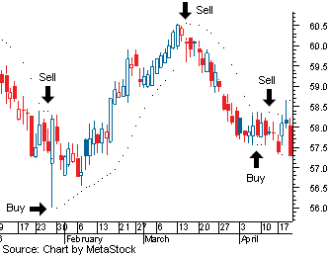
Predictors
MACD
SAR
Source:http://investopedia.com; http://stockcharts.com
Source:http://investopedia.com; http://stockcharts.com
Notes:
MACD: Moving average convergence divergence (MACD) is a trend-following momentum indicator that shows the relationship between two moving averages of prices. The MACD is calculated by subtracting the 26-day exponential moving average (EMA) from the 12-day EMA. A nine-day EMA of the MACD, called the "signal line", is then plotted on top of the MACD, functioning as a trigger for buy and sell signals.
In the chart shown here, the yellow area shows the MACD Line in negative territory as the 12-day EMA trades below the 26-day EMA. The initial cross occurred at the end of September (black arrow) and the MACD moved further into negative territory as the 12-day EMA diverged further from the 26-day EMA. The orange area highlights a period of positive MACD values, which is when the 12-day EMA was above the 26-day EMA. Notice that the MACD Line remained below 1 during this period (red dotted line). This means the distance between the 12-day EMA and 26-day EMA was less than 1 point, which is not a big difference
SAR: Developed by Welles Wilder, the Parabolic SAR refers to a price-and-time-based trading system. SAR stands for “Stop And Reverse,” which is the actual indicator used in the system. The parabolic SAR is a popular indicator used by traders to determine the future short-term momentum of a given asset. SAR trails price as the trend extends over time. The indicator is below prices when prices are rising and above prices when prices are falling.
The parabolic SAR indicator is graphically shown on the chart of an asset as a series of dots placed either above or below the price (depending on the asset's momentum). A small dot is placed below the price when the trend of the asset is upward, while a dot is placed above the price when the trend is downward. As you can see from the chart below, transaction signals are generated when the position of the dots reverses direction and is placed on the opposite side of the price as it was earlier.

Slide 15


First, we use T as the target variable
Notes:
The selection of the values 0.1 and −0.1 is purely heuristic and we can also use other thresholds.
Still, these values mean that during the 10 day-period used to generate the T values, there were at least four average daily prices that are 2.5% above the current close (4 ⇥ 0.025 = 0.1).
If we follow this path, we will then have to “translate” our model predictions into trading signals. This means to decide upon the thresholds on the predicted T values that will lead to either of the three possible trading actions. We will carry out this transformation using the following values see here

Slide 16
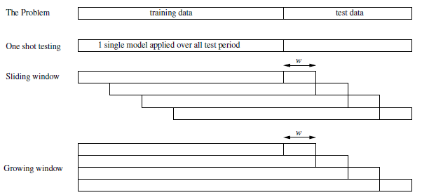
Three forms of obtaining predictions for a test period.
Notes:
Since data changes, we are going to have to change our predictive model rather than adapt our existing one to deal with this change. There are three ways to include newer data into our model.
single model for all test period,
(2) growing window with a fixed updating step of w days,
This model adds the new data to the existing test series giving us a growing window of time we will be using for our test period
(3) sliding window with the same updating step w.
For each new observation point added to the test period, the oldest existing observation is deleted

Slide 17
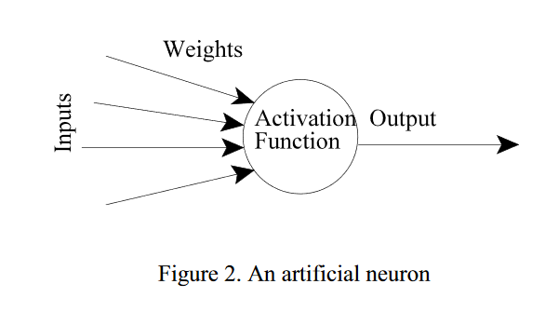
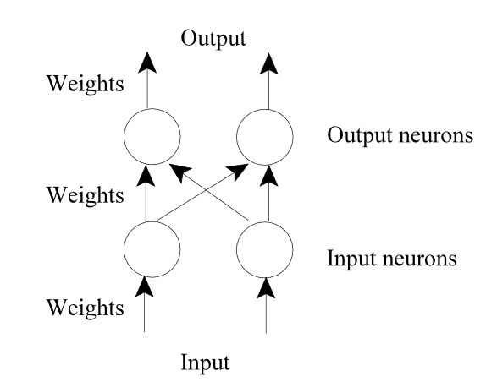
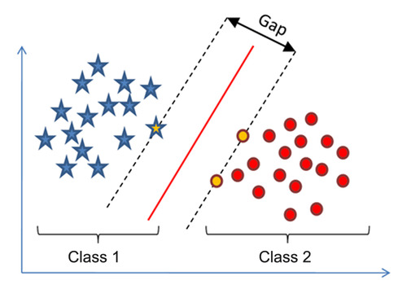
Artificial Neural Network – (ANN) and Support Vector Machine – (SVM) are the two models we used
ANN
SVM
Notes:
We used two models in order to forecast S&P 500, ANN and SVM
Artificial Neural Network – (ANN): Artificial neural networks (ANNs) are frequently used in financial forecasting because of their ability to deal with highly nonlinear problems.
It is a set of computing units working together to produce a final output. Each components output is fed to every other component. In addition, each neuron has a weight associated with it.
We use ANN for stock market prediction because the function allows us to give it large numbers of input and can have a predicted output which was not known. We use it to make a forecast for our data set, which is nonlinear in nature.
Support Vector Machine – (SVM): The basic idea behind SVMs is that of mapping the original data into a new, high-dimensional space, where it is possible to apply linear models to obtain a separating hyper plane, for example, separating the classes of the problem, in the case of classification tasks.
The mapping of the original data into this new space is carried out with the help of the so-called kernel functions.
SMVs are linear machines operating on this dual representation induced by kernel functions.
Similarly like ANN we use SVM because it takes our data into a new, high-dimensional space, where it is possible to apply linear models. It allows us to use our data to predict future pricing while ignoring part of the date which is not needed by our model.

Slide 18
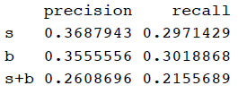
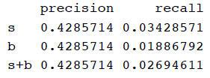
Performance of SVM better than ANN, better precision and recall score.
Output from ANN
Output from SVM
Notes:
Performance of ANN not good, low precision and recall score.

Slide 19

Two types of trading positions believed to generate profit
Long Positions
Short Positions
Buy time t
Price p
Sell time t
Price p
Sell
t+x
Buy
later than t
Notes:
Now we will explain how to use the signal predictions obtained with the modeling techniques described previously. We have assumed that we will be trading in future markets. These markets are based on contracts to buy or sell a commodity on a certain date in the future at the price determined by the market at that future time.
Our trading system will open two types of trading positions: Long and Short. Long positions are opened by buying a commodity at time t and price p, and selling it at a later time t + x. The trader here anticipates a price rise in the future, thus allowing him to make some profit with that transaction. In Short positions, the trader sells the security at time t with price p with the obligation of buying it in the future at time later than t with an anticipation that the price will fall down in future. In general we can say that Short positions will be opened up when we believe that the prices will depreciate in future and Long positions will be opened up when we believe that the prices will appreciate in future.

Slide 20

The first strategy used is a bit conservative
Trading Strategy
#1
Open one position at a time
Relinquish position after 10 days
Remove position once it reaches L% loss limit
Notes:
The details of the first trading strategy we are going to use are the following (Short positions):
All decisions will be taken at the closing price of the day. We’ll assume that at the end of day t, our models provide evidence that the prices will go down in future, that is, predicting a low value of T or a sell signal.
If we already have a position opened, the indication of the model will be ignored.
If we currently do not hold any opened position, we will open a Short position by issuing a sell order. When this order is carried out by the market at a price pr sometime in the future, we will immediately post two other orders.
The first is a buy limit order with a target price of pr – p%, where p% is a target profit margin. This type of order is carried out only if the market price reaches the target limit price or below. We will wait 10 days for this target to be reached. If the order is not carried out by this deadline, we will buy at the closing price of the 10th day.
The second order is a buy stop order with a price limit pr + l%. This order is placed with the goal of limiting our eventual losses with this position. The order will be executed if the market reaches the price pr + l%, thus limiting our possible losses to l%.

Slide 21
The second strategy is more risky
Trading Strategy
#2
No limit on amount of positions opened
Relinquish position after 10 days
Remove position once it reaches L% loss limit
Notes:
The details of the first trading strategy we are going to use are the following (Long positions):
All decisions will be taken at the closing price of the day. We’ll assume that at the end of day t, our models provide evidence that the prices will go up in future, that is, predicting a high value of T or a buy signal.
If we already have a position opened, the indication of the model will be ignored.
If we currently do not hold any opened position, we will open a Long position by issuing a buy order. When this order is carried out by the market at a price pr sometime in the future, we will immediately post two new orders.
The first is a sell limit order with a target price of pr + p%, where p% is a target profit margin. This type of order is carried out only if the market price reaches the target limit price or above. We will wait 10 days for this target to be reached. If the order is not carried out by this deadline, we will sell at the closing price of the 10th day.
The second order is a sell stop order with a price limit pr - l% which is placed with the goal of limiting our eventual losses with this position. The order will be executed if the market reaches the price pr - l%, thus limiting our possible losses to l%.

Slide 22
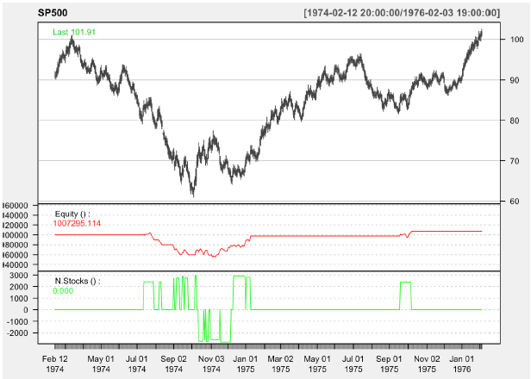
Results of trading using Policy 1 (Short Position) based on the signals of an SVM. Its Negative Return.

Slide 23
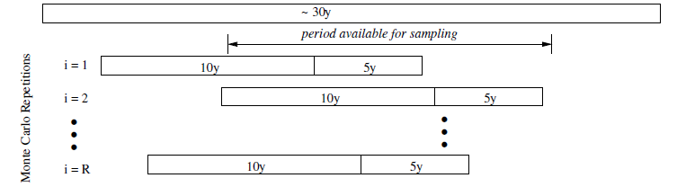
Time series cases are challenging
Monte Carlo
random sampling
The Monte Carlo experimental process.
Training Data:
10 years
Test Set: 5 years
Dataset: 30 years
Cross-validation should not be
applied to time series problems.
Notes:
Since data from time series cases have an attached time tag, we did not use methodologies that include random resampling that changes the original order of the observations. It is important for us, in this case to use more recent data to test the models on
Monte Carlo is a method that relies on random sampling to obtain different results and this is the methodology we used.
Our dataset includes roughly 30 years of daily quotes. We will evaluate all alternatives by estimating their performance on a test set of 5 years of quotes, when given 10 years of training data. This ensures train and test sizes that are su!ciently large; and, moreover, it leaves space for di↵erent repetitions of this testing process as we have 30 years of data

Slide 24


Monte Carlo analysis output on test set:
These methods made a single trade over the testing period with an average return of 0.25%, which is
-77% below the naive buy and hold strategy.
Useless models.

Slide 25
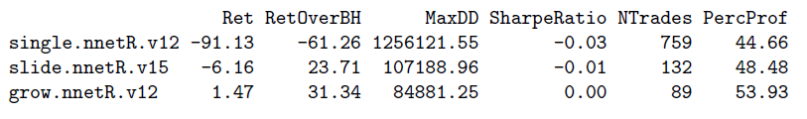

Slide 26
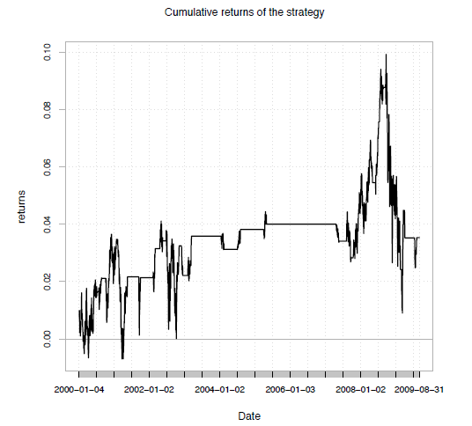
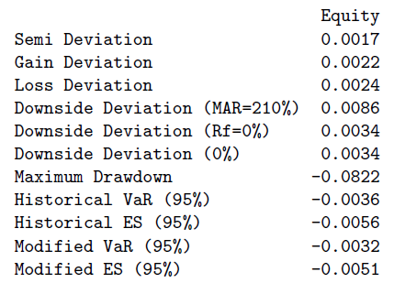
The cumulative returns on the final evaluation period of the
“grow.nnetR.v12” system.

Slide 27


Conclusion: Our model is not good enough for prediction
Test Set
Training Set
Notes:
Our Training model gave us good results but our test model is giving us a miniscule profit

Slide 28
References
“Stock Market Forecast: Chaos Theory Revealing How the Market Works”. Feburary 9, 2016. http://iknowfirst.com/ stock_market_ forecast_chaos_theory_revealing_how_the_stock_market_work
“Standard & Poor's 500 Index - S&P 500” http://www.investopedia.com/terms/s/sp500.asp.
http://stockcharts.com
Gershenson, Carlos. “Artificial Neural Networks for Beginners “ http://arxiv.org/ftp/cs/papers/0308/0308031.pdf
“Support Vector Machines” http://scikit-learn.org/stable/modules/svm. html

