Slide 1
Estimating CO using the Parlikar Estimator
Joe and the Joes
Joe Hakim, Steven Chen, Chris Le, Richard Liu

Slide 2
Cohort Comparison: Married vs. Unmarried
Scripted a search mapping i2b2 exported values to MIMIC files available
on i2b2: 279 patients with CO
on OneDrive: 22 patients from i2b2 set
Use very large categories to obtain large sections: married and unmarried
on i2b2: 150 married, 129 unmarried
on OneDrive: 12 married, 10 unmarried

Slide 3
Cohort Comparison: Analysis
Testing the original 3 estimators with 22 patients
Quantitative
Mean and RMS error
Using C2 calibration introduces too much noise/error to get useful results from such a subtle difference
Total Peripheral Resistance to provide additional insight
Qualitative
Observe more of what makes constitutes estimator performance eg sensitivity, stability
A more subjective comparison
Analyzing and representing 66 graphs can be clumsy

Slide 4
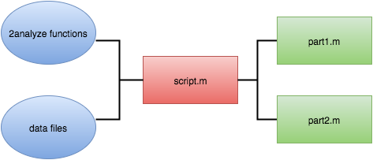
Code Overview

Slide 5

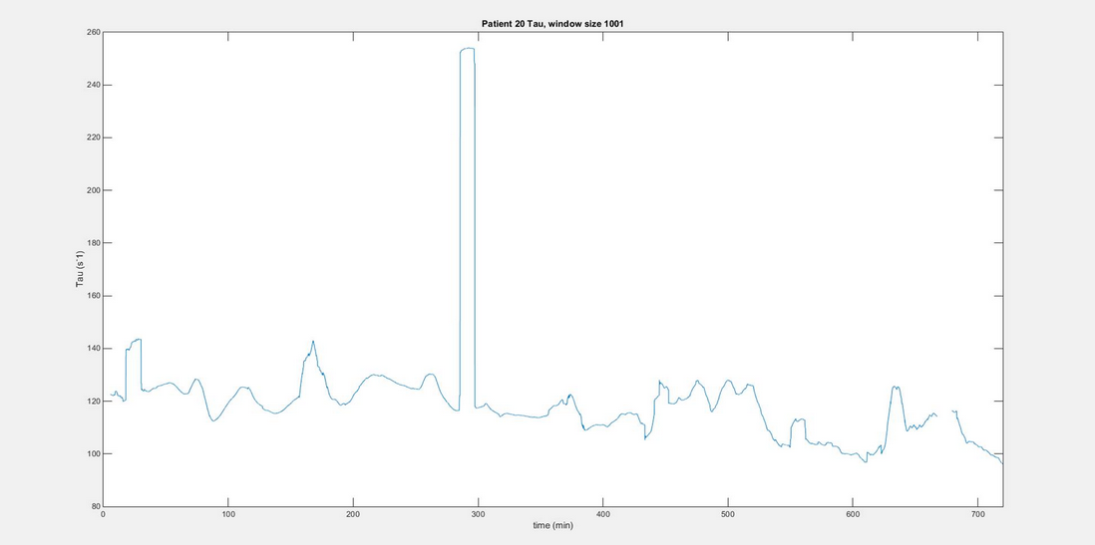
Parlikar Estimator - Tau_{n} Calculation
Use a window for calculation of tau_{n}
tau_{n} ≈ mean(tau_{n-x} + … + tau_{n+x}), window from -x to x
Smoother beat-to-beat estimation of tau

Slide 6
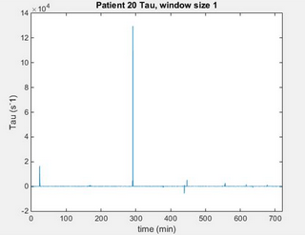
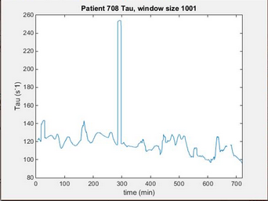
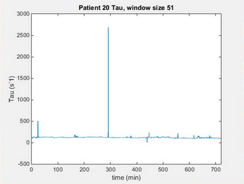

Slide 7

Parlikar Estimator - Compliance Calibration
Goal: normalize estimated CO values
Methods:
Average C from TD
Using only first TD (C2)
Using Least Squares with
Use known CO_{TD} values to create known C_{TD} values.
Create linear regression with C_{TD} against MAP values to find gamma values and find the affine relation and then solve for compliance values at each heartbeat.
Use the newly created C values to estimate for CO across all heartbeats.

Slide 8
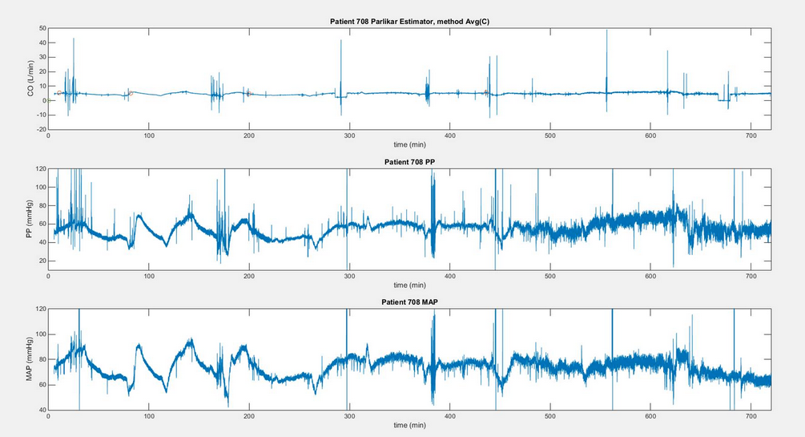
Parlikar + PP + MAP GRAPHS HERE

Slide 9
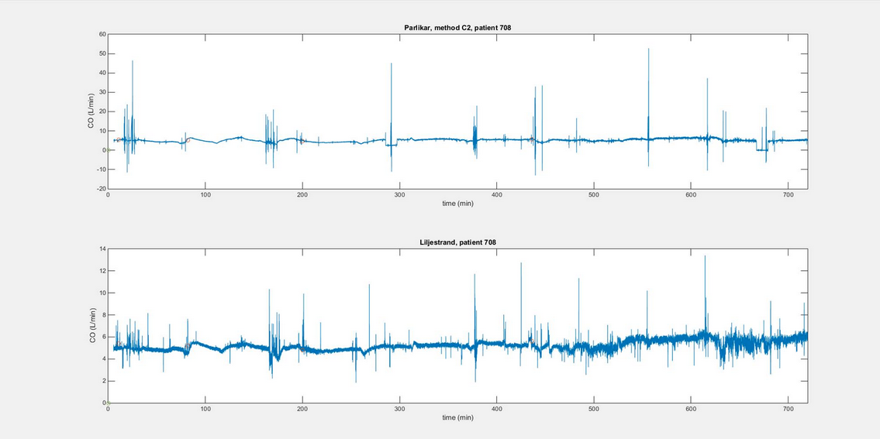
Parlikar vs. Liljestrand GRAPHS HERE

Slide 10
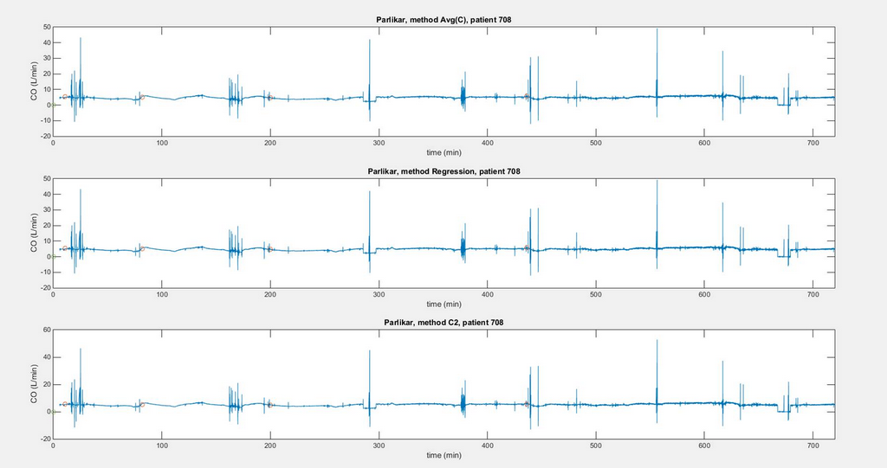

Slide 11
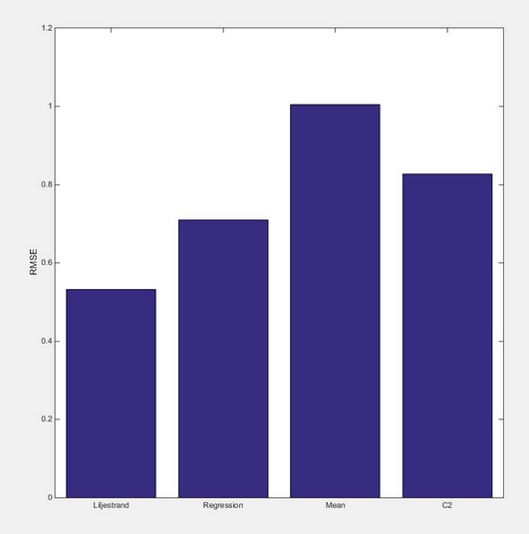
Comparison of Compliance Methods
Root Mean Square Error Comparison
> Regression: State-dependent
> Mean
> C2

Slide 12
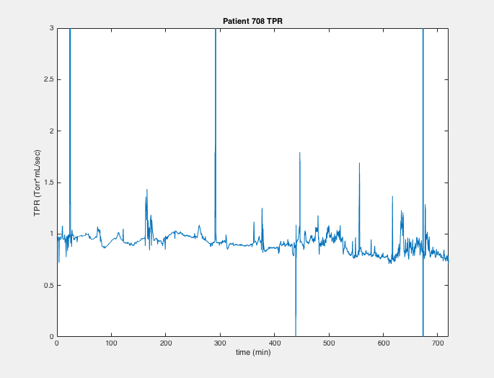

TPR GRAPH

Slide 13
Reflection
Implementing a mathematical algorithm into MATLAB poses non-mathematical issues
Syncing up time-scales and matrix sizes
Logistics
Distributing work amongst ourselves to work on separately and then come together at the end was not the most efficient method.

Slide 14
Conclusions
Liljestrand had the least RMS errors between the CO estimated values and the CO_{TD} values. Therefore, unless there is a special case that requires beat-to-beat analysis or when the TPR needs to be calculated considering compliance, Liljestrand is a better estimator than Parlikar.
For finding compliance, deriving an affine relationship between the compliance and the mean arterial pressure from a linear regression of known values yielded the least RMS error.

Slide 15

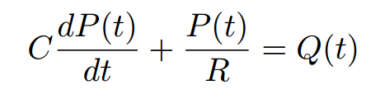

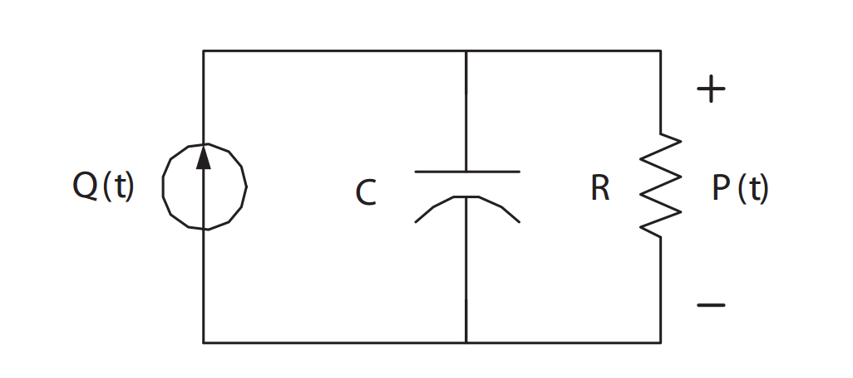


Appendix

