Slide 1

Microprocessors Final Project
Jackson Hall

Slide 2
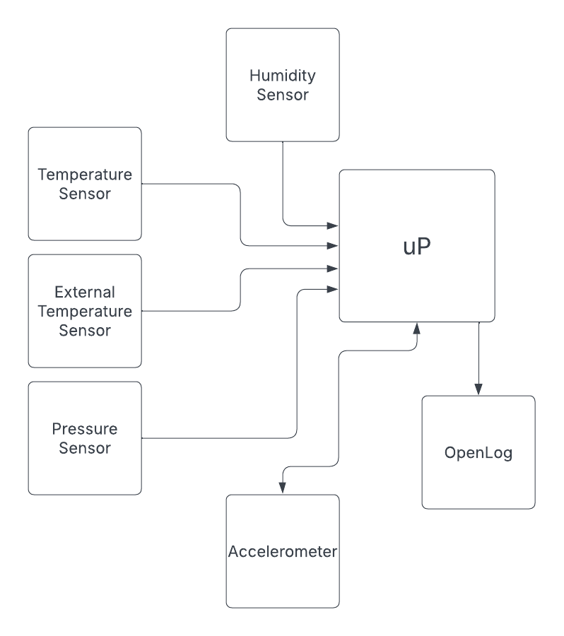
Block Diagram

Slide 3
System Cost
Original Design
Part | Cost ($)
Sparkfun Openlog | $ 16.95
Sparkfun Accelerometer | $ 16.95
Sparkfun Humidity Sensor | $ 10.95
Arduino Uno R3 | $ 27.60
Silicon Pressure Sensor | $ 11.70
PCB Shield (assumed) | $ 2.00
LEDs | $ 0.08
Pin Headers (16POS) | $ 0.87
TOTAL | $ 89.24
My Design
Part | Cost ($)
Adafruit BME280 | $ 14.95
TMP36GT9Z Temp Sensor | $ 1.42
MPU6050 Accelerometer | $ 6.99
Sparkfun Openlog | $ 16.95
PCB Shield (assumed) | $ 2.00
Arduino Uno R4 | $ 20.00
LEDs | $ 0.08
330 Ohm Resistor
Pin Headers (16POS) | $ 0.87
TOTAL | $ 63.40

Slide 4
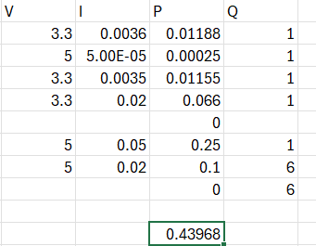
System Power Consumption
P = ~440mW

Slide 5
Alternative Design
A few improvements can be made to the initial design.
The temperature, pressure and humidity sensors can be consolidated to a single module, which drastically reduces costs.
Better and cheaper components were also chosen in general without reducing the quality of the design.

Slide 6
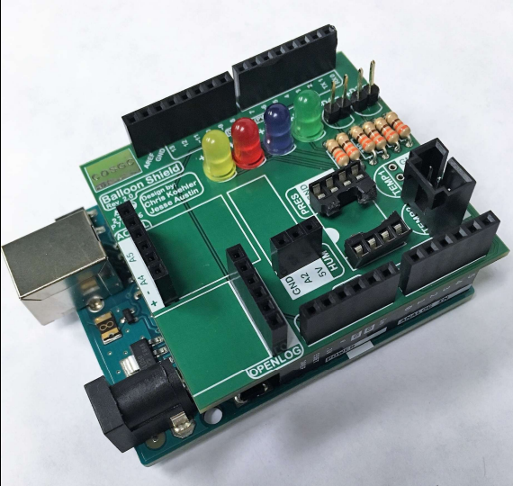
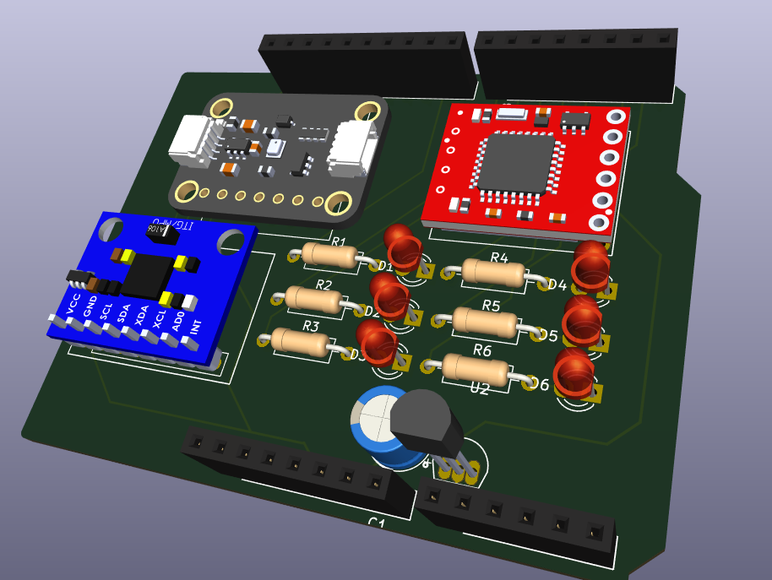
PCB Design
VS.

Slide 7
References
https://www.colorado.edu/center/spacegrant/statewide-programs/remote-kits-learning-modules/high-altitude-balloon-payload-remote-skill-module-0#accordion-1065444066-1

