Slide 1

Microprocessors Final Project
Jackson Hall

Slide 2
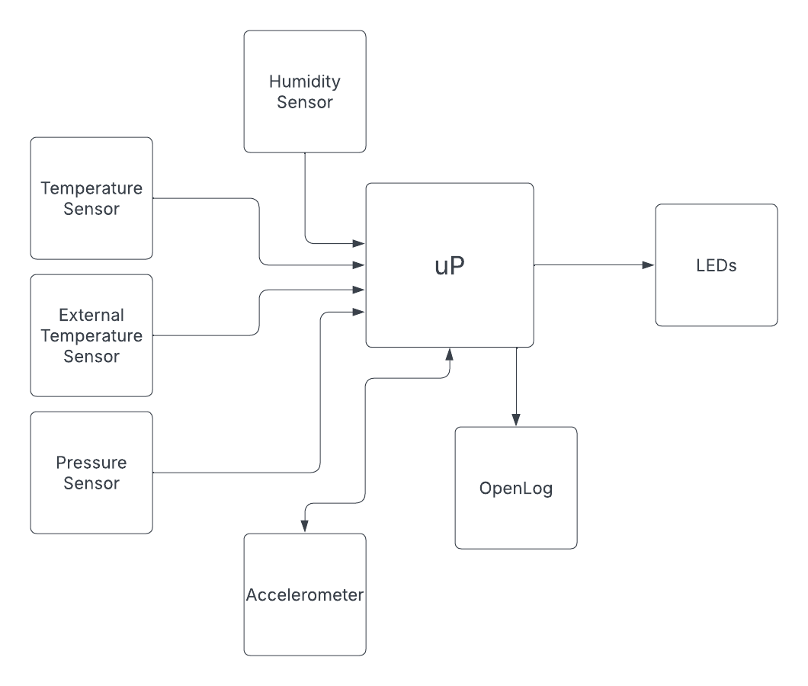
Block Diagram
Can be combined!

Slide 3
System Cost
Original Design
Part | Cost ($)
Sparkfun Openlog | $ 16.95
Sparkfun Accelerometer | $ 16.95
Sparkfun Humidity Sensor | $ 10.95
Arduino Uno R3 | $ 27.60
Silicon Pressure Sensor | $ 11.70
PCB Shield (assumed) | $ 2.00
LEDs | $ 0.08
Pin Headers (16POS) | $ 0.87
TOTAL | $ 89.24
My Design
Part | Cost ($)
Adafruit BME280 | $ 14.95
TMP36GT9Z Temp Sensor | $ 1.42
MPU6050 Accelerometer | $ 6.99
Sparkfun Openlog | $ 16.95
PCB Shield (assumed) | $ 2.00
Arduino Uno R4 | $ 20.00
LEDs | $ 0.08
330 Ohm Resistor
Pin Headers (16POS) | $ 0.87
TOTAL | $ 63.40
Discontinued!

Slide 4
System Weight
Original Design
My Design
Part | Weight (g)
Sparkfun Openlog | 2
Sparkfun Accelerometer | 2
Sparkfun Humidity Sensor | 2
Arduino Uno R3 | 25
Silicon Pressure Sensor | 2.5
PCB Shield (Assumed price) | 20
LEDs | 1.2
Pin Headers (16POS) | 3
 | 57.7
Part | Weight (g)
Adafruit BME280 | 1.2
TMP36GT9Z Temp Sensor | 0.5
MPU6050 Accelerometer | 1
Sparkfun Openlog | 2
PCB Shield | 20
Arduino Uno R4 | 25
LEDs | 1.2
Pin Headers (16POS) | 3
 | 53.9

Slide 5
Max Power Consumption
V | I | P
3.3 | 2.00E-02 | 6.60E-02
3.3 | 0.005 | 1.65E-02
3.3 | 0.001 | 3.30E-03
5 | 0.01 | 5.00E-02
5 | 0.005 | 2.50E-02
 |  | 0.00E+00
 |  | 0.00E+00
5 | 0.06 | 3.00E-01
 |  | 0.4608
V | I | P
3.3 | 0.0036 | 0.01188
5 | 5.00E-05 | 0.00025
3.3 | 0.0035 | 0.01155
3.3 | 0.02 | 0.066
 |  | 0
5 | 0.05 | 0.25
5 | 0.02 | 0.1
 |  | 0
 |  | 0.43968
P = ~460mW
P = ~440mW

Slide 6
Alternative Design
A few improvements can be made to the initial design.
The temperature, pressure and humidity sensors can be consolidated to a single module, which drastically reduces costs.
Better and cheaper components were also chosen in general without reducing the quality of the design.

Slide 7
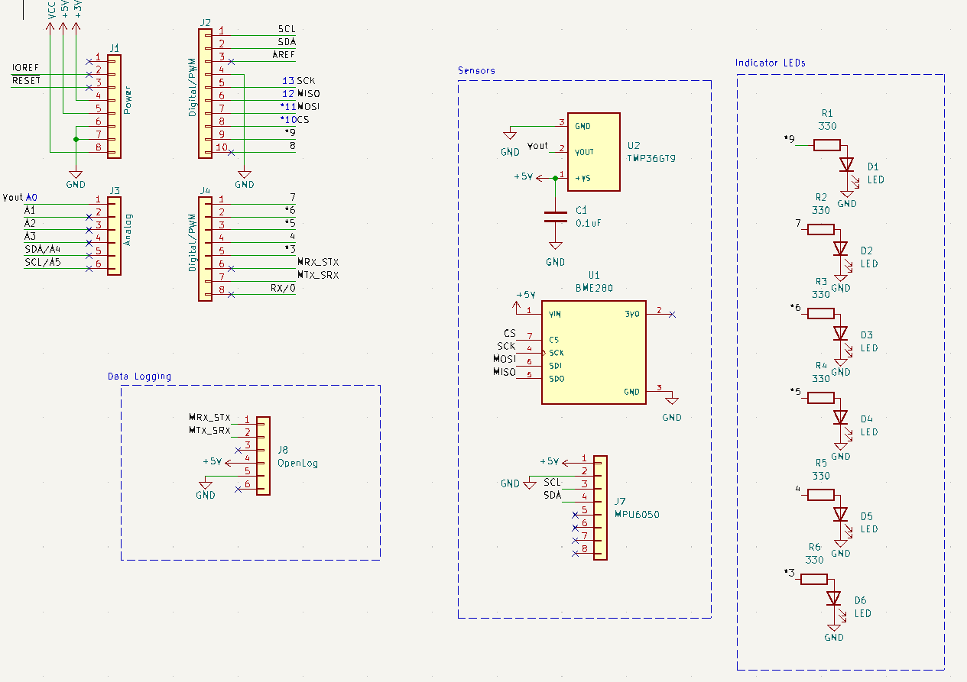
Schematic

Slide 8
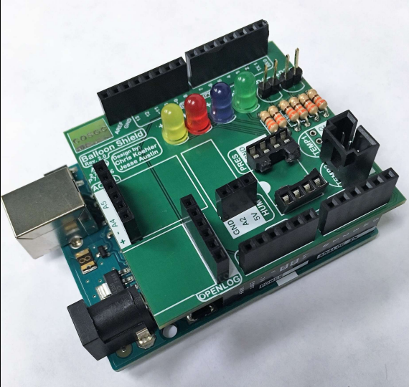
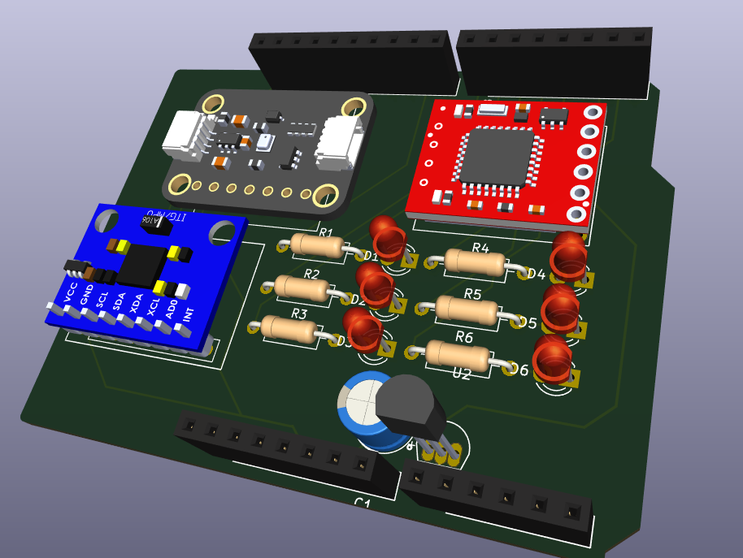
PCB Design
VS.

Slide 9
References
https://www.colorado.edu/center/spacegrant/statewide-programs/remote-kits-learning-modules/high-altitude-balloon-payload-remote-skill-module-0#accordion-1065444066-1

