Slide 1

CMPE110: Computer Architecture CMP
Ehsan K. Ardestani

Slide 2
Quiz #4
Write Down one positive and one negative property for each of these VM/Cache integration schemes
PIPT:
+ No aliasing
- Translation before access to cache (Performance)
- Every access needs translation (Power/Energy)
VIVT
+ No translation needed before access (Performance)
+ No translation needed before access (Power/Energy)
- Aliasing
VIPT
+ No aliasing
+ No extra cycle for translation
- Translation needed for every access (Power/Energy)
Which one you recommend?
Depends on application and constraints, but in general, VIPT has more pros.

Slide 3
Performance Basics: Latency
Latency: wall-clock time, elapsed time,…
Medical dictionary definition:
the interval between stimulation and response
How long it takes to do X?

Slide 4
Performance Basics: Throughput
Throughput or bandwidth
Webster definition:
the amount of material, data, etc., that enters and goes through something
I would rather say:
The rate that a unit of work is completed or started by a mechanism
How much X work is done in a given time?

Slide 5
Ways to improve performance
Faster technology (higher clock frequency)
Better compiler (lower IC)
More efficient pipelines (better CPI)
Parallelism
Instruction-level parallelism
Out-of-Order techniques
Super scalar pipelines
Parallel processing
Job-level parallelism

Slide 6
 |  | Data Streams
 |  | Single | Multiple
Instruction Streams | Single | SISD: Our processor, Intel Pentium 4 | SIMD: SSE instructions, multimedia extensions
 | Multiple | MISD: No example | MIMD: Intel Xeon

Slide 7
Chip-level Multiprocessing
Multiple processor on the same chip
Collection of processing elements that co-operate to solve a problem
hopefully faster than one core alone
Why do we care about multiprocessing?
Getting harder to improve performance by lowering latency
Power and thermal issues
Increase throughput
Issues
communication and synchronization
how is data shared among cores?
how is co-operation achieved?
Shared Memory Model, Message Passing Model
sizing
how large a collection of cores?
how powerful is each core?
how much memory?
performance and scalability
how does this scale?

Slide 8

Measuring Performance
Speedup?
measured against execution time of best available sequential code
data set remains constant
Ideal
Well programmed
1
1
Bad programmed

Slide 9

Measuring Performance
Efficiency?
Speedup over number of processors
data set remains constant
1
1

Slide 10
Cache Coherency
Caches play key performance role
reduce average data access time
reduce bandwidth demands placed on shared interconnect and memory
But private processor caches create a problem
copies of a variable can be present in multiple caches
a write by one processor may not become visible to others
they’ll keep accessing stale value in their caches
cache coherence problem
need to take actions to ensure visibility, preserve programmer intuition

Slide 11
Ex: Cache Coherence Problem
LD [100]
core0
ST [100]
core1
core2
LD [100]
L1 Cache
L1 Cache
L1 Cache
M[100]
D[100]
?
BUS
MEMORY or L2
M[100]

Slide 12
Snoopy Cache Coherence
Basic Idea
Transactions on bus are visible to all processors
Processors or their representatives can snoop (monitor) bus and take action on relevant events (e.g. change state)
Implementing a “Protocol”
Protocol is distributed algorithm: cooperating state machines
set of states, state transition diagram, actions
Cache controller now receives inputs from both sides:
requests from processor, bus requests/responses from snooper
In either case, takes zero or more actions
updates state, responds with data, generates new bus actions
Granularity of coherence is typically cache block
like that of allocation in cache and transfer to/from cache

Slide 13
Basic MSI Protocol
States
Invalid (I)
Shared (S): one or more
Dirty or Modified (M): one only
Processor events:
PrRd (read)
PrWr (write)
Bus transactions
BusRd: asks for copy with no intent to modify
BusRdX: asks for copy with intent to modify
BusWB: updates memory
Actions
update state, perform bus transaction, flush value onto bus

Slide 14
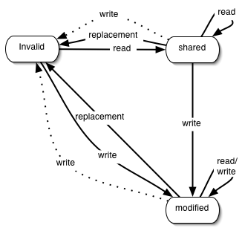
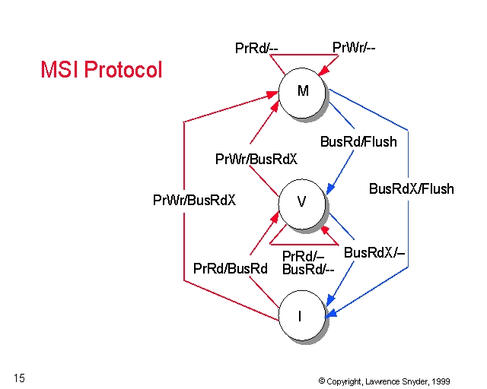
MSI State Diagram
S

Slide 15
MSI Sample Coherence Messages
LD [100]
core0
ST [100]
core1
core2
LD [100]
L1 Cache
L1 Cache
L1 Cache
BUS
MEMORY or L2

Slide 16
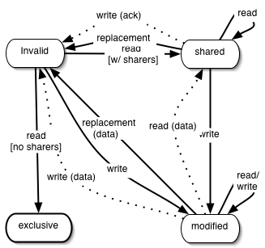
MESI
One extra state to reduce traffic. Check [sharers or no sharers]

Slide 17
Next
Chip-level Multiprocessing (CMP)

