Slide 1
Worksheet I.
Exercise Solutions
Ata Kaban
A.Kaban@cs.bham.ac.uk
School of Computer Science
University of Birmingham

Slide 2
Worked exercises on Sequence Models
In a casino, two differently loaded but identically looking dice are thrown in repeated runs. The frequencies of numbers observed in 40 rounds of play are as follows:
Dice 1, [Nr, Frequency]: [1,5], [2,3], [3,10], [4,1], [5,10], [6,11]
Dice 2, [Nr, Frequency]: [1,10], [2,11], [3,4], [4,10], [5,3], [6,2]
Characterize the two dice by the corresponding random sequence model they generated. That is, estimate the parameters of the random sequence model for both dice.
ANSWER
Die 1, [Nr, P_1(Nr)]: [1, 0.125], [2,0.075], [3,0.250], [4,0.025], [5,0.250], [6,0.275]
Die 2, [Nr, P_2(Nr)]: [1,0.250], [2,0.275], [3,0.100], [4,0.250], [5,0.075], [6,0.050]

Slide 3
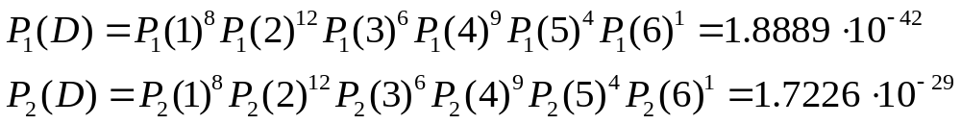
(ii) Some time later, one of the dice has disappeared. You (as the casino owner) need to find out which one. The remaining one is now thrown 40 times and here are the observed counts:
[1,8], [2,12], [3,6], [4,9], [5,4], [6,1]. Use a Bayes’ rule to decide the identity of the remaining die.
ANSWER
Since we have a random sequence model (i.i.d. data) D, the probability of D under the two models is
Since there is no prior knowledge about either dice, we use a flat prior, i.e. the same 0.5 for both hypotheses.
Because P_1(D) < P_2(D), and the prior is the same for both hypothesies, we conclude that the die in question is the die no. 2.

Slide 4
Seq Models - Exercise 1
Sequences:
(s1): A B B A B A A A B A A B B B
(s2): B B B B B A A A A A B B B B
Models:
(M1): a random sequence model with parameters P(A)=0.4, P(B)=0.6
(M2): a first order Markov model with initial probabilities 0.5 for both symbols and the following transition matrix: P(A|A)=0.6, P(B|A)=0.4, P(A|B)=0.1, P(B|B)=0.9.
Which sequence s1 and s2 comes from which models M1 or M2?

Slide 5
Answer
Intuitively:
s2 contains more state repetitions, which is an evidence that indicates that the Markov structure of M2 is more likely than the random structure of M1.
s1 is apparently more random, therefore it is more likely generated from M1.
Formally:
log P(s1|M1)=7*log(0.4)+7*log(0.6)=-9.9898
log P(s1|M2)=log(0.5)+3*log(0.6)+4*log(0.4)+3*log(0.1)+3*log(0.9)=-13.1146
The former of these two probabilities is larger, so s1 is more likely to be generated from M1.
Similarly, for s2 we get:
log P(s2|M1)=5*log(0.4)+9*log(0.6)= -9.1789
log P(s2|M2)=log(0.5)+4*log(0.6)+log(0.4)+log(0.1)+7*log(0.9)=-6.6928
The latter is larger, so s2 is more likely to be generated from M2.

Slide 6
RL. Exercise 2a).
The figure below depicts a 4-state grid world, which’s state 2 represents the ‘gold’. Using the immediate reward values shown on the figure and employing the Q-learning algorithm, do anti-clockwise circuits on the four states updating the action-state table.
1
2
-10
50
Note.
Here, the Q-table will be updated after each cycle.
-10
-2
50
-2
-2
3
-2
4

Slide 7
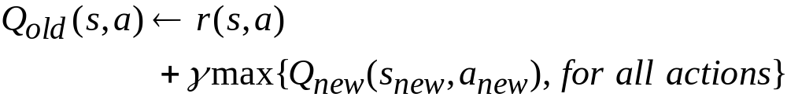
Solution
1
2
-10
Initialise each entry of the table of Q values to zero
50
-10
-2
50
-2
Q | ↑ | ↓ | → | ←
1 | 0 | 0 | 0 | 0
2 | 0 | 0 | 0 | 0
3 | 0 | 0 | 0 | 0
4 | 0 | 0 | 0 | 0
-2
3
-2
4
Iterate:
Notes:
Imagine that the game doesn’t end when we get the gold or fall into the pit and that we are just continuously wander round in an anticlockwise manner.

Slide 8
First circuit:
1
2
-10
Q(3, →) = -2 +0.9 max{Q(4, ←),Q(4, ↑)}= -2
Q(4, ↑) = 50 +0.9 max{Q(2, ↓),Q(2, ←)}= 50
Q(2, ←) = -10 +0.9 max{Q(1, →),Q(1, ↓)}= -10
Q(1, ↓) = -2 +0.9 max{Q(3, ↑),Q(3, →)}= -2
Q(3, →) = -2 +0.9 max{Q(4, ←),50}=43
50
-10
-2
50
-2
-2
3
-2
4
Q | ↑ | ↓ | → | ←
1 | - | -2 | 0 | -
2 | - | 0 | - | -10
3 | 0 | - | 43 | -
4 | 50 | - | - | 0
Notes:
OK we start at square 3 go East (we will end up in 7 where we could have two actions) we get a reward of -2
Then we are in 4 we go North (we end up in 11 where we have two actions) we get a reward of 50
Eventually we come back to state 3 and go East again however this time one of the Q values (Q(7,N) is not zero instead it is 50).
In this way gradually the Q values get determined.
It can be shown mathematically that as long as we visit every state-action pair INFINITELY OFTEN then we will always converge on the true Q values.

Slide 9
Second circuit:
r | ↑ | ↓ | → | ←
1 | - | -2 | 50 | -
2 | - | -2 | - | -10
3 | -10 | - | -2 | -
4 | 50 | - | - | -2
Q(4, ↑) = 50 +0.9 max{Q(2, ↓),Q(2, ←)}= 50 +0.9 max{0,-10}=50
Q(2, ←) = -10 +0.9 max{Q(1, →),Q(1, ↓)}= -10 +0.9 max{0,-2}=-10
Q(1, ↓) = -2 +0.9 max{Q(3, ↑),Q(3, →)}= -2 +0.9 max{0,43}= 36.7
Q(3, →) = -2 +0.9 max{Q(4, ←), Q(4,↑)}=-2 +0.9 max{0,50}=43
Q | ↑ | ↓ | → | ←
1 | - | 36.7 | 0 | -
2 | - | 0 | - | -10
3 | 0 | - | 43 | -
4 | 50 | - | - | 0
Notes:
OK we start at square 3 go East (we will end up in 7 where we could have two actions) we get a reward of -2
Then we are in 4 we go North (we end up in 11 where we have two actions) we get a reward of 50
Eventually we come back to state 3 and go East again however this time one of the Q values (Q(7,N) is not zero instead it is 50).
In this way gradually the Q values get determined.
It can be shown mathematically that as long as we visit every state-action pair INFINITELY OFTEN then we will always converge on the true Q values.

Slide 10
Third circuit:
r | ↑ | ↓ | → | ←
1 | - | -2 | 50 | -
2 | - | -2 | - | -10
3 | -10 | - | -2 | -
4 | 50 | - | - | -2
Q(4, ↑) = 50 +0.9 max{Q(2, ↓),Q(2, ←)}= 50 +0.9 max{0,-10}=50
Q(2, ←) = -10 +0.9 max{Q(1, →),Q(1, ↓)}= -10 +0.9 max{0,36.7}=23.03
Q(1, ↓) = -2 +0.9 max{Q(3, ↑),Q(3, →)}= -2 +0.9 max{0,43}= 36.7
Q(3, →) = -2 +0.9 max{Q(4, ←), Q(4,↑)}=-2 +0.9 max{0,50}=43
Q | ↑ | ↓ | → | ←
1 | - | 36.7 | 0 | -
2 | - | 0 | - | 23.03
3 | 0 | - | 43 | -
4 | 50 | - | - | 0
Notes:
OK we start at square 3 go East (we will end up in 7 where we could have two actions) we get a reward of -2
Then we are in 4 we go North (we end up in 11 where we have two actions) we get a reward of 50
Eventually we come back to state 3 and go East again however this time one of the Q values (Q(7,N) is not zero instead it is 50).
In this way gradually the Q values get determined.
It can be shown mathematically that as long as we visit every state-action pair INFINITELY OFTEN then we will always converge on the true Q values.

Slide 11
Fourth circuit:
r | ↑ | ↓ | → | ←
1 | - | -2 | 50 | -
2 | - | -2 | - | -10
3 | -10 | - | -2 | -
4 | 50 | - | - | -2
Q(4, ↑) = 50 +0.9 max{Q(2, ↓),Q(2, ←)}= 50 +0.9 max{0,23.03}=70.73
Q(2, ←) = -10 +0.9 max{Q(1, →),Q(1, ↓)}= -10 +0.9 max{0,36.7}=23.03
Q(1, ↓) = -2 +0.9 max{Q(3, ↑),Q(3, →)}= -2 +0.9 max{0,43}= 36.7
Q(3, →) = -2 +0.9 max{Q(4, ←), Q(4,↑)}=-2 +0.9 max{0,70.73}=61.66
Q | ↑ | ↓ | → | ←
1 | - | 36.7 | 0 | -
2 | - | 0 | - | 23.03
3 | 0 | - | 61.66 | -
4 | 70.73 | - | - | 0
Notes:
OK we start at square 3 go East (we will end up in 7 where we could have two actions) we get a reward of -2
Then we are in 4 we go North (we end up in 11 where we have two actions) we get a reward of 50
Eventually we come back to state 3 and go East again however this time one of the Q values (Q(7,N) is not zero instead it is 50).
In this way gradually the Q values get determined.
It can be shown mathematically that as long as we visit every state-action pair INFINITELY OFTEN then we will always converge on the true Q values.

Slide 12
Exercise 2b).
In some RL problems, rewards are positive for goals and are either negative or zero the rest of the time.
Are the signs of these rewards important, or only the intervals between them?
Prove, using the standard discounted return R_{t} below, that adding a constant C to all the elementary rewards adds a constant, K, to the values of all the states, and thus does not affect the relative values of any states under any policies.
What is K in terms of C and γ?

Slide 13
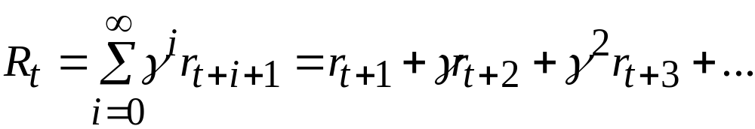

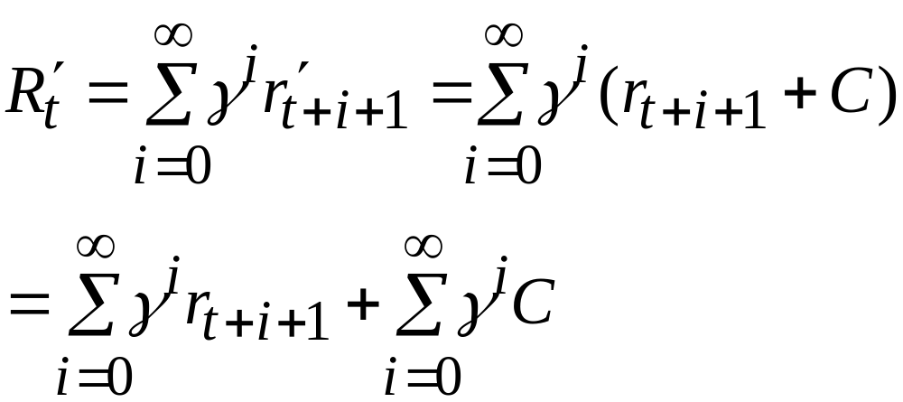
Solution
Add a constant C to all elementary rewards

Slide 14
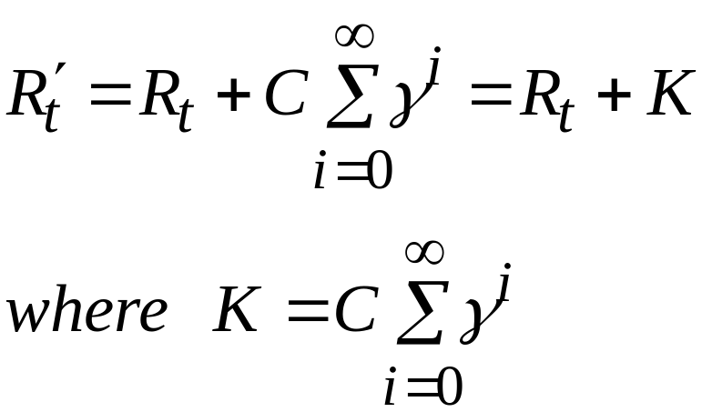
Thus only intervals between rewards are important not absolute values
Notes:
So indeed we find that only relative rewards are important.

Slide 15
Exercise 2c).
Imagine you are designing a robot to escape from a maze.
You decide to give it a reward of +1 for escaping from the maze and a reward of zero at all other times.
Since the task seems to break down naturally into episodes (successive runs through the maze), you decide to treat it as an episodic task, where the goal is to maximise the expected total reward:

Slide 16
R_{t} = r_{t+1} + r_{t+2} + r_{t+3} + … + r_{T}
After running the learning agent for a while, you find that it is showing no signs of improvement in escaping from the maze.
What is going wrong?
Have you effectively communicated to the agent what you want it to achieve?
Notes:
Question continued

Slide 17
Solution
Imagine the following episode
NE NE NE NE E
t t+1 t+2 t+3 t+4 t+5
Rewards 0 0 0 0 1
R_{t} =1
No reward is being given for escaping in the minimum number of steps
Notes:
OK, what is happening here

Slide 18
Possible solution: reward with -1 for each NE state and 0 or 1 for the escaped state
NE NE NE NE E
t t+1 t+2 t+3 t+4 t+5
Rewards -1 -1 -1 -1 0
R_{t} =-4
In general if it takes k steps to escape, the cumulative reward would be -k. We want to find a policy to maximise R_{t} . The best policy would make R_{t} = 0 (escape at next time step)
Notes:
Here is another way of looking at it.

Slide 19
Optional material: Convergence proof of Q-learning
Recall: Sketch of proof
  Consider the case of deterministic world, where each (s,a) is visited infinitely often.
  Define a full interval as an interval during which each (s,a) is visited.
  Show, that during any such interval, the absolute value of the largest error in Q table is reduced by a factor of γ.
  Consequently, as γ<1, then after infinitely many updates, the largest error converges to zero.

Slide 20
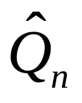
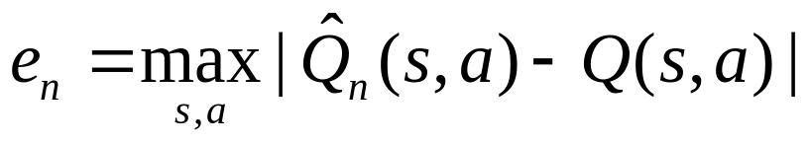
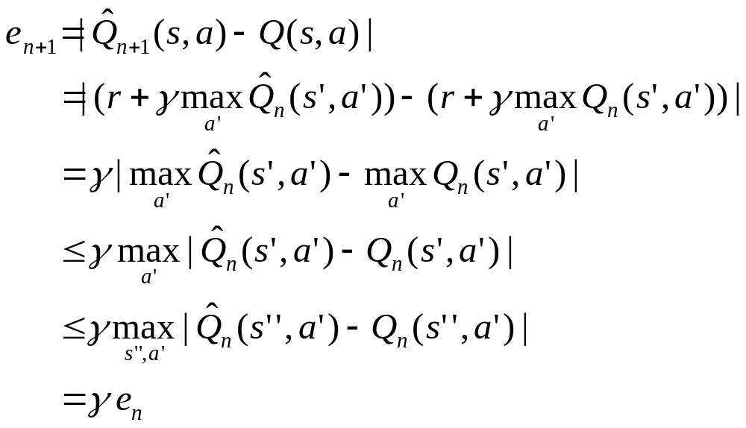
Solution
Let be a table after n updates and e_{n} be the maximum error in this table:
What is the maximum error after the (n+1)-th update?

Slide 21
Obs. No assumption was made over the action sequence! Thus, Q-learning can learn the Q function (and hence the optimal policy) while training from actions chosen at random as long as the resulting training sequence visits every (state, action) infinitely often.

