Slide 1
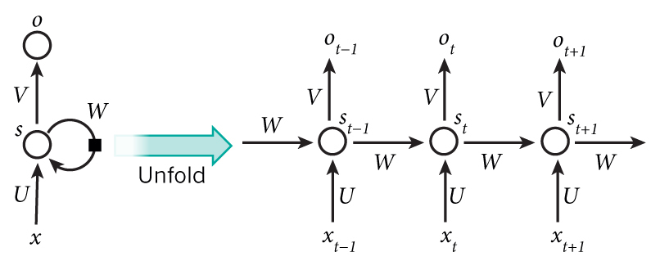
Recurrent Neural Networks
Material from:
WildML (http://www.wildml.com/2015/09/recurrent-neural-networks-tutorial-part-1-introduction-to-rnns/)
Andrej Karpathy (http://karpathy.github.io/2015/05/21/rnn-effectiveness/)
Trask (https://iamtrask.github.io/2015/11/15/anyone-can-code-lstm/)
Colah (http://colah.github.io/posts/2015-08-Understanding-LSTMs/)
Figure from Nature

Slide 2
Recurrent Neural Networks
In a traditional neural network we assume that all inputs (and outputs) are independent of each other.
RNNs are called recurrent because they perform the same task for every element of a sequence, with the output being depended on the previous computations.
RNNs is have a “memory” which captures information about what has been calculated so far.
x0
y0
x1
y1
x2
y2

Slide 3
Recurrent Neural Networks
A glaring limitation of Vanilla Neural Networks is that they are too constrained: they accept a fixed-sized vector as input and produce a fixed-sized vector as output
Not only that: These models perform this mapping using a fixed amount of computational steps (e.g. the number of layers in the model).
The core reason that recurrent nets are more exciting is that they allow us to operate over sequences of vectors: Sequences in the input, the output, or in the most general case both.

Slide 4
Recurrent Neural Networks
RNNs have a deceptively simple API: They accept an input vector x and give you an output vector y.
However, crucially this output vector’s contents are influenced not only by the input you just fed in, but also on the entire history of inputs you’ve fed in in the past.
Written as a class, the RNN’s API consists of a single step function:

Slide 5
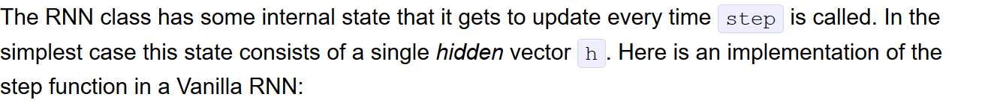
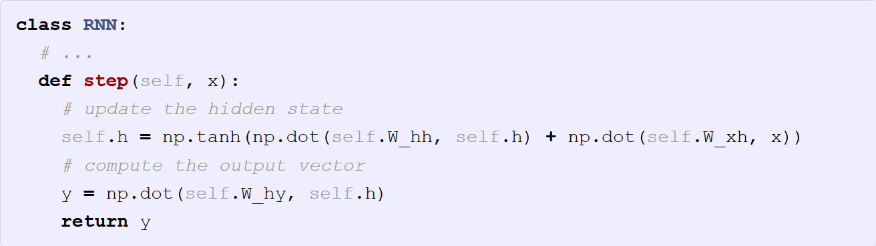
Recurrent Neural Networks

Slide 6
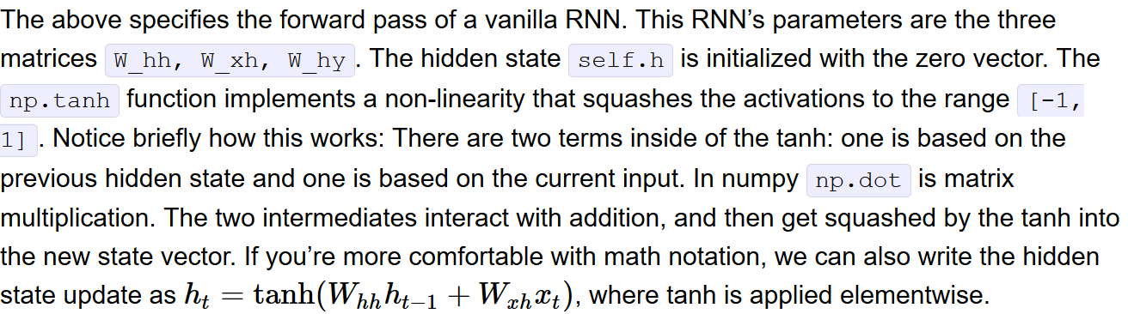
RNNs are neural networks and everything works monotonically better (if done right) if you put on your deep learning hat and start stacking models up like pancakes. For instance, we can form a 2-layer recurrent network as follows:
y1 = rnn1.step(x) y = rnn2.step(y1)
In other words we have two separate RNNs: One RNN is receiving the input vectors and the second RNN is receiving the output of the first RNN as its input. Except neither of these RNNs know or care - it’s all just vectors coming in and going out, and some gradients flowing through each module during backpropagation.
Recurrent Neural Networks

Slide 7
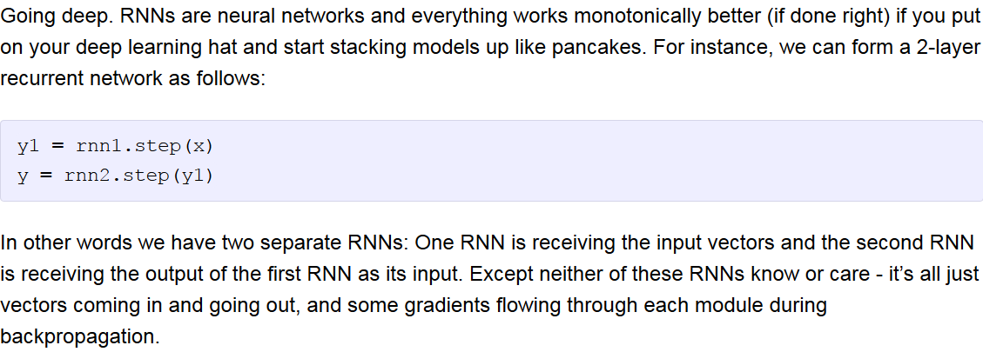
RNNs are neural networks and everything works monotonically better (if done right) if you put on your deep learning hat and start stacking models up like pancakes. For instance, we can form a 2-layer recurrent network as follows:
y1 = rnn1.step(x) y = rnn2.step(y1)
In other words we have two separate RNNs: One RNN is receiving the input vectors and the second RNN is receiving the output of the first RNN as its input. Except neither of these RNNs know or care - it’s all just vectors coming in and going out, and some gradients flowing through each module during backpropagation.
Recurrent Neural Networks – going deeper

Slide 8
The above diagram shows a RNN being unrolled (or unfolded) into a full network. By unrolling we simply mean that we write out the network for the complete sequence.
For example, if the sequence we care about is a sentence of 5 words, the network would be unrolled into a 5-layer neural network, one layer for each word.

Slide 9
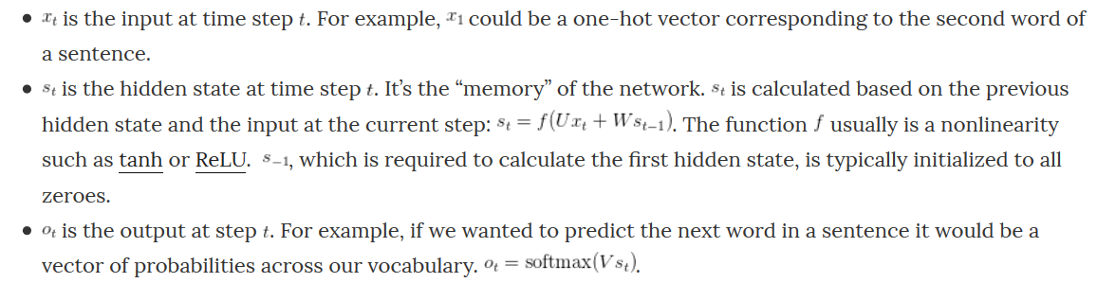

Slide 10
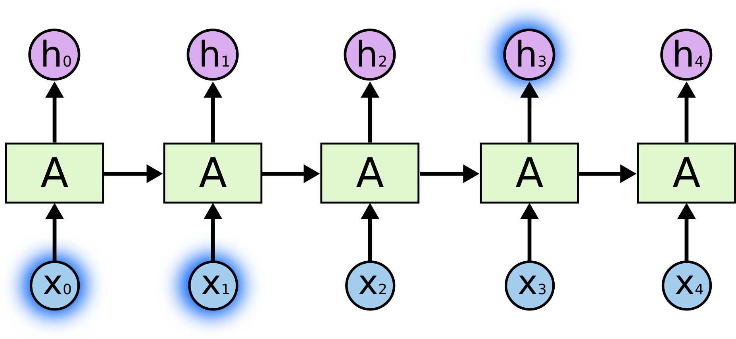
LSTM RNNs
Sometimes, we only need to look at recent information to perform the present task.
For example, consider a language model trying to predict the next word based on the previous ones.
If we are trying to predict the last word in “the clouds are in the sky,” we don’t need any further context – it’s pretty obvious the next word is going to be sky.
In such cases, where the gap between the relevant information and the place that it’s needed is small, RNNs can learn to use the past information.

Slide 11
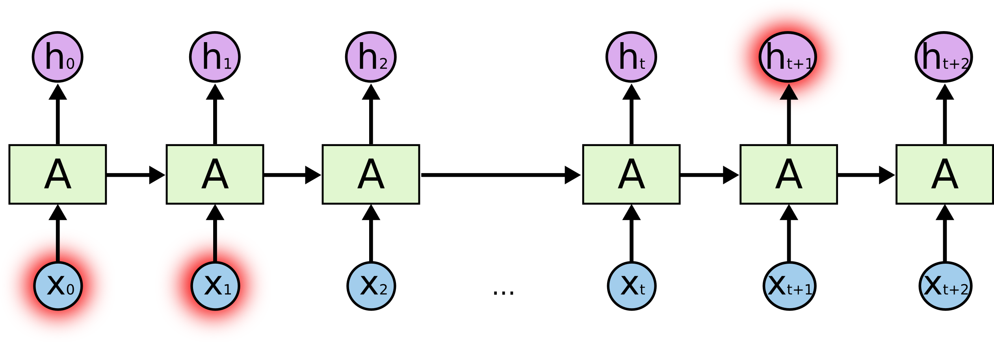
LSTM RNNs
But consider trying to predict the last word in the text “I grew up in France… I speak fluent French.”
Recent information suggests that the next word is probably the name of a language, but if we want to narrow down which language, we need the context of France, from further back.
It’s entirely possible for the gap between the relevant information and the point where it is needed to become very large.
Unfortunately, as that gap grows, RNNs become unable to learn to connect the information.

Slide 12
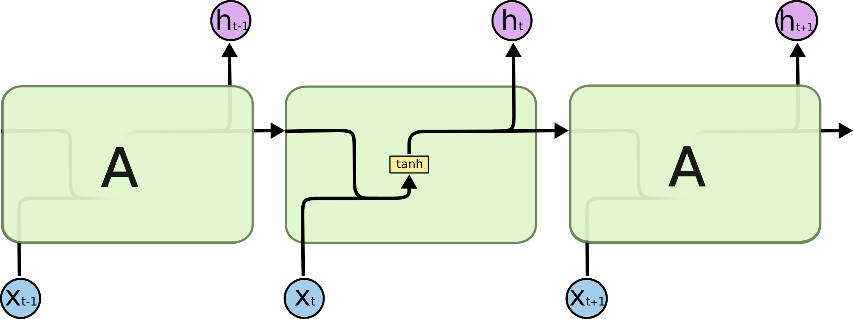
LSTM RNNs
Long Short Term Memory networks – usually just called “LSTMs” – are a special kind of RNN, capable of learning long-term dependencies.
LSTMs are explicitly designed to avoid the long-term dependency problem.
All recurrent neural networks have the form of a chain of repeating modules of neural network. In standard RNNs, this repeating module will have a very simple structure, such as a single tanh layer:

Slide 13

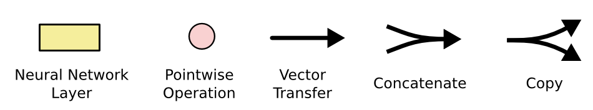
LSTM RNNs
LSTMs also have this chain like structure, but the repeating module has a different structure. Instead of having a single neural network layer, there are four, interacting in a very special way.

Slide 14
LSTM RNNs
LSTMs also have this chain like structure, but the repeating module has a different structure. Instead of having a single neural network layer, there are four, interacting in a very special way.

Slide 15
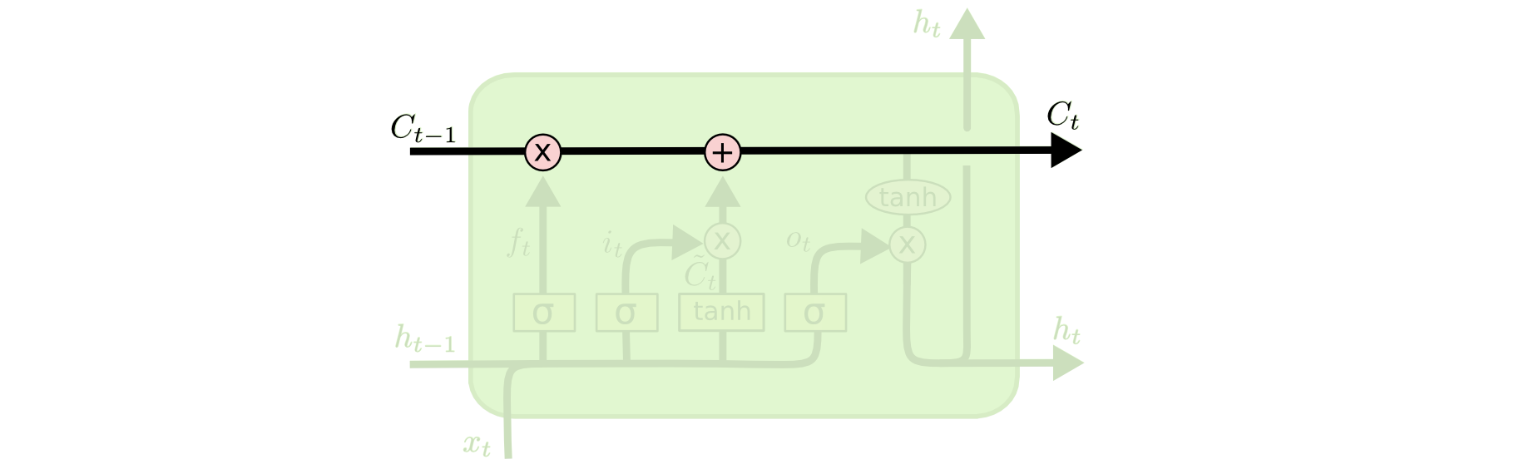
LSTM RNNs
The key to LSTMs is the cell state, the horizontal line running through the top of the diagram.
The cell state is kind of like a conveyor belt. It’s very easy for information to just flow along it unchanged.
The LSTM does have the ability to remove or add information to the cell state, carefully regulated by structures called gates.
c serves as the memory, while h acts a copy of it that can be passed to further process the inputs in the next time-step.

Slide 16
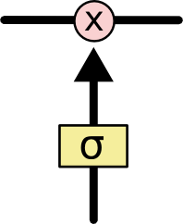
LSTM RNNs
Gates are a way to optionally let information through. They are composed out of a sigmoid neural net layer and a pointwise multiplication operation.
The sigmoid layer outputs numbers between zero and one, describing how much of each component should be let through. A value of zero means “let nothing through,” while a value of one means “let everything through!”
An LSTM has three gates.

Slide 17
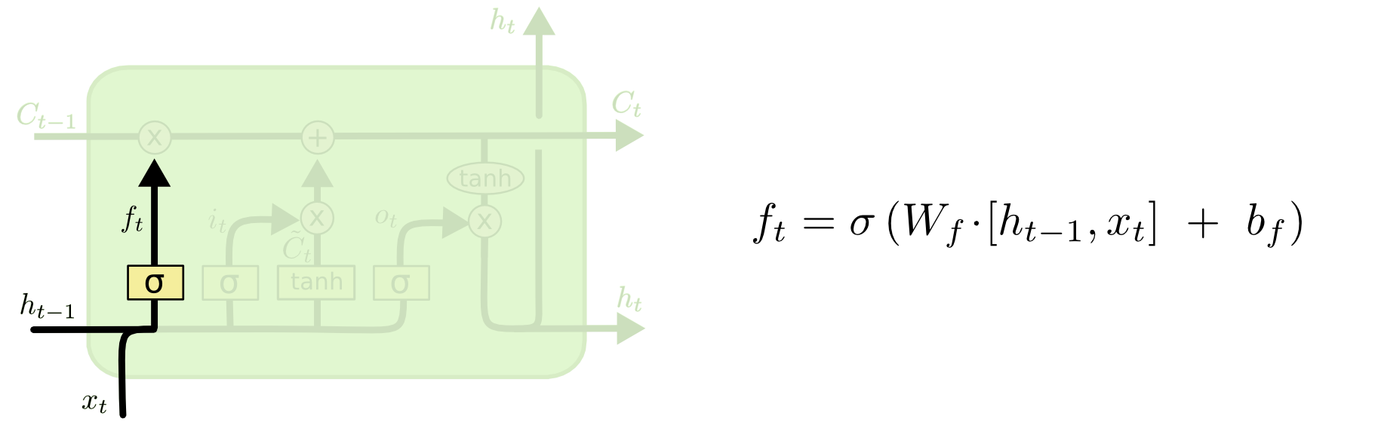
LSTM RNNs – Gate 1
The first step in our LSTM is to decide what information we’re going to throw away from the cell state. This decision is made by a sigmoid layer called the “forget gate layer.” It looks at h_{t-1} and x_{t} and outputs a number between 0 and 1 for each number in the cell state C_{t-1}
1 represents “completely keep this” while a 0 represents “completely get rid of this.”

Slide 18
LSTM RNNs – Gate 1 - forget
Let’s go back to our example of a language model trying to predict the next word based on all the previous ones:
The cell state might include the gender of the present subject, so that the correct pronouns can be used. When we see a new subject, we want to forget the gender of the old subject.

Slide 19
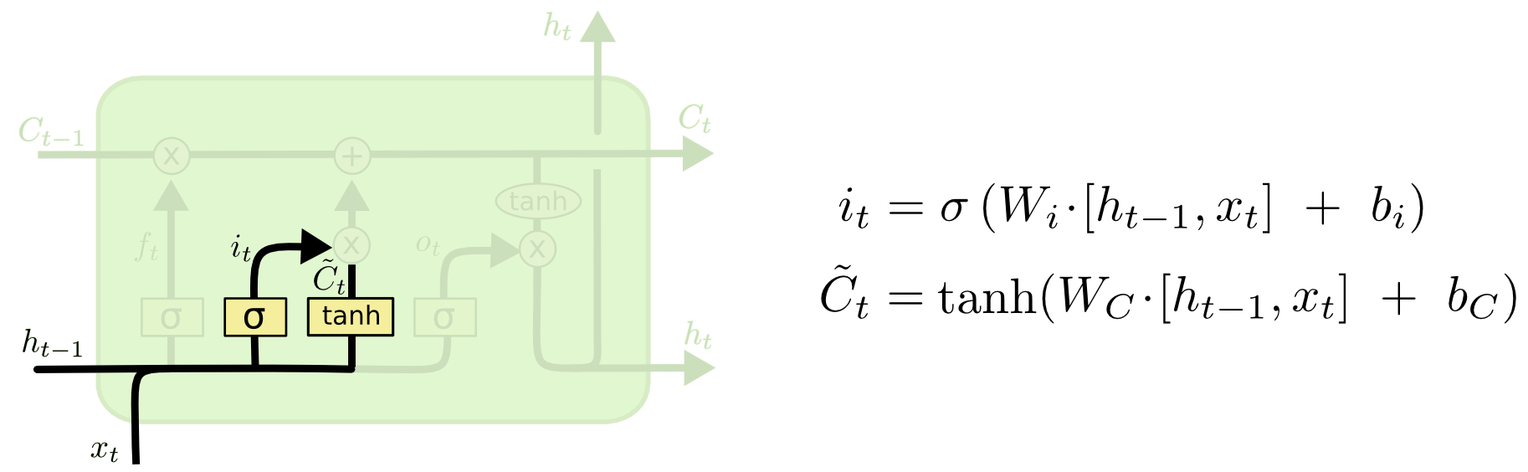
LSTM RNNs – Gate 2 - input
The next step is to decide what new information we’re going to store in the cell state. This has two parts. First, a sigmoid layer called the “input gate layer” decides which values we’ll update. Next, a tanh layer creates a vector of new candidate values, ~C_{t} , that could be added to the state. In the next step, we’ll combine these two to create an update to the state.
In the example of our language model, we’d want to add the gender of the new subject to the cell state, to replace the old one we’re forgetting.

Slide 20
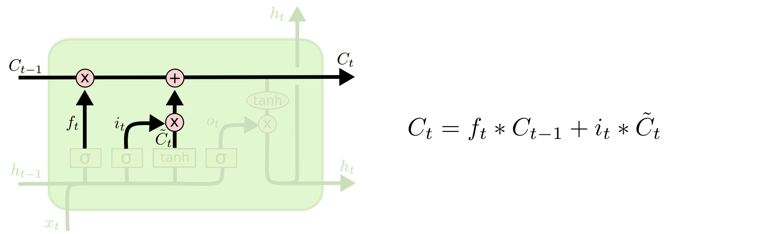
LSTM RNNs – Update
It’s now time to update the old cell state, C_{t-1} into the new cell state C_{t}
We multiply the old state by f_{t}, forgetting the things we decided to forget earlier. Then we add i_{t} * ~C_{t} . This is the new candidate values, scaled by how much we decided to update each state value.
In the case of the language model, this is where we’d actually drop the information about the old subject’s gender and add the new information, as we decided in the previous steps.

Slide 21
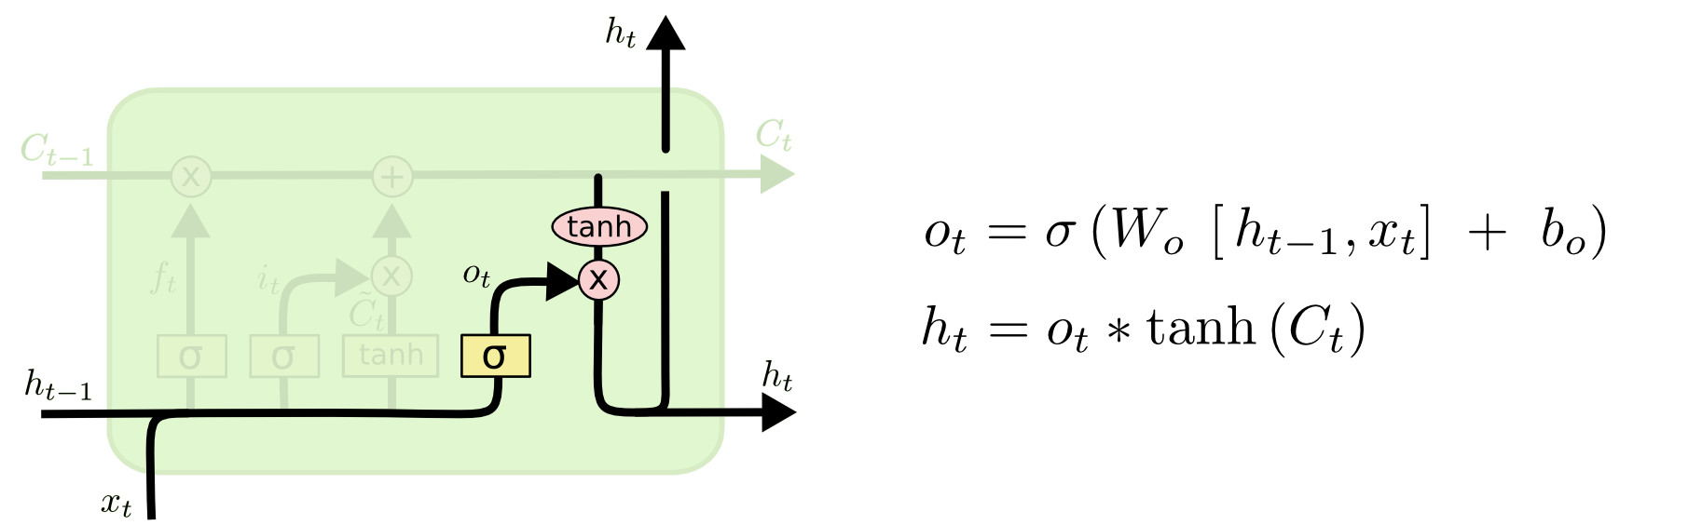
LSTM RNNs – Gate 3 - output
Finally, we need to decide what we’re going to output. First, we run a sigmoid layer which decides what parts of the cell state we’re going to output. Then, we put the cell state through tanh and multiply it by the output of the sigmoid gate, so that we only output the parts we decided to.
For the language model example, since it just saw a subject, it might want to output information relevant to a verb, in case that’s what is coming next.

Slide 22
LSTM RNNs
The previous diagrams can be summarized with this pseudocode block:
input_gate = tanh(dot(input_vector, W_input) + dot(prev_hidden, U_input) + b_input) forget_gate = tanh(dot(input_vector, W_forget) + dot(prev_hidden, U_forget) + b_forget) output_gate = tanh(dot(input_vector, W_output) + dot(prev_hidden, U_output) + b_output) candidate_state = tanh(dot(x, W_hidden) + dot(prev_hidden, U_hidden) + b_hidden)
memory_unit = prev_candidate_state * forget_gate + candidate_state * input_gate new_hidden_state = tanh(memory_unit) * output_gate

Slide 23
Language generation/modeling
Let’s start by giving the RNN a huge chunk of text and ask it to model the probability distribution of the next character in the sequence given a sequence of previous characters.
This will then allow us to generate new text one character at a time.

Slide 24
Language generation/modeling
As a working example, suppose we only had a vocabulary of four possible letters “helo”, and wanted to train an RNN on the training sequence “hello”.
This training sequence is in fact a source of 4 separate training examples:
1. The probability of “e” should be likely given the context of “h”
2. “l” should be likely in the context of “he”
3. “l” should also be likely given the context of “hel”
4. “o” should be likely given the context of “hell”.

Slide 25
Language generation/modeling
1. we will encode each character into a vector using 1-of-k encoding (i.e. all zero except for a single one at the index of the character in the vocabulary)
2. and feed them into the RNN one at a time with the step function
3. We will then observe a sequence of 4-dimensional output vectors (one dimension per character), which we interpret as the confidence the RNN currently assigns to each character coming next in the sequence.

Slide 26
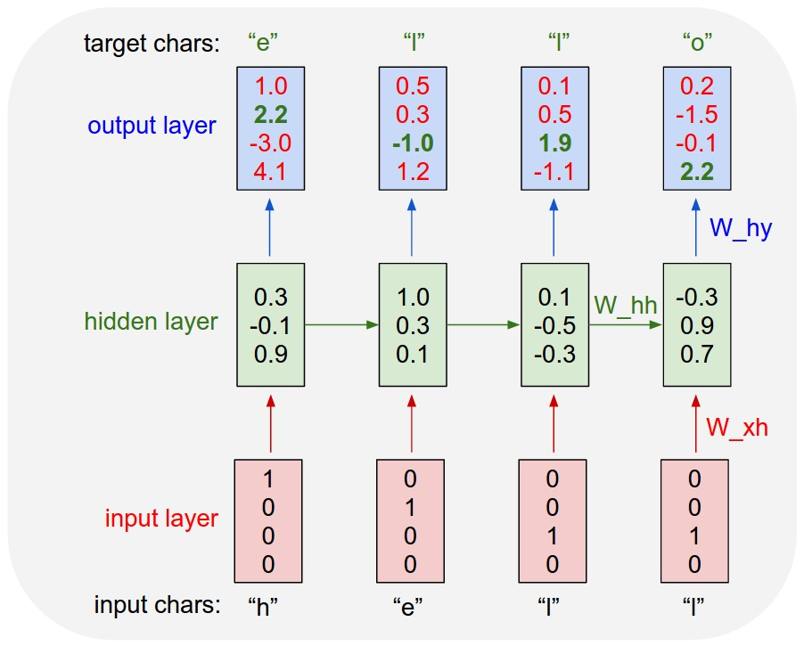
Language generation/modeling

Slide 27
Language generation/modeling
For example, we see that in the first time step when the RNN saw the character “h” it assigned confidence of 1.0 to the next letter being “h”, 2.2 to letter “e”, -3.0 to “l”, and 4.1 to “o”.
Since in our training data (the string “hello”) the next correct character is “e”, we would like to increase its confidence (green) and decrease the confidence of all other letters (red).
Similarly, we have a desired target character at every one of the 4 time steps that we’d like the network to assign a greater confidence to.

Slide 28
Language generation/modeling
Since the RNN consists entirely of differentiable operations we can run the backpropagation algorithm to figure out in what direction we should adjust every one of its weights to increase the scores of the correct targets (green bold numbers).
We can then perform a parameter update, which nudges every weight a tiny amount in this gradient direction.
If we were to feed the same inputs to the RNN after the parameter update we would find that the scores of the correct characters (e.g. “e” in the first time step) would be slightly higher (e.g. 2.3 instead of 2.2), and the scores of incorrect characters would be slightly lower. We then repeat this process over and over many times until the network converges.

Slide 29
Language generation/modeling
A more technical explanation is that we use the standard Softmax classifier (also commonly referred to as the cross-entropy loss) on every output vector simultaneously. The RNN is trained with mini-batch Stochastic Gradient Descent and I like to use RMSProp or Adam (per-parameter adaptive learning rate methods) to stablilize the updates.
Notice also that the first time the character “l” is input, the target is “l”, but the second time the target is “o”. The RNN therefore cannot rely on the input alone and must use its recurrent connection to keep track of the context to achieve this task.
At test time, we feed a character into the RNN and get a distribution over what characters are likely to come next. We sample from this distribution, and feed it right back in to get the next letter. Repeat this process and you’re sampling text!

