Slide 1
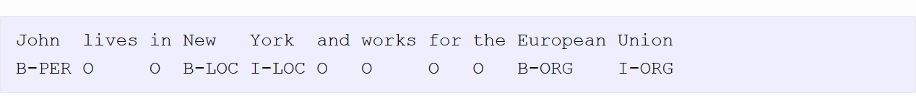
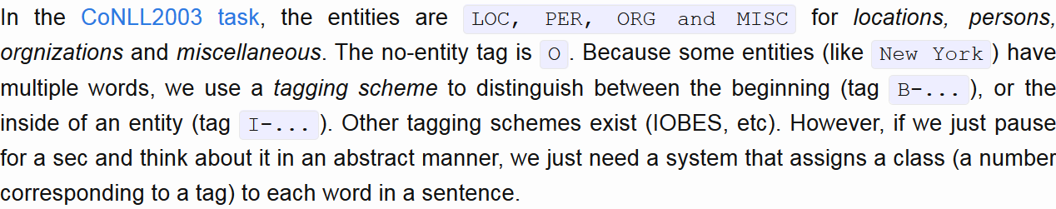
Named Entity Recognition

Slide 2
This problem is non-trivial because a lot of entities – such as names or organizations, have no real prior knowledge
Thus, we need to extract contextual information from the sentence

Slide 3
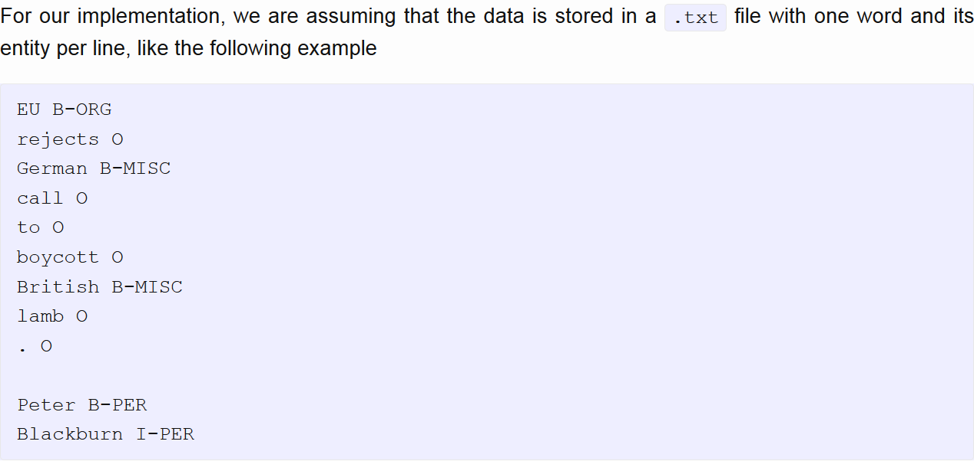

Slide 4
Model
Three parts:
Word representation (use pretrained word embeddings)
Contextual word representation – Bidirectional LSTM
Decoding – transferring our coded word representation to a classification of whether or not its an entity

Slide 5
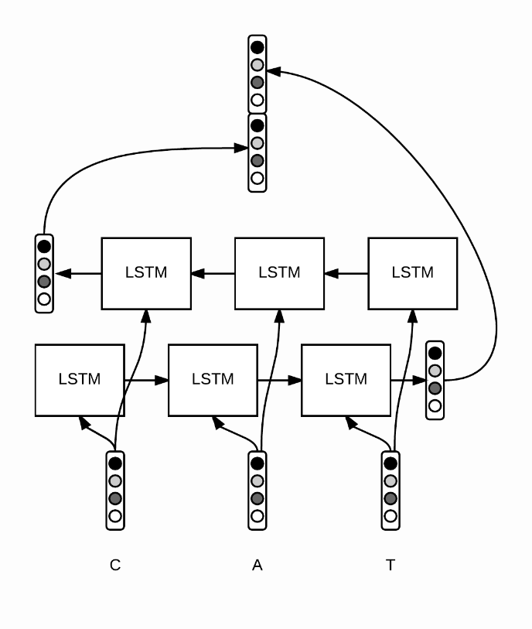
Bidirectional LSTM

