Slide 1
0XXX_HF_AB2
AB₂
Notes:
Put sample number on this page. Format is (Number formatted with 4 digits with leading zeros)_H(“F” for Flux, “S” for solid state, “M” for arc melt, “V” for vapor transport, etc)_(Formula). For Formula, don’t use decimals or parenthesis. The subtitle contains the properly formatted target formula.

Slide 2
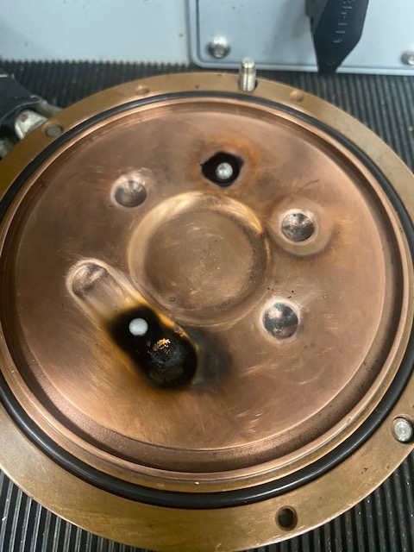
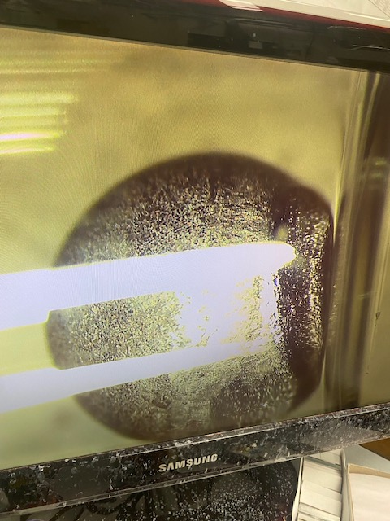
HfTa4Zr

