Slide 1
TRAVEL AGENCY MANAGEMENT SYSTEM
Travel Agent ChatBot
Instructor: Dov Kruger
Hunny Balani | hb426
Jhanavi Behl | jb2040

Slide 2
Overview
Develop a comprehensive database management system for efficient travel agency operations
Developed a ChatBot to handle all complex query operations
Integrated natural language conversion to SQL via AI, eliminating the need for users to be proficient in SQL
Notes:
comprehensive database management system for a travel agency to manage its operations such as customer information, booking details, itinerary management and transaction details.

Slide 3
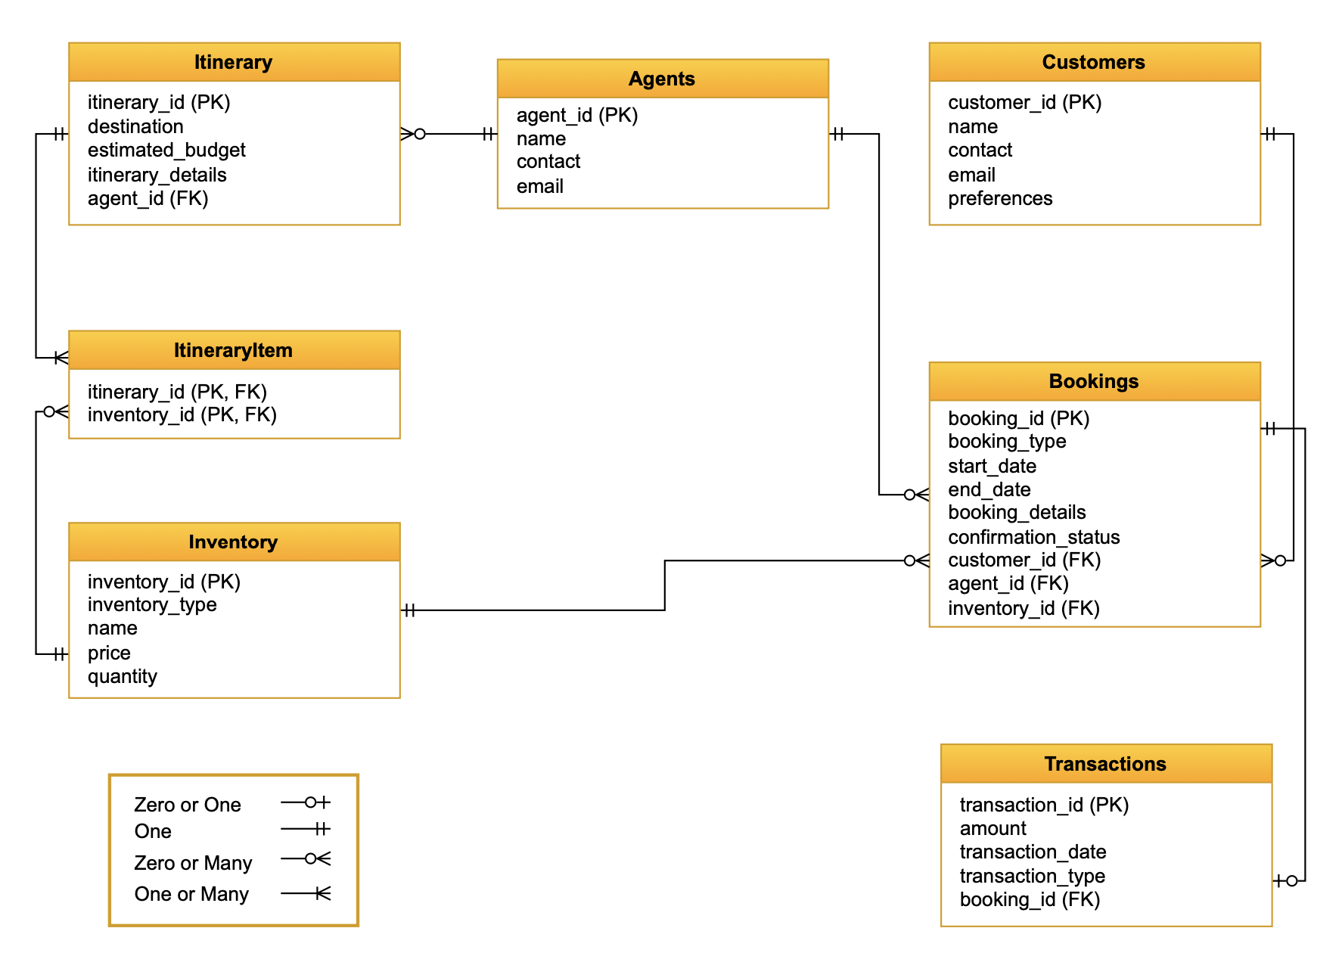
Entity Relationship Diagram

Slide 4
Database - Stored Procedures
Update Agent
Update Customer
Make Payment
Get Bookings
Create Booking
Update Single Booking
Cancel Single Booking
Cancel Bookings
Notes:
We incorporated the following stored procedures into our database to help AI perform complex operations by using this directly.

Slide 5
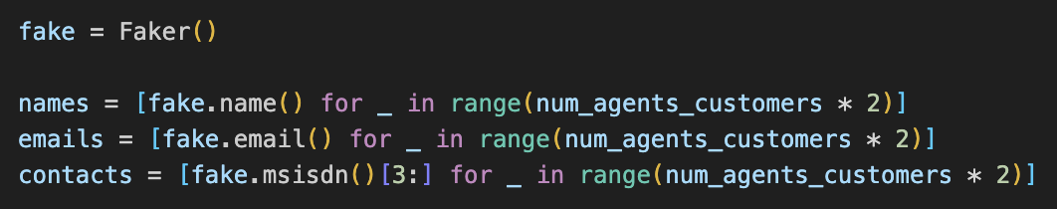
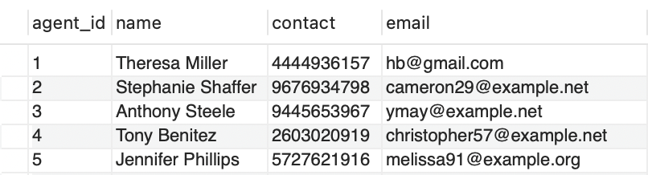
Database - Insertion
A python library called Faker that generates realistic fake data
Offers various data generation capabilities:
Name
Company Name
Contact Number
Random text

Slide 6
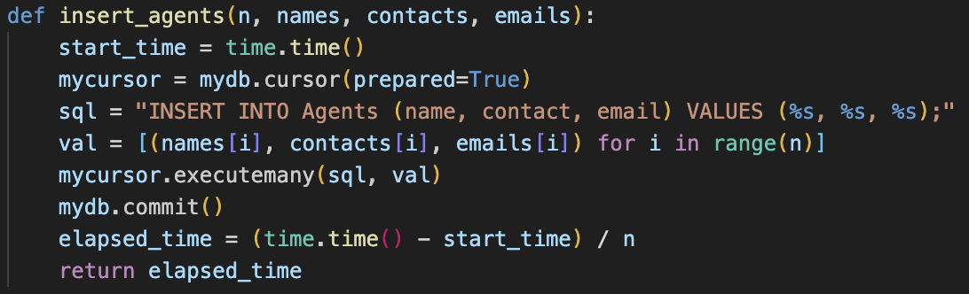
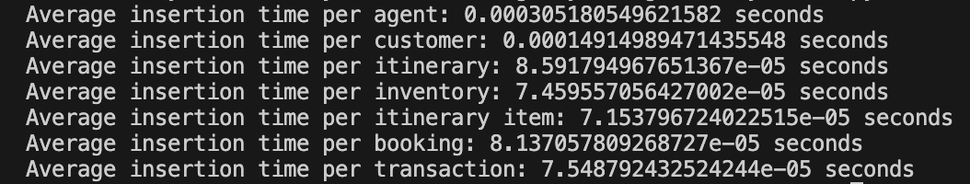
Database - Benchmarking
Utilized prepared statements for efficient data insertion into the database
Recorded and analyzed the average insertion time per transaction
Calculated the average insertion time for different parameters:
Agents
Customers
Itinerary
Inventory
Bookings

Slide 7
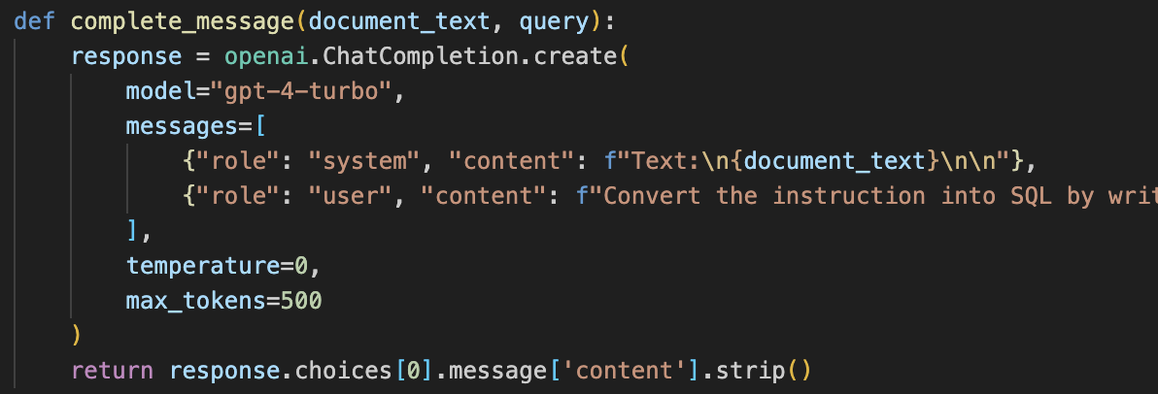
ChatCompletion API Integration
Utilize ChatCompletion API for generating SQL commands from English queries
System Role
Provides essential context for the AI
Content: Parses SQL files, i.e., database structure and available stored procedures
User Role:
Guides the AI's actions and outputs
Content: Contains English queries

Slide 8
Demo

Slide 9
Future Scope
ChatCompletion API is not always be accurate
Need for improvement and optimization in generating correct responses
With improved accuracy, we can transition towards a better chat-centric UI

Slide 10
Thank You!

Slide 11
References & Links
https://platform.openai.com/docs/models/gpt-4-turbo-and-gpt-4
https://platform.openai.com/docs/api-reference/chat/create
https://faker.readthedocs.io/en/master/
https://pypi.org/project/tabulate/
https://matplotlib.org/stable/users/explain/animations/animations.html
Figma Wireframe

