Slide 1
Agentic AI Hackathon: Building Intelligent Agents with IBM Granite and LangFlow
Project Title: AI-Driven Traffic Congestion Early Warning System

Slide 2



Name of the team: Technest
Details of Team members
TEAM MEMBER NAME | Recent Passport Photo | Email ID | Phone number [WhatsApp]
Jhanavi C |  | Jhanavic2005@gmail.com | 7676999663
Impana.p |  | impanap04@gmail.com | 9110208155
Chaithanya R |  | rchaithanya024.@gmail.com | 8050559285

Slide 3
Problem statement
Urban traffic congestion is becoming increasingly complex due to rapid urbanization, rising vehicle density, unpredictable weather conditions, road incidents, and infrastructure limitations. Traffic authorities currently lack intelligent systems that can predict congestion risks early and provide planning-level insights. Existing systems are reactive rather than proactive, leading to delayed responses, poor planning, and inefficient traffic management decisions.

Slide 4
Proposed solution
We propose an Agentic AI-based Traffic Congestion Early Warning System using Lang flow and IBM Granite Model. The system uses multiple AI agents to: Analyze real-time traffic data Detect congestion risk patterns Predict early warning signs Provide planning-level advisory insights. The system is assistive, not controlling infrastructure, and supports authorities in decision-making and planning.

Slide 5
Need of project
Increasing urban traffic complexity
Lack of early congestion prediction systems
Reactive traffic management approach
Need for intelligent planning support tools
Demand for AI-assisted smart city infrastructure
Support data-driven governance

Slide 6
End user of project
Traffic Management Authorities
Smart City Planners
Urban Transport Departments
City Administration Bodies
Infrastructure Planning Agencies
Public Safety Authorities

Slide 7
Technology Used
Platform:
Langflow
Langflow Components:
Agent
Chat Input
Chat Output
FAISS (Vector Store)Split Text
Embedding Model
AI Models:
IBM Granite Model (e.g., ibm-granite-3-2-8b)
IBM Watsonx.ai
Architecture:
Agentic AI Architecture
RAG (Retrieval Augmented Generation)

Slide 8
Novelty and Uniqueness
Multi-agent architecture for intelligent traffic planning
AI-driven early congestion risk prediction
RAG-based historical and policy knowledge integration
Assistive AI (non-controlling system)
Smart city–oriented design
Ethical AI using IBM Granite governance
Scalable for city-wide deployment

Slide 9
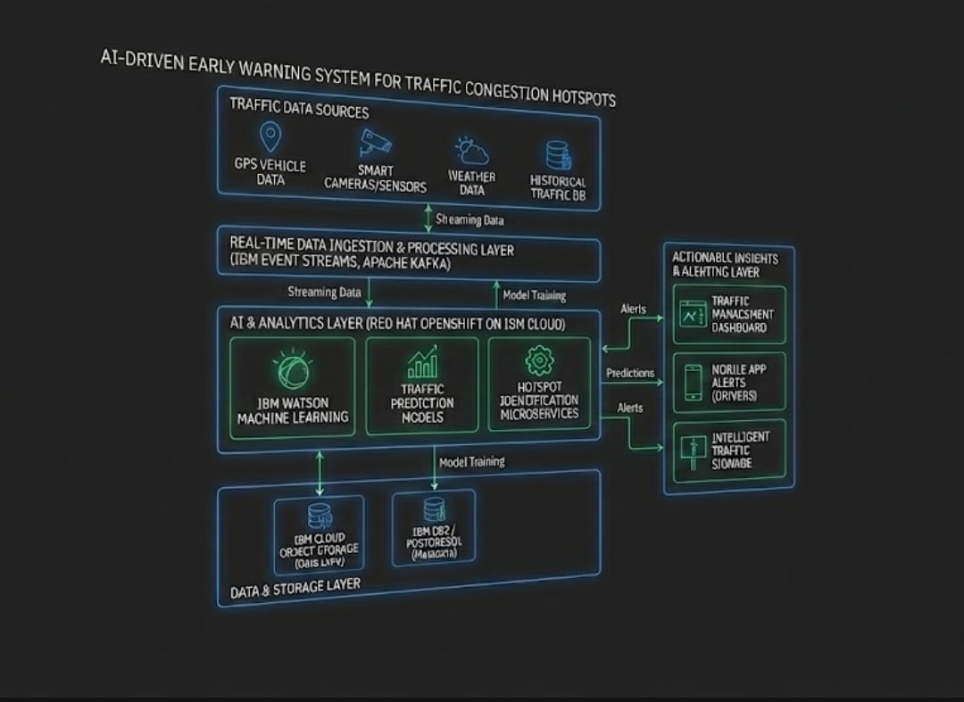
Technical flow diagram - Architecture blueprint

Slide 10
Langflow component Used
Chat Input
Chat Output
Agent Nodes
IBM Watsonx AI NodeI
BM Granite Model
FAISS Vector Store
Split Text Component
Embedding Model
RAG Pipeline

Slide 11
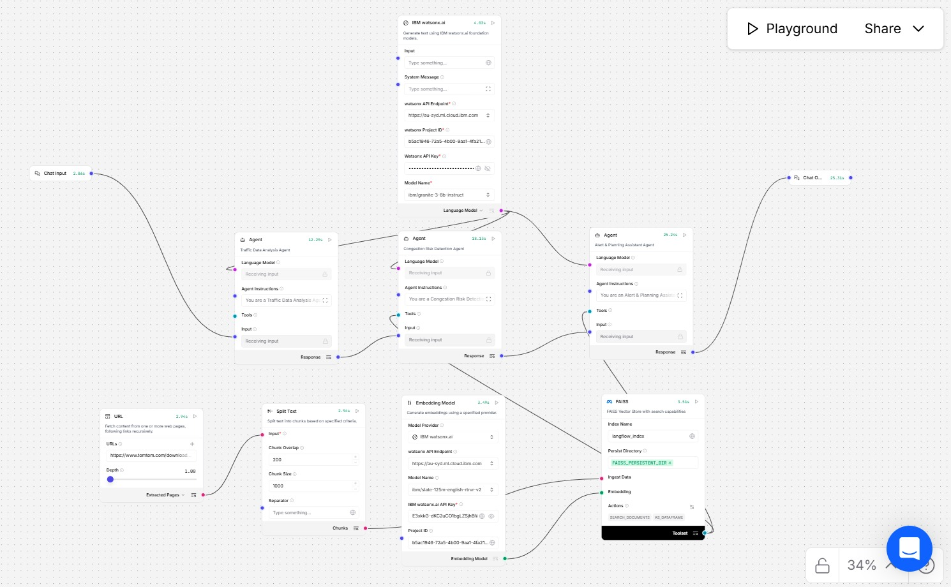
Input Screenshot 1

Slide 12
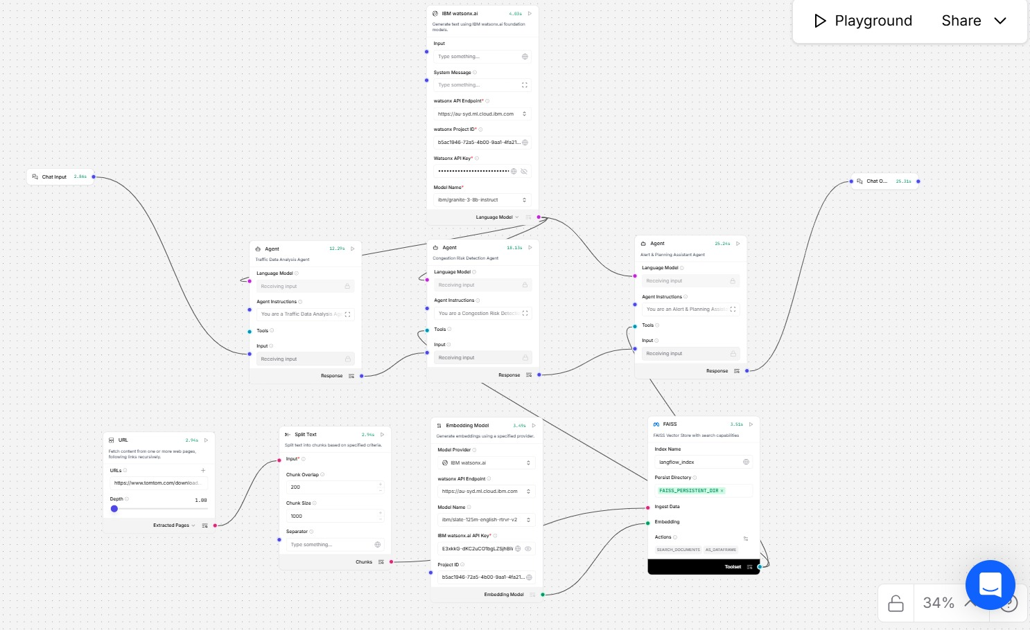
Input Screenshot 2

Slide 13
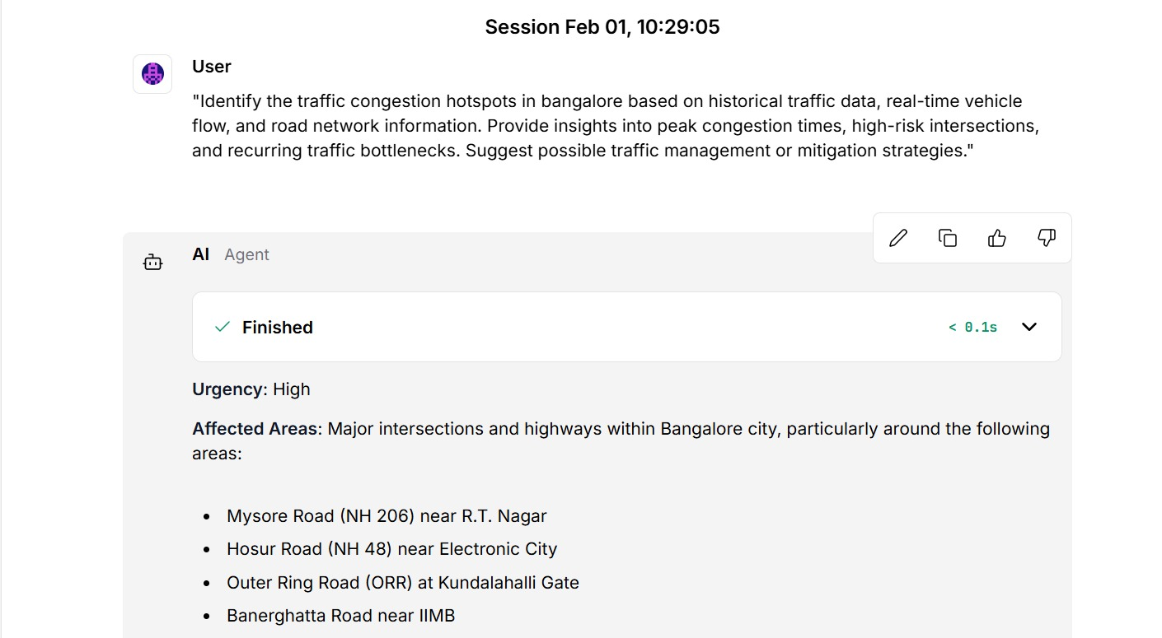
Output Screenshot 1

Slide 14
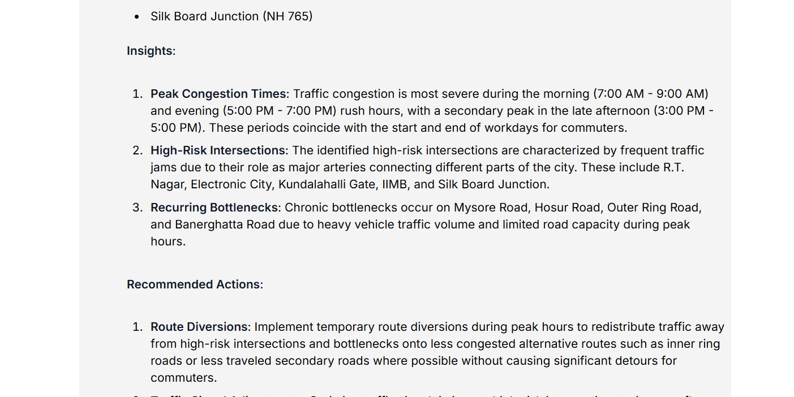
Output Screenshot 2

Slide 15
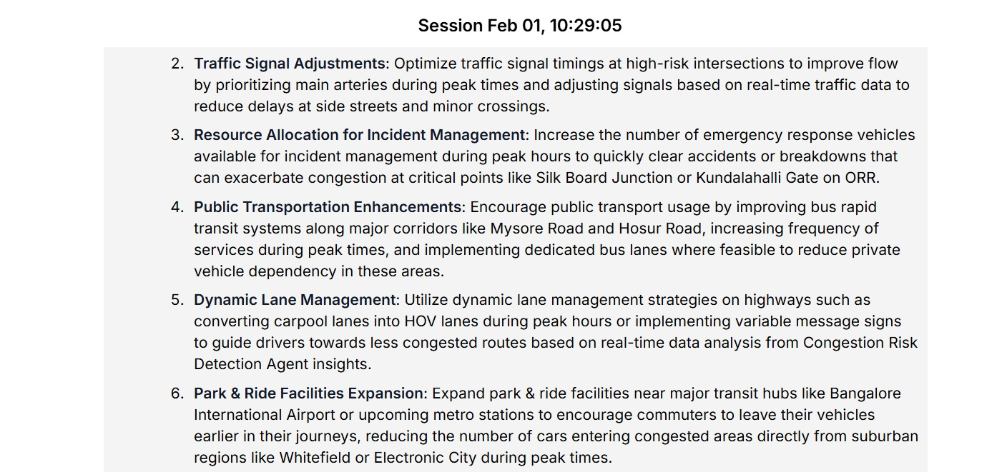
Output Screenshot 3

Slide 16
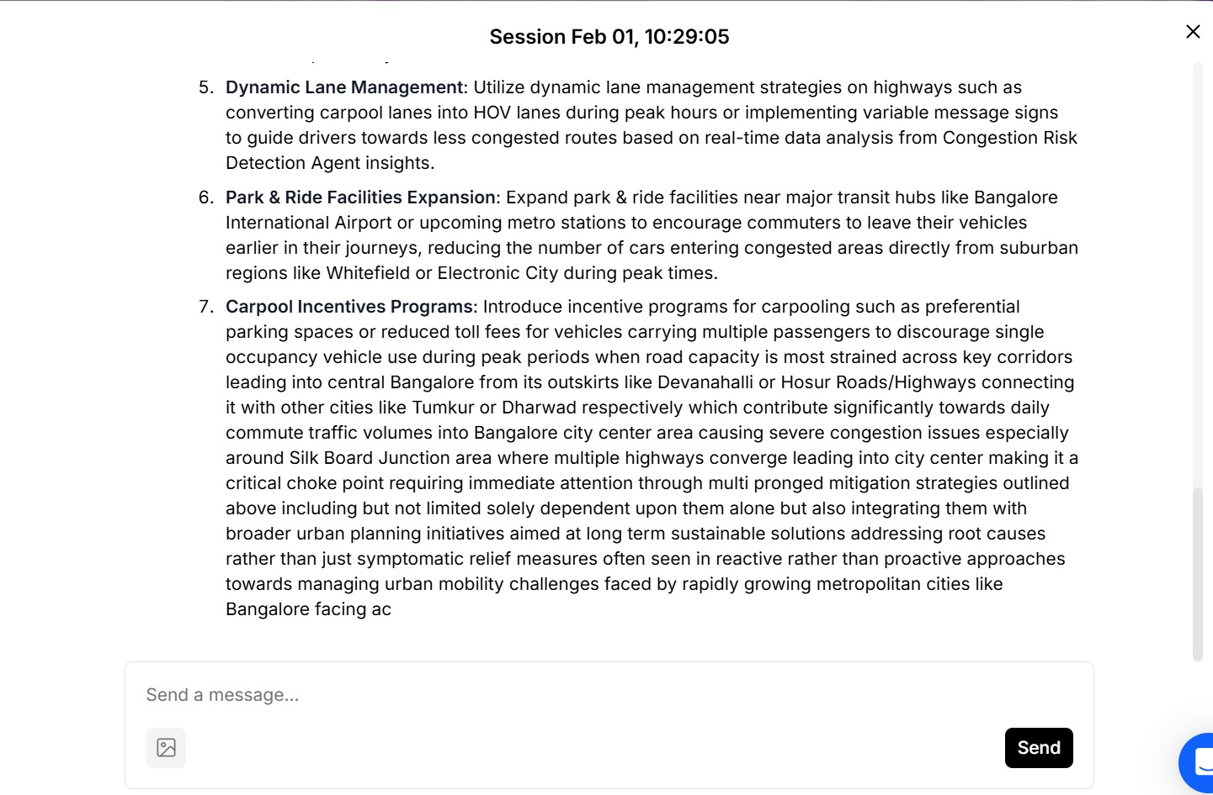
Output Screenshot 4

Slide 17
Future Scope
Real-time IoT sensor integration
CCTV traffic vision analysis
AI-based traffic signal automation
Digital twin city simulation
Public transport optimization
Emergency vehicle routing
Citizen traffic advisory apps
Autonomous traffic management systems
·
·
·

Slide 18
Git Hub Link
The working Github URL – https://github.com/jhanavic9999/Traffic-Congestion-Hotspots.git
Three files github repository :
1) Traffic Congestion Hotspots (Langflow model export ) file ,
2) hackthon_problemstatement.pdf file
3) projectpresntation.pptx file
·
·

Slide 19
References
Smart City Traffic Management Frameworks
Urban Mobility Planning Guidelines
IBM Watsonx Documentation
IBM Granite Model Documentation
Langflow Documentation
FAISS Vector Database DocumentationAI in Intelligent Transportation Systems Research Papers
·
·
·

Slide 20


