Slide 1


Slide 2
Cefepime Resistance Predictor: Unlocking E. coli Insights Jhanavi Dave Under mentorship of: Hayden Sansum

Slide 3
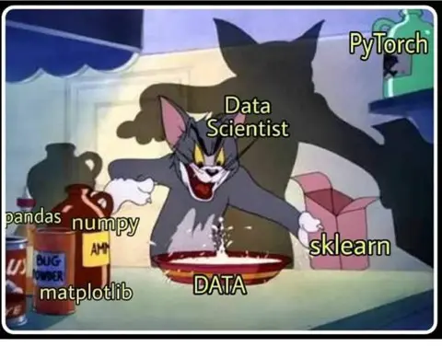

Picture / Favorite Meme
Notes:
How I felt during the final notebook creation and execution :P

Slide 4
Introduction
Gene Presence/Absence captures high-level genetic markers
Kmers provide fine-grained genomic details
Combining both can improve prediction accuracy
Ensures that the model is not overly reliant on one type of data
Makes the model more robust to noise or missing information

Slide 5
Aims & Approach
Aim: Compare models and features to predict resistance of Cefepime in E.coli bacteria
Approach: Comparison of models over same features
Features used: Gene Presence/Absence, Kmers.
Model used: Random Forest Classifier, Logistic Regression and Gradient Boosting Models.
Training: Initial Load & Split, then matrix building with PA & Kmers, then implementation and hypertuning of models.
Validation: Balanced accuracy, GridSearchCV and RandomSearchCV.

Slide 6
Summary
Random Forest Classifier was quick to train and complete execution to determine results.
Best model over feature: Random Forest Classifier over Kmers.
Accuracy score: 0.91250
The model didn’t just memorize, it actually learned meaningful patterns.
It is interpretable, stable, and robust enough to be trusted for further development or deployment.

Slide 7
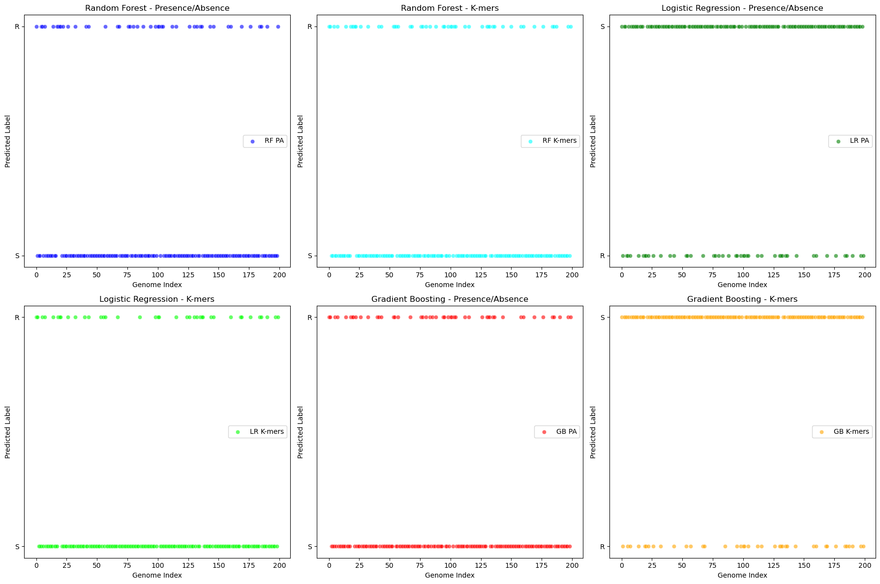
Results

Slide 8
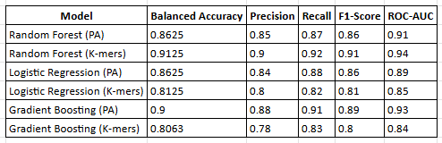
Model Performance

Slide 9
Learning Outcomes
What worked well:
Random Forest handled high-dimensional gene data effectively.
Combining gene presence/absence and kmers improved model robustness.
Challenges faced:
High dimensionality made tuning slow and complex.
A model update (switching to RandomizedSearchCV and tuning parameters) unexpectedly dropped accuracy to 0.0, likely due to an incorrect hyperparameter space or overfitting in cross-validation but failure in final evaluation.

Slide 10
Learning Outcomes
What I learned:
Importance of balanced accuracy for imbalanced datasets.
GridSearchCV helps but comes at a computational cost.
Data visualization really helps with debugging and communicating results.

Slide 11
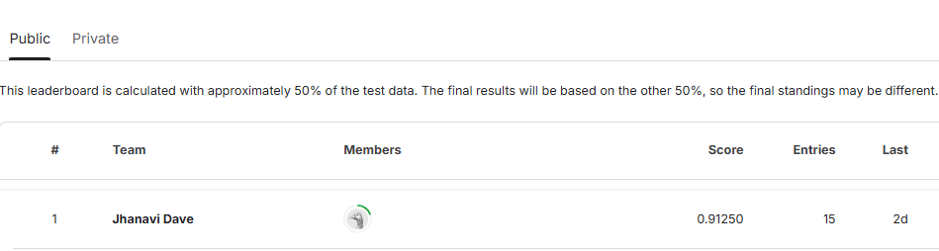
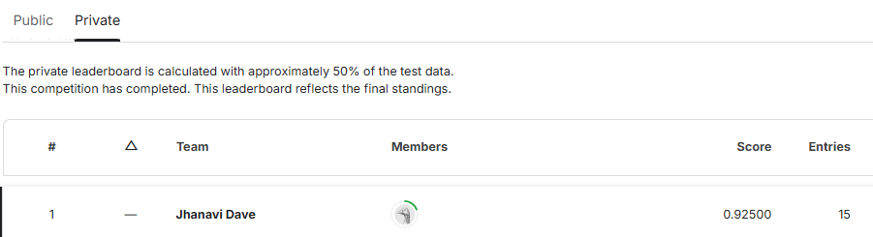
Kaggle Score Snapshot

Slide 12
Next Steps
Improvements to explore:
Debug the 0.0 accuracy issue from RandomizedSearchCV; double-check parameter ranges and data splitting.
Try deep learning approaches (CNNs for kmer matrices).
Test for other antibiotics v/s bacteria.
What I didn’t get to do:
More granular uncertainty analysis (confidence intervals, calibration).
Validate tuned model's generalizability — might explore nested CV or parameter space diagnostics.

Slide 13

Thanks!

