Slide 1

Cloud Computing COT 5930 Assignment 1
John Hancock
September 30th, 2014
Florida Atlantic University

Slide 2
Requirements
Create an Amazon Web Services (AWS) account.
Create a virtual machine (VM) using the AWS account.
Use the VM to access AWS S3 service and upload some data.
  Do a simple operation with the uploaded data.
  Produce graphics to showcase results of operations on data.
Study the feasibility of using cloud computing for an international video game development team.
When requirements a fulfilled we state this explicitly with a statement in bold.

Slide 3
Create AWS Account
This slide explains how we meet the requirement to create an AWS account.
We have an existing AWS account.
We Initially registered for a free usage tier account as described in [1] sometime around 18 months ago.
We love VM's because every time we create one it is like getting a new computer for free.
VM's are safer to experiment with.
They don't clutter our working areas.
We have no objections to the cost of running the VM's for this project; it only costs a few dollars a month to leave the instance running.

Slide 4
Create a VM using AWS
These slides explains how we meet the requirement to create a virtual machine on our AWS accounts.
Our AWS account has two medium instances
  Instance ID i-e223c8c3, running Amazon Linux AMI
  Instance ID i-a4de0184, running Ubuntu Linux
We follow the documentaion in [2] to create the instances.
We use the AMI instance, i-e223c8c3 for this assignemnt.

Slide 5
VM Details
VM is hosted in us-east-1b availability Zone [3].
/proc/cpuinfo says the VM cpu is: Intel(R) Xeon(R) CPU E5-2650 0 @ 2.00GHz
The free command reports the VM has about 4 GB of RAM.
The df command reports that the VM has about 8 GB of disk space – total! We are already using 28% of the space.
/proc/version shows the operating system is: Linux version 3.10.48-55.140.amzn1.x86_64
We can use the yum command to install a plethora of software – a least the part of the plethora that will fit in 8 GB.

Slide 6
VM Management
AWS VM's are managed via a management console.
Here we can see the AMI medium instance is running.
The management console is telling us that we are using paravirtualization (see next slide).
Course materials [4] state that paravirtualization is better for management, but more difficult to maintain because the host operating system must be modified to support paravirtualization.

Slide 7
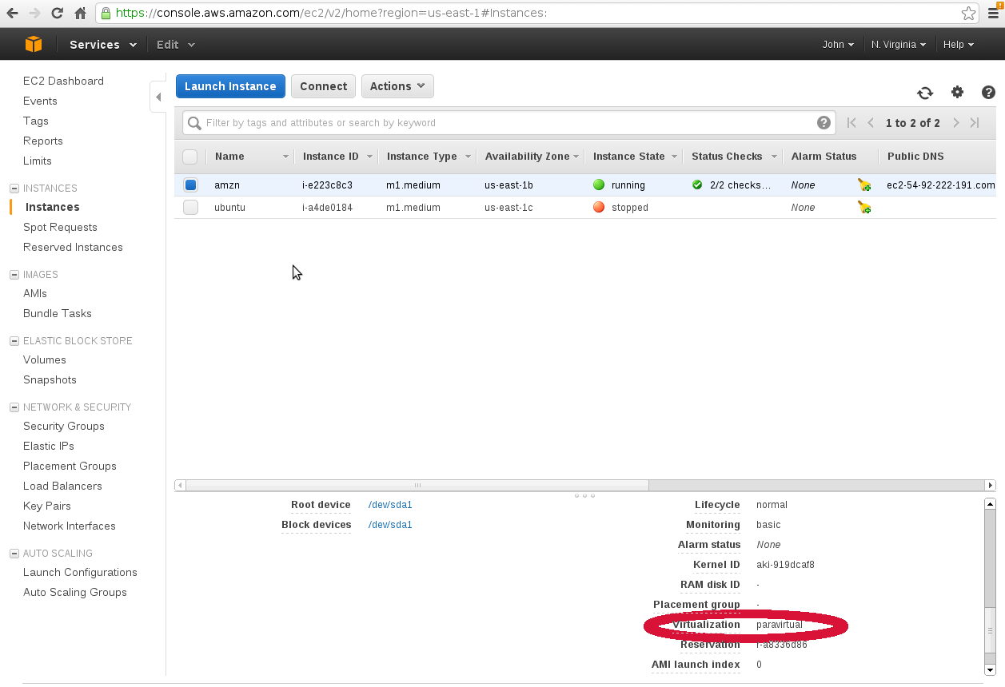
VM Management

Slide 8
VM Access
We use an SSH client to access the VM (image on next slide).
One must follow steps in the Amazon Documentation [6] for authorizing inbound traffic for SSH access.
Practically, using the AWS VM via SSH is exactly like using a convential personal computer with Linux installed on it.
  It is easy for administrators with pre-cloud skill sets to adapt to managing VM's hosted in AWS.
For AMI instances, one can install other network services (e.g. web, database), using the Yum utility
However, it is likely one will also need add traffic authorizations for the ports that the services use, as described in [6].

Slide 9
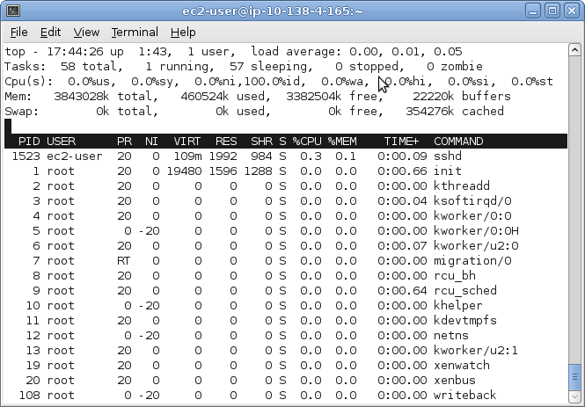
VM Access
Here is an image of an SSH session where we are connected to our
AWS VM and running the top command.

Slide 10
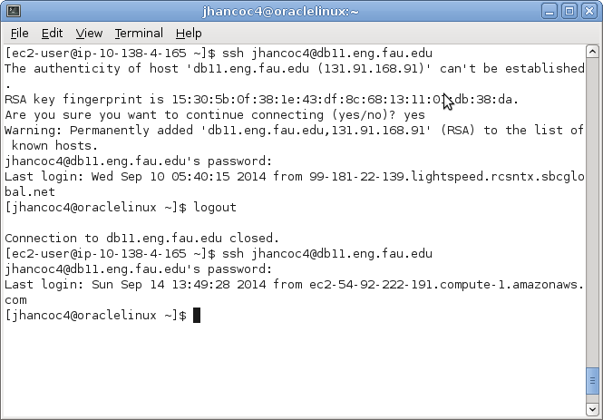
VM Access
Here is a screenshot where we use the AWS VM to connect to our
db11 account at FAU. The second log in shows that the
previous connection is from AWS.

Slide 11
AWS Simple Storage Service
Assignment 1 requires us to use the VM to access AWS simple storage service (S3), and upload some data.
We found some hints in some heroku.com documentation [6].
The first step is to create a bucket.
We create a bucked called, “buckminster2014.”

Slide 12
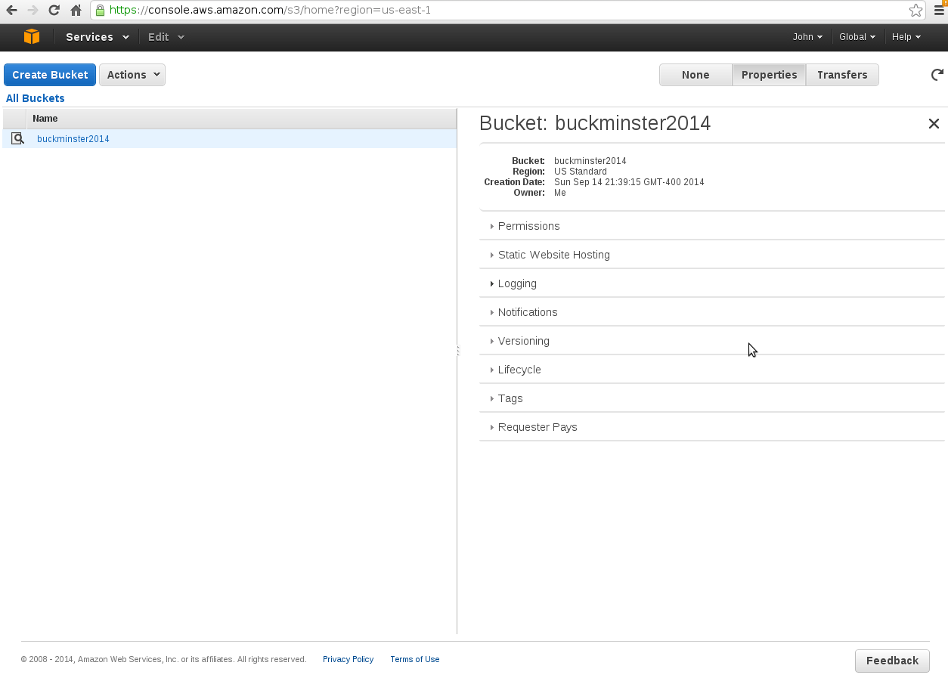
S3 Console
We found creating a bucket is fairly intuitive; choose S3 under services
and then click the button that says, create bucket. The image here is
the screen one sees after creating the bucket.

Slide 13
Upload Data to S3
AWS documentation [7] explains how to use the aws command line interface to upload data to an S3 bucket.
However, before that, one must configure the aws client with some credentials in order to use the aws utility to connect to S3.
Remember the .csv file you downloaded from AWS when you set up your account with your credentials, maybe called, credentials.csv? Well, I didn't, but luckily I saw it sitting there in this directory I created when I set everything up, so I used the keys in that file and everything worked.

Slide 14
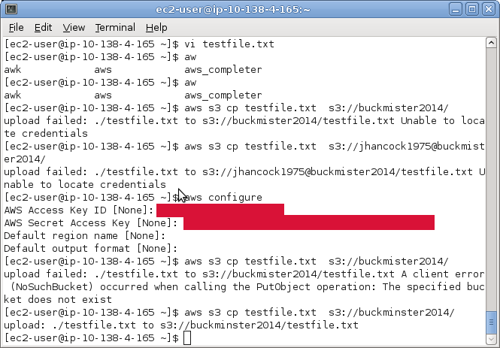
Configure & Use aws CLI
This image shows the error one receives when one has not configured the aws
command line interface (CLI) to use access keys, how to configure the access
keys (aws configure), and the syntax for uploading a file (aws s3 cp …).
My particular key values are masked in red.

Slide 15
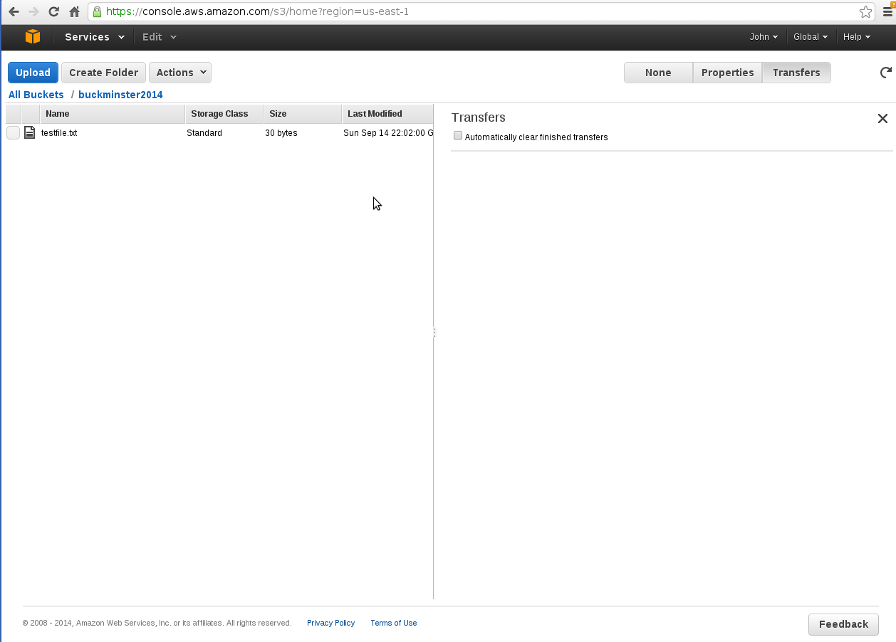
Verify File In S3
After using the aws utility to upload a file, we can see the file in the s3 console.

Slide 16
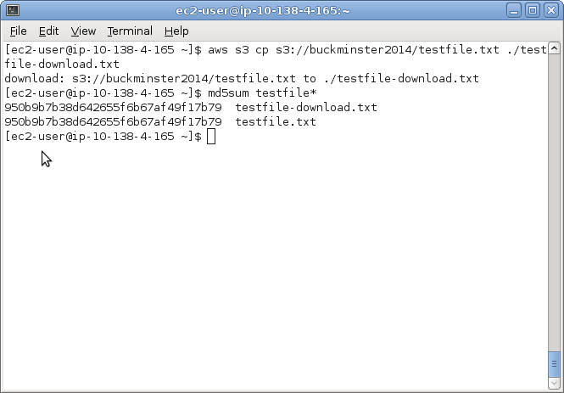
Retrieve Data Using aws Command
This fulfills the assignment 1 requirement to do a simple operation with the data we uploaded to S3 and display the results.
We can also download data from the S3 bucket using the aws command.
The image below shows shell commands to download the test file we stored earlier. We use the md5sum command as a way to check that file contents are unchanged:
The command is essentially the same (aws s3 cp …)
We only reverse source and destination operands.

Slide 17
Case Study: Game Development in the Cloud
This assignment requires a discussion on the feasibility of using cloud computing for an international video game development team.
Whether or not cloud computing is practical to apply in this scenario depends on project details.
We answer this question fully in a separate PDF file submitted along with this presentation.

Slide 18
Game Development in the Cloud
The first idea that comes to mind is fielding every developer virtual machines to game development. We believe this is not cost effective for resource intensive game development. Powerful AWS instances get expensive. For example, Amazon bills $0.21 per hour for a c.3 large instance. Which comes out to $153.72 per month. Or $1,844.64 per year. Tiger Direct offers a machines with similar resources for around $800.00, so it would be cheaper to ship developers machines to work on.

Slide 19
References
[1] Amazon.com, Inc. 2014, September 14. How Do I Get Started with the AWS Free Usage Tier? [Online]. Available: http://docs.aws.amazon.com/gettingstarted/latest/awsgsg-intro/gsg-aws-free-tier.html
[2]Amazon.com, Inc. 2014, September 14. Getting Started with Amazon EC2 Linux Instances. [Online] Available: http://docs.aws.amazon.com/AWSEC2/latest/UserGuide/EC2_GetStarted.html
[3]Amazon.com, Inc. 2014 September 14. Regions and Availability Zones. [Online] Available: http://docs.aws.amazon.com/AWSEC2/latest/UserGuide/using-regions-availability-zones.html
[4] E. Fernandez, “Cloud Computing 2014 IAAS,” September, 2014. Slides 53-54. Florida Atlantic University Blackboard Web Site.
[5] Amazon.com, Inc. 2014 September 14. Authorizing Inbound Traffic for Your Instances. [Online] Available: http://docs.aws.amazon.com/AWSEC2/latest/UserGuide/authorizing-access-to-an-instance.html
[6] Heroku Inc. 2014 September 14. Using AWS S3 to Store Static Assets and File Uploads. [Online] Available: https://devcenter.heroku.com/articles/s3
[7] Amazon.com, Inc. 2014 September 14. Amazon Simple Storage Service (Amazon S3). [Online] Available: http://docs.aws.amazon.com/AWSEC2/latest/UserGuide/AmazonS3.html
[8] Amazon.com, Inc. 2014 September 14, Configuring the AWS Command Line Interface. [Online] Available: http://docs.aws.amazon.com/cli/latest/userguide/cli-chap-getting-started.html
[9] Amazon.com, Inc. 2014 September 20, Amazon EC2 Pricing. [Online] Available: http://aws.amazon.com/ec2/pricing/

