Slide 1
COT5930 Final Project
John Hancock, December 7th 2014

Slide 2
Question 1
Question 1 requires us to investigate feasibility and practicality of a private cloud for a group of water treatment plants.
In the following slides we develop use cases for a system of water treatment plants. We consider using a private cloud for monitoring, and controlling water treatment plants, as well as responding to emergencies and interacting with customers.
We assess the feasibility and practicality of handling these use cases with private cloud infrastructure.
We rate the feasibility and practicality of each implementation and draw conclusions based our ratings.

Slide 3
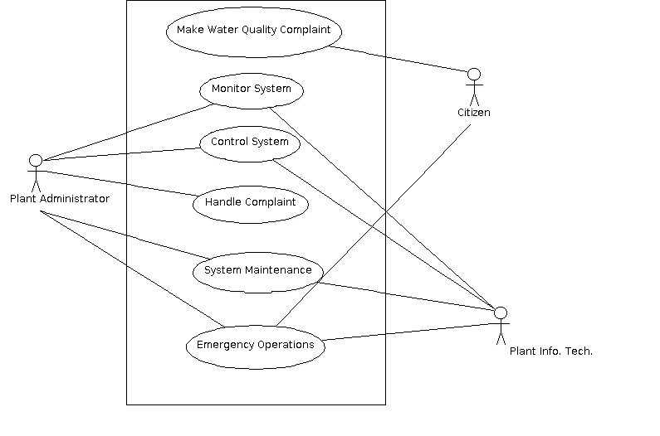
Private Cloud For Water Treatment
Figure 1: Water Treatment Information technology System Use Case Diagram
A private cloud to operate water treatment plants is feasible and practical if it supports these use cases.

Slide 4
Private Cloud Use Case Evaluation
Use Case | Feasibility* | Practicality*
Make Water Quality Complaint / Customer Relations | Cloud infrastructure is compatible with newer forms of communication: E-Mail & social media; Integrating telephony with private cloud is possible [1,2] | It is practical to handle on-line customer relations in a private cloud, telephony is not as practical. Cisco offers VM’s for call management (vendor lock-in).
Monitor System | Use adaptor pattern to standardize information from plant sensor networks. | Estimate high cost for expertise in transforming individual plant monitoring systems to unified system.
Control System: Filter/purify water fall in this category | Use adaptor pattern to standardize control of actuators for system function. | Estimate high cost, long implementation time, regulatory complications for unifying plant control systems
*Legend: green feasible/practical | *Legend: yellow: somewhat feasible/practical | *Legend: red: not feasible/practical

Slide 5
Private Cloud Use Case Evaluation
Use Case | Feasibility* | Practicality*
Handle Complaint: Actions resulting from customer relations | Private cloud infrastructure easily integrated with e-mail/SMS, etc. to alert operations after customer relations vets complaint | Practical; common cloud use/case: Install ticket system on VM instance in private cloud.
System Maintenance | Refers to private cloud maintenance as well as plant maintenance. We can run project management (PM) software on cloud instance for both. | Practical; maintenance of private cloud infrastructure is simplified - VM hosts can be standardized. PM software in in VM takes advantage of cloud.
Emergency Operations | Highly feasible; private clouds are a proven technology. | Centralized control of filtering and purification operations becomes a common point of failure for plants.
*Legend: green feasible/practical | *Legend: yellow: somewhat feasible/practical | *Legend: red: not feasible/practical

Slide 6
Question 1: Conclusions
Overall the project is feasible but not practical, we would recommend private cloud for implementing the use cases that are yellow or green in both feasibility and practicality
However we see no reason not to use a lower cost public cloud infrastructure for the remaining use cases, except for telephony.

Slide 7
Question 1: Conclusions
Feasibility
We view feasibility as a discrete property.
A use case is feasible or it is not.
The degree of difficulty and cost of implementation is inversely proportional to the practicality.
We found all use cases feasible (green).
Not surprising; we can install and use most software running in virtual machine instances.
Some use cases require standardizing features of existing plants, in our experience standardizing existing, non-homogenous systems is highly challenging.
Overall the project is feasible.

Slide 8
Question 1: Conclusions
Practicality
Overall, the project is not practical.
We have two use cases that are practical (green), two that are somewhat practical (yellow), and one that is not practical (red).
Telephonic customer relations practical but we might incur vendor lock-in; we were only able to find a Cisco VM for call management
Integrating water treatment command and control from various plants could incur a high cost in terms of money and time due to the level of expertise necessary to implement a unified system. We also suspect regulatory hurdles.

Slide 9
Question 2: Cloud Broker Requirements
Question 2 specifies that we must define requirements for a cloud broker, including security and reliability requirements.
We combine the broker pattern in [4], the reference architecture for cloud computing in [3], the security reference architecture in [5], and the acknowledgement pattern in [6] to create a UML diagram for a cloud broker that includes security and reliability functions.
We define requirements for system components in the next slides.

Slide 10
Cloud Broker Requirements
Broker Client Side Interface:
Authenticates users via delegation to the Authenticator
Client Side Proxy:
Intercepts all requests clients make to the broker
Delegates authorization check on request to the Reference Monitor
Broker:
maintains list of available services
delegates translation of requests and responses to Bridge
Server Side Proxy:
delegates authorization to forward translated request to reference monitor
forwards translated requests to Cloud Service Providers
forwards provider responses to Broker for translation

Slide 11
Cloud Broker Requirements
Reliability Components
Monitoring System
Sender
polls Receivers with monitoring request
reports poll status
receives poll result, which can be, “responded”, or “timed out” from Timer
Timer
starts timer with message from Sender that Sender sends simultaneously with receiver poll
receives response from Acknowledger, tells sender we have response to poll, or tells sender poll timed out

Slide 12
Cloud Broker Requirements
Reliability Components
Monitored System
For this design, monitored components extend both Acknowledger and Receiver Classes
Acknowledger
receives notification of poll from receiver
sends acknowledgement of poll to timer
Receiver
Receives monitoring poll from sender
alerts Acknowledger to send acknowledgement

Slide 13
Cloud Broker Requirements
Security Components
Reference Monitor
associated classes query the Reference Monitor to decide whether or not a request or response should be forwarded to the intended receiver
delegates authorization checks to Authorizer
delegates logging of authorization checks to security logger
Authenticator
delegates logging of authentication requests to security logger
handles user authentication for Client Side User Interface
Security Logger
records activity of Reference Monitor, Authenticator
Please See the UML Diagram for system on the next slide.

Slide 14
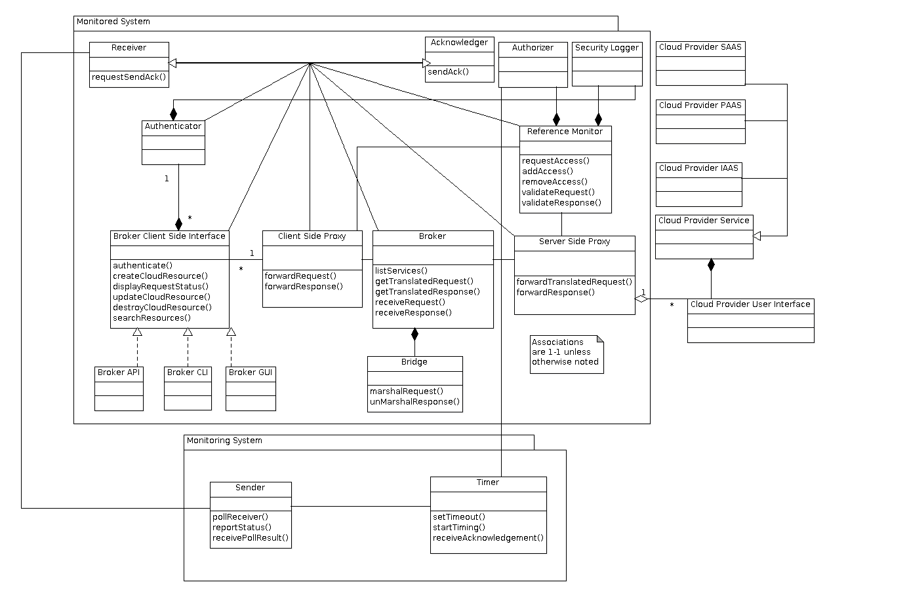

Slide 15
Question 3: SLA
The Chapter 3 presentation [3] illustrates how we can use the UML diagram in Ludwig et al.[9]
to be more precise about writing SLA’s.
We use the UML diagram in [9] to write our SLA.
The Chapter 3 presentation also mentions that NIST is a source for service level agreement documentation. We use the service agreement outline, appendix C of the NIST Special Publication 800-35, “Guide to Information Technology Security Services,” [10] to write the SLA below.
SLA begins on next slide

Slide 16
Question 3: SLA
1. Introduction
1.1.Purpose
The purpose of this document is to define the service level agreement for TravelCorp's use of Saas.com's SaasTravel software.
1.2. Participants
The participants in this agreement are TravelCorp, Saas.com, and Picayune Metrics (Auditors) - Supporting Party
TravelCorp (Travel Agency, renting software) - Signatory Party
Saas.com (provider of Software as a Service services) - Signatory Party
1.3. General Service Description
Saas.com provides SaasTravel travel agency software as a service.

Slide 17
Question 3: SLA
2. Service Environment
The environment where Saas.com will perform the service is at the data center facility Saas.com owns. The service will be available on line at https://TravelCorp.com/TravelSaas/ accessible in current versions of Internet Explorer and FireFox web browsers.
2.1. Entities and Locations
The entities entering into this service level agreement are: Saas.com: service provider, TravelCorp: service consumer, Picayune Metrics: service auditor
2.2. Policies, Procedures and Standards
2.2.1 Policies
2.2.1.1 Security
Saas.com will ensure the confidentiality, integrity, and availability of the TravelSaas software it rents to TravelCorp.
2.3.1 Procedures
2.3.1.1 Authentication
Saas.com will provide a procedure for authenticating the identities of SaasTravel software users.

Slide 18
Question 3: SLA
2.4.3 Standards
Saas.com guarantees that SaasTravel user passwords are stored as SHA-512 hashes.
Saas.com guarantees that it will allow users to connecto to TravelCorp's instance of SaasTravel software using SSL 3.0 as
defined in https://tools.ietf.org/html/rfc6101.
2.5. Agreements and Licenses
Sass.com provides a license of SaasTravel to TravelCorp for up to 5,000 unique users. Picayune Metrics will arbitrate disputes over between TravelCorp and Saas.com as to the exact number of unique users.
Saas.com is the sole owner of the copyright to SaasTravel.
TravelCorp or Picayune Metrics may not use any reverse engineering techniques to discover the implementation details of SaasTravel.

Slide 19
Question 3: SLA
3. Roles and Responsibilities
3.1. Service Provider Responsibilities
3.1.1. Service Tasks
Saas.com will make the SaasTravel application available to authorized users as designated by TravelCorp on a continuing basis
Saas.com will provide a mechanism for TravelCorp to designate users as authorized, and a mechanism to authenticate users per the authentication procedure described above.
Saas.com is responsible for banning TravelCorp users of its SaasTravel software that Saas.com deems as acting with malicious intent to disrupt
the SaasTravel software service.
3.1.2. Documentation
Saas.com will provide documentation for its SaasTravel software that describes all features and functions available to users.
The documentation will be available as part of SaasTravel software.
Saas.com will provide a facility for TravelCorp to customize SassTravel documentation.

Slide 20
Question 3: SLA
3.1.3. Service Support
The software Saas.com provides to TravelCorp will be customizable to the extent that it appears to be a TravelCorp product. Personnel at
Saas.com will be available via telephone at 1-888-555-1212 24 hours a day to assist TravelCorp. with technical support issues regarding customization of Saas.com's SassTravel software.
Users that TravelCorp designates as authorized will be able to receive technial support using the SaasTravel software Saas.com provides for
TravelCorp via telephone at 1-888-555-1212.
3.1.4. Reporting Requirements
Picayune Metrics will issue a monthly report to Saas.com and TravelCorp containing test results. Prior to testing TravelCorp and Saas.com will
approve Picayune Metrics' testing plan.
3.2. Client Organization Responsibilities
TravelCorp is responsible for auditing the legality and propriety of the activity the users of SassTravel that it designates as authorized.
TravelCorp is responsible for alerting Saas.com of sub-standard performance of SaasTravel software in a timely fashion. Sub-standard
performance is performance measured to be less than at the levels defined in section 4 below.

Slide 21
Question 3: SLA
4. Service Level
4.1. Objectives
The objective of this section is to provide concrete metrics for assessing the performance of the SaasTravel software Saas.com provides for
TravelCorp, to define responsibilities of the supporting party for assessing these metrics, to define acceptable levels of these metrics.
4.2. Metrics
Uptime - the percent of time during the current month that the SaasTravel software is available to TravelCorp users.
Throughput - the number of distinct user operations per second a user can complete using SaasTravel software as described in
documentation for SaasTravel software.
Saas.com and Travel corp will approve distinct user operations in the testing plan described in section 3.1.4, "Reporting Requirements."
4.3. Service Level
Saas.com is responsible for SaasTravel software's availablitly. SassTravel must be available to TravelCorp's authorized users no less
than 99.5% of the time in one month. SaasTravel must be capable of handling 3 user input transactions per second in order to be considered
available.

Slide 22
Question 3: SLA
4.4. Service Level Assessment
Picayune Metrics will be authorized to to conduct test procedures on TravelCorp's instance of SaasTravel that Saas.com provides to
TravelCorp.
Picayune Metrics will submit a testing plan to Saas.com and TravelCorp for their approval prior to conducting tests.
The results of Picayune Metrics testing verify that Saas.com is providing an instance of SaasTravel performant to the degree stated in section
4.3, "Service Level," above.
5. Terms and Adjustments
5.1. Costs
TravelCorp will pay Saas.com a monthly fee of $10,000 to grant its users access to TravelSaas software.
5.2. Period of Performance
The period of performance is a month as mentioned in section 4.2 above. A month is defined as 00:00 on the first day of the month according to
the time available on http://www.time.gov/, and 23:23:59 on the last day of the month according to http://www.time.gov/.

Slide 23
Question 3: SLA
5.3. Dispute Resolution
Saas.com and TravlCorp will first attempt to resolve any disputes with Picayune Metrics as mediator before resorting to litagation.
5.4. Remedies for Non-Compliance
TravelCorp and Saas.com may request a ruling on whether or not either party is not in compliance with this agreement from Pickayune Metrics .
In the event that TravelCorp is not in compliance with this service level agreement, Saas.com is free to terminate provision of SaasTravel software to TravelCorp users.
In the event that Saas.com is not in compliance with this service level agreement, TravelCorp will receive one day of service, free of charge
for every percentage point of the percent of time in one month that Saas.com does not provide service at the levels of uptime and throughput
defined in section 4.3, "Service Level," of this document.
5.5.Maintenance of Agreements
TravelCorp, Saas.com, and Pickayune Metrics will meet annualy to review this service level agreement.

Slide 24
Question 4: Cloud Type Survey
The requirement for question 4 is to make a recommendation for which type of cloud is suitable for an application for designing airplane parts.
Our options are:
private
public
hybrid
We used the example answer for question 1 given in [11] when writing our answer.
We create a table of factors, score how each option supports the factors, and make a final recommendation based on scores.
Assumptions:
complex computations are a trade secret
our organization is distributed over a wide area
Color coding: in the tables below cells are color coded
red means not recommended
yellow means neutral
green means recommended

Slide 25
factor/system type | private cloud | public cloud | hybrid
Expense | Highest up-front cost. We must purchase all equipment. Constantly improving performance of new systems means value of equipment we purchase will depreciate. | We will incur a recurring cost of payments to cloud provider. | We incur a recurring cost of payments to provider, and we incur a large up-front cost for purchasing the private components of the cloud.
Security | We have total control of security implementation. We get a cost savings if we can apply existing resources to secure the private cloud. We can also control degree of access from outside world. | We are dependent on the cloud provider’s policies implementations, and security maintenance timetable. Large providers are bigger targets. We may be forced to allow our traffic to the public cloud provider to traverse the public internet. We may be forced to apply our own security infrastructure on top of the public cloud provider’s. | We inherit security challenges for both public and private clouds. However, we attain might some fault tolerance if the public and private components have a very different security implementations; the differing implementations can have different, hopefully non-overlapping vulnerabilities.

Slide 26
Structured Data | Expensive to update hardware for scaling up; e.g. purchasing new disk drives to accommodate increased storage requirements. Structured data PAAS is a common use case, myriad solutions are already in existence, easy for public provider to deliver. Privately hosted structured data is more secure. We have lower latency and no impact of external forces for throughput to structured data services. | Public providers offer mature structured data PAAS solutions. Solutions are doubly vulnerable We have structured data platform vulnerabilities; e.g., SQL injection attacts, and provider infrastructure vulnerabilities to contend with. We can have higher latency to public provider, as well as other public internet traffic to contend with. | We could store more sensitive data in the private cloud component, and less sensitive data in the public cloud; however this would incur a higher maintenance cost. If we use 100% public structured data PAAS, we inherit public cloud security concerns. Hibridizing structured data builds in fault tolerance.
Real-Time Aspects | We host private cloud on our premises so we low latency between real-time services and other components. Easiest way to guarantee quality of service necessary for real-time interaction. | External factors from public internet could prevent guarantee of low latency necessary for real-time aspects. SLA to guarantee lower latency could be expensive. | We would want to host components providing real-time aspects in private side of cloud. Interfacing real-time aspects with publicly hosted components is an extra hassle.

Slide 27
Complex Computation | We own all computing resources, so we are not penalized for exceeding computation resource consumption limits. We are free to develop highly customized implementations optimized on factors of our choosing. We can handle Computations that produce large amounts of output locally, and save on the cost of moving output. | Public providers offer Hadoop PAAS which is a suitable platform for complex calculations for which we have efficient, distributed implementations. However, we assume those implementations are trade secrets. Public cloud providers charge more for instances with increased computational capacity. | Given the advantages of privately hosting complex computations, we would again incur the headache of interfacing public components to private computation services.
Interactivity | We have a geographically distributed work force, private cloud will favor workers closest to it, or we will have to build more expensive redundant components in different locations. | Providers offer choice of location for hosting instances, we can leverage this and providers’ proximity to the internet backbone to create an evenly distributed interactivity resources. We have a security concern for interaction that involves sensitive information. | Hybrid solution affords the possibility that we accommodate dispersion of workers with public components, and protect sensitive information in private components.

Slide 28
Scaling | Scaling is expensive. We bear the cost of adding new hardware, expanding licenses for scaling up, we get little or small reduction in cost for scaling down; we are stuck with extra hardware, we might save on power consumption costs. | Scaling up or down is less costly. We can scale in increments the provider makes available. Expanding licenses is probably going to cost the same and scaling down licensing is just as costly as in the private case. Ease of scaling is a public cloud provider’s selling point. | Hybridizing might be a good option to scale private components up at a low cost, but could require re-implementation. If we know which components we expect to scale up or down we can put them in the public section of the cloud, and take advantage of public providers’ ease of scaling.
Administration | Like security, we have total control of the system, so administration is simplified. However, not necessarily easier, because we have to dedicate our own resources for administration. | Low level administration tasks are part of services. We do administration via parameters exposed in management consoles, API’s or CLI’s. Administration is easier, therefore less costly. | We get the responsibility of low-level administration of private components, plus new challenges that can arise from interfacing public and private components.

Slide 29
Reliability | Expensive. We have to build in our own redundancy. Back-up facilities and hardware are an added cost. | We can leverage multiple providers to attain a and fault tolerant design. Even if we do not opt for complete redundancy we can distribute components in the providers’ infrastructure such that one outage will not disable the entire system. We can engineer graceful degradation of services easily if we work with different public providers. | Similar to the public case, but intrinsic in the assumption that the hybrid will have public and private components. Hosting different components of the cloud in different infrastructure will give us a degree of fault tolerance, and we can opt to host duplicates of some components in both the public and private segments of our cloud.
Recommendation:
Our recommendation is to use a private cloud.
Hybrid cloud scores 5 red, 3 yellow, and 1 green
Private cloud scores 4 red, 2 yellow, and 3 green
Public cloud scores are exactly the same as Private
Although we have a tie, the Private cloud gets more green ratings for categories that are requirements for the project: real-time aspects, and complex computation. Private cloud has better security, so is the better choice for storing trade secrets in the cloud.

Slide 30
References
[1] M. Holloway, “Install Cisco Unified Communications Manager 9 (CUCM or CallManager 9) in VMWare,” 2010, accessed 28 Nov. 2014, [Online] Available: http://www.markholloway.com/blog/?p=2403
[2] Cisco, Inc., “Cisco Unified Communications Manager (CallManager),” accessed 28 Nov. 2014, [Online] Available: http://www.cisco.com/c/en/us/products/unified-communications/unified-communications-manager-callmanager/index.html
[3] E. Fernandez, “Cloud Computing Fall 2014 Ch. 3 Architectures,” accessed 28 Nov. 2014, [Online] Available: https://bb.fau.edu/bbcswebdav/pid-1512974-dt-content-rid-16104953_1/xid-16104953_1
[4] E. Fernandez, “Cloud Computing 2014 Ch.5 PaaS,” accessed 28 Nov. 2014, [Online] Available: https://bb.fau.edu/bbcswebdav/pid-1582248-dt-content-rid-16827122_1/xid-16827122_1
[5] E. Fernandez, “Cloud Computing 2014 Chapter 7: Security,” accessed 28 Nov. 2014 [Online] Available: https://bb.fau.edu/bbcswebdav/pid-1611859-dt-content-rid-17069278_1/xid-17069278_1
[6] E. Fernandez, “Cloud Computing 2014 Chapter 9: Reliability, availability, and fault tolerance Identity Management,” accessed 28 Nov. 2014 [Online] Available: https://bb.fau.edu/bbcswebdav/pid-1624150-dt-content-rid-17226657_1/xid-17226657_1

Slide 31
References
[9] H. Ludwig et. al, "Web Service Level Agreement (WSLA) Language Specification, Version 1.0, Revision wsla-2003/01/28, International Business Machines Corp. 2003. Accessed 01 Dec. 2014, [Online] Available: http://www.research.ibm.com/people/a/akeller/Data/WSLASpecV1-20030128.pdf
[10] T. Grace et al., “Guide to Information Technology Security Services,” Special Publication 800-35, National Institute of Standards and Technology, Oct. 2003, accessed 01. Dec. 2014, [Online] Available: http://csrc.nist.gov/publications/nistpubs/800-35/NIST-SP800-35.pdf
[11] E. Fernandez, “Cloud Computing 2014 Chapter 10: The mobile cloud Chapter 11: The future,” accessed 28 Nov. 2014 [Online] Available:
https://bb.fau.edu/bbcswebdav/pid-1624151-dt-content-rid-17226660_1/xid-17226660_1

