Slide 1
Gender Pay Gap
By Jhancy Amarsingh , Nikita Dharmadhikari , Seshadivya Batlanki

Slide 2
Introduction
The gender pay gap, often known as the wage gap, is the average difference in pay between men and women who work. Women are usually seen to be underpaid compared to men. In terms of the pay gap, there are two types of figures: non-adjusted and adjusted pay gaps. Differences in hours worked, jobs chosen, education, and working experience are often taken into consideration in the latter.
The reasons go beyond "equal pay for equal effort" and include legal, social, and economic factors.
From a public policy standpoint, the gender wage gap can be an issue because it diminishes economic productivity and makes women more likely to rely on welfare assistance, especially as they get older.

Slide 3
Describing The Gender Pay Gap
"Women earn 77 cents for every dollar earned by males."
The wage disparity between men and women is measured by the gender wage gap. It's usually determined by dividing women's wages by men's wages, and it's expressed as a percentage or in dollars.
The income disparity narrows as a woman's education increases.
http://graphics.wsj.com/gender-pay-gap/

Slide 4
About The Dataset
Our dataset seeks the data used in the well-known publication "The Gender Salary Disparity: Extent, Patterns, and Explanations," which gives new empirical evidence on the size and trends of the wage gap between men and women, which narrowed significantly between 1980 and 2010.
Our dataset contains Microdata from the Panel Study of Income Dynamics (PSID) from 1980 to 2010 and Data from the Current Population Survey (CPS) to offer supplementary US data on gender pay gap.

Slide 5
Data Characteristics:
Sex of the individual are given the numbers 1,2 which indicate 1 for male and 2 for female respectively.
hrwage indicates the hourly wage.
annhrs refer to the annual hours worked by the individuals.
yrsexp refer to his/her work experience.
region - East West North and South
degree
occ2name
race - White , black , hisp

Slide 6
Execution Steps:
Data can be downloaded from kaggle.com.
Using PySpark, We created a spark context and put the data into a spark Sql DataFrame.
Choosing null value imputation methods and dealing with outliers.
Looking over the data summary.
Preparing the data so that it may be used for the analysis that has been prepared
Choosing the columns we'll need for our analysis (both from technical and business perspective)
The multivariable linear regression model is used.
Calculating the root mean square error value to assess the model's performance
Performing a data analysis and visualization sequence

Slide 7
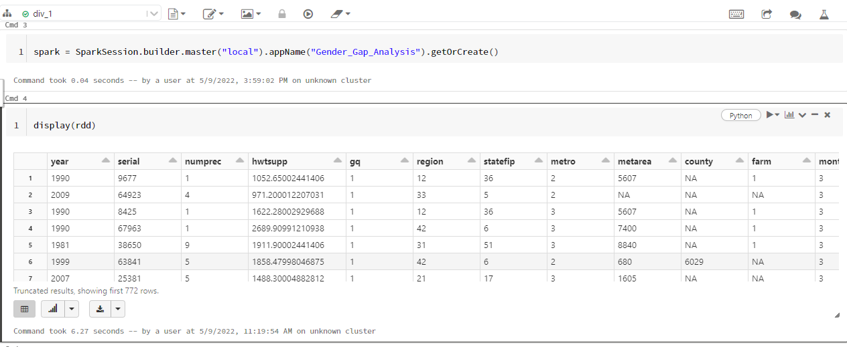
Loading The Dataset Into Databricks

Slide 8
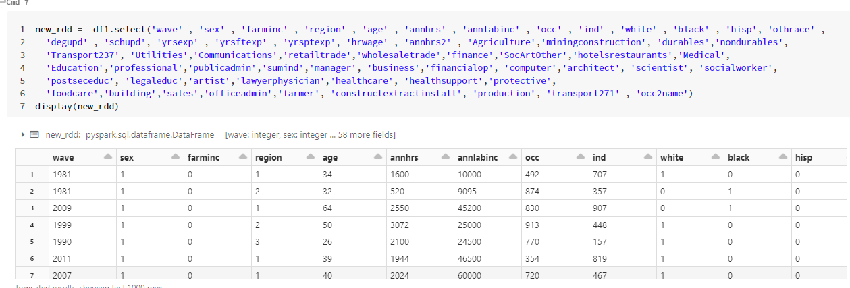
Data Selection
Notes:
Our dataset has 274 columns.
This selection of necessary data is done to make the tasks simpler. Additionally, the computation speeds also gets improved while working with a smaller data set.

Slide 9
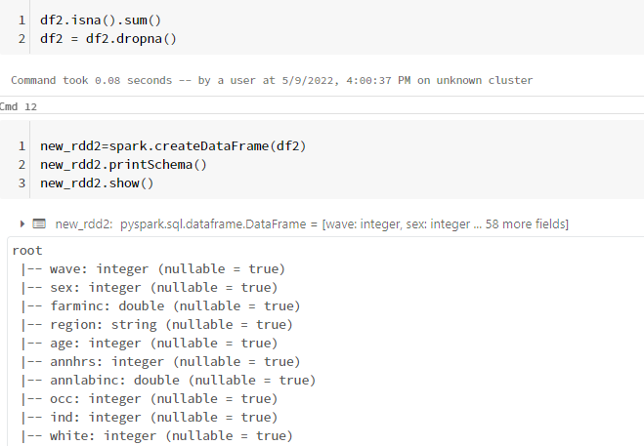
Pre processing

Slide 10
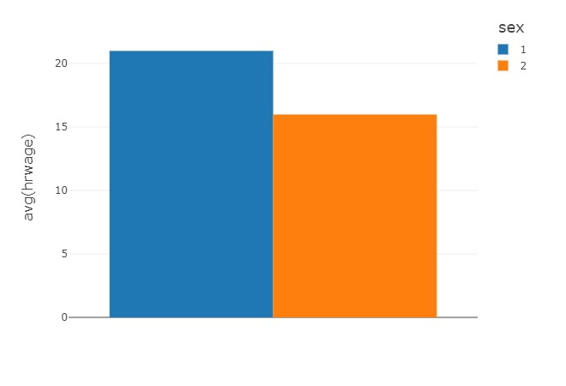
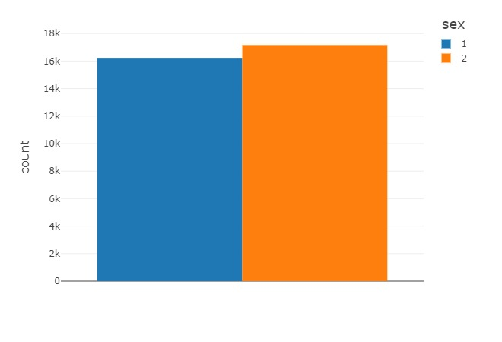
Distribution of genders
Notes:
Why does a gender pay gap still persist? Much of this gap has been explained by measurable factors such as educational attainment, occupational segregation and work experience. The narrowing of the gap is attributable in large part to gains women have made in each of these dimensions. Even though women have increased their presence in higher-paying jobs traditionally dominated by men, such as professional and managerial positions, women as a whole continue to be overrepresented in lower-paying occupations relative to their share of the workforce. This may contribute to gender differences in pay.

Slide 11
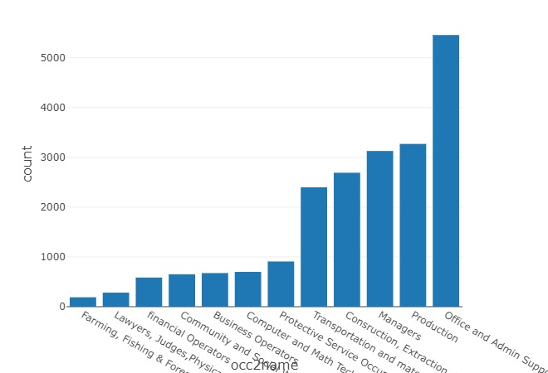
Occupation count across gender

Slide 12
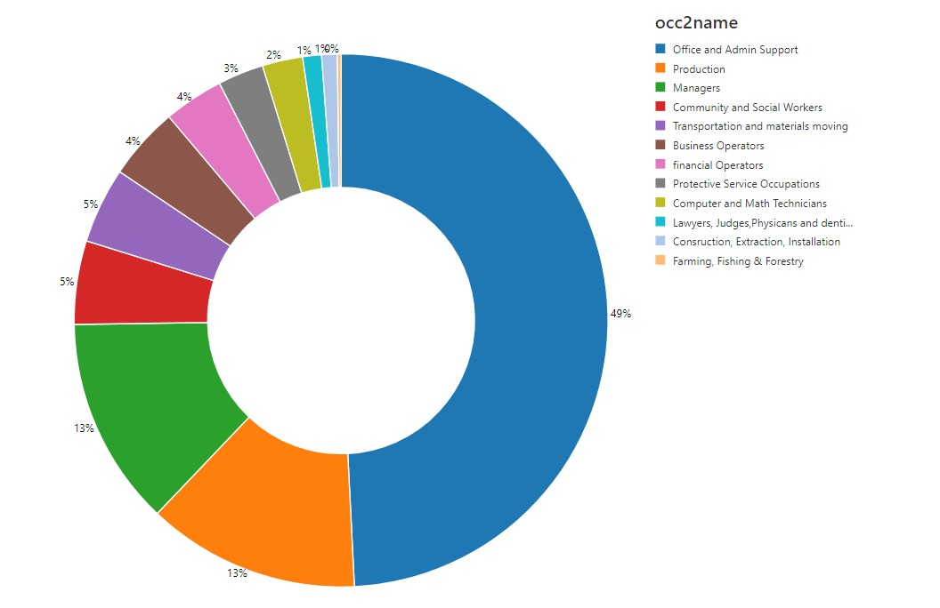
Which occupation had women enpowerment?

Slide 13
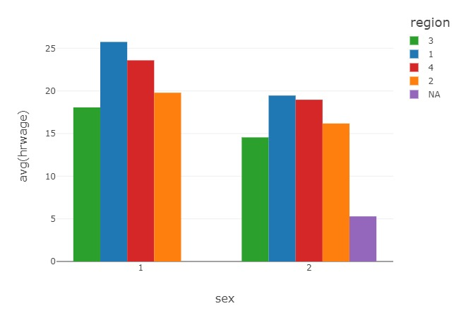
Hourly wage across gender

Slide 14
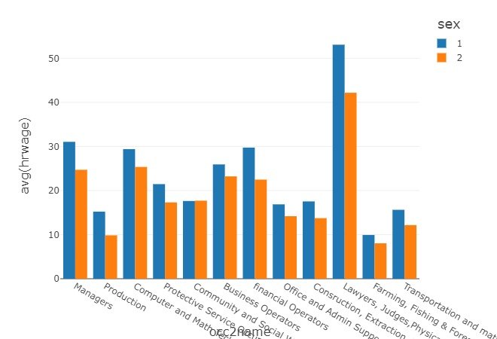
Comparison of Gender wages based on the occupation level
Notes:
Women earn less than men in nearly all occupations You can see how women’s earnings compare with men’s in over all occupations using our visualization. There aren't any occupations where women earn slightly more than their male counterparts, such as health care social workers.

Slide 15
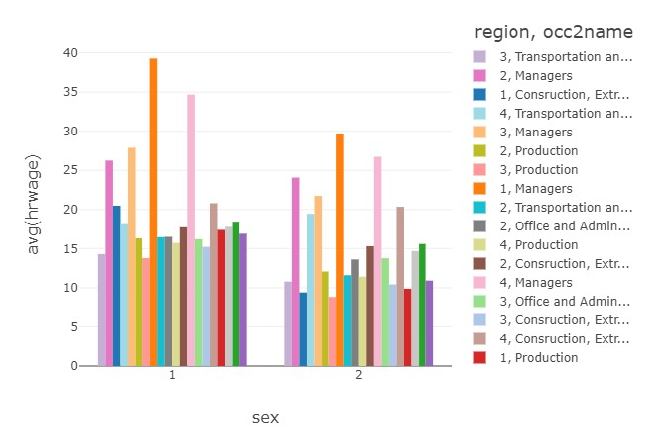
Hourly wage across region for top 5 occupations

Slide 16
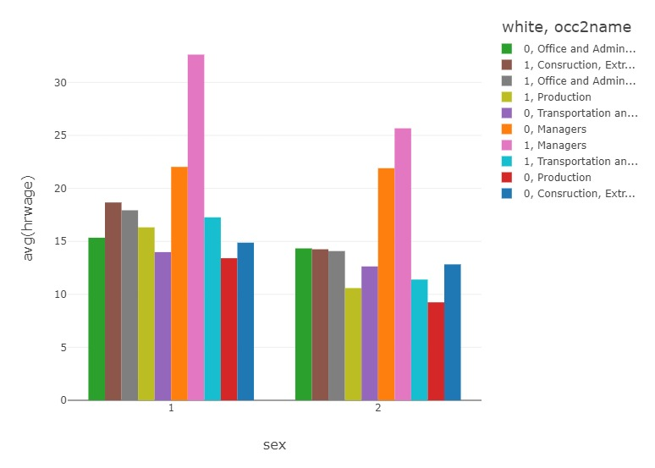
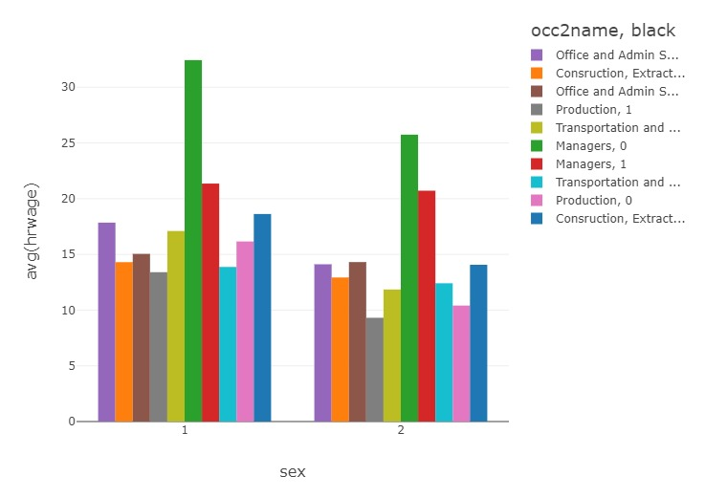
Racial comparison
Notes:
Women earn less than their same race and ethnicity counterpart at every occupation .

Slide 17
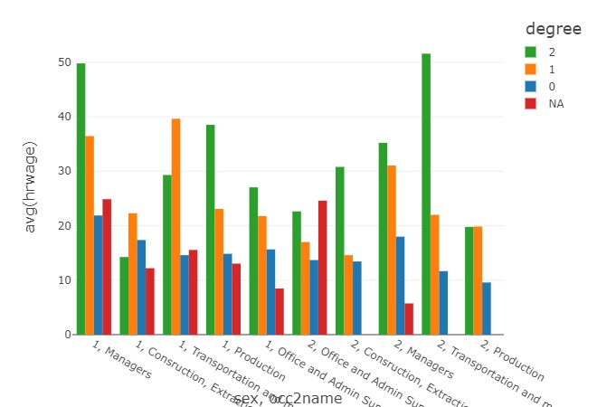
Degree Vs Hourly wages
Notes:
Women at every level of educational attainment Compared with white men with the same education, Black and Latina women with only a bachelor’s degree have the largest gap at 65%, and Black women with advanced degrees earn 70% of what white men with advanced degrees earn. Educational attainment is not enough to close gender earnings gaps. In fact, most women with advanced degrees earn less than white men, on average, with only a bachelor’s degree.
Women are paid less than similarly educated men at every level of education. And the wage gap tends to rise with education level. This, again, in part likely reflects labor market policies that foster more-equal outcomes for workers in the lower tier of the wage distribution. It also may be affected by certain challenges that disproportionately affect women’s ability to secure jobs at the top of the wage distribution, such as earnings penalties for time out of the workforce, excessive work hours, domestic gender roles, and pay and promotion discrimination.

Slide 18
Modeling Linear Regression
Linear Regression Analysis consists of more than just fitting a linear line through a cloud of data points. It consists of 3 stages – (1) analyzing the correlation and directionality of the data, (2) estimating the model, i.e., fitting the line, and (3) evaluating the validity and usefulness of the model.
Steps:
Read the preprocessed data .
Use Vector Assembler ( a transformer ) to create a single vector column from a list of columns mentioned.
Select the transformed input column and target column that should be predicted.
Split the data set such that the training set has 75% of data and the testing set has 25% of the total data.
Loading the Linear Regression model and fitting the training data. Fitting is nothing but training.
Finally, predict the values.

Slide 19
Outcomes
To identify and visualize the trends in occupation levels of male and female.
To identify the top 5 occupations which have driving women force.
To identify the demographics and racial trends in the data.
To identify and visualize the occupations by the most and least pay.
To identify the hindsight information on the age attributes of working individuals.
To identify how degree impacts the wages across gender.
To predict the annual income given the region , occupation , race , education, annual hours , gender details using linear regression model.

Slide 20
What could be done?
Pay secrecy must go.
Eliminating wage bargaining
Employers not relying on previous pay when determining a new employee's salary
Making work simpler for moms by providing cheap child care, paid parental leave, and more flexible hours, among other things.
Notes:
To begin to close the gender wage gap, women need updated comprehensive equal pay legislation, such as the Paycheck Fairness that will strengthen existing protections and further combat discriminatory practices. Beyond public policy, society must confront cultural biases that continue to harm women by devaluing their work and confining them to specific gender roles. Only by enacting essential policies and shifting cultural attitudes can the United States begin to dismantle the structures that systematically disadvantage and shortchange women and their families.
How much does the gender pay gap cost women over a lifetime? The average woman worker loses more than $530,000 over the course of her lifetime because of the gender wage gap, and the average college-educated woman loses even more—nearly $800,000 . It’s worth noting that each woman’s losses will vary significantly based on a variety of factors. And, as explained later, the gap may play a role in the retirement insecurity of older American women.

Slide 21
References
https://www.kaggle.com/datasets/fedesoriano/gender-pay-gap-dataset
https://medium.com/featurepreneur/linear-regression-with-pyspark-in-10-steps-c6b3263a2c4
http://graphics.wsj.com/gender-pay-gap/
https://www.pewresearch.org/fact-tank/2021/05/25/gender-pay-gap-facts/
Blau, Francine & Kahn, Lawrence. (2017). The Gender Wage Gap: Extent, Trends, and Explanations. Journal of Economic Literature. 55. 789-865. 10.1257/jel.20160995.

Slide 22
Thankyou

