Slide 1
Silicon Photonics
Jim

Slide 2
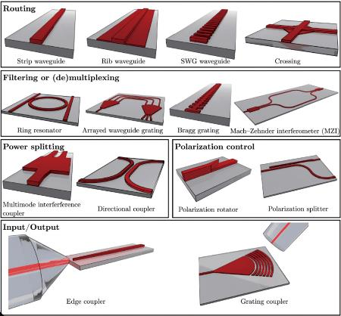
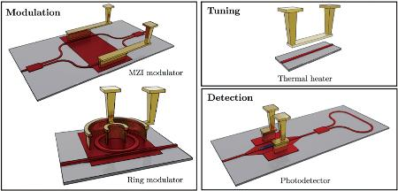
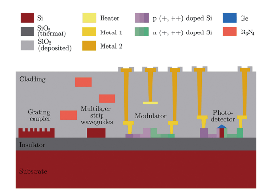
Outline
矽光子介紹
光波導 Waveguide
耦合器 Directional coupler
環形共振器 Ring resonator
饋入與輸出口 I/O couple
干涉調變器 MRM & MZM modulator
鍺光偵測器 Ge on Si Photonics
光通訊協議 Protocol to enhance the data capacity
可程式光學IC Programmable PIC
應用場景與供應鏈
Passive component
Active component

Slide 3
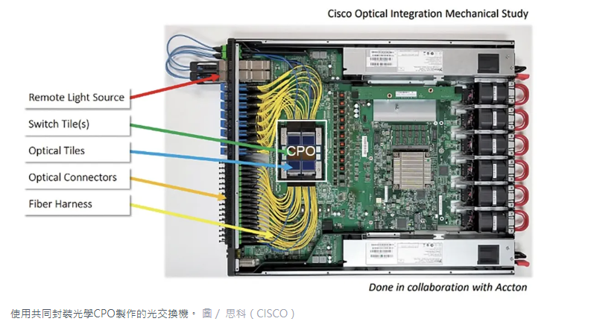
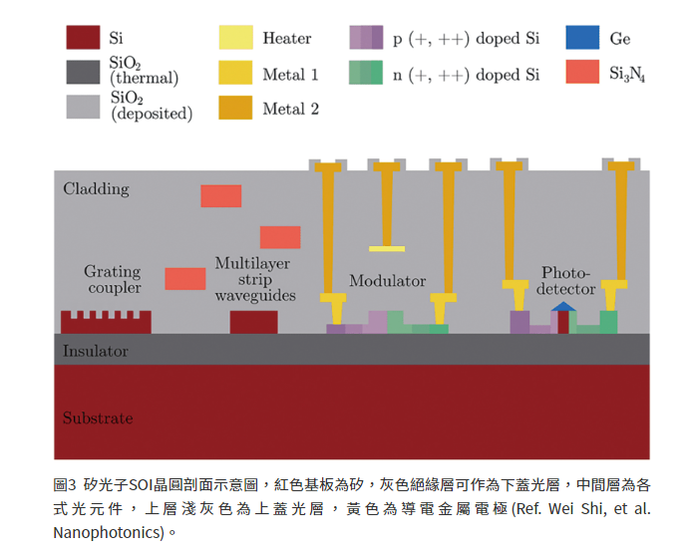
What is silicon photonics
Silicon photonics is a technology that constructs large-scale photonic circuits on silicon wafers using silicon semiconductor manufacturing techniques.
This technology leverages the properties of light to achieve high-speed, high-capacity, and low-power data transmission.

Slide 4
Problems Solved by Silicon photonic
High data rate and Low Latency: light polriaztion and mode 、 high group velocity
Energy Efficiency: low loss
Scalability: heat、crosstalk、mature silicon wafer processes(low cost)

Slide 5
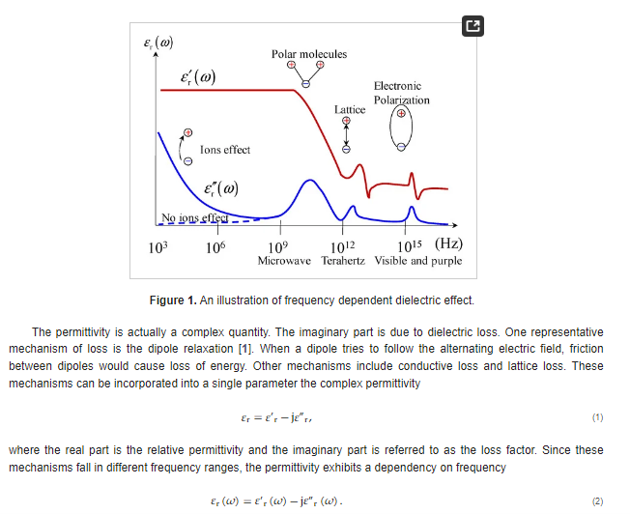
Why silicon photonics can achieve ?
Example:
FR_4 @10^10Hz : Dk 4 ,Df 0.01
SiO2 @10^14Hz : Dk 1.4 ,Df 0.00001

Slide 6
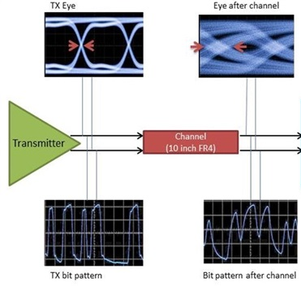
矽光子Q&A
矽光子要解決的問題是什麼?
A:要解決目前數字信號的高速傳輸的瓶頸
信號衰減：在長距離傳輸過程中，信號會因為傳播損耗而逐漸衰減。這要求增設中繼站或使用放大器來維持信號的質量。
干擾和噪聲：尤其在銅線等傳統媒介上，外部電磁干擾和其他噪聲可以顯著影響信號質量，導致數據錯誤和傳輸效率下降。
信號衰減：光波導具有低損耗特性
干擾和噪聲：光彼此之間不會有耦合關系
數字信號在傳輸的過程中會漸漸見失真

Slide 7
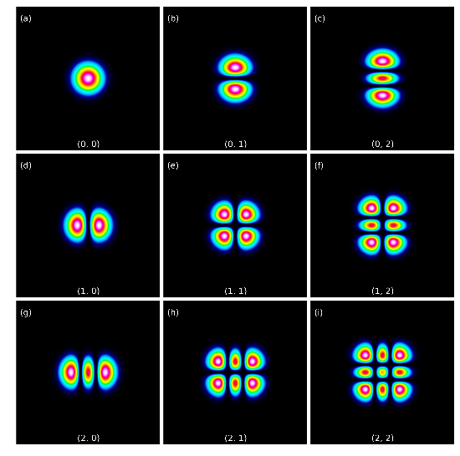
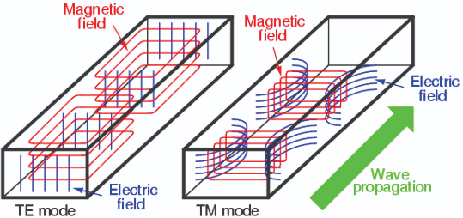
Waveguide
Principle of waveguide
Because of the boundary condition,
only certain mode can propagate in the wave guide.
Also, we need the large difference of reflection index
to get the good confinement of electric field.
矽光子其中一個關鍵技術是在矽晶圓上製作光波導作為訊號傳輸管道，光波導是利用光在不同折射率邊界會產生全反射的性質，使被侷限在光波導中。

Slide 8
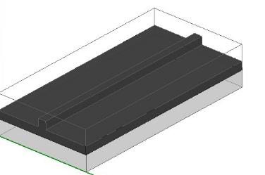
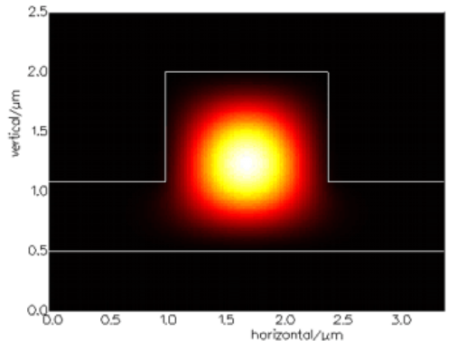
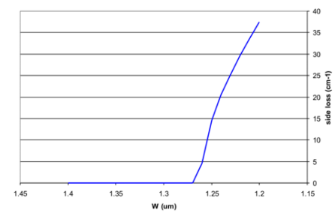
Waveguide
SOI wave guide
The refractive index difference between Si and SiO2 is significant (3.47 & 1.44 @ 1550nm).
This high difference of n means it has an excellent ability to confine optical fields.
The SOI wafer is compatible with the semiconductor process
The production cost of SOI is high
SiO₂
Si
SiO₂
Si
Good confinement of electric field(rib waveguide)
Loss is dependent on wavelength(because of n(reflection index) )
SOI（矽氧化物絕緣體）光波導是一種重要的集成光學平台，廣泛應用於光通訊領域。SOI光波導的核心技術在於利用矽（Si）和氧化矽（SiO2）兩種材料的折射率差異來實現光的有效導引。在SOI結構中，矽層作為導光層，而氧化矽層則作為底層來支撐矽層並提供光學隔離。SOI光波導在1.3微米（um）以上的波長表現出低損耗的特性。這一波長範圍不僅涵蓋了光通訊中常用的O與C波段（1.31和1.55微米波段），這些都是光纖通訊中重要的傳輸窗口。低損耗特性意味著光在傳輸過程中的能量損失極低，這對於提高通訊距離和信號品質至關重要

Slide 9
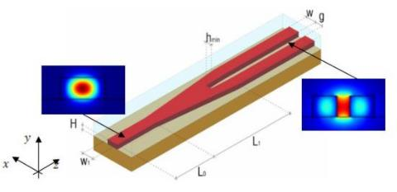
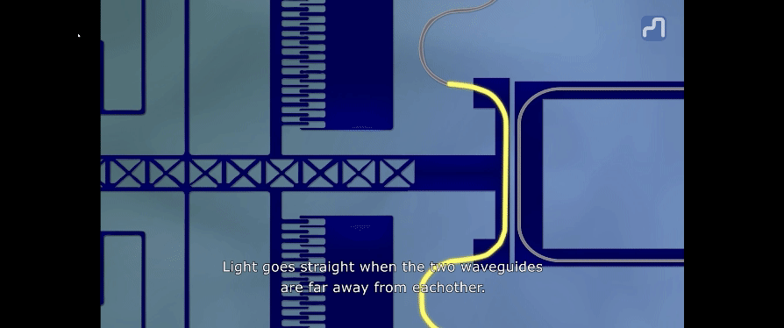
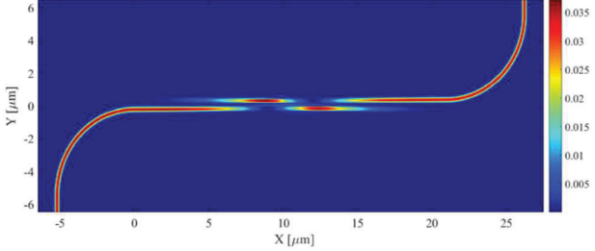
Directional coupler
Directional coupler principle
When the trace too close, they will form the new wave guide.
Light can couple to another trace under certain conditions.
By adjust the distance between trace can control the coupling strength
方向耦合器是一種常用於光通訊和集成光學的裝置，能夠將光信號從一條波導耦合到另一條波導。這種耦合過程主要取決於兩條波導間的距離和相互作用長度。

Slide 10
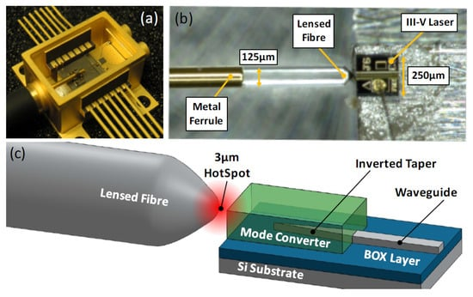
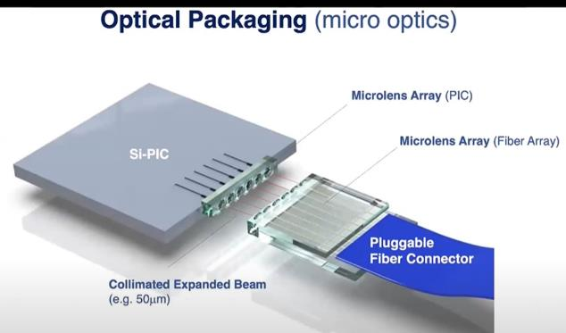
I/O couple
Edge couple
邊緣耦合是一種常用於實現高效率光信號從光纖到波導或芯片的轉移的技術。通過使用精確製作的鏡頭光纖和精細設計的模式轉換器，可以最大化入射光信號的耦合效率，從而降低能量損失，提高整體系統的性能。
在光學封裝中，使用微透鏡陣列來聚焦和導引光束至特定位置，這對於矽光子元件（如矽基光集成電路）的精確對接至關重要。這種對接技術支持高密度光路的配置，使得多通道光信號處理成為可能。

Slide 11
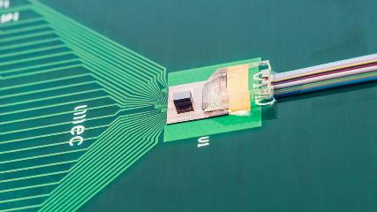
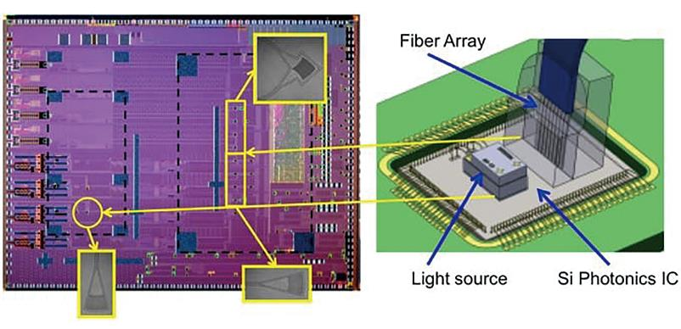
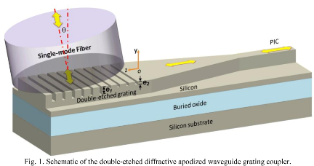
I/O couple
Grating couple

Slide 12
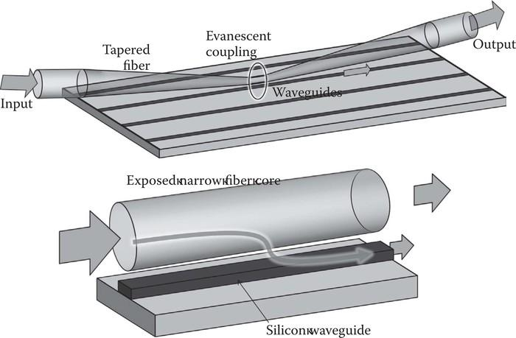
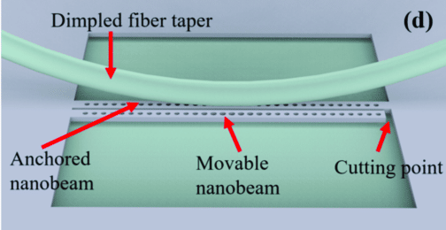
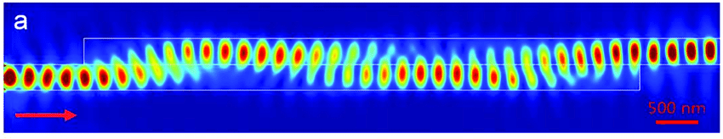
I/O couple
Evanescent-wave coupling

Slide 13
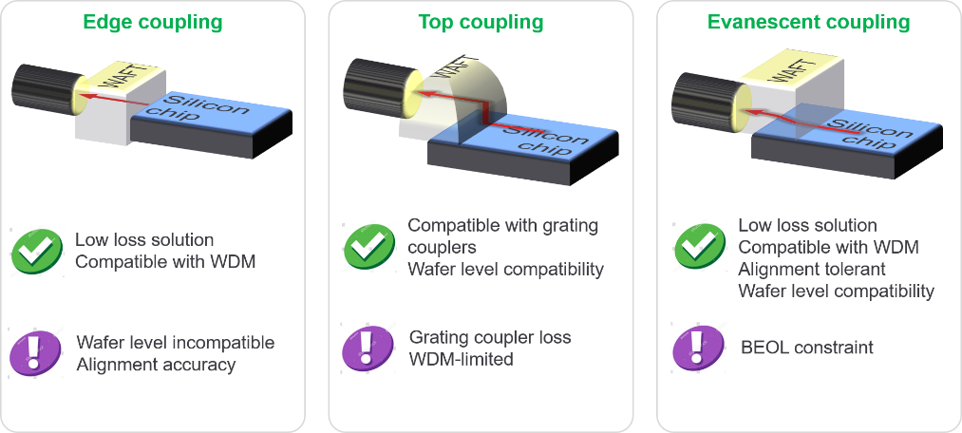
I/O couple
Waveguide Array to Fiber Transposer
Chips will usually have packaged connectors.
One issue to consider here is whether it is WDM or single frequency.

Slide 14
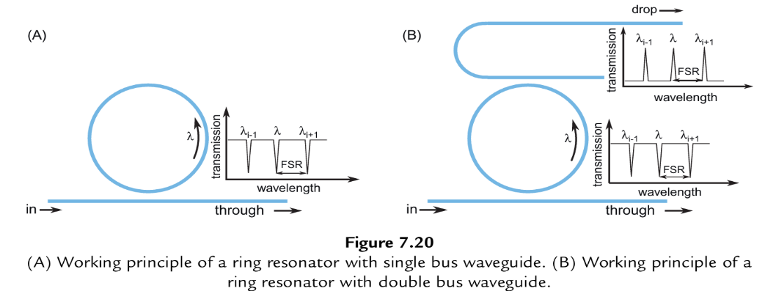
Ring resonator
Principle of ring resonator
A portion of the light enters the ring structure, while the rest continues to propagate forward.
Subsequently, these light waves interfere again in the coupling region.
Destructive interference occurs when their phase difference reaches π/2.
This type of resonator has a simple structure, compact size. Its high Q factor indicates low energy loss, but conversely, it has a very narrow bandwidth.

Slide 15
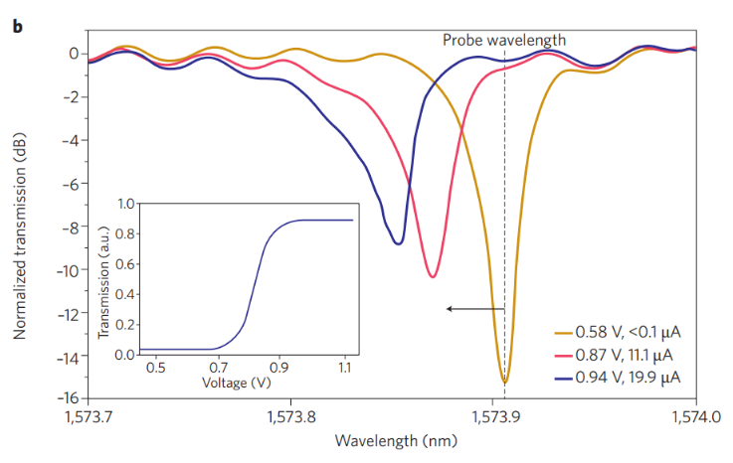
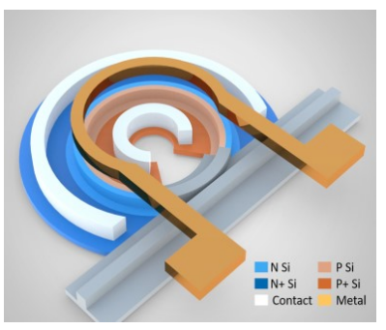
Micro-Ring Modulator
Use the ring resonator and EO(Plasma Dispersion effect) effect or TO(Thermal) to make modulator

Slide 16
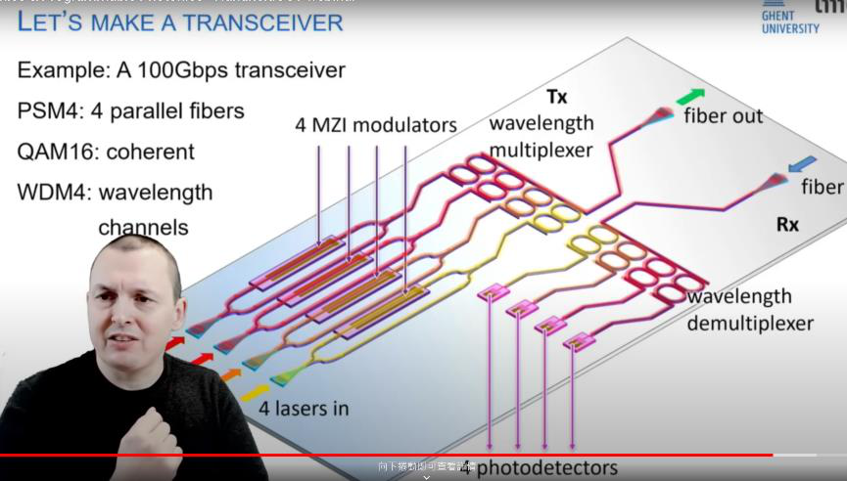
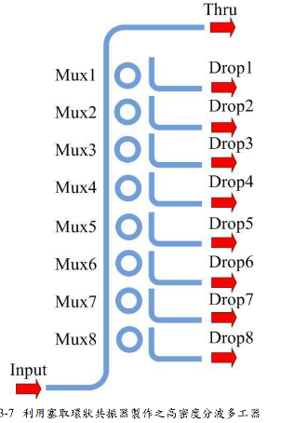
Ring cavity
Using as DEMUX or MUX
https://www.youtube.com/watch?v=GmDFK7eyjuQ

Slide 17
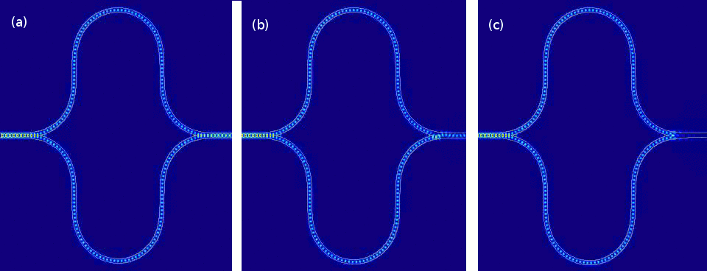
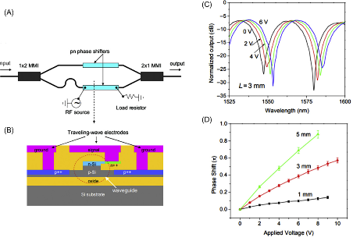
Mach-Zehnder modulator
Principle of MZM
Following is a demonstration of a simple Mach-Zehnder Interferometer (MZI) with phase shifts of 0, π/4, and π/2
0 : constructive interference, π/4 :linear control range, π/2 : destructive interference
Left is a standard Mach-Zehnder modulator that incorporates both a basic MZI and a phase modulator.
PN semiconductors are used as the modulating elements.
By adjusting the carrier concentration through voltage, the refractive index is changed.(plasma dispersion effect)
Also, can control the phase difference between two separate optical paths.
https://medium.com/lightmatter/optical-components-for-matrix-processing-73687cdd7aa6
High‑performance Mach–Zehnder modulator using tailored plasma dispersion effects in an ITO/ graphene‑based waveguide

Slide 18
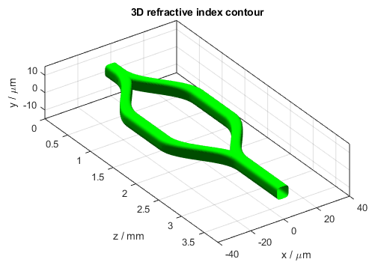
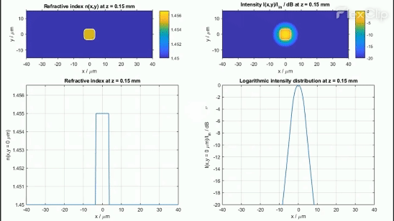
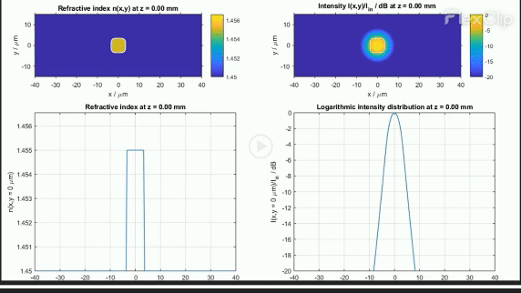
Mach-Zehnder modulator
Principle of MZM for x,y plane
Initially, light is split through a -3dB directional coupler.
Subsequently, the light travels through two distinct paths.
When we adjust the refractive index of one of the paths, a phase difference occurs.
The light are combined again through a -3dB directional coupler.
They interfere with each other.
Destructive interference occurs when the phase difference reaches pi/2
https://www.codeseeder.com/examples/mach-zehnder-modulator/

Slide 19
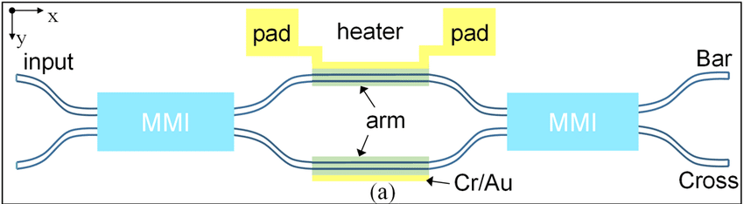
Mach-Zehnder modulator
Thermo-optic effect
We can also use the thermo-optic effect for phase modulation, but its speed is much slower(ms us) compared to the electro-optic effect.
Multi-Mode Interference (MMI) Coupler

Slide 20
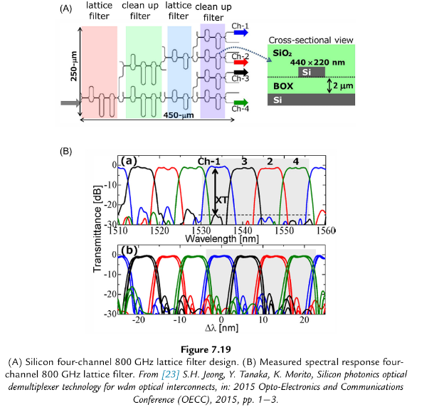
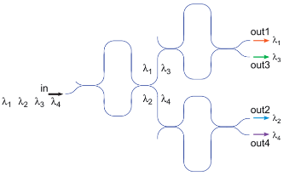
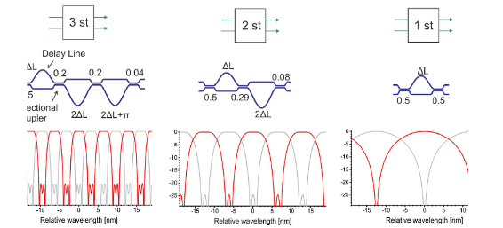
Mach-Zehnder modulator
Other MZM example :
Use MZM as the demux
High order MZM
Photonics Integrated Circuits Shibnath Pathak Research and Development, Lumentum Holdings Inc., San Jose, CA, United States

Slide 21
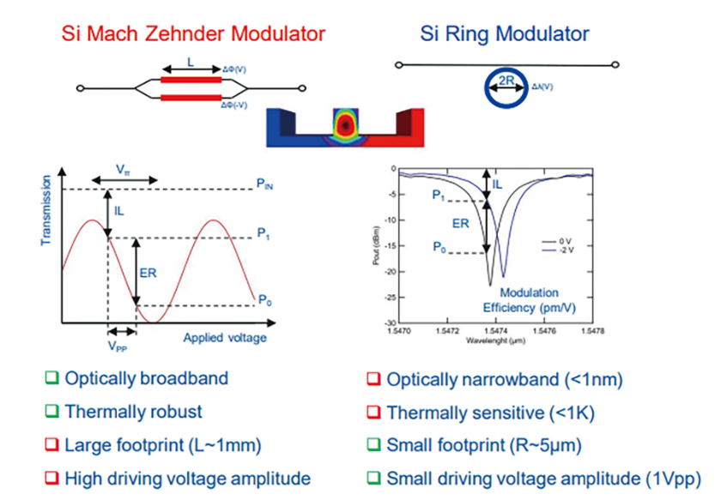
MZM vs. MRM
The frequency response of MZM is broader and flatter.
MRM has a narrower bandwidth, and its peak variation is sharper, but it requires a smaller footprint
We usually mix MZM and MRM in design to get the broadband and small footprint.

Slide 22
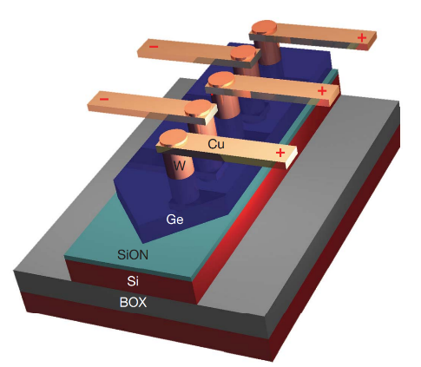
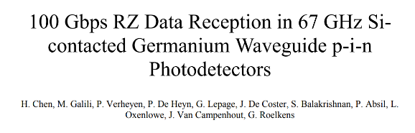
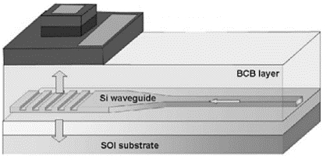
Ge on Si Photonics
The operational bandwidth of the silicon waveguide heterogeneously integrated germanium photodiode can reach above 35GHz.
https://opg.optica.org/oe/fulltext.cfm?uri=oe-18-5-4986&id=196132

Slide 23
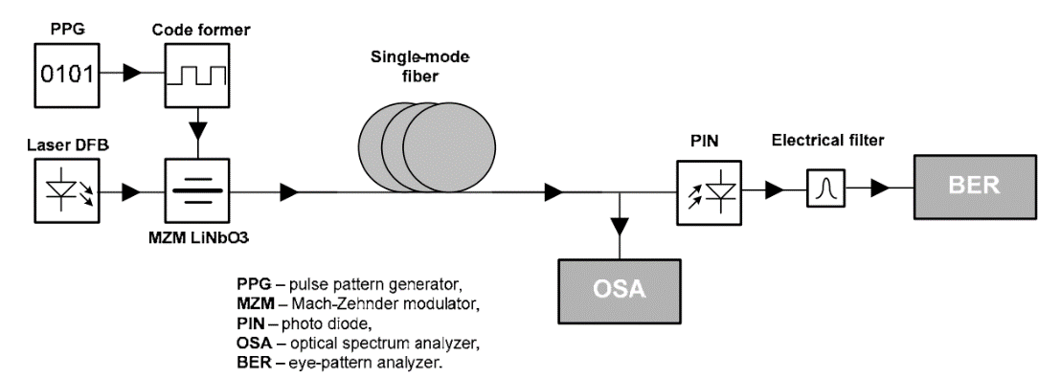
Simplified optical transmission system
➋
➏
➍
➌
➊
➎
The diagram outlines a basic optical communication system:
A continuous light source (typically a laser) is essential.
Electronic signals are encoded into an amplitude modulator (either EOM or EAM).
This modulated light conveys information to our DUT.
A directional coupler divides the signal between the OSA and the high-speed O2E (high speed photodetector)
Use OSA to monitor the spectrum
The O2E converts the optical signal into electronic and see its signal quality.

Slide 24
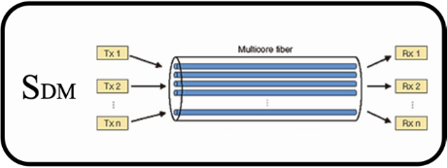
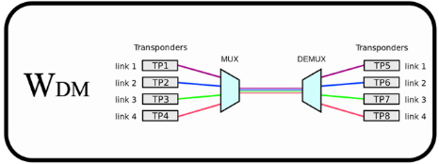
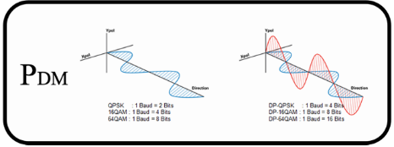
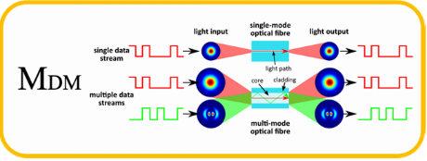
Protocol to enhance the data capacity
WDM, SDM, MDM, PDM
WDM(Wavelength-division multiplexing)
SDM(space-division multiplexing)
PDM(Polarization-division multiplexing)
MDM(Mode Division Multiplexing)
Other methods:
Advanced signal modulation techniques such as Pulse Amplitude Modulation (PAM) or Coherent
are gradually being adopted to enhance the overall transmission capacity of optical transceivers.
https://www.2cm.com.tw/2cm/zh-tw/tech/2A7C08CE5B6C4A21A9BA7AF531D17AF6

Slide 25
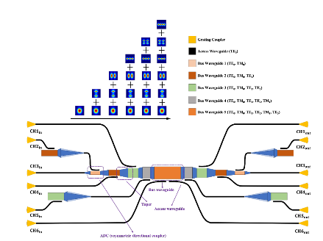
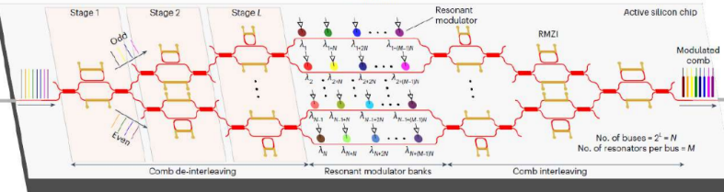
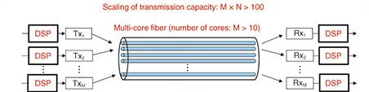

Example of WDM, SDM, MDM, PDM
WDM
MDM
PDM
SDM
PDM
應用於光通訊的矽光子元件研究 Research on Silicon Photonics Integrated Devices for Optical Communication Applications

Slide 26

Example of WDM, SDM, MDM, PDM
Combining various XDM is also a potential direction
https://www.2cm.com.tw/2cm/zh-tw/tech/2A7C08CE5B6C4A21A9BA7AF531D17AF6

Slide 27


Programable PIC
By a lot of directional coupler we can make a lot of logical unit
Each coupler is programable
Left is its mechanism.
We can change its coupling
by tuning the space between two traces.
https://ieeexplore.ieee.org/document/9049105

Slide 28



Slide 29


Waveguide
SWG waveguide
SWG waveguides have a periodicity below the Bragg condition
Can adjusts refractive index and dispersion without altering fabrication thickness.
Used for various optical functions like polarization control and wavelength filtering.
Uses Bloch mode for low-loss light transmission.

Slide 30

https://www.pida.org.tw/main/article_show/0279
https://www.degruyter.com/document/doi/10.1515/nanoph-2020-0309/html

