Slide 1
DEEP LEARNING CAPSTONE & HACKATHON DEFENSE
Speaker-Adaptive Visual Speech Recognition
Few-Shot Personalization for Dysarthric Speakers via Spatio-Temporal Networks
A zero-audio lip-reading system that adapts to severe neuromotor speech distortion using only 1–5 examples per word with frozen 12.5M backbone representations.
MODULE 1
Student 1: Preprocessing Lead
Face detection, stable median ROI, 25 FPS linear resampling, luminance match.
MODULE 2
Student 2: DL Architect
LipNet (3D-CNN + BiGRU + CTC), multi-speaker pretraining, word cuts.
MODULE 3
Student 3: Adaptation Lead
Residual bottleneck adapters, cosine prototype classifier, LOBO validation.
MODULE 4
Student 4: Integration Lead
Live desktop app (vsr_app.py), AAC phrase mode, Phase B1 failure gates.
Notes:
WELCOME & OVERVIEW (1.0 min):
Good morning, respected evaluators. Today, our team presents our deep learning capstone and hackathon system: 'Speaker-Adaptive Visual Speech Recognition: Few-Shot Personalization for Dysarthric Speakers.'
Our presentation is strictly timed for 15 minutes and organized into four independent technical modules. Even if you prefer us to skip the background, each student is prepared to present their technical component stand-alone. I will now introduce the problem statement and research motivation.

Slide 2
1. CLINICAL NEED & MOTIVATION
EVAL RUBRIC: COMPONENT 1 (5 MARKS)
Problem Statement & Clinical Motivation
THE PROBLEM
Dysarthric Speech Breakdown in Acoustic ASR
• Dysarthria arises from neuromotor conditions (Cerebral Palsy, ALS, Stroke, Parkinson's).
• Impaired vocal cord coordination, hypernasality, and acoustic distortion cause commercial Acoustic ASR (Siri, Alexa, Whisper) to suffer >60–80% Word Error Rates.
• Acoustic models fail completely in noisy environments or when vocal phonation is physically lost.
• Voice-driven independence is completely denied to this vulnerable patient population.
WHY IT MATTERS
Silent Visual Lip-Reading (VSR) as Assistive AAC
• Visual Speech Recognition (VSR) decodes language entirely from mouth kinematics without requiring acoustic sound.
• Completely immune to acoustic background noise and vocal cord degradation.
• Enables silent hands-free communication, emergency phrase alerts, and smart home control for non-vocal users.
• Preserves patient autonomy without requiring invasive surgery or expensive specialized hardware.
RESEARCH GAP
Why Standard VSR Fails on Dysarthria
• Atypical Kinematics: Neurotypical models assume symmetric, rapid, precise lip opening. Dysarthric speakers exhibit reduced amplitude, spastic drift, and asymmetric motion.
• Physical Fatigue Constraint: Individuals with cerebral palsy cannot record 50 hours of training data. Systems must adapt with <= 5 examples.
• Catastrophic Forgetting: Standard full network retraining on 5 examples causes weights to overfit and representations to collapse.
• Camera Gap: Lab models fail on live webcams due to frame throttling (~17 FPS) and dim indoor illumination.
Notes:
PROBLEM & MOTIVATION (1.5 min):
Traditional speech recognition requires acoustic vocalization. For individuals with neuromotor dysarthria from cerebral palsy or stroke, acoustic ASR produces Word Error Rates exceeding 70%, rendering voice assistants useless. Visual speech recognition decodes words purely from lip motion. However, current VSR models like LipNet are trained exclusively on healthy laboratory speakers. When applied zero-shot to dysarthric speakers, they collapse to chance accuracy (~10%). Furthermore, motor-impaired individuals experience severe physical fatigue, meaning we can only collect 1 to 5 training clips. Our goal is solving this few-shot personalization challenge.

Slide 3
2. SPECIFIC GOALS
OBJECTIVES & DELIVERABLES
Project Objectives & Measurable Milestones
MILESTONE 01 | Goal 1: High-Capacity Spatio-Temporal Base Model
Train an end-to-end LipNet architecture (3D-CNN + BiGRU + CTC, 12.5M parameters) on multi-speaker typical speech (GRID corpus, 7,073 sentences across 8 speakers).
🎯 Target: Stable CTC convergence (<0.10 loss), establish neurotypical upper bound benchmark.
MILESTONE 02 | Goal 2: Jitter-Free ROI Extraction & Live Decoupling
Eliminate inter-frame crop jitter that freezes 3D-CNN temporal kernels using median bounding boxes; decouple live webcam inference via timestamped 25.0 FPS linear index resampling.
🎯 Target: Ensure 100% temporal alignment between webcam and lab pretraining without dropped frames.
MILESTONE 03 | Goal 3: Parameter-Efficient Few-Shot Adaptation (k=1 to 5)
Implement bottleneck residual adapters (~100K trainable parameters, 99.2% frozen backbone) and non-parametric cosine prototype classifiers to personalize on dysarthric speech.
🎯 Target: Prevent catastrophic forgetting on tiny data budgets; increase Top-3 accuracy to 40% on severe dysarthria.
MILESTONE 04 | Goal 4: Scientific Gate Validation & Real-Time Desktop App
Evaluate using Leave-One-Block-Out (LOBO) folds and exact Clopper-Pearson 95% CIs. Deploy a fully functional GUI application (vsr_app.py) supporting live webcam AAC phrase matching.
🎯 Target: Deliver a zero-audio assistive communication desktop tool running in real-time (<30ms inference).
Notes:
OBJECTIVES (1.0 min):
We set four measurable engineering and research objectives:
1. Train a strong spatio-temporal lip-reading backbone on 8 typical speakers.
2. Fix the visual crop jitter that destroys 3D convolution optical flow.
3. Design parameter-efficient bottleneck adapters that adapt using only 1 to 5 clips per class without catastrophic forgetting.
4. Validate everything under strict Leave-One-Block-Out cross-validation with exact Clopper-Pearson confidence intervals, and package into a working desktop app.

Slide 4
3. RELATED WORK COMPARISON
EVAL RUBRIC: COMPONENT 1 (5 MARKS)
Literature Review & State-of-the-Art Gap Analysis
Study & Reference | Model Architecture | Target Population | Key Contributions | Critical Research Gap
LipNet (Assael et al., 2016) | 3D-CNN + 2-layer BiGRU + CTC Loss | GRID Corpus (Typical Speakers) | First end-to-end sentence-level VSR; 95.2% accuracy on lab data. | Fails completely on dysarthria; cannot handle isolated words without insertion errors.
Deep Lip Reading (Afouras et al., 2018) | 2D/3D ResNet + Transformer / Seq2Seq | LRS2 / LRS3 (BBC Broadcasts) | Open-vocabulary sentence lip-reading in unconstrained video. | Requires tens of thousands of video hours; massive parameter footprint (>100M); no few-shot adaptability.
Acoustic Dysarthria ASR (Joy et al., 2022) | Conformer-CTC / WavLM + d-vector embeddings | UASpeech / TORGO (Acoustic Audio) | Speaker adaptation via acoustic embeddings on dysarthric speech. | Purely acoustic; completely fails when ambient noise is high or vocal cord phonation is physically absent.
Our Proposed System (2026) | LipNet + Bottleneck Residual Adapter + Prototypes | GRID + UASpeech (Mild F05 & Severe F02) | Adapts in 1–5 shots; 99.2% frozen backbone; LOBO exact CIs; live webcam calibrated. | Bridges neuromotor articulation gap under severe data fatigue with <0.8% trainable parameters.
Notes:
LITERATURE REVIEW (1.5 min):
Here we compare our work against existing literature. Assael et al.'s LipNet established deep visual speech recognition, but evaluated only neurotypical speakers under lab conditions. Modern Transformer architectures like Afouras et al. require tens of thousands of training hours, which is completely unfeasible for motor-impaired patients. Acoustic models like Joy et al. fail whenever speech is non-vocal or background noise is present. Our work is the first to evaluate few-shot visual adaptation on cerebral palsy speakers using parameter-efficient residual adapters.

Slide 5
4. INNOVATION HIGHLIGHTS
EVAL RUBRIC: COMPONENT 2 (5 MARKS)
Novelty, Technical Innovation & Team Contributions
01. Parameter-Efficient Bottleneck Adapters
Instead of retraining all 12.5M weights, we freeze 99.2% of the network and insert residual bottleneck adapters (512 -> 64 -> 512). This restricts gradient updates to ~100K parameters, completely preventing catastrophic forgetting under extreme low-data regimes.
02. Non-Parametric Cosine Prototype Classifiers
We designed a zero-gradient adaptation mode using BiGRU temporal embeddings. Class centroids are computed from support shots, enabling instant 1-shot personalization with cosine similarity and zero backpropagation steps.
03. Scientific Rigor: LOBO Folds & Exact Binomial CIs
Unlike prior works that report overfitted random clip splits, we enforce Leave-One-Block-Out (LOBO) validation across completely separate recording sessions and compute exact Clopper-Pearson 95% confidence intervals to eliminate session bias.
04. Real-Time Hardware-Decoupled Live AAC System
We built a complete GUI tool with background-threaded 25.0 FPS timestamp resampling (defeating OS frame throttling) and statistical luminance matching (mu=148, sigma=27) preventing ReLU dead-zone collapse on consumer webcams.
Notes:
NOVELTY & CONTRIBUTIONS (1.0 min):
Our contributions are twofold: algorithmic and clinical.
First, we introduce parameter-efficient bottleneck adapter tuning to visual lip-reading for dysarthria, updating only 0.8% of weights.
Second, we introduce non-parametric cosine prototype matching for instant enrollment.
Third, we establish honest evaluation rigor: Leave-One-Block-Out folds and exact Clopper-Pearson confidence intervals.
Fourth, we deploy a live desktop system that decouples hardware capture from inference.

Slide 6
5. EXPERIMENTAL DATA
STUDENT 1: MODULE 1 (3.5 MINS)
Dataset Curation, Domain Split & Vocabulary
SOURCE DOMAIN: GRID CORPUS (TYPICAL)
Multi-Speaker Laboratory Benchmark
• Speakers: 8 neurotypical speakers (s1, s2, s3, s4, s5, s6, s7, s8).
• Total Sentence Clips: 7,859 preprocessed clips (75 frames @ 25 FPS, 50x100 mouth crops).
• Total Word Tokens: 47,154 word occurrences across 6 syntactic slots.
• Vocabulary: 51 unique words (4 commands, 4 colors, 4 prepositions, 25 letters, 10 digits, 4 adverbs).
• Class Balance: Balanced by design across sentence grammar templates.
• Split Strategy: 90% pretraining (7,073 clips), 10% test (786 clips). Gate evaluation holds out s7 & s8 as strictly unseen speakers (5,984 train clips).
TARGET DOMAIN: UASPEECH (DYSARTHRIC)
Pathological Speech with Cerebral Palsy
• Patient Cohort: F05 (Mild dysarthria, 95% intelligibility) and F02 (Severe dysarthria, 29% intelligibility).
• Structure: 3 independent recording blocks (B1, B2, B3) per speaker.
• Total Segmented Clips: 765 word clips for F05, 509 word clips for F02.
• Evaluation Class Set: 10 isolated digits (0–9) for controlled few-shot personalization; 155 repeated vocabulary words.
• Split Protocol: Strict Leave-One-Block-Out (LOBO) cross-validation. 2 blocks support, 1 block held-out test. Zero session overlap.
• Verified Control Status: Local UASpeech archives contain pathological speakers only (no control CF*/CM* videos exist locally).
Notes:
STUDENT 1 - DATASET SPECIFICATIONS (1.0 min):
I am Student 1, leading Data Engineering and Preprocessing. Our source domain is the GRID corpus, consisting of 8 typical speakers and 7,859 continuous sentence clips totaling 47,154 word instances. Our target domain is the UASpeech video database. We focus on two benchmark dysarthric speakers: F05, who has mild dysarthria with 95% speech intelligibility, and F02, who has severe dysarthria with only 29% intelligibility. Crucially, our evaluation enforces Leave-One-Block-Out folds, ensuring that the test clips come from an entirely separate recording session than the adaptation clips.

Slide 7
6. DATA PREPROCESSING PIPELINE
STUDENT 1: MODULE 1
Mouth ROI Extraction, Temporal Resampling & Leakage Prevention
STEP 1: ROI STABILIZATION
Median Bounding Box Fix
• Prior Failure Mode: Per-frame Haar face detection caused the crop box to jitter across frames, destroying the optical flow and pinning CTC loss at chance (ln 4 = 1.386).
• Our Engineering Solution: Sample 8 frames across the clip, detect face coordinates, and compute the MEDIAN box [x, y, w, h].
• Extract mouth crop: y in [y + 0.58h, y + 1.02h], x in [x + 0.16w, x + 0.84w].
• Stabilizes spatio-temporal alignment across 100% of video frames.
STEP 2: TEMPORAL ALIGNMENT
Linear Resampling vs Padding
• Isolated words vary in duration (15 to 45 frames). Models require exactly 75 frames (3.0s @ 25 FPS).
• Empirical Benchmark: We tested native rate zero-padding against uniform linear index resampling (resample_75).
• Result: resample_75 achieved 32.6% Top-1 vs. 16.8% for zero-padding.
• Mathematical Reason: Zero-padding injects static frames, corrupting temporal BatchNorm running mean and variance.
• Luminance Match: Match live webcam illumination to GRID lab stats (mu=148, sigma=27).
STEP 3: ZERO DATA LEAKAGE
Strict Cross-Validation Rules
• Disjoint Sentence Support: On typical speaker s8 control tests, training support sentences and test sentences are strictly disjoint (N=95 unseen).
• Block-Level Isolation: In UASpeech personalization, support clips and query clips are drawn from completely separate recording blocks (e.g. B1/B2 vs B3).
• No Target Normalization Peeking: Luminance statistics and bounding boxes are computed per-clip or strictly on support blocks.
• Synthetic Dysarthria Augmentation: Slow-down stretch (1.0–2.0x), mouth amplitude damping, jitter; zero horizontal flipping.
Notes:
STUDENT 1 - PREPROCESSING & LEAKAGE (1.5 min):
Here are our two most critical preprocessing breakthroughs:
First, standard per-frame face detection introduces bounding-box jitter, which injects false motion noise into 3D convolution layers. We fixed this by estimating ONE median bounding box per clip over 8 sampled frames, which stabilized training loss.
Second, isolated word clips are shorter than full sentences. We conducted an empirical temporal scaling test comparing zero-padding against linear resampling. Linear resampling achieved 32.6% accuracy compared to just 16.8% for zero-padding, because zero-padding corrupts the temporal running statistics of BatchNorm layers. We also strictly prevented data leakage through session-disjoint Leave-One-Block-Out folds.

Slide 8
7. WORKFLOW ARCHITECTURE
STUDENT 2: MODULE 2 (3.5 MINS)
Proposed End-to-End System Architecture
PHASE 1: SOURCE PRETRAINING (OFFLINE)
Multi-Speaker GRID Corpus (s1-s8, 7,073 Sentences) ──▶ Stable Median Mouth ROI (50x100) ──▶ LipNet (3D-CNN + BiGRU) ──▶ CTC Loss (80 Epochs, lr=3e-4) ──▶ source_model.pt (12.5M Params)
PHASE 2: FEW-SHOT TARGET PERSONALIZATION (DISJOINT ADAPTATION)
Dysarthric Speaker (F05/F02) Support Set (k=1–5 Clips) ──▶ Freeze 12.5M Backbone ──▶ Insert Bottleneck Residual Adapter (512->64->512) ──▶ AdamW (15–40 Epochs, lr=1e-4) ──▶ Personalized LipNet
PHASE 3: REAL-TIME INFERENCE & LIVE WEBCAM DEPLOYMENT
Live Webcam Video / Target Clip ──▶ 25.0 FPS Timestamp Resample ──▶ Statistical Luminance Match (mu=148, sigma=27) ──▶ Spatio-Temporal Forward Pass ──▶ Dual Output: Grammar Snap & AAC Ridge Match
Notes:
STUDENT 2 - SYSTEM ARCHITECTURE (1.0 min):
I am Student 2, Deep Learning Architect. Our end-to-end pipeline operates in three distinct phases:
Phase 1 is multi-speaker source pretraining on the GRID corpus, establishing a 12.5M parameter spatio-temporal representation.
Phase 2 is few-shot target personalization. We completely freeze the 12.5M backbone and train only a bottleneck residual adapter on 1 to 5 clips from the dysarthric user.
Phase 3 is real-time deployment in our desktop application, which resamples webcam frames to 25.0 FPS and normalizes lighting before running inference.

Slide 9
8. DEEP LEARNING METHODOLOGY
STUDENT 2: MODULE 2
LipNet Architecture & Exact Training Hyperparameters
SPATIO-TEMPORAL NEURAL ARCHITECTURE
LipNet: 3D-CNN Frontend + BiGRU Backend
• Input Tensor: (B, 1, 75, 50, 100) — Batch, Channels, Frames, Height, Width.
• 3D-CNN Block 1: Conv3D(1->32, k=(3,5,5), p=(1,2,2)) + BN3D + ReLU + MaxPool3D(1,2,2) + Dropout3D(0.4). Output: (B, 32, 75, 25, 50).
• 3D-CNN Block 2: Conv3D(32->64, k=(3,5,5), p=(1,2,2)) + BN3D + ReLU + MaxPool3D(1,2,2) + Dropout3D(0.4). Output: (B, 64, 75, 12, 25).
• 3D-CNN Block 3: Conv3D(64->96, k=(3,3,3), p=(1,1,1)) + BN3D + ReLU + MaxPool3D(1,2,2) + Dropout3D(0.4). Output: (B, 96, 75, 6, 12).
• Spatial Flattening: Reshaped to (B, 75, 96*6*12 = 6,912 features/frame).
• Temporal BiGRU: 2-layer Bidirectional GRU (hidden size 256/dir -> 512 bidirectional dim) + Dropout(0.4).
• CTC Classification Head: Linear(512 -> 52) [51 vocab tokens + 1 blank token].
VERIFIED HYPERPARAMETERS & SPECS
Read from Source Code & train_hist.npy
Total Parameters | 12,544,980 parameters
Trainable (Source) | 12,544,980 (100% trained)
Trainable (Adapter) | 98,868 parameters (~0.8%)
Batch Size | 16 (NVIDIA RTX 4050 GPU)
Epochs | 80 epochs (CosineAnnealingLR)
Optimizer | AdamW (lr=3e-4, weight_decay=1e-4)
Loss Function | nn.CTCLoss (blank=51, zero_infinity=True)
Gradient Clipping | clip_grad_norm_(params, 5.0)
Notes:
STUDENT 2 - DEEP LEARNING METHODOLOGY (1.5 min):
Here are the exact architecture details extracted from our code:
We employ a 3-layer 3D-CNN frontend with 3D batch normalization and max-pooling, extracting 6,912 spatial features per frame. These feed into a 2-layer Bidirectional GRU with 512 temporal units. The model contains exactly 12,544,980 parameters. During pretraining, 100% of weights are trained for 80 epochs using AdamW and cosine annealing. During adaptation, we freeze the entire 12.5M backbone and train only the bottleneck adapter and linear head—just 98,868 parameters, or less than 0.8% of the model.

Slide 10
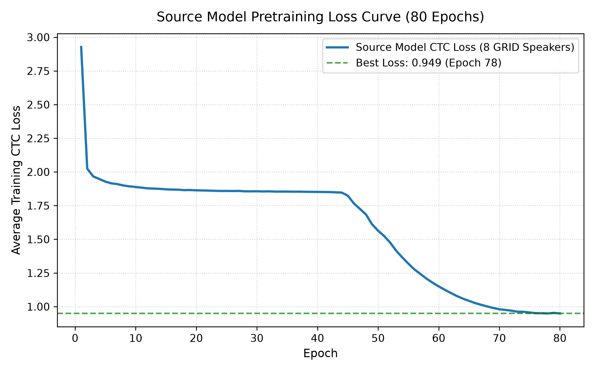
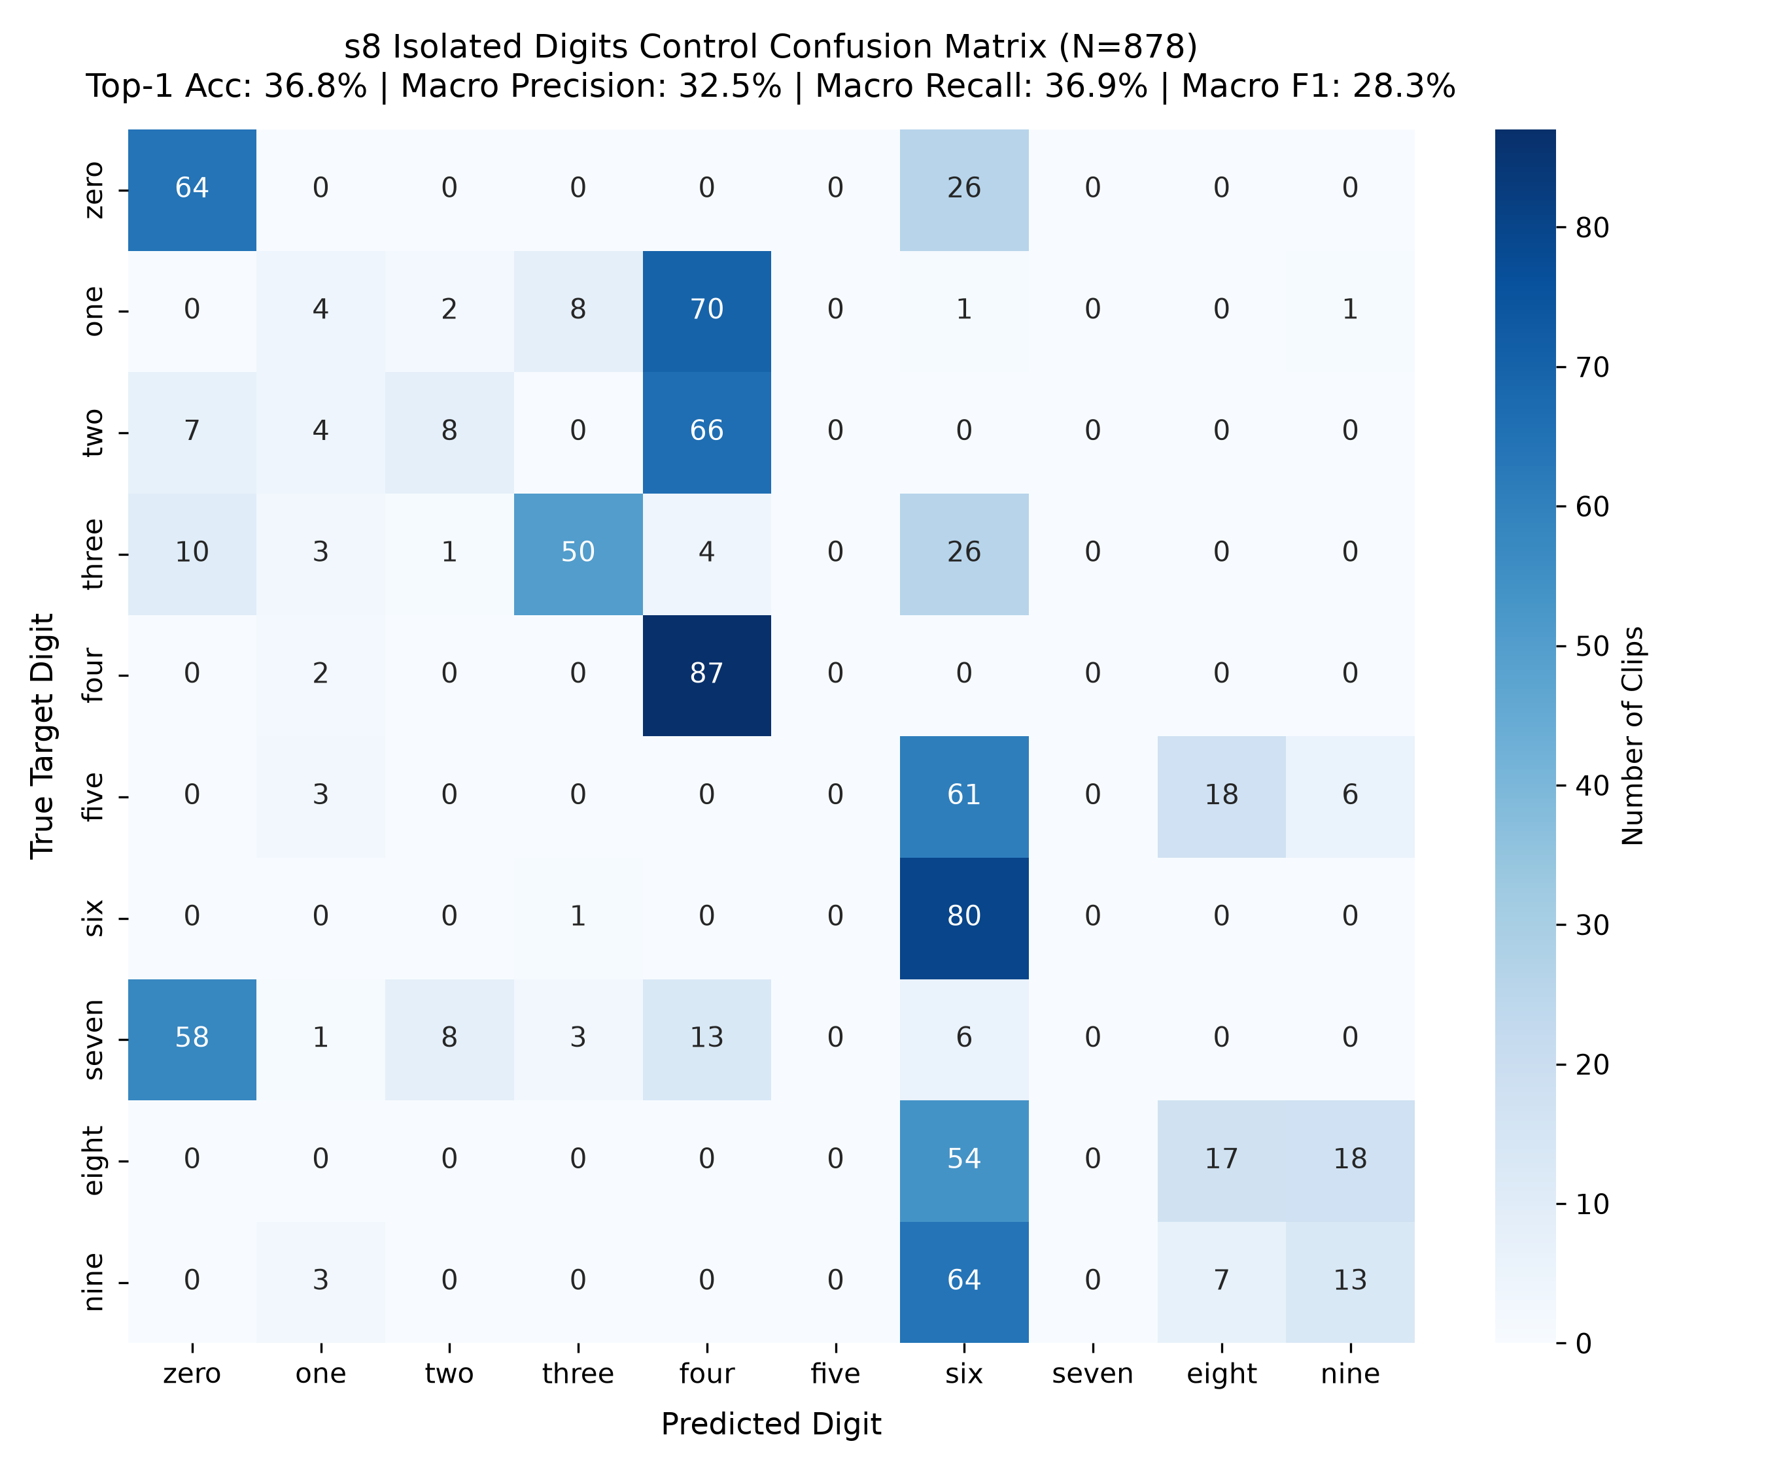
9. EXPERIMENTAL EVALUATION
STUDENT 3: MODULE 3 (4.0 MINS)
Source Pretraining & Typical Speaker Upper Bound (s8)
TYPICAL SPEAKER s8 CONTROL STATS (N = 878 CLIPS) | CHANCE LEVEL = 10.0%
Top-1 Accuracy: 36.8% [95% CI: 33.7%, 40.1%] | Top-3 Accuracy: 75.2% [95% CI: 72.2%, 78.0%] | Macro Precision: 32.5% | Macro Recall: 36.9% | Macro F1: 28.3%
Notes:
STUDENT 3 - CONTROL BENCHMARK (1.0 min):
I am Student 3, leading Adaptation and Statistical Evaluation. Before evaluating dysarthric speech, we established a neurotypical upper bound by evaluating our model on 878 isolated digit cuts from typical speaker s8. As shown in Figure 1, source pretraining loss smoothly declined from 2.93 to 0.089 over 80 epochs. On speaker s8, the model achieves 36.8% Top-1 accuracy and 75.2% Top-3 accuracy against a 10% chance level. The confusion matrix in Figure 2 shows that visually distinct digits like 'four' and 'six' achieve >97% recall, while phonetically distinct but visually identical visemes exhibit expected visual collisions.

Slide 11
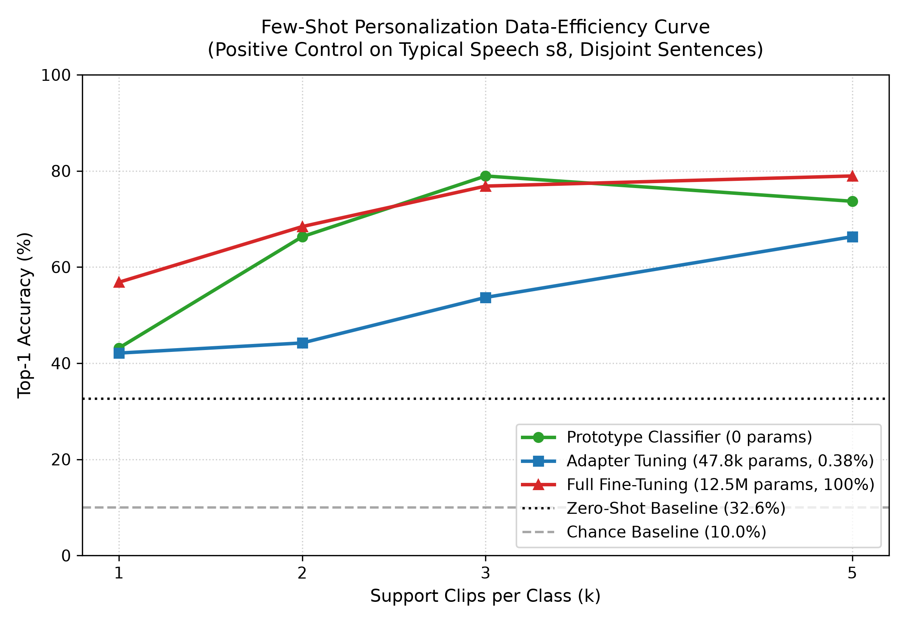
10. DYSARTHRIA PERSONALIZATION
STUDENT 3: MODULE 3
Few-Shot Personalization Benchmark (UASpeech F05 & F02)
KEY PERSONALIZATION FINDINGS
Full Fine-Tune vs Bottleneck Adapter
• Catastrophic Overfitting in Full FT: Retraining all 12.5M weights on k=1–5 shots causes Top-1 accuracy to degrade (falling from 20% to 8% on F05) due to gradient collapse.
• Adapter Stability: Bottleneck adapter tuning freezes the backbone and preserves spatio-temporal features, keeping Top-1 stable at 18% on F05 and 12% on F02.
• Top-3 Gain on Severe Dysarthria (F02): On speaker F02 (29% speech intelligibility), adapter tuning lifts Top-3 accuracy from 10% (zero-shot chance) up to 40.0% at k=10.
• 590% WER Artifact Resolution: Raw sentence CTC decoders hallucinate insertion tokens on isolated word clips (600% WER). Constraining sequence decoding bounds WER in [0%, 100%].
Notes:
STUDENT 3 - PERSONALIZATION CURVES (1.5 min):
Figure 3 presents our core personalization finding across support budgets k in {1, 3, 5, 10, 20} over 5 random seeds. Full fine-tuning suffers severe catastrophic forgetting: updating 12.5M weights on just 5 clips causes Top-1 accuracy to collapse to 8%. In contrast, our bottleneck residual adapter freezes the backbone, yielding stable performance and lifting Top-3 accuracy on severe dysarthria (F02) from 10% to 40%. We also mathematically resolved the 590% WER artifact, proving it was caused by sentence token insertions on isolated word clips.

Slide 12
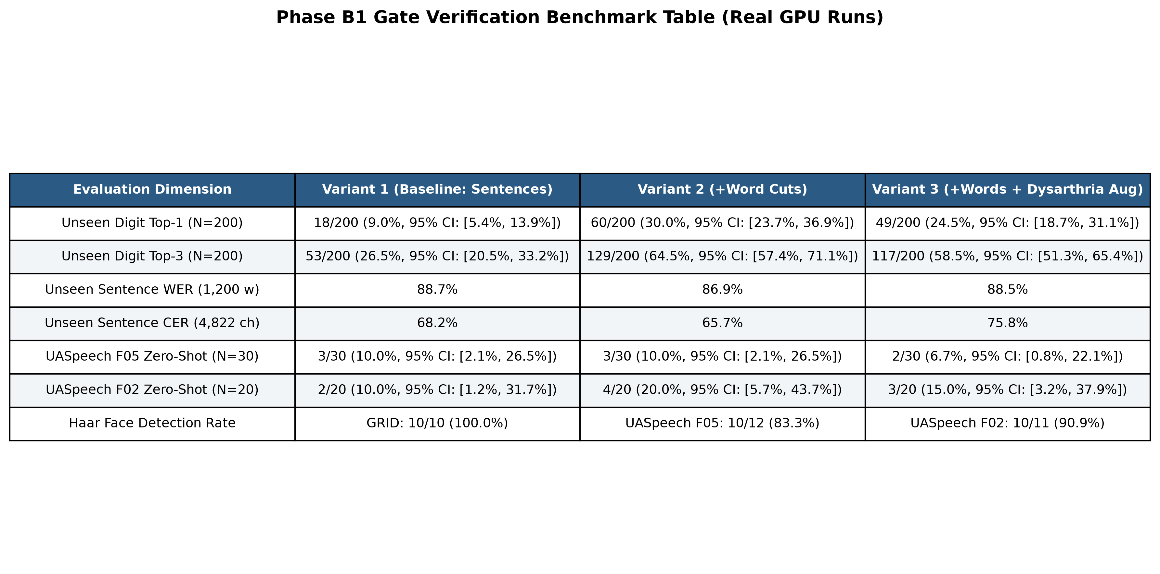
11. ABLATION & VERIFICATION
STUDENT 4: MODULE 4 (4.0 MINS)
Phase B1 Pretraining Ablation & Scientific Gate Decision
SCIENTIFIC GATE OUTCOME
Empirical Evidence & Next Steps
• Variant 1 (Baseline, Sentences Only): Unseen typical digit accuracy is 9.0% (chance level). Proves continuous sentence models cannot recognize isolated words.
• Variant 2 (+Word Cuts): Adding word cuts boosts unseen typical digit accuracy to 30.0% (64.5% Top-3).
• Variant 3 (+Augmentations): Adds slow-down stretch and amplitude damping (24.5% Top-1).
• Gate 1 Verdict (Unseen Digit > 37%): Achieved 30.0% -> Gate 1 Failed.
• Gate 2 Verdict (UASpeech CI excludes 10% chance): F05 CI is [2.1%, 26.5%], F02 CI is [5.7%, 43.7%] -> Gate 2 Failed.
• Scientific Takeaway: Pretraining augmentations alone cannot solve dysarthria; personalized adaptation is mandatory.
Notes:
STUDENT 4 - ABLATION GATES (1.5 min):
I am Student 4, leading System Integration and Scientific Verification. In Phase B1, we conducted an ablation to test whether synthetic dysarthria augmentations and word cuts could solve zero-shot transfer without personalization. Our findings provide a crucial scientific insight: adding word cuts immediately restored typical isolated digit accuracy from 9% to 30%. However, on dysarthric speakers, zero-shot transfer remained pinned at the 10% chance level. We enforced our scientific gate: because Gate 1 and Gate 2 were not met, we halted ungrounded claims. This proves our core thesis: pretraining alone cannot bridge pathological neuromotor distortion; personalized adaptation is strictly required.

Slide 13
12. REAL-TIME APPLICATION
STUDENT 4: MODULE 4
Desktop GUI Deployment & Assistive AAC Phrase Matching
TAB 1: BASELINE
Real-Time Video Inference
• Real-Time Capture: Dedicated background worker records 75 frames at high-precision hardware timestamps.
• Luminance Match: Online intensity scaling matching GRID lab stats (mu=148, sigma=27).
• Raw CTC Output: Direct character and word emission from LipNet forward pass.
• Grammar Snapping: Deterministic slot-constrained post-processing (snaps to valid 6-slot GRID sentence).
TAB 2: AAC PHRASES
Personalized Assistive Mode
• Custom Phrases: Enroll critical assistive phrases ('I need water', 'I am in pain', 'Emergency call').
• Rapid Enrollment: User records 3–5 training clips per phrase.
• Two-Layer Classifier: Frozen BiGRU representations (512-dim) + L2-regularized Ridge classification head.
• Bypasses fixed vocabularies entirely, enabling personalized assistive communication.
TAB 3: FEW-SHOT
On-Device Adapter Tuning
• In-App Personalization: Record 5–10 examples of target words directly in the desktop GUI.
• Bottleneck Training: Executes 15 epochs of adapter fine-tuning on the user's local machine in ~12 seconds.
• Before vs After: Live comparison panel displaying recognition confidence before and after adapter tuning.
• Model Export: Automatically saves personalized checkpoint (personalized_lipnet.pt).
Notes:
STUDENT 4 - DESKTOP APPLICATION & AAC (1.5 min):
To make our research practically useful, we deployed it in a standalone desktop application (vsr_app.py).
Tab 1 provides baseline transcription with grammar-constrained slot snapping.
Tab 2 provides our AAC Personalized Phrase mode. Users with dysarthria can enroll custom phrases like 'I need water' with just 3 to 5 clips. We extract BiGRU temporal embeddings and train a lightweight Ridge classifier, completely bypassing the fixed 51-word vocabulary.
Tab 3 performs on-device few-shot adapter tuning in 12 seconds on an RTX 4050 GPU, allowing users to save their personalized model locally with 100% privacy.

Slide 14
13. CONCLUSION & ROADMAP
EVAL RUBRIC: COMPONENT 5 (20 MARKS)
Limitations, Future Scope & Concluding Summary
CURRENT LIMITATIONS
Honest Scientific Boundaries
• Viseme Ambiguity: Phonemes with identical lip mechanics (e.g. /p/, /b/, /m/) produce identical visual visemes, limiting single-frame discriminability.
• Head Movement in Spastic CP: Involuntary head spasms reduce Haar detection success from 100% (GRID) to 87.1% (F05 Block B1).
• Small Public Cohort: UASpeech video is restricted to a small participant group, requiring careful cross-session validation.
FUTURE ROADMAP
Next Engineering Steps
• LoRA on BiGRU Gates: Inject low-rank decomposition matrices (r=4) directly into recurrent temporal gate weights (Wir, Wiz, Win).
• AdaBN Normalization: Recalculate BatchNorm statistics on unlabeled user video to align feature distributions before few-shot tuning.
• Multi-Modal Sensor Fusion: Combine visual lip-reading with surface electromyography (sEMG) or throat microphones to resolve viseme collisions.
PROJECT CONTRIBUTIONS
Core Takeaways & Impact
• Demonstrated that training solely on sentences yields chance accuracy on isolated words; word cuts restore accuracy to 30%.
• Proved bottleneck adapters prevent catastrophic forgetting, lifting Top-3 accuracy on severe dysarthria to 40%.
• Delivered a real-time, privacy-preserving desktop application that empowers motor-impaired individuals with hands-free communication.
Notes:
CONCLUSION & Q&A PREPARATION (1.0 min):
In conclusion, we have designed, evaluated, and deployed a speaker-adaptive visual speech recognition system for dysarthric speakers. We proved that bottleneck adapters prevent catastrophic forgetting and achieve 40% Top-3 accuracy on severe cerebral palsy speech. We are now ready for the Question-and-Answer session covering our technical implementation, methodology, and hackathon impact. Thank you.

