Slide 1
Java Servlets
M. L. Liu
Distributed Computing, M. L. Liu

Slide 2
Introduction
Servlets are modules that extend request/response-oriented servers, such as Java-enabled web servers.
Servlets are to servers what applets are to browsers: an external program invoked at runtime.
Unlike applets, however, servlets have no graphical user interface.
Servlets can be embedded in many different servers because the servlet API, which you use to write servlets, assumes nothing about the server's environment or protocol.
Servlets are portable.
Distributed Computing, M. L. Liu

Slide 3
Servlet Basics
A servlet is an object of the javax.servlet class.
It runs inside a Java Virtual Machine on a server host.
Unlike applets, servlets do not require special support in the web browser.
The Servlet class is not part of the Java Development Kit (JDK). You must download the JDSK (Java Servlet Development Kit).
A servlet is an object. It is loaded and runs in an object called a servlet engine, or a servlet container.
Distributed Computing, M. L. Liu

Slide 4
Uses for Servlets http://java.sun.com/docs/books/tutorial/servlets/overview/index.html
Providing the functionalities of CGI scripts with a better API and enhanced capabilities.
Allowing collaboration between people. A servlet can handle multiple requests concurrently, and can synchronize requests. This allows servlets to support systems such as on-line conferencing.
Forwarding requests. Servlets can forward requests to other servers and servlets. Thus servlets can be used to balance load among several servers that mirror the same content, and to partition a single logical service over several servers, according to task type or organizational boundaries.
Distributed Computing, M. L. Liu

Slide 5

Generic Servlets and HTTP Servlets
Java Servlet Programming, O’Reilley Press
Every servlet must implement the javax.servlet.Servlet interface
Most servlets implement the interface by extending one of these classes
  javax.servlet.GenericServlet
  javax.servlet.http.HttpServlet
A generic servlet should override the service( ) method to process requests and generate appropriate responses.
An HTTP servlet overrides the doPost( ) and/or doGet( ) method.
Distributed Computing, M. L. Liu

Slide 6
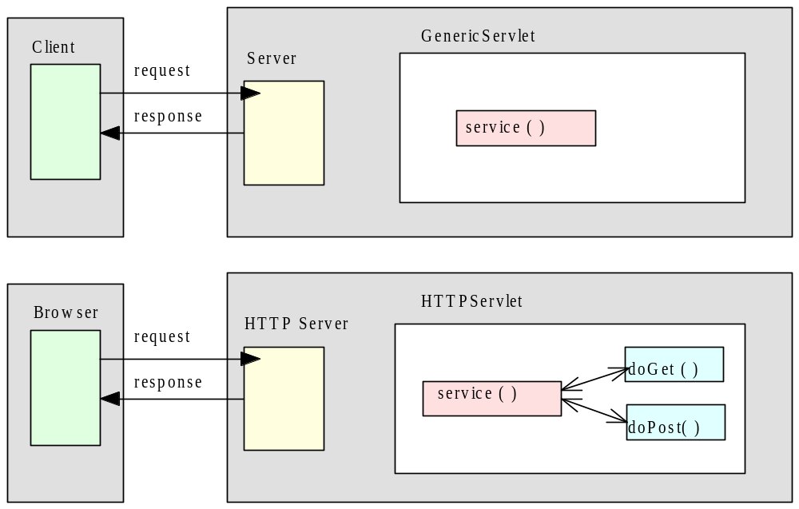
Generic and HTTP Servlets
Distributed Computing, M. L. Liu

Slide 7
A simple Servlet, from http://java.sun.com/docs/books/tutorial/servlets/overview/simple.html
public class SimpleServlet extends HttpServlet {
/** * Handle the HTTP GET method by building a simple web page. */
public void doGet (HttpServletRequest request, HttpServletResponse response) throws ServletException, IOException {
PrintWriter out;
String title = "Simple Servlet Output";
// set content type and other response header fields first response.setContentType("text/html");
// then write the data of the response out = response.getWriter(); out.println("<HTML><HEAD><TITLE>");
out.println(title);
out.println("</TITLE></HEAD><BODY>");
out.println("<H1>" + title + "</H1>");
out.println("<P>This is output from SimpleServlet."); out.println("</BODY></HTML>");
out.close();
}
}
Distributed Computing, M. L. Liu

Slide 8

Using HTTP Servlet to process web forms http://java.sun.com/docs/books/tutorial/servlets/client-interaction/req-res.html
Requests and Responses
Methods in the HttpServlet class that handle client requests take two arguments:
  An HttpServletRequest object, which encapsulates the data from the client
  An HttpServletResponse object, which encapsulates the response to the client
public void doGet (HttpServletRequest request, HttpServletResponse response)
public void doPost(HttpServletRequest request, HttpServletResponse response)
Distributed Computing, M. L. Liu

Slide 9
HttpServletRequest Objects http://java.sun.com/docs/books/tutorial/servlets/client-interaction/req-res.html
An HttpServletRequest object provides access to HTTP header data, such as any cookies found in the request and the HTTP method with which the request was made.
The HttpServletRequest object also allows you to obtain the arguments that the client sent as part of the request.
To access client data:
  The getParameter method returns the value of a named parameter. If your parameter could have more than one value, use getParameterValues instead. The getParameterValues method returns an array of values for the named parameter. (The method getParameterNames provides the names of the parameters.)
  For HTTP GET requests, the getQueryString method returns a String of raw data from the client. You must parse this data yourself to obtain the parameters and values.
Distributed Computing, M. L. Liu

Slide 10
HttpServletRequest Interface
public String ServletRequest.getQueryString( ); returns the query string of the requst.
public String GetParameter(String name): given the name of a parameter in the query string of the request, this method returns the value.
  String id = GetParameter(“id”)
public String[ ] GetParameterValues(String name): returns multiple values for the named parameter – use for parameters which may have multiple values, such as from checkboxes.
  String[ ] colors = req.getParmeterValues(“color”);
    if (colors != null)
    for (int I = 0; I < colors.length; I++ )
    out.println(colors[I]);
public Enumeration getParameterNames( ): returns an enumeration object with a list of all of the parameter names in the query string of the request.
Distributed Computing, M. L. Liu

Slide 11
HttpServletResponse Objects http://java.sun.com/docs/books/tutorial/servlets/client-interaction/req-res.html
An HttpServletResponse object provides two ways of returning data to the user:
  The getWriter method returns a Writer
  The getOutputStream method returns a ServletOutputStream
Use the getWriter method to return text data to the user, and the getOutputStream method for binary data.
Closing the Writer or ServletOutputStream after you send the response allows the server to know when the response is complete.
Distributed Computing, M. L. Liu

Slide 12
HttpServletResponse Interface
public interface HttpServletResponse extends ServletResponse: “The servlet engine provides an object that implements this interface and passes it into th servlet through the service method” – “Java Server Programming”
public void setContentType(String type) : this method must be called to generate the first line of the HTTP response:
  setContentType(“text/html”);
public PrintWriter getWriter( ) throws IOException: returns an object which can be used for writing the responses, one line at a time:
  PrintWriter out = res.getWriter;
  out.println(“<h1>Hello world</h1>”);
Distributed Computing, M. L. Liu

Slide 13
Servlets are Concurrent servers http://java.sun.com/docs/books/tutorial/servlets/client-interaction/req-res.html
HTTP servlets are typically capable of serving multiple clients concurrently.
If the methods in your servlet do work for clients by accessing a shared resource, then you must either:
  Synchronize access to that resource, or
  Create a servlet that handles only one client request at a time.
Distributed Computing, M. L. Liu

Slide 14
Handling GET requests http://java.sun.com/docs/books/tutorial/servlets/client-interaction/http-methods.html
public class BookDetailServlet extends HttpServlet {
public void doGet (HttpServletRequest request,
HttpServletResponse response) throws ServletException, IOException
{
...
// set content-type header before accessing the Writer response.setContentType("text/html");
PrintWriter out = response.getWriter();
// then write the response
out.println("<html>" +
"<head><title>Book Description</title></head>" + ... );
//Get the identifier of the book to display
String bookId = request.getParameter("bookId");
if (bookId != null) {
// fetch the information about the book and print it ... } out.println("</body></html>");
out.close(); } ...}
Distributed Computing, M. L. Liu

Slide 15
Handling POST Requests http://java.sun.com/docs/books/tutorial/servlets/client-interaction/http-methods.html
public class ReceiptServlet extends HttpServlet {
public void doPost(HttpServletRequest request, HttpServletResponse response) throws ServletException, IOException {
...
// set content type header before accessing the Writer response.setContentType("text/html");
PrintWriter out = response.getWriter( );
// then write the response
out.println("<html>" + "<head><title> Receipt </title>" + ...);
out.println("Thank you for purchasing your books from us " + request.getParameter("cardname") + ...);
out.close();
}
...
}
Distributed Computing, M. L. Liu

Slide 16
The Life Cycle of an HTTP Servlet
The web server loads a servlet when it is called for in a web page.
The web server invokes the init( ) method of the servlet.
The servlet handles client responses.
The server destroys the servlet (at the request of the system administrator). A servlet is normally not destroyed once it is loaded.
Distributed Computing, M. L. Liu

Slide 17
Servlet Examples
See Servlet\simple folder in code sample:
HelloWorld.java: a simple servlet
Counter.java: illustrates that a servlet is persistent
Counter2.java: illustrates the use of synchronized method with a servlet
GetForm.html, GetForm.java: illustrates the processing of data sent with an HTTP request via the GET method
PostForm.html, PostForm.java: illustrates the processing of data sent with an HTTP request via the POST method
Distributed Computing, M. L. Liu

Slide 18
Session State Information
The mechanisms for state information maintenance with CGI can also be used for servlets: hidden-tag, URL suffix, file/database, cookies.
In addition, a session tracking mechanism is provided, using an HttpSession object.
Distributed Computing, M. L. Liu

Slide 19
Cookies in Java http://java.sun.com/products/servlet/2.2/javadoc/index.html
A cookie has a name, a single value, and optional attributes such as a comment, path and domain qualifiers, a maximum age, and a version number. Some Web browsers have bugs in how they handle the optional attributes, so use them sparingly to improve the interoperability of your servlets.
The servlet sends cookies to the browser by using the HttpServletResponse.addCookie(javax.servelet.http.Cookie) method, which adds fields to HTTP response headers to send cookies to the browser, one at a time. The browser is expected to support 20 cookies for each Web server, 300 cookies total, and may limit cookie size to 4 KB each.
The browser returns cookies to the servlet by adding fields to HTTP request headers. Cookies can be retrieved from a request by using the HttpServletRequest.getCookies( ) method. Several cookies might have the same name but different path attributes.
Distributed Computing, M. L. Liu

Slide 20
Processing Cookies with Java
Java Server Programming – Wrox press
A cookie is an object of the javax.servlet.http.cookie class.
Methods to use with a cookie object:
public Cookie(String name, String value): creates a cookie with the name-value pair in the arguments.
    import javax.servlet.http.*
    Cookie oreo = new Cookie(“id”,”12345”);
public string getName( ) : returns the name of the cookie
public string getValue( ) : returns the value of the cookie
public void setValue(String _val) : sets the value of the cookie
public void setMaxAge(int expiry) : sets the maximum age of the cookie in seconds.
Distributed Computing, M. L. Liu

Slide 21
Processing Cookies with Java – 2
Java Server Programming – Wrox press
public void setPath(java.lang.String uri) : Specifies a path for the cookie to which the client should return the cookie. The cookie is visible to all the pages in the directory you specify, and all the pages in that directory's subdirectories. A cookie's path must include the servlet that set the cookie, for example, /catalog, which makes the cookie visible to all directories on the server under /catalog.
public java.lang.String getPath() : Returns the path on the server to which the browser returns this cookie. The cookie is visible to all subpaths on the server.
public String getDomain( ) : returns the domain of the cookie.
    if orea.getDomain.equals(“.foo.com”)
    … // do something related to golf
public void setDomain(String _domain): sets the cookie’s domain.
Distributed Computing, M. L. Liu

Slide 22
doGet Method using cookies
public void doGet(HttpServletResponse req, HttpServletResponse res)
throws ServletException, IOExceiption{
res.setContentType(“text/html”);
PrintWriter out = res.getWriter( );
out.println (“<H1>Contents of your shopping cart:</H1>”);
Cookie cookies[ ];
cookies = req.getCookies( );
if (cookies != null) {
for ( int i = 0; i < cookies.length; i++ ) {
if (cookies[i].getName( ).startWith(“Item”))
out.println( cookies[i].getName( ) + “: “ + cookies[i].getValue( ));
out.close( );
}
Distributed Computing, M. L. Liu

Slide 23
Servlet & Cookies Example
See Servlet\cookies folder in code sample:
Cart.html: web page to allow selection of items
Cart.java: Servlet invoked by Cart.html; it instantiates a cookie object for each items selected.
Cart2.html: web page to allow viewing of items currently in cart
Cart2.java: Servlet to scan cookies received with the HTTP request and display the contents of each cookie.
Distributed Computing, M. L. Liu

Slide 24
HTTP Session Objects http://java.sun.com/products/servlet/2.2/javadoc/index.html
The javax.servlet.http package provides a
public interface HttpSession: Provides a way to identify a user across more than one page request or visit to a Web site and to store information about that user.
The servlet container uses this interface to create a session between an HTTP client and an HTTP server. The session persists for a specified time period, across more than one connection or page request from the user. A session usually corresponds to one user, who may visit a site many times.
Distributed Computing, M. L. Liu

Slide 25
HTTP Session Object - 2 http://java.sun.com/products/servlet/2.2/javadoc/index.html
This interface allows servlets to
  View and manipulate information about a session, such as the session identifier, creation time, and last accessed time
  Bind objects to sessions, allowing user information to persist across multiple user connections
Session object allows session state information to be maintained without depending on the use of cookies (which can be disabled by a browser user.)
Session information is scoped only to the current web application (ServletContext), so information stored in one context will not be directly visible in another.
Distributed Computing, M. L. Liu

Slide 26
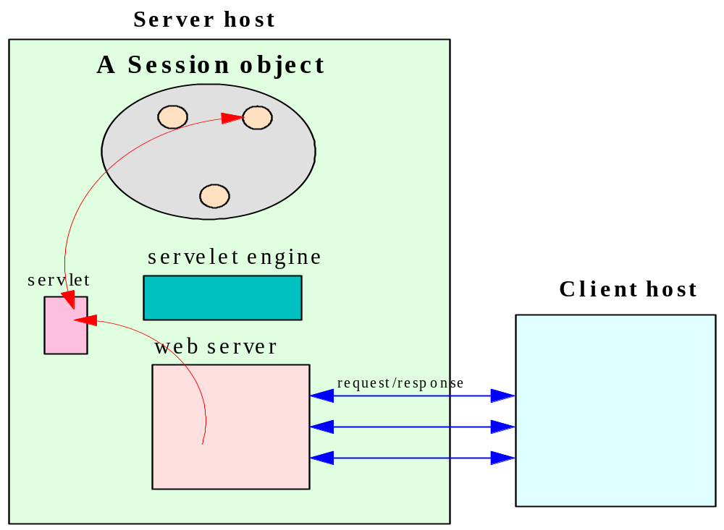
The Session object
Distributed Computing, M. L. Liu

Slide 27
Obtaining an HTTPSession Object
  A session object is obtained using the getSession( ) method of the HttpServletRequest object (from doPost or doGet)
  public HTTPSession getSession(boolean create): Returns the current HttpSession associated with this request or, if if there is no current session and create is true, returns a new session. If create is false and the request has no valid HttpSession, this method returns null.
  To make sure the session is properly maintained, you must call this method before the response is committed.
    public class ShoppingCart extends HttpServlet {
    public void doPost(HttpServletRequest req, HttpServletRespnse res)
    throws ServletException, IOException
    …
    // get session object
    HttpSession session = req.getSession(true)
    if (session != null) {
    …
    } …
Distributed Computing, M. L. Liu

Slide 28
The HTTPSession Object methods
public java.lang.String getId( ): returns a string containing the unique identifier assigned to this session. The identifier is assigned by the servlet container and is implementation dependent.
public java.lang.Object getAttribute(java.lang.String name): returns the object bound with the specified name in this session, or null if no object is bound under the name.
public java.util.Enumeration getAttributeNames( ): returns an Enumeration of String objects containing the names of all the objects bound to this session.
public void removeAttribute(java.lang.String name): removes the object bound with the specified name from this session. If the session does not have an object bound with the specified name, this method does nothing.
Distributed Computing, M. L. Liu

Slide 29
Session Object example
See Servlet\Session folder in code sample:
Cart.html: web page to allow selection of items
Cart.java: Servlet invoked by Cart.html; it instantiates a session object which contains descriptions of items selected.
Cart2.html: web page to allow viewing of items currently in cart
Cart2.java: Servlet to display items in the shopping cart, as recorded by the use a session object in the Cart servlet
Distributed Computing, M. L. Liu

Slide 30
Summary - 1
A servlet is a Java class.
Its code is loaded to a servlet container on the server host.
It is initiated by the server in response to a client’s request.
Once loaded, a servlet is persistent.
Distributed Computing, M. L. Liu

Slide 31
Summary - 2
For state information maintenance:
  hidden form fields
  cookies
  the servlet’s instance variables may hold global data
  a session object can be used to hold session data
Distributed Computing, M. L. Liu

