Slide 1

Project Title – TELECOM CUSTOMER RETENTION
NAIDU JHANSI BHARATH
SRM University AP

Slide 2

PROBLEM STATEMENT
To predict whether a telecom customer is likely to churn based on service they get

Slide 3
Project Description
I want to build a predictive model to check wheather customer is going to leave our service or not

Slide 4

WHO ARE THE END USERS?
Telecom Company’s Customer Retention Team
Marketing Department
Business Analysts
Data Science Team

Slide 5

Technology Used
Programming Language: Python
Libraries: Pandas, NumPy, Matplotlib, Seaborn, Scikit-learn
Tools: Google Colab
Algorithm Used: Logistic Regression, Decision Tree, Random Forest
Dataset: Telecom Customer Churn Dataset

Slide 6
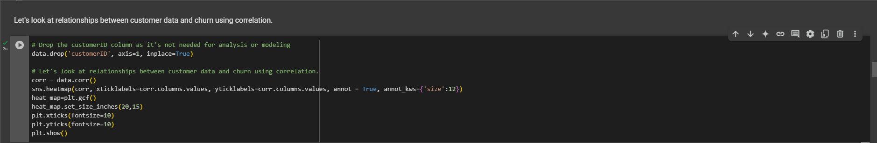
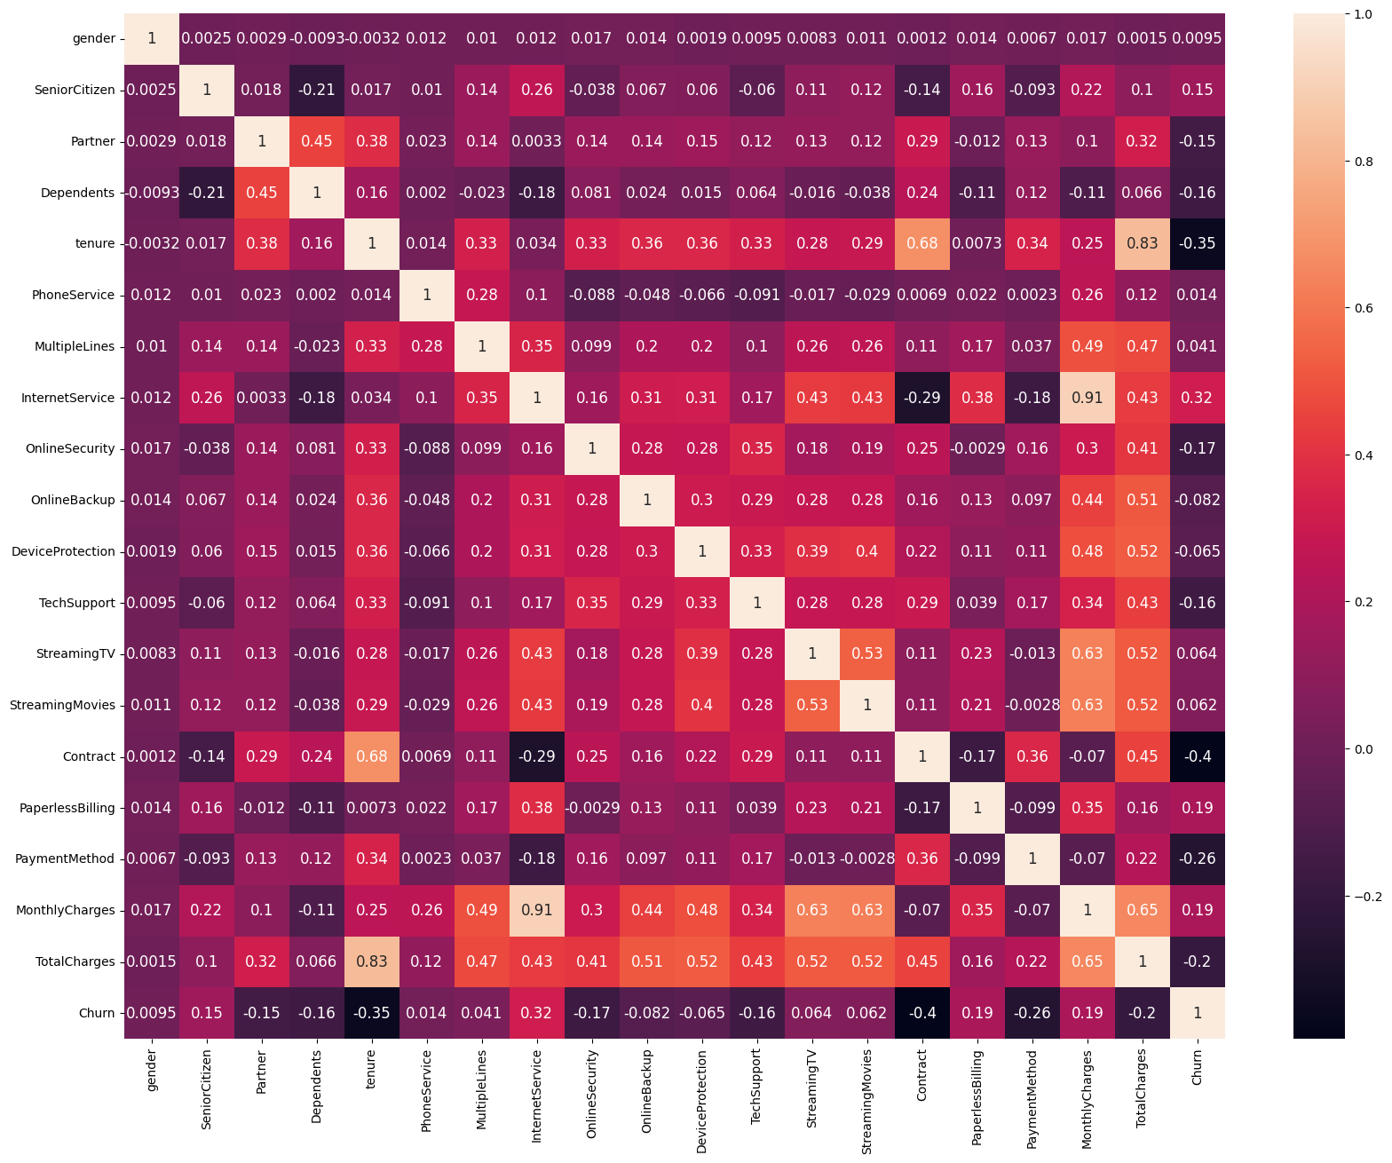
RESULTS
GitHub Link - https://github.com/jhansibharath-n/Telecom-Customer-Retention

Slide 7
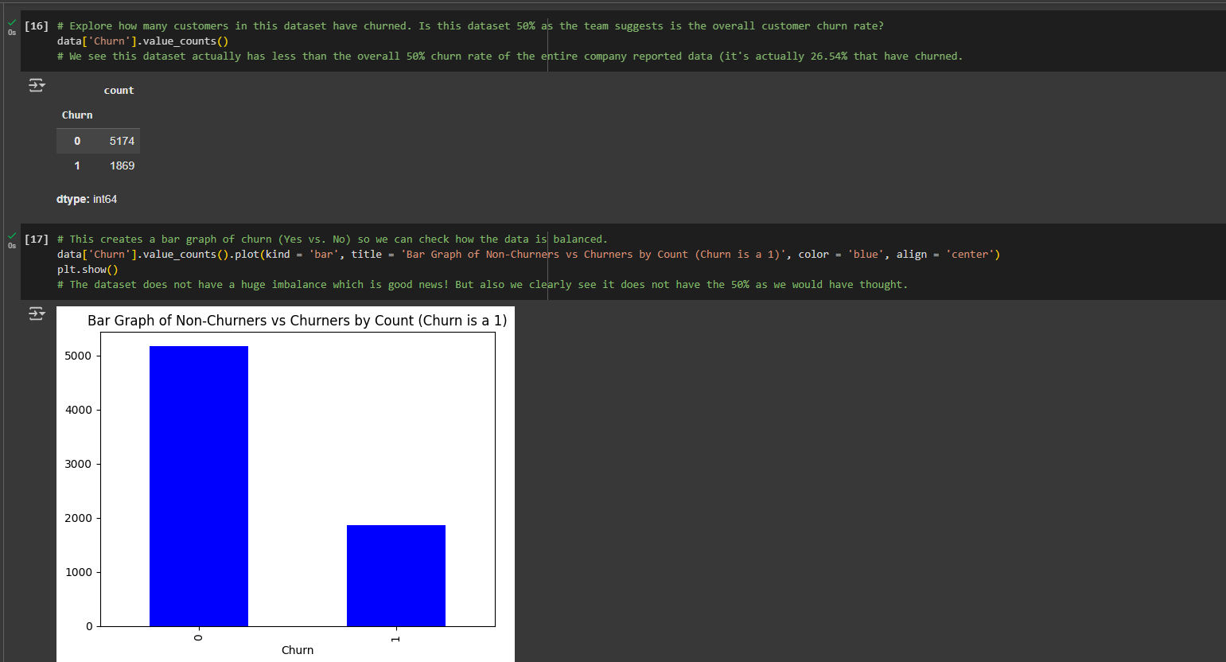
RESULTS

Slide 8
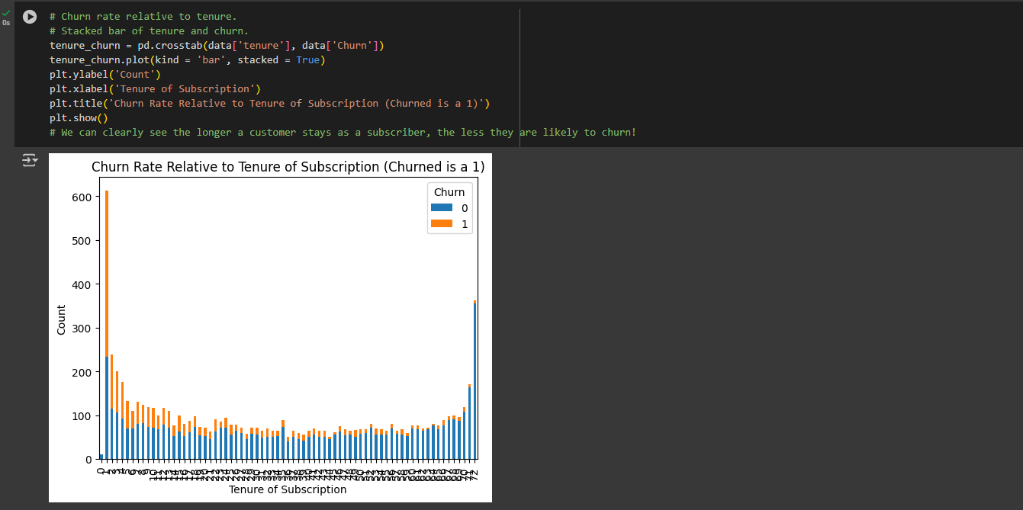
RESULTS

Slide 9
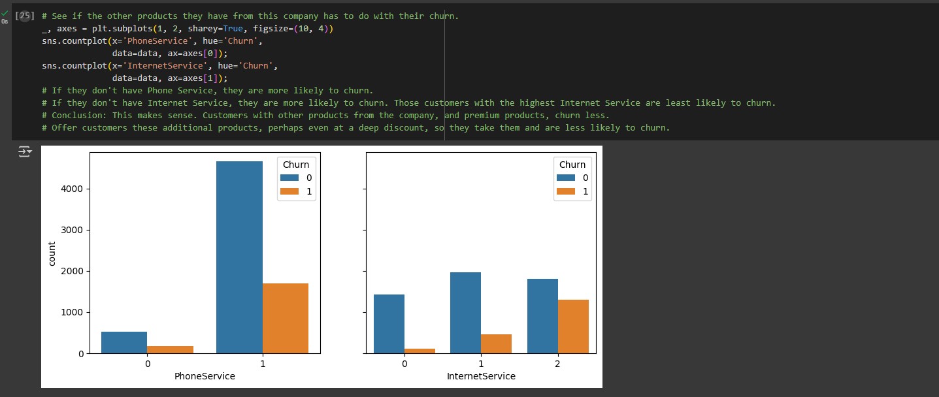
RESULTS

Slide 10
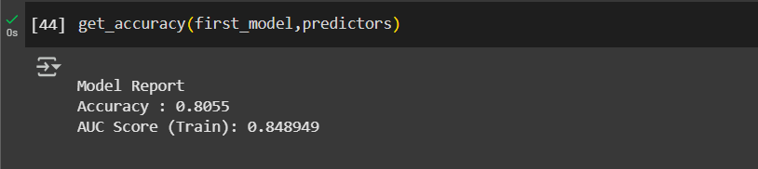
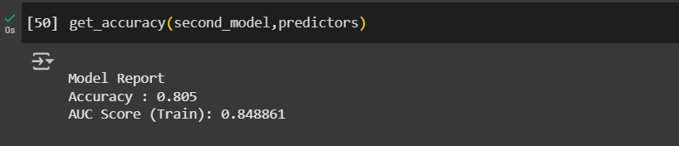
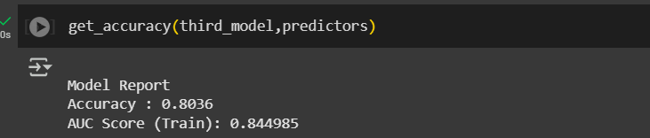
RESULTS

Slide 11
Thank you

