Slide 1
Test Automation
Overview and Demo
www.cigniti.com | Distribution is Restricted. Copyright © 2018, Cigniti Technologies

Slide 2



























Gallop Unified Test Automation Framework
Highlights
  CI Server
Visual Studio Code
Config. File
Generic Utility Libraries
Protractor based Unified Framework for Web and API testing.
Supports UI and Non UI based test automation
Pro-Agile – CI enabled using Jenkins
Centralized, easy to configure settings for the scripts to run across the environments
Execution summary reports
Customized HTML reporting with custom reporting engine for reports in HTML formats
Standardized protractor functions to identify and operate page elements
Decoupled Gulp files to handle multiple application configurations and settings
Ability to prioritize and execute a subset of test suites
Web
Accelerators
Data
Driver
Log
Generator
Application Specific
Library
Build Definitions
Test Definitions
Build Script
Repository
Automation Scripts
Object Management
Page Object Factory
  Test Management
Test Input Data
Html Reports
Test Suites
Test Plans
Test Cases
Web Agent
OS
Application Under Test

Slide 3
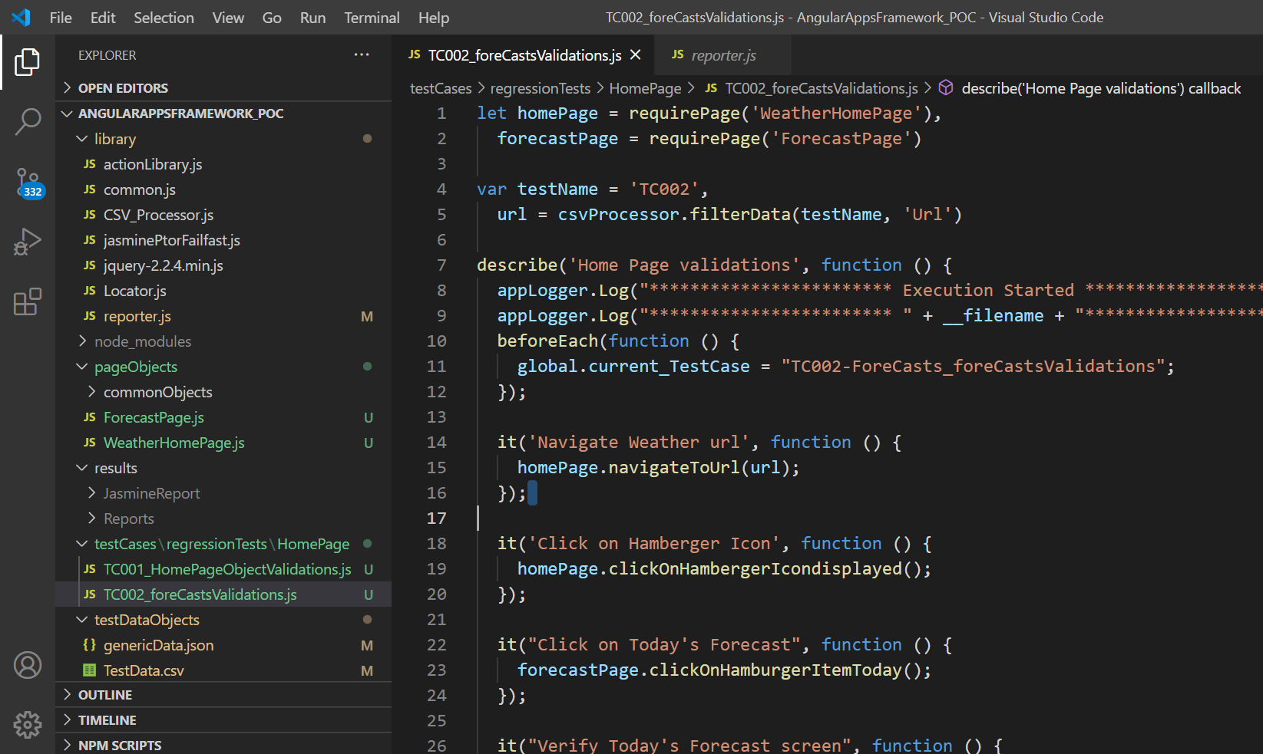
Demo – Web Test Automation
Demonstrating POC UI Test Automation Framework
Validate Shipping Contact is auto populated based on Shipping customer selection
Validate billing Contact is auto populated based on Shipping customer selection
Validate Ordering Contact is auto populated based on Shipping customer selection
Validate “Customer & Job Details” is highlighted
Enter Job name
Select Sales Rep value
Select Rush job value
Select Sample required
Click on 'X' mark on Create Job window/Back button
Click on Create Job button present on the job list screen.
Validate header
Select Shipping Customer form Dropdown and Enter Shipping Customer
Select billing Customer form Dropdown and Enter billing Customer
Validate Shipping Contact is auto populated based on Shipping customer selection
Validate billing Contact is auto populated based on Shipping customer selection
Validate Ordering Contact is auto populated based on Shipping customer selection
Validate “Customer & Job Details” is highlighted
Enter Job name
Select Sales Rep value
Select Rush job value
Select Sample required
Click on Next button
Click on ASI button
Enter any apprel type in products Name like Shirts,trousers etc.
Click on search button
Mouse over on any product
Click on Order Now button
Validate Product image, product name, product code and vendor name on the top left corner of the screen
Validate different colors are displayed in each row
Validate different sizes are displayed in each column
Enter the quantity under each size and color
Click on Add Pricing button
In 'Quantities and Color ' page Enter Quantity
Click on Add Pricing button
In 'Set Dates & Pricing ' page select Requested Ship date
Select In Hand date
Click on Calendar next to each product and set Requested ship date and In hand date
Select any or all the check box under 'DO NOT SHOW CUSTOMERS' section
Enter Cost for each item
Enter Price for each item
Enter Customer Item for each item
Click on Add Line Item button
Validate the Status column value
Validate Décor column value
Application under test | Weather Forcats
Scripting language | JavaScript
Automation Tool | Protractor, Jasmine
Reporting | HTML
Scenario : Verify Weather Forecasts
Launch application
Click on Hamburger Icon.
Click on Today Forecast
Verify Hourly Forecast screen is should be displayed.
Click on Hamburger Icon.
Click on Hourly Forecast
Verify Hourly Forecast screen is should be displayed.
Click on Hamburger Icon.
Click on 10-day Forecast
Verify 10-day Forecast screen is should be displayed.
Click on Hamburger Icon.
Click on Weekend Forecast
Verify Weekend Forecast screen is should be displayed.
Click on Hamburger Icon.
Click on Monthly Forecast
Verify Monthly Forecast screen is should be displayed.

Slide 4
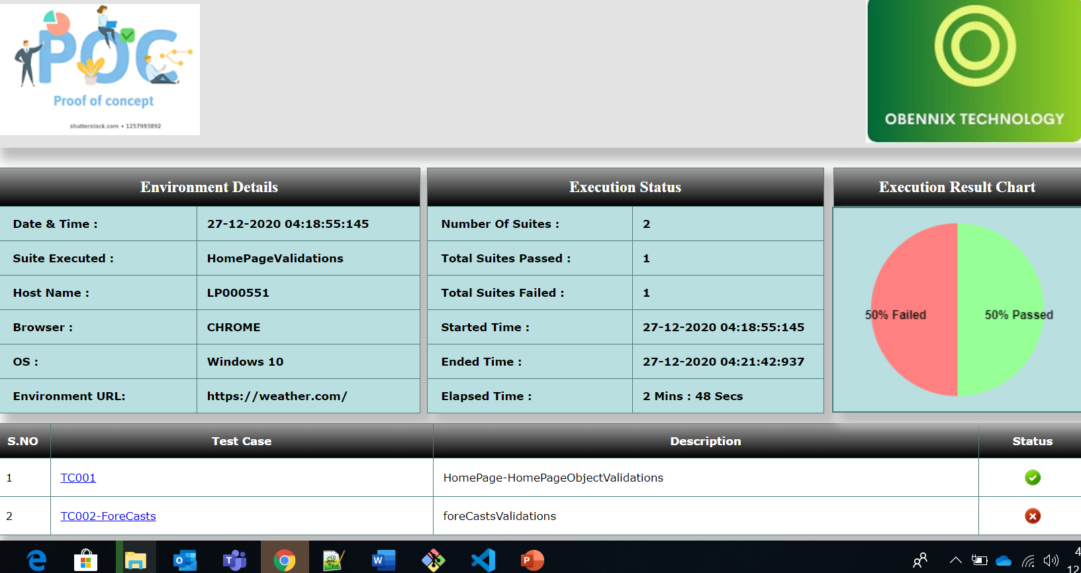

Slide 5
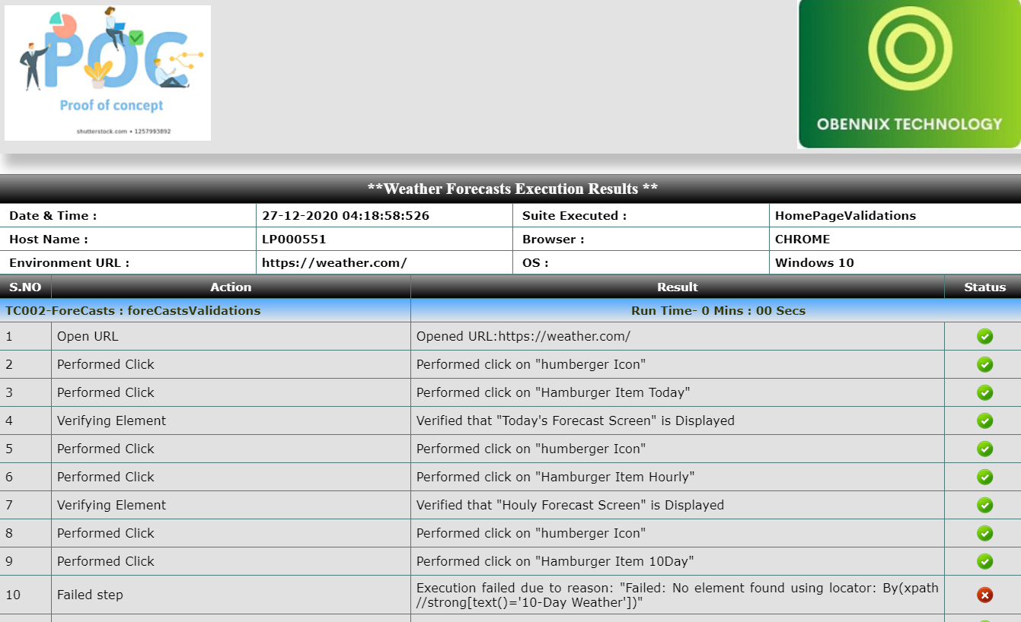

Slide 6

Thank You

