Slide 1
A Recommender System for Boutique shop in houston
Applied Data Science Capstone
IBM Data Science Professional Certificate

Slide 2
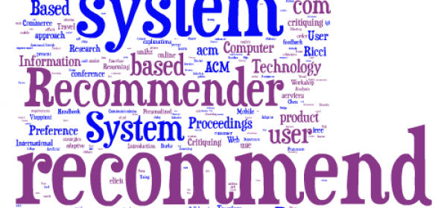
A venue Recommender System for shops
Image is from this site: https://www.geo-viz.com/blog/business-aspects-recommender-systems<

Slide 3
Synopsis
Part 1: Problem Description
Well there are many factors to be considered to open a small or big level business. For example, say I wants to open a boutique shop, first and foremost important point to decide is the location for the new shop. On what basis can I decide my shop’s location? Do I want to rent the place or can I afford to buy it? While selecting the place there are key points to consider like I need to check out how many boutique shops are there in that specific location? If incase there are already two boutique shop which have good ratings, will it be risky to open new one near these shops? What all factors will help me to run my business above average

Slide 4
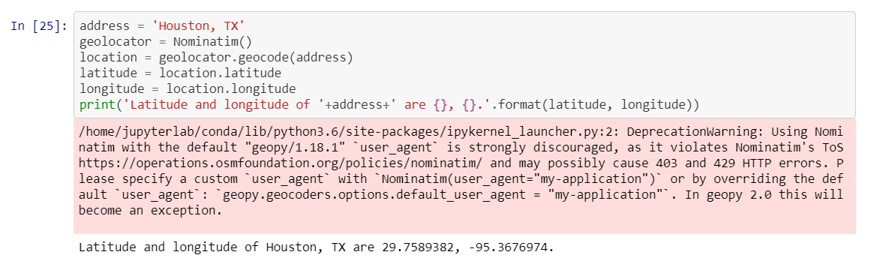
Synopsis
Part 2: Data We Need
We will need geo-locational information about that specific shop and the neighborhoods in that city. We assume it is “Downtown" in Houston. This is easily provided for us by the contractor, because the contractor has already made up his mind about the Houston.

Slide 5
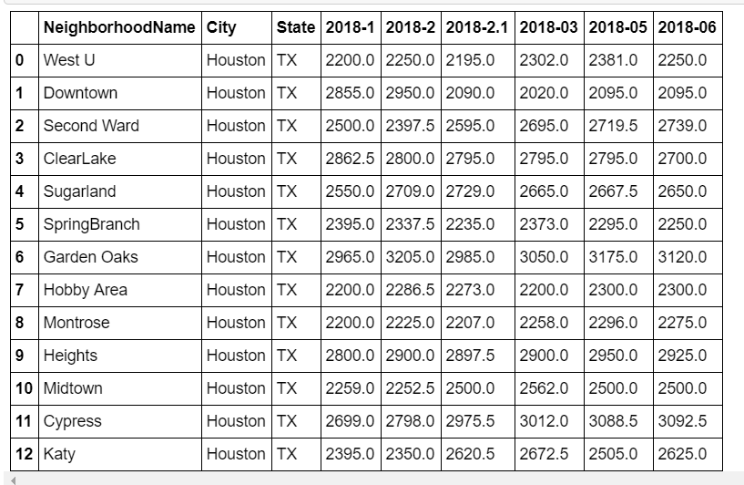
Synopsis
Part 2: Data We Need
b) We will need data about different venues in different neighborhoods of that specific borough. In order to gain that information we will use "Foursquare" locational information.

Slide 6
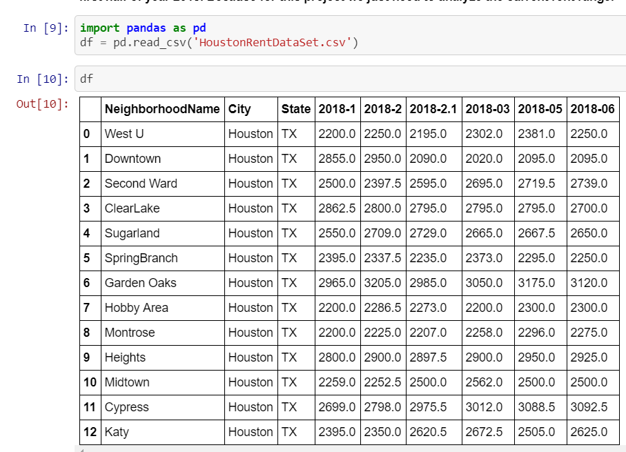
Main Article
Part 1: Identifying Neighborhoods in Houston"

Slide 7
Main Article
Part 2: Connecting to Foursquare and Retrieving Locational Data for Each Venue in Every Neighborhood
After finding the list of neighborhoods, we then connect to the Foursquare API to gather information about venues inside each and every neighborhood. For each neighborhood, we have chosen the radius to be 500 meter. It means that we have asked Foursquare to find venues that are at most 500 meter far from the center of the neighborhood.

Slide 8
Main Article
Part 3: Processing the Retrieved Data and Creating a DataFrome for All the Venues inside the Downtown Houston
When the data is completely gathered, we will perform processing on that raw data to find our desirable features for each venue. Our main feature is the category of that venue. After this stage, the column "Venue's Category" will be One-hot encoded and different venues will have different feature-columns. After On-hot encoding we will integrate all restaurant columns to one column "Total Boutique" and all food joint columns to "Total Joints" column.

Slide 9
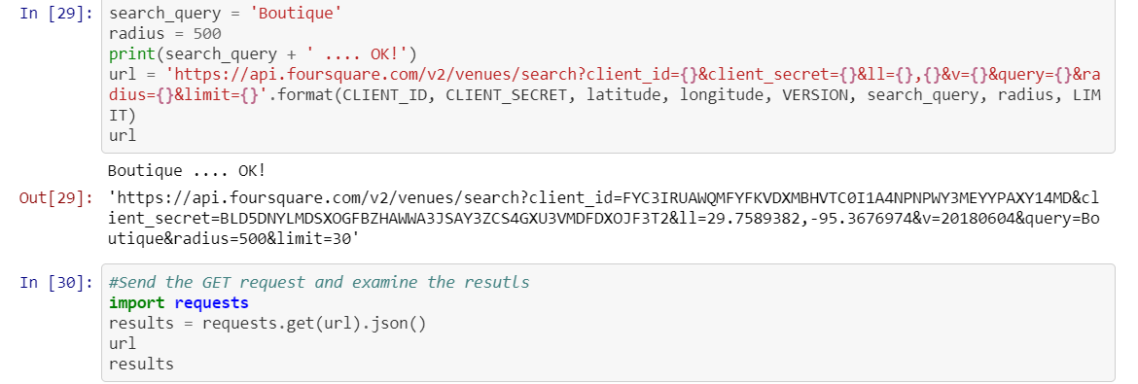
Main Article
Part 3: Processing the Retrieved Data and Creating a Data Frame for All the Venues inside the Houston

Slide 10
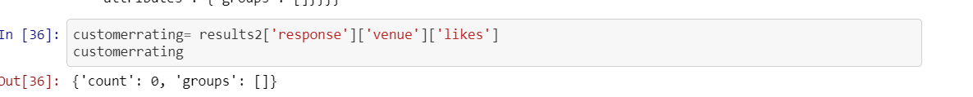
Decision Making and Reporting Results
Part 3: Based on the rating for the neighborhood Boutique shops, we can decide if it is a good location to open our new shop or not.
And by analyzing the near by shops ratings and likes we can decide the customer analysis for that specific location.

Slide 11
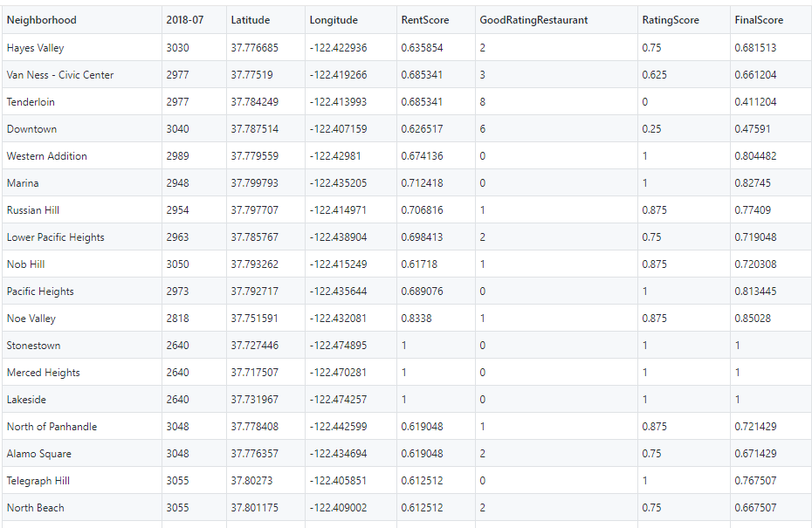
Conclusion
Like this for every neighborhood we can retrieve the rating value from json and calculate the final Score.

Slide 12

Image is from: https://contenthub-static.grammarly.com/blog/wp-content/uploads/2017/10/thank-you-760x400.jpg

