Slide 1

RESUME ANALYZER
SUBMITTED BY:
JHANSI SREYA JAGARAPU(00856274)
SATHWIK SARANGAM (00872880)

Slide 2
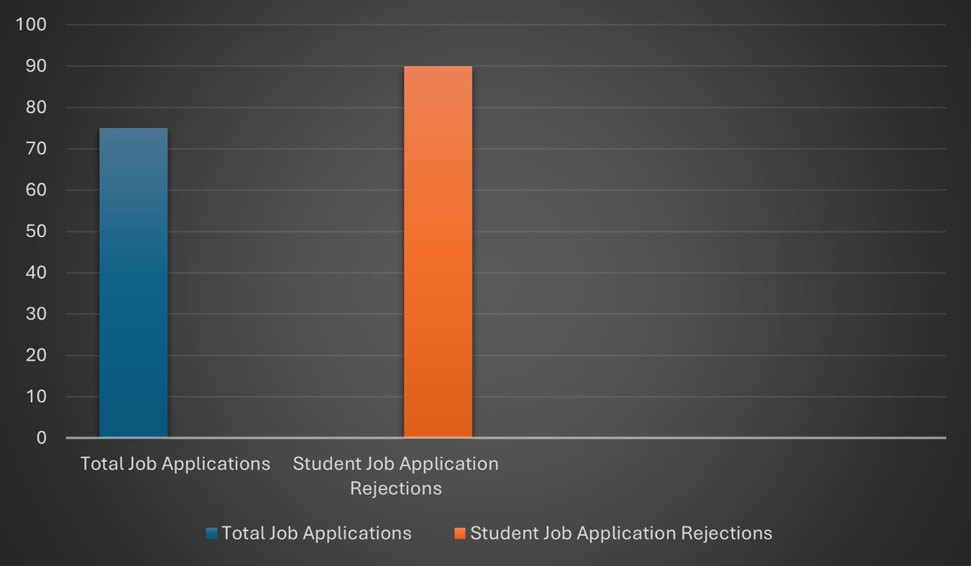
INTRODUCTION
According to recent studies, approximately 75% of job applications are rejected, with student applicants facing an even higher rejection rate of approximately 90%.
Major reason behind student rejections is the mismatch between their skills and the job roles they apply for.
Resume Analyzer is a solution designed to tackle the issue of student rejections in job applications.

Slide 3
WHAT DOES RESUME ANALYZER DO?
Resume Analyzer aligns your skills with those specified in the job description, offering insights into compatibility. Utilizing synonyms and related terms enhances skill extraction for a comprehensive analysis of your qualifications.
It evaluates your resume's quality through a scoring system, highlighting areas for improvement and optimization.
The tool offers recommendations on suitable job roles based on your skills, guiding you towards positions where you're likely to succeed.
Resume Analyzer suggests the optimal resume format for the specific job role, ensuring your qualifications are effectively showcased.
It also provides number of skills that are matched to the job description by using quantifiable achievements.

Slide 4
DATASET
modified_jobs.csv
Job Id
Work Type
Job Title
Experience
Qualifications
Salary Range
location
Country
Role
Job Description
combined_skills.csv
Skills
resumes dataset
A set of resumes with different styles such as infographics and normal resumes

Slide 5
EVALUATION METHODOLOGY
The project’s evaluation hinges on the successful implementation of :
Data Collection and Preparation
Feature Extraction
Extraction of skills
Using related words or synonyms for skills extraction
Matching percentage or matching confidence
Using quantifiable achievements for KNN and SVM algorithm implementation
Listing of jobs suitable for Resume
Predicting accuracy, precision, recall and F1 score

Slide 6
DELIVERABLES
Proposal Presentation : Explanation of the project, approach, and evaluation methodology
Datasets : Datasets and their uses are explained
Flowchart : To explain how resume analyzer works, a flow chart is used for better understandings
Implementation : Explanation of code and results
YouTube video : Demonstrating the project and execution of the code
GitHub repository : Documentation, final working code, required resources, YouTube video, and other reference links.

Slide 7
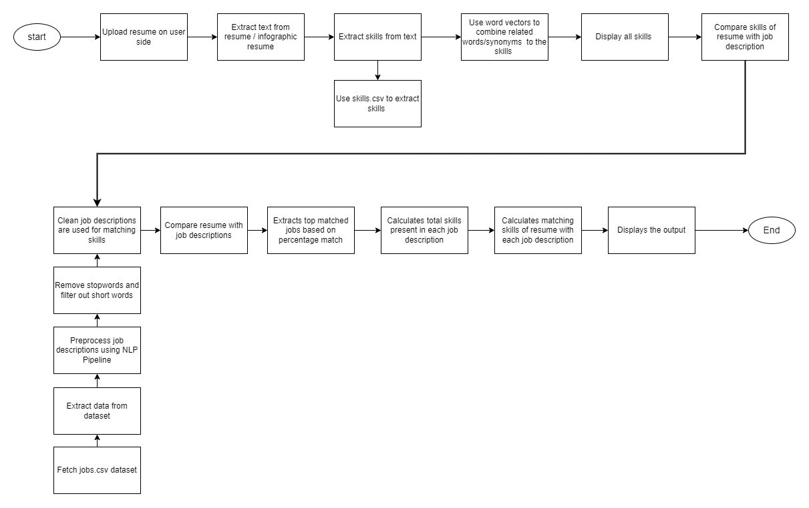
FLOWCHART 1

Slide 8
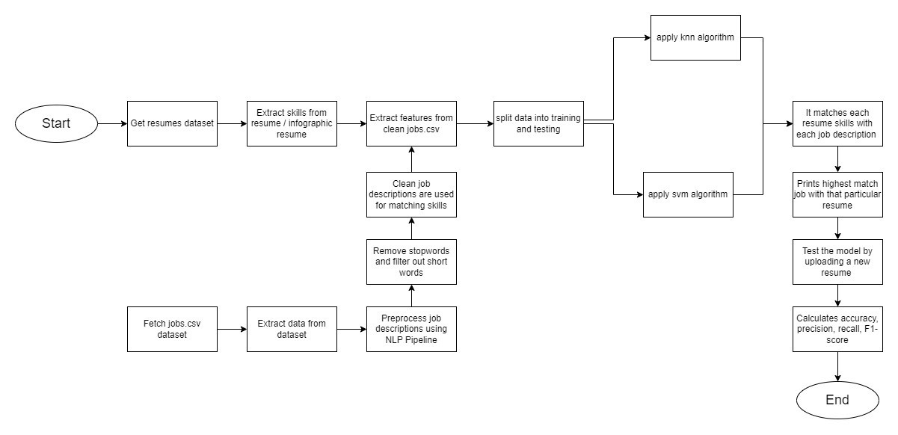
FLOWCHART 2

Slide 9
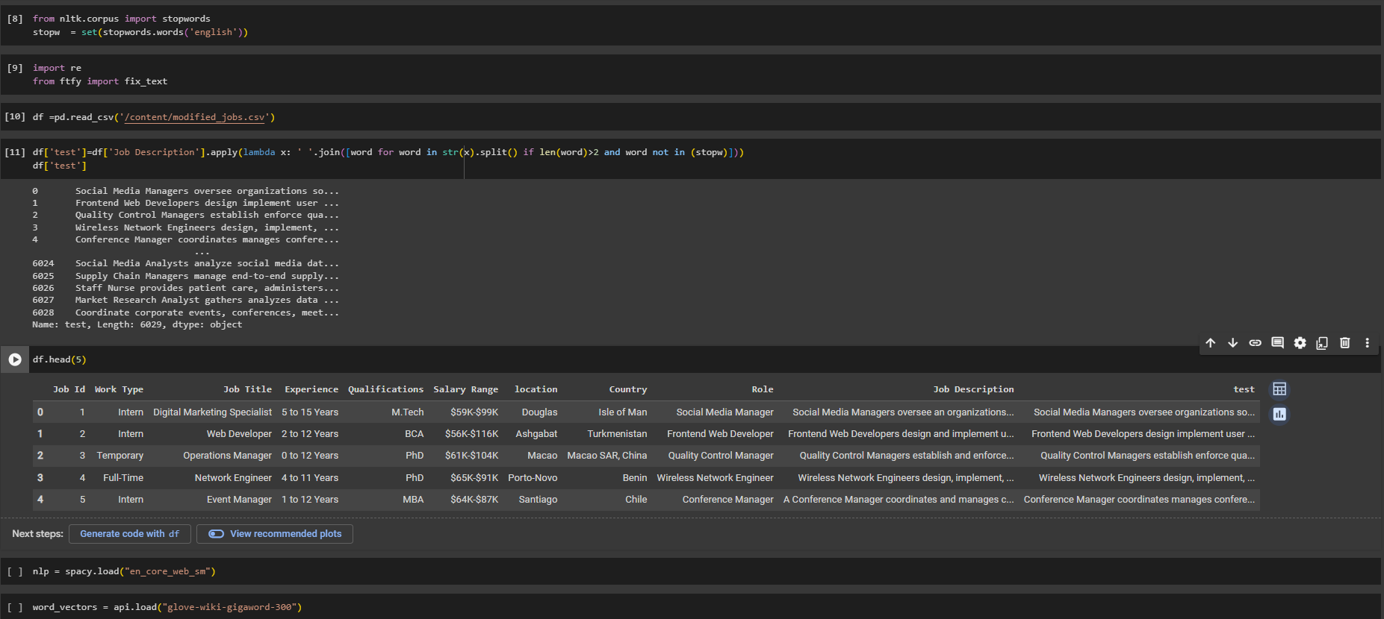
PSEUDO CODE AND RESULTS
Pre Processing of job description using NLP stopwords

Slide 10
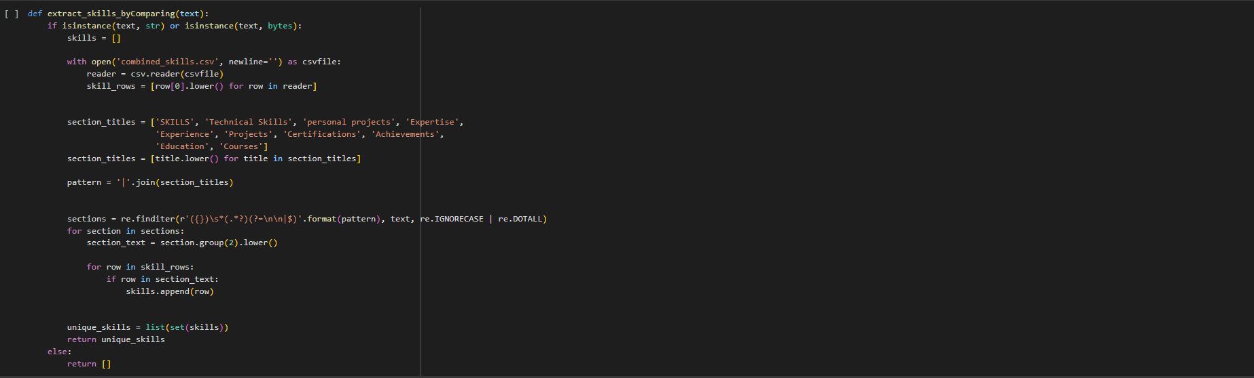
PSEUDO CODE AND RESULTS
Extracting skills from resume text by comparing with skills.csv file

Slide 11
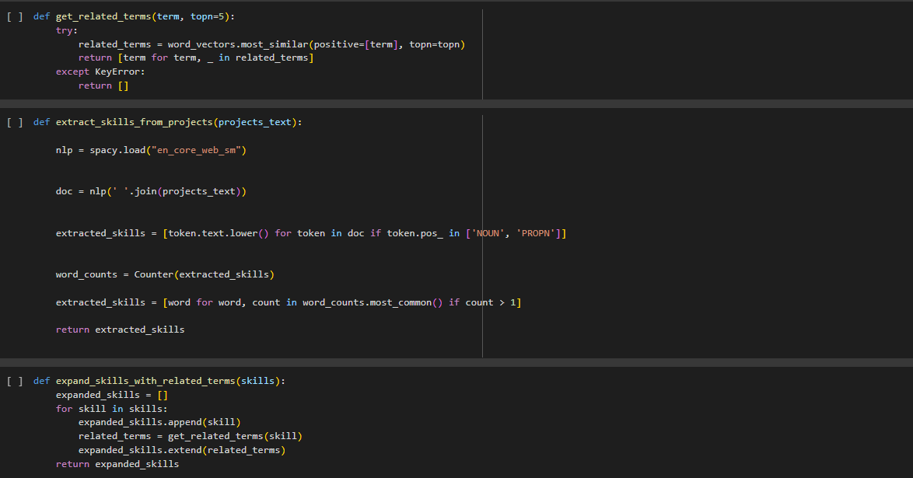
PSEUDO CODE AND RESULTS
Adds related words/synonyms to skills array

Slide 12
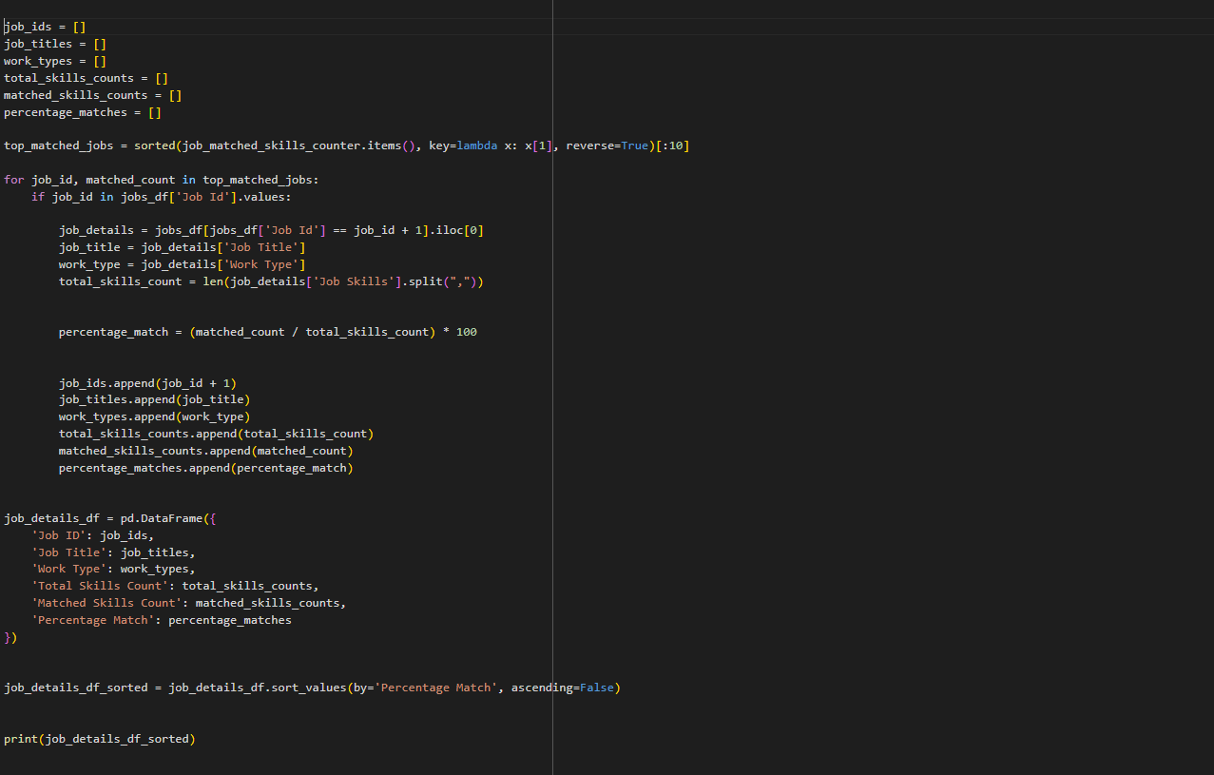
PSEUDO CODE AND RESULTS
Matches resume skills with job description skills and calculates percentage match and matched skills

Slide 13
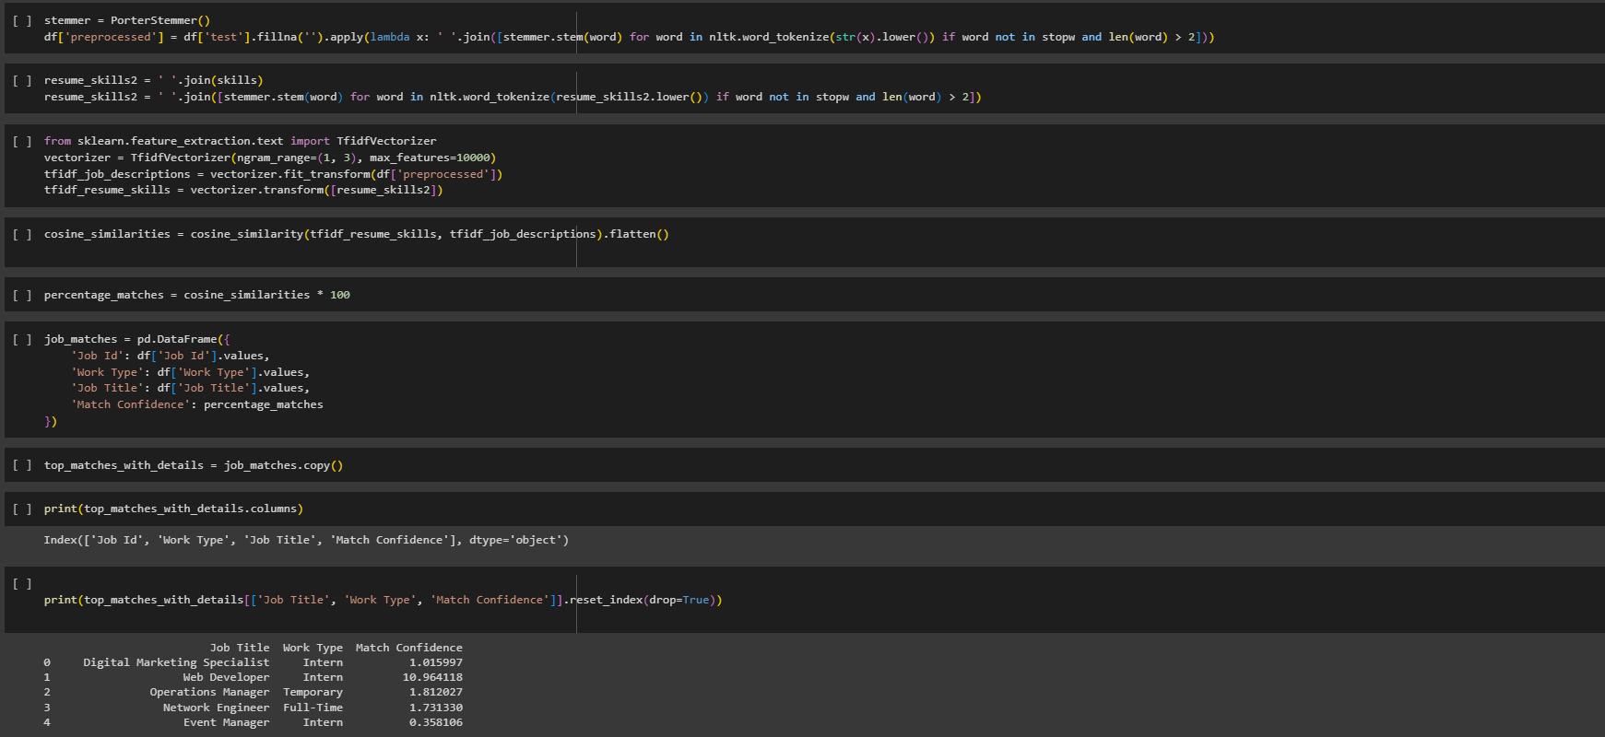
PSEUDO CODE AND RESULTS
Tokenizes skills using NLP and finds cosine similarity between job description and resume skills to calculate matching confidence

Slide 14
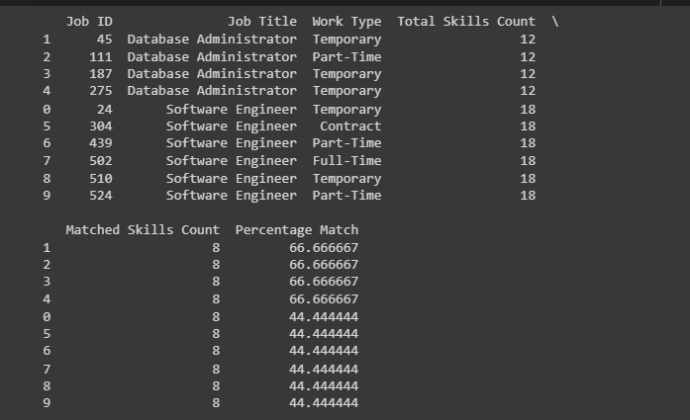
PSEUDO CODE AND RESULTS
Results of skills extracted and percentage match with other features

Slide 15
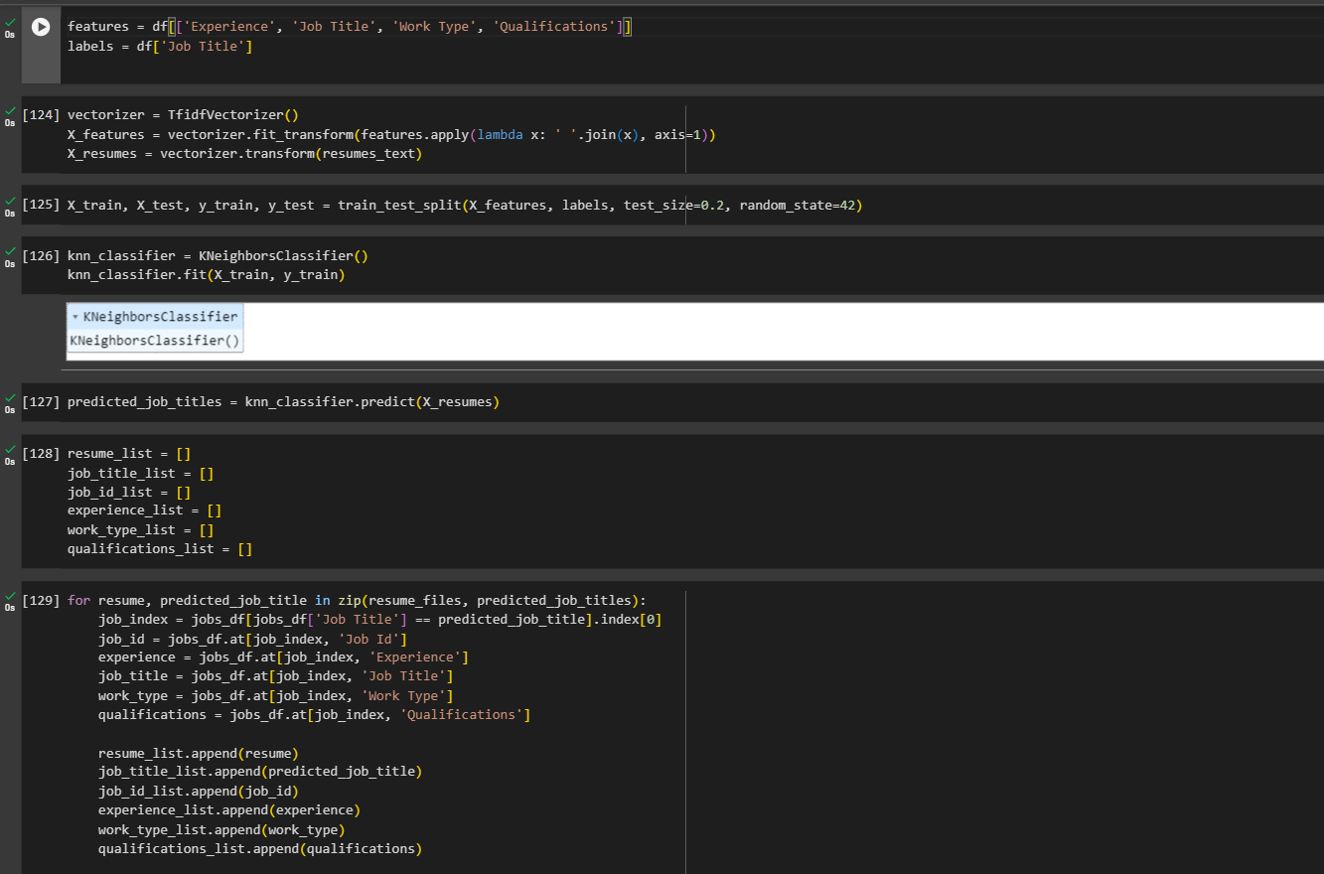
PSEUDO CODE AND RESULTS
Quantifiable achievements to match resumes using KNN Algorithm

Slide 16
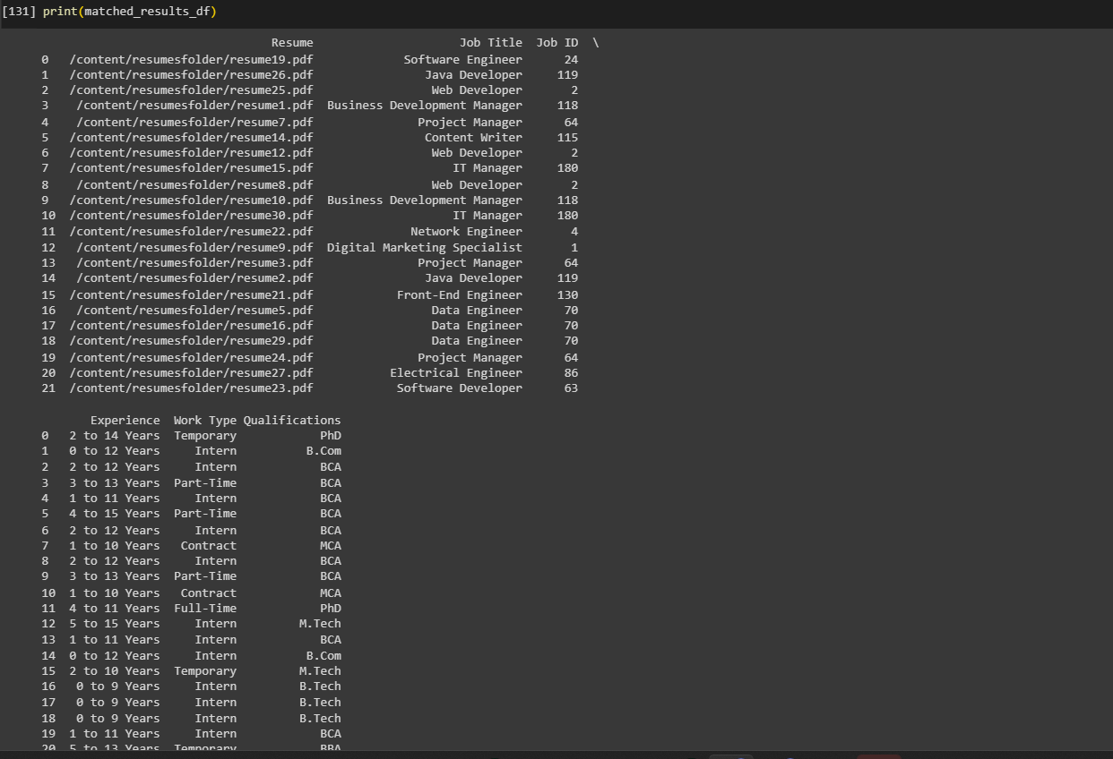
PSEUDO CODE AND RESULTS
Output of matching each resume with its highly matched jobs using KNN Algorithm

Slide 17
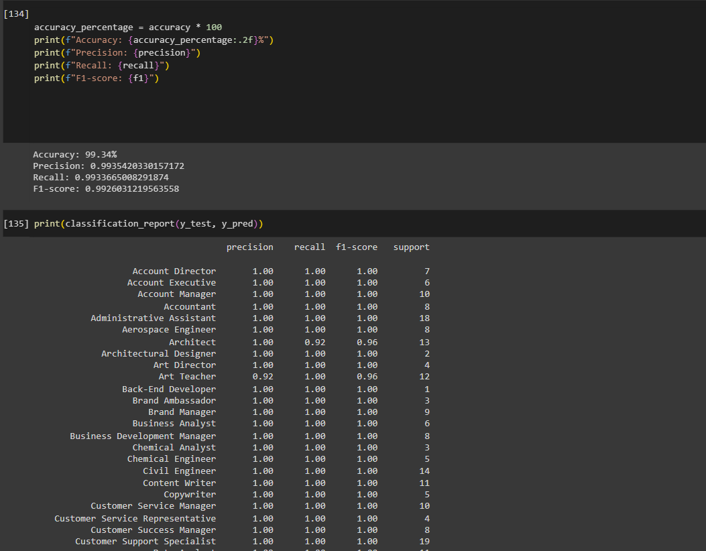
PSEUDO CODE AND RESULTS
Results of accuracy, precision, recall, F1-score using KNN Algorithm

Slide 18
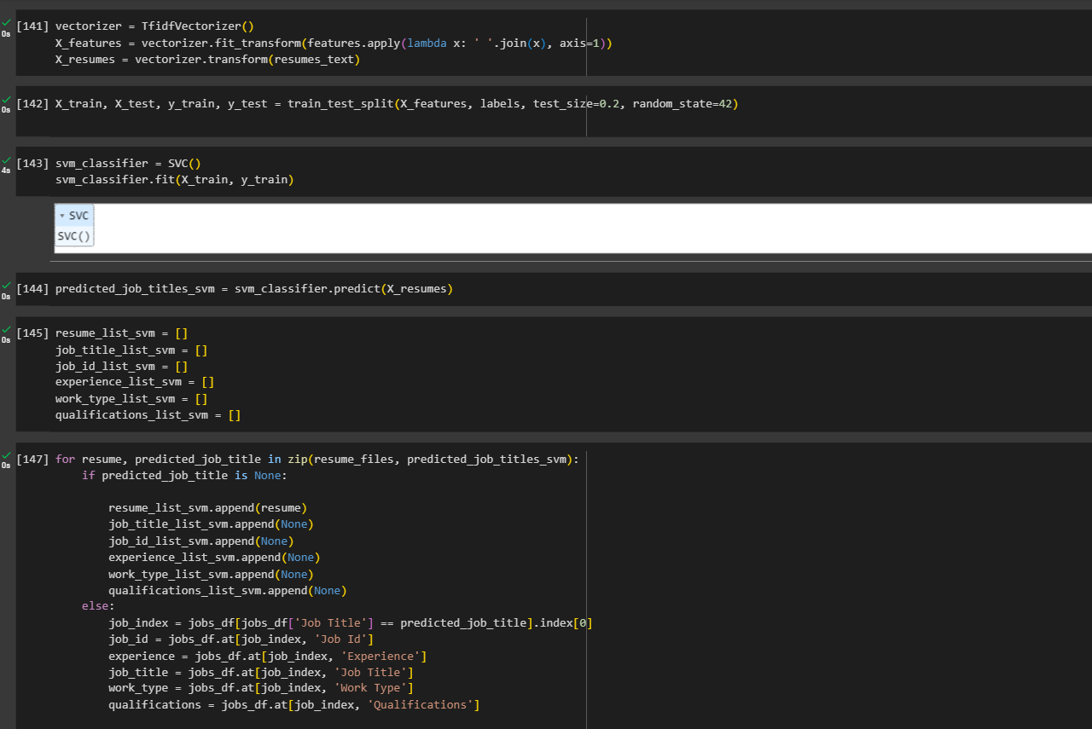
PSEUDO CODE AND RESULTS
Quantifiable achievements to match resumes using SVM Algorithm

Slide 19
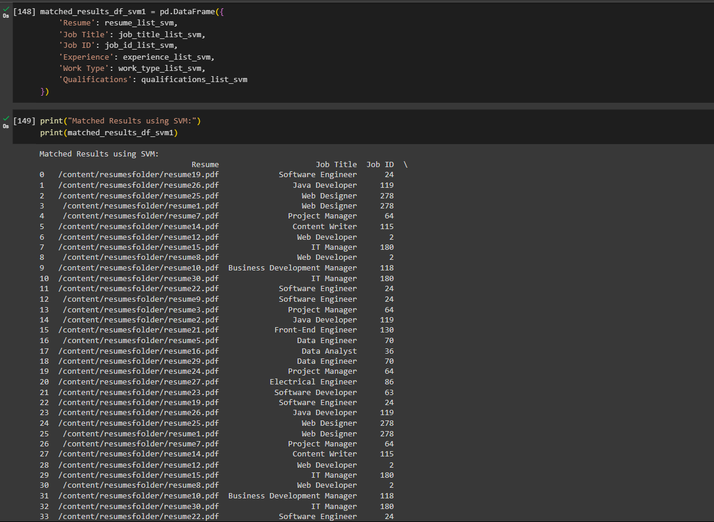
PSEUDO CODE AND RESULTS
Output of matching each resume with its highly matched jobs using SVM Algorithm

Slide 20
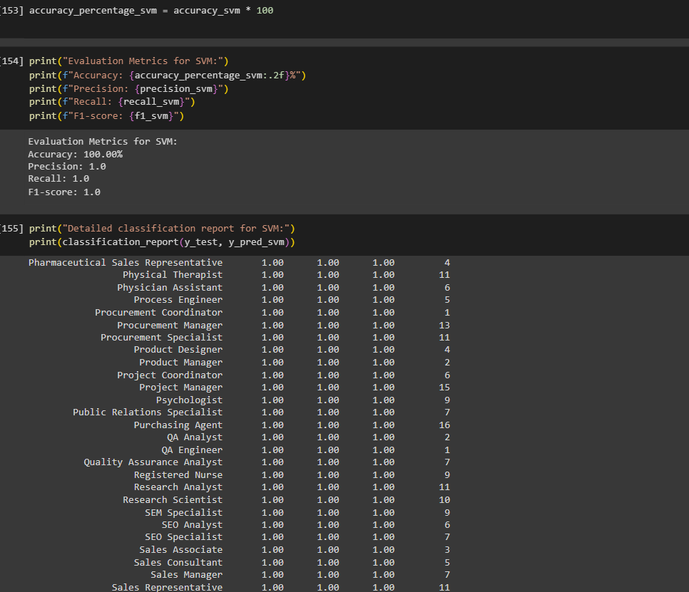
PSEUDO CODE AND RESULTS
Results of accuracy, precision, recall, F1-score using SVM Algorithm

Slide 21
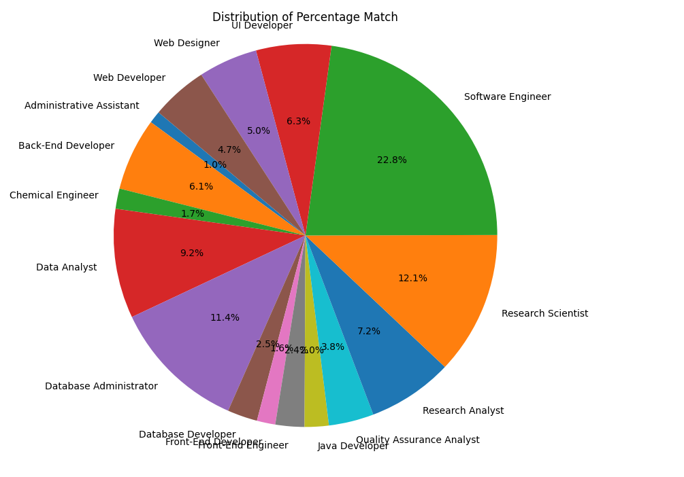
PSEUDO CODE AND RESULTS
Pie Chart between job title and percentage match

Slide 22
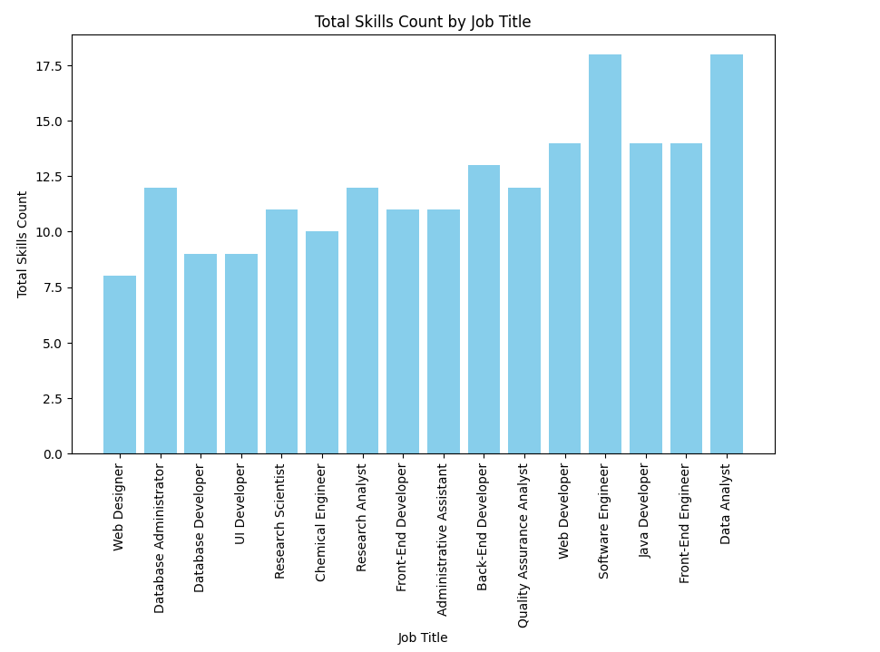
PSEUDO CODE AND RESULTS
Bar Chart between job title and total skills count

Slide 23
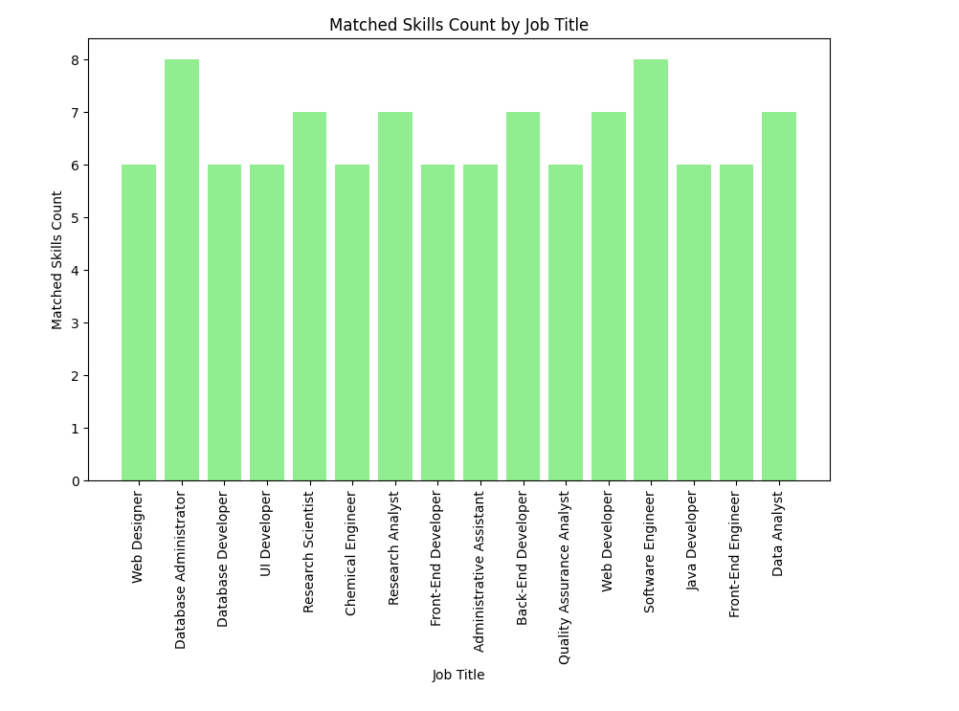
PSEUDO CODE AND RESULTS
Bar Chart between job title and matched skills count

Slide 24
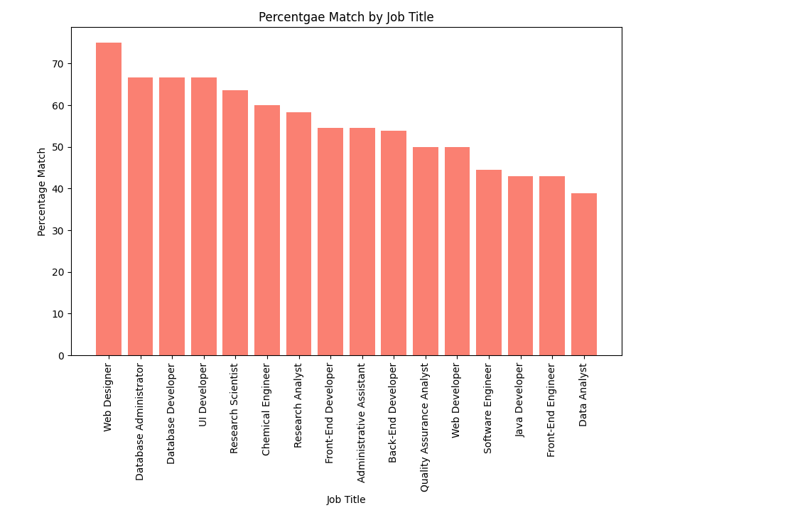
PSEUDO CODE AND RESULTS
Bar Chart between job title and percentage match

Slide 25
CONCLUSION
This project is aimed at developing a machine learning model to analyze resumes and produce some results.
In many applications available online, the resume screening is done from the recruiter’s side to ease the selection process for their company.
This application takes the resume uploaded by the user as input and displays matching job roles as output.
It also has features like calculating matching percentage, providing number of matched skills and displaying highly matched jobs with each resume.

Slide 26


