Slide 1
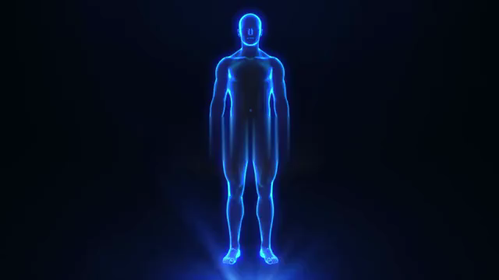
DISEASE PREDICTION AND DETECTION SYSTEM
Slide 5
Slide 4
Slide 3
Slide 2
Slide 1

Slide 2
INTRODUCTION
DATA
MINING
GITHUB
Data mining technique is one of the most challenging and leading research areas in healthcare due to the high importance of valuable data
Github will be used for version control of the project
Slide 5
DISEASE
PREDICTION
Slide 4
IDE
The chances/risk of a patient of having a lethal disease is calculated by the system based on input attributes like gender, age, BP etc.
Jupyter Notebooks, Google colab will be used
Slide 3
LIBRARIES
ALGO
Slide 2
We plan on using Python libraries like Numpy, Pandas, Sklearn, Seaborn etc.
ML Algorithms like Naive Bayes and random forest would be used
Slide 1

Slide 3
Procedure Flowchart
Collecting Datasets for various diseases' patient data
Graphical representation of the data
Identifying trends, patterns, relations in data
Slide 5
Data Cleaning and transformation
Feature Selection
Final Inference
Slide 4
Performance analysis and enhancement
Slide 3
Data Collection
Data Visualization
Trend Analysis and Classification
Slide 2
Removing Noise and Invalid/Null values in the data
Selecting and creating attributes for classification/clustering
Predicting or detecting the presence of disease using filtered info
Slide 1

Slide 4






Work Process
More about the Steps followed to create the system
Data Collection
Feature Selection
Finding and collecting datasets of patient data of life threatening diseases and can perform efficiently on such model from authentic sources
Attributes are selected for classification or clustering of data and any new, required attribute is created. This helps in data mining process
Slide 5
Slide 4
Data Transformation
Trend Analysis
Reading, Cleaning or Smoothing data, removing noise and invalid values of attributes
Identifying trends, relations and correlations in the data and accordingly classifying the data in various classes
Slide 3
Data Visualization
Final Inference
Plotting various functions on the data for easy understanding and analysis of data using libraries like matlplotlib or seaborn
Final inference is drawn, whether the person is infected with the particular disease or not on the basis of analysis and classification performed above
Slide 2
Slide 1

Slide 5



Usage of the System
A Disease Prediction and Detection System can have various utilities
Timely Prediction of disease
Reduces burden on doctors
Slide 5
Eases Research
Aid agriculture
Slide 4
The system allows a patient to make an early/timely prediction of a disease which helps in reducing the risk of it
Since this is a prediction cum detection system, the predictions can be done by system algorithms thus reducing workload of doctors
Slide 3
The system allows collection, maintenance and analysis of large amount of data which eases the process of research on these diseases
The model can be expanded so that it can use image recognition to detect plant disease in crop and thus help agriculture
Slide 2
Slide 1

Slide 6
Thanks for Listening with great patience
Slide 5
Slide 4
Slide 3
Slide 2
Slide 1

