Slide 1
Dashboard Summary
Interactive Power BI Analysis - Sales & Orders (2003–2004)

Slide 2
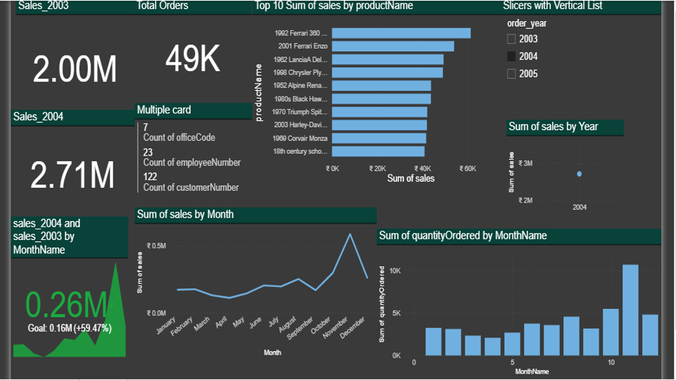
Dashboard Overview

Slide 3
Quantity Ordered by Month
• November and December show high order volumes.
• Indicates strong year-end demand.
• Data helps in planning inventory cycles.

Slide 4
Yearly Sales Comparison
• Clear difference between 2003 and 2004 sales.
• Sales improved significantly in 2004.
• Dashboard slicer allows filtering by year.

Slide 5
Key Metrics (2003 vs 2004)
• 2003 Sales: ₹2.00M • 2004 Sales: ₹2.71M • Growth: ₹0.71M (+59.47%) • Total Orders: 49,000 • Sales 2004 > Sales 2003 in every month

Slide 6
Sales
• Total Sales in 2003: ₹2.00M.
• Total Sales in 2004: ₹2.71M.
• Sales growth: ₹0.71M (≈59.47%).
• Higher monthly performance seen in 2004.

Slide 7
Top 10 Selling Products
• Highest: 1992 Ferrari 360 • Others: 2001 Ferrari Enzo, 1982 Lancia Delta, Chrysler Plymouth, Alpine Renault, Harley-Davidson, etc.

Slide 8
Monthly Trends
• Peak Sales: December • Monthly growth is consistent throughout 2004 • Quantity Ordered is highest in Nov-Dec • Use slicer for year-wise comparison

Slide 9
KPI Card Analysis
• KPI shows 2004 outperforming 2003
• Goal: ₹0.16M exceeded by 59.47%
• Helpful for management tracking.

Slide 10
Total Orders
• Total orders processed across years: 49K.
• Orders increased proportionally with sales in 2004.
• Indicates higher demand and customer activity.

