Slide 1
Problem Statement : Estimation of crop progression particularly in rainy season much crop may be severally affected by aberrant Monsoon/flood/drought and immediate response is needed to help farmers (This will help in policy formulation for contingent planning etc.)
Problem Code : NS269 Team Leader: Harsh Raval
College Code : 982
College Name : Universal College Of Engineering
Team Name : Technocrates_1

Slide 2
Solution :
This model aims to predict the effective crop yield using machine learning algorithms for a practical solution. It will provide the farmers a variety of options before cultivating onto agricultural field. Our software will also recommend the farmers to grow profitable crops depending upon the conditions.
List of Sections:
1.Cross Platform Application with Multi-Lingual Support for precise prediction of crop yield for farmers.
2.Notifications – > To stay updated about weather and the user will get an alert if there are chances of floods in the area so as to minimize the damage due to floods
3.Crop growing Recommendation – based on the weather.
4.Profitable crop recommendation-Our model will suggest the farmers profitable crops to grow based on the area and other parameters.
Mobile Application
An mobile app through which you can connect to the system and provide an interface to interact with the crop prediction model.

Slide 3
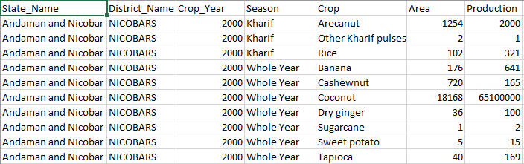
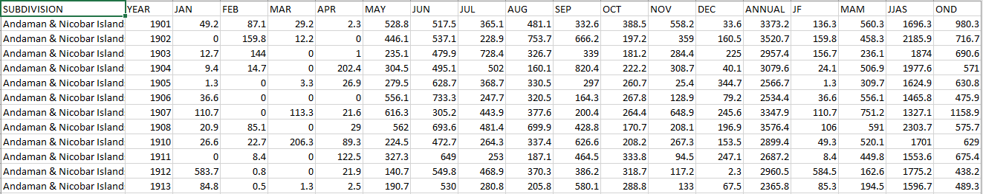
GARBLED DATASETS
Source : data.gov.in

Slide 4
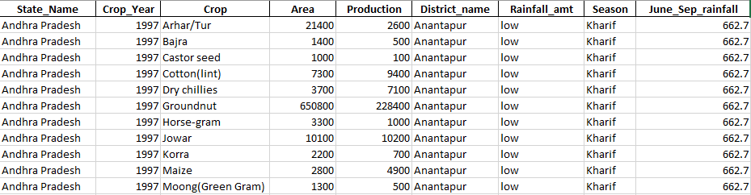
Workflow of the model:
Getting data ready through pre-processing steps:
Fetching datasets from “data.gov.in” related to Crop and Rainfall.
Merging rainfall and crop datasets accordingly in order to create a single dataset which
will be relevant to our problem statement.
Replacing NAN values in columns with mean of that particular column.
Detecting and Removing Outliers.
Sorting and Filtering the crop column as to remove the crops with very less samples.
Dependency : Data only available till 2014
FINAL DATASET

Slide 5
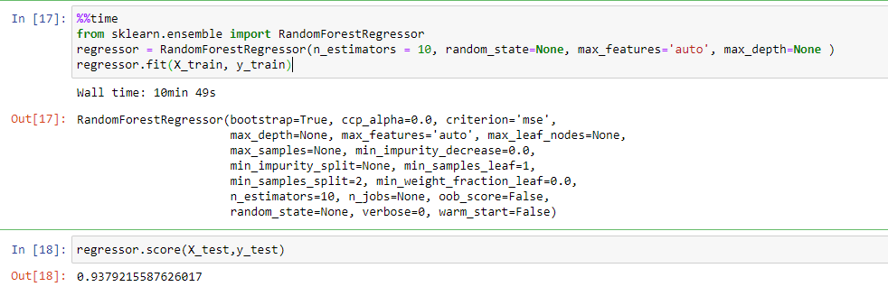
Making of Yield Prediction Machine Learning Model:
We trained our model with:
K Neighbours Regressor
Support Vector Regressor
Random Forest Regressor
Decision Tree Regressor
Out of all these Regression Algorithms, Random Forest Regressor was the one with Highest Accuracy Percentage of about 94%
We used K-Fold Cross Validation with 5 Folds to test our model for accuracy on different testing sets. Results were very satisfying.
Our Crop Yield Prediction Model was Successful.

Slide 6
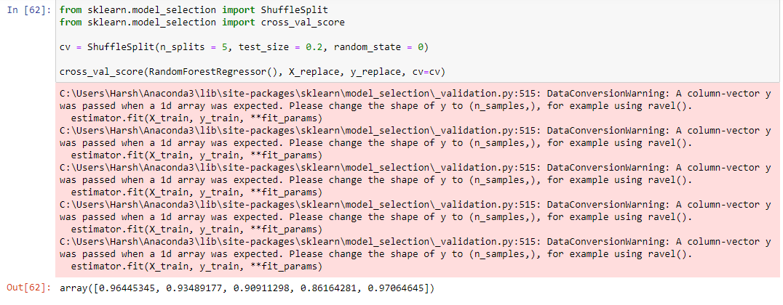
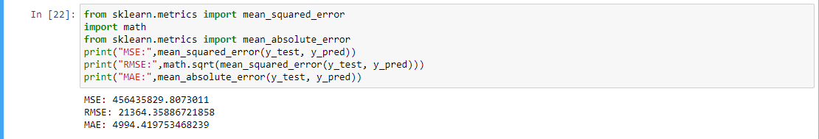
Yield Prediction Model Evaluation
Cross Validation Score Results
R2 Score
MSE, RMSE & MAE Scores

Slide 7
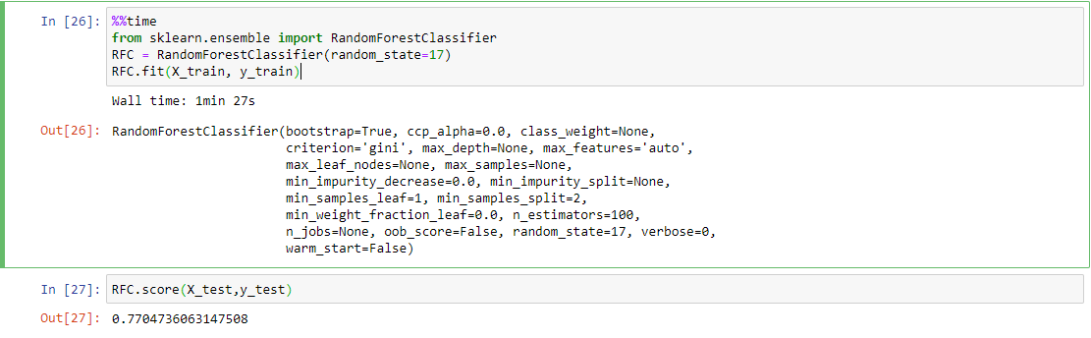
Making of Profitable Crop Prediction Machine Learning Model:
These was an Extreme Multi-Class Classification problem.
We decided to filter top 24 Crops that are grown in India and later perform classification on this crops.
The dataset for classification was highly imbalanced.
These time we trained our model with:
K Neighbours Classifier
Decision Tree Classifier
Random Forest Classifier
Tuning the parameters.
Surprisingly, even this time Random Forest Classifier was the one which fitted itself on our data very well compared to other classification algorithms.
We were able to receive an accuracy of 77% for extreme multi-class classification with 24 unique classes.

Slide 8
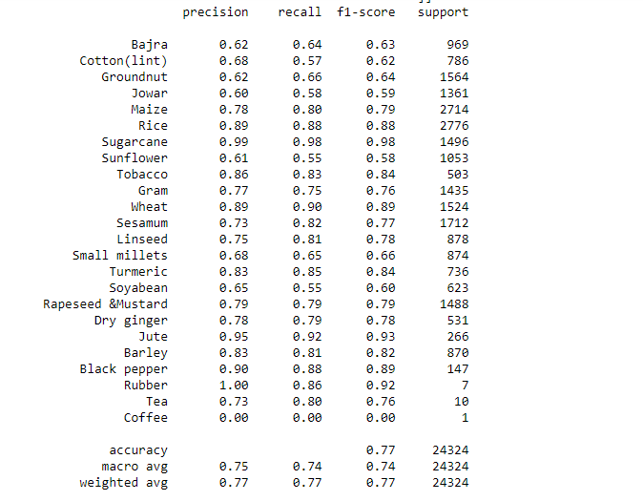
Profitable Crop Model Evaluation
Classification Report

Slide 9
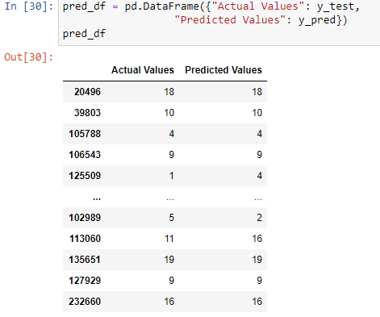
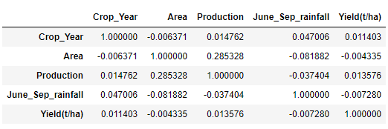
A Glance of Model’s Performance
Correlation between Numeric Columns

Slide 10
Rainfall calculation:
1. Used 7- day rain forecast info based on the user’s real-time location from OpenWeatherMaps API and accordingly estimated real-time rainfall for the coming monsoon(Jun-Sep).
2. This estimated rainfall is then fed to the model to predict the yield and getting the profitable crop.
3. Based on rainfall we tried to determine the chances of flood in specific areas.
API used
OpenWeatherMaps: For getting the rainfall data, giving daily weather info to farmers to assist them in farming
2. NewsAPI: To get latest updates regarding agricultural loans/schemes and news related to agriculture guidance/activities across India.
Flask
To make our app device friendly so that it can work on any sort of android and iOS device we have ensured that all the computational part is done on the server side by creating APIs of our training models and this will improve the app performance on client side and will also help to keep the size of the app as minimal as possible
Also our APIs will be useful in future as anyone can use it for their project

Slide 11
UI
The UI of the app is created using Flutter framework which is an open-source UI software development kit and is created by google
Considering the fact that everyone won’t prefer English as a language to use the app we have also given a multi lingual support in which a user can select between Hindi and English depending upon his preference

