Slide 1
Angular
Day -1

Slide 2
Angular CLI
Install the CLI using the npm package manager:
npm install -g @angular/cli
To create a new folder for Angular project, following command is to be executed: ng new the expected file name
Thereafter add the path of the folder: cd file name
To start the execution of the project on the web:
ng serve
On browser, open https://localhost:4200/ to see the application running

Slide 3
Debugging Angular Apps
Steps required=
Create an angular application
Install “Debugger for Chrome” extension from vs code extension
Go to run and debug, and click on the button if not yet agreed
Select Chrome
App will now run

Slide 4
Anatomy of the project
Package.json- When creating any project the first file been created is this. Filename, Script, Versions, Ng commands, dependencies, devDependencies. If you wish to add any external dependency in the project, you can add them into devDependencies.
Node_modules- never to make any changes in this folder. It holds all the dependencies and devDependencies installed.
Src folder- This is the folder in which 90% coding is been done.
Environments- The environment setup for the testing and production time of the application is done using this folder.

Slide 5
Anatomy of the project
Assets- The important files of the user are been store in this folder in such way that it is visible publically. Eg: images, fonts, css, icons, html, etc.
Index.html- This is the entry point of the application for html files. It is the first file that is loaded on the page.
Main.ts- This is the first js file loaded on the web page. This file interacts the js files with index.html .
Style.css- Any styling which is required to be done globally is done here.
App.js- This is the root component. This provides angular by default.

Slide 6
Anatomy of the project
.Editorconfig- This manages the settings of the editor.
Karma.config- This helps you in testing the application.
Package.lock.json- It keeps the file directories of package.json
Tslint- It provides the validation for where to use let, var, arrow function etc.
Typescript files- The other ts files which are required for the angular projects.
E2e- It is for end-to-end testing and integration.

Slide 7
Basics of the Project
The whole content on the browser is seen through the app.component.html.
To create your own project, the app.component.html file has to be done empty first.
With variables, functions, object, array, etc.
In app.component.ts file the assignment of the variables, functions, objects, arrays, etc.
But no specification before variable as var or let is supported.
Same way, no function keyword before the function is used.

Slide 8
Angular Interpolation
Then the codes written in the app.component.ts file to inherit in app.component.html file, the command name has to be written in {{}}.

Slide 9
Angular Component
Component are the classes which interact with the file .html files and then are displayed on the web browser.
A component has 4 files
The default component is app component
To make a new component is more efficient to build using the terminal or command line.
The command is ng g c (the desired name of the component)
The name of the component to add in the html file, it is to be written as <(the selector name of the ts file)>

Slide 10
Angular Modules
Components
Service
Directive
Pipes

Slide 11
Angular Module
It is the combination of the components, directives, pipes, and service.
Many components can be added to the module.
The command to create a new module is ng g m (desired name of the module)
To add the components in the created module:- ng g c (the module name)/(the component name)
First the component is to be exported from the module and then it can be imported in the app module by specifying the import path and add the component name in the imports.
For further use it can be then used in app.component.html file.

Slide 12
How to call a function in angular?
Step 1: Define a function in the app.component.ts file
Step 2: In the app.component.html file create a button
Step 3: After the button created, to perforn the function on the button click, command :
<button (click)=“the function name”> Button name <button>
Step 4: The button will be having the functionality of calling the function

Slide 13
Events used in Angular
Click
Key up
Key up with enter and space
Keydown
Blur
Mouseover and mouseleave
Get values on textbox

Slide 14
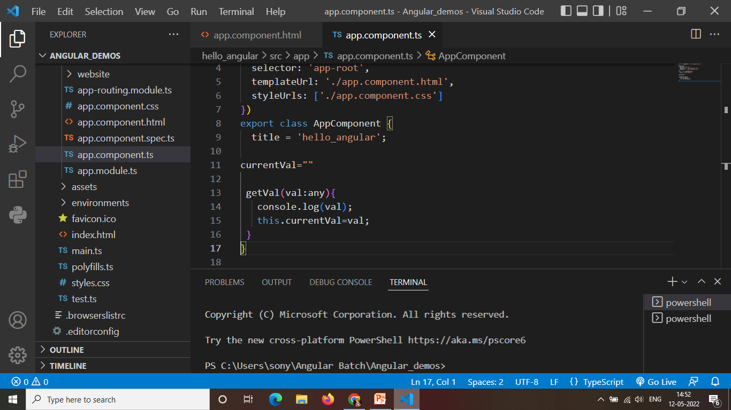
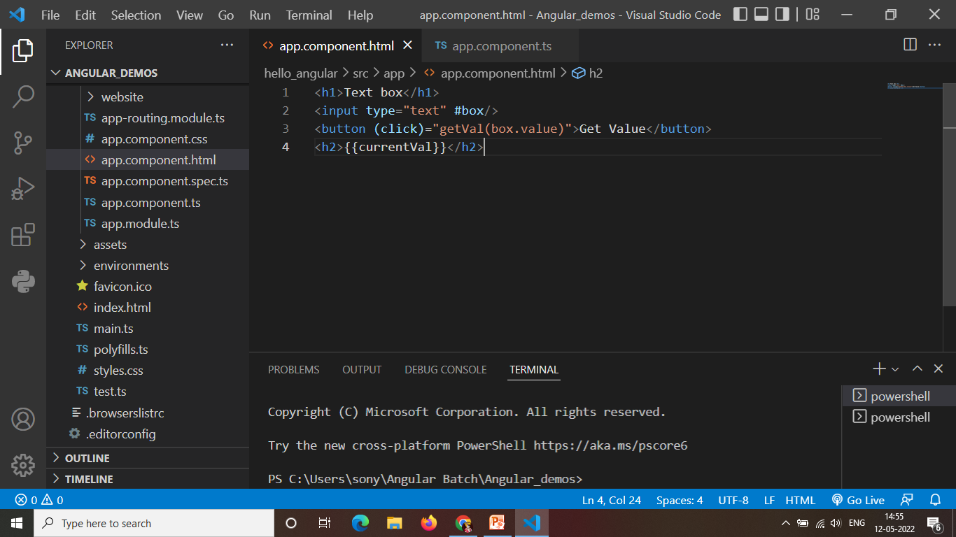
Get textbox values
App.component.ts
App.component.html

Slide 15
Property Binding
The property binding is some what similar to the interpolation.
The property of ts file to use in html file [ ] for the attribute is used.

