Slide 1
Part I(Section 4): Data Preparation
Data Overview and Outliners
Part II(Section 5-7): Model Constrution
Feature Extraction on Words
Quantity Prediction Model
Occupancy Prediction Model
Comprehensive Evaluation Model
Multiclassification Model
Calculation of Weights by the Entropy Weighting Method
The Division of Difficulty Levels By Weighted Euclidean Distance Clustering
(1) Periodic Analysis
(2) Residual Analysis
Comparison of Improved and Baseline Models
Interpretation of the Black Box Model DBDT with the SHAP Algorithm
Correction and Correlation Analysis of the Proportion of Hard Mode
Results
(visualization)
Results and Correlation Analysis
(visualization)
Weight Analysis
Part III(Section 8-10): Result Analysis
Sensitivity Analysis of n
Model Evaluation and Further Discussion
Conclusion

Slide 2
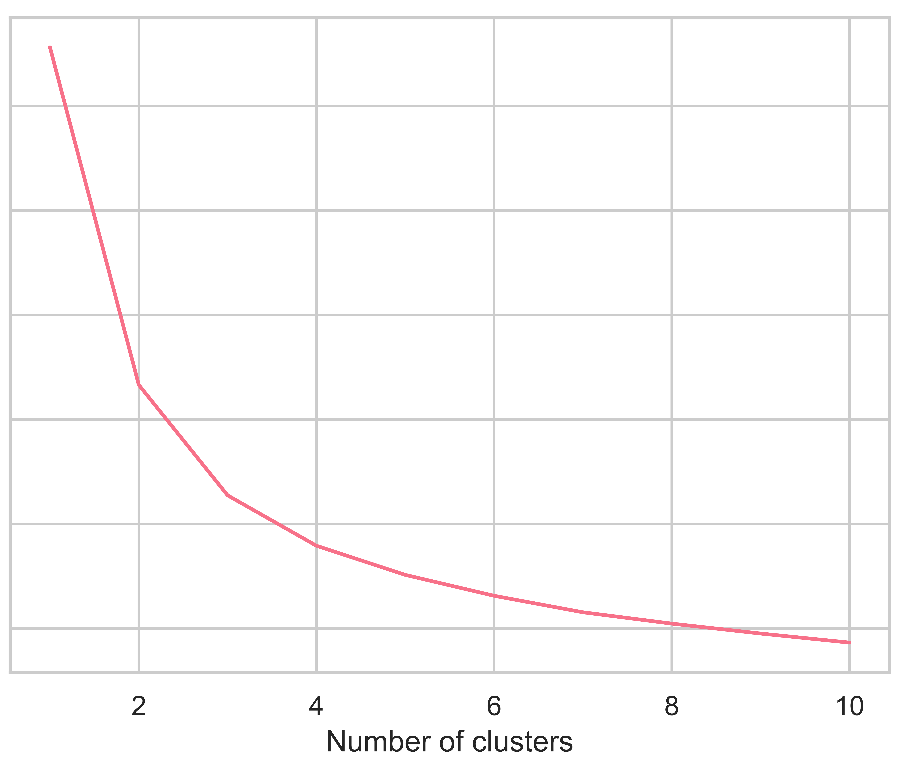
60
50
SSE
40
30
20
10

