Slide 1
Spam Message Data Analysis
Forge Launch Skills Challenge | @jhapappu7165

Slide 2
Why This Dataset?
I chose the Spam/Ham SMS dataset because it's small, clean, and realistic.
Spam detection is a simple yet impactful machine learning problem that highlights how text features can separate promotional vs. conversational messages.

Slide 3
Questions Explored
1. How imbalanced is the dataset?
2. Do spam and ham differ in message length (words/characters)?
3. What does that imply about message patterns?

Slide 4
Data Cleaning & Processing
- Renamed columns (Category → label, Message → message)
- Dropped missing rows
- Lowercased and removed punctuation
- Added word and character counts

Slide 5
Dataset Overview
• Total Messages: 5,572
• Ham: 4,825 | Spam: 747
• Spam Ratio: 13.41%
• Ham Avg Word Count: 14.10
• Spam Avg Word Count: 23.52

Slide 6
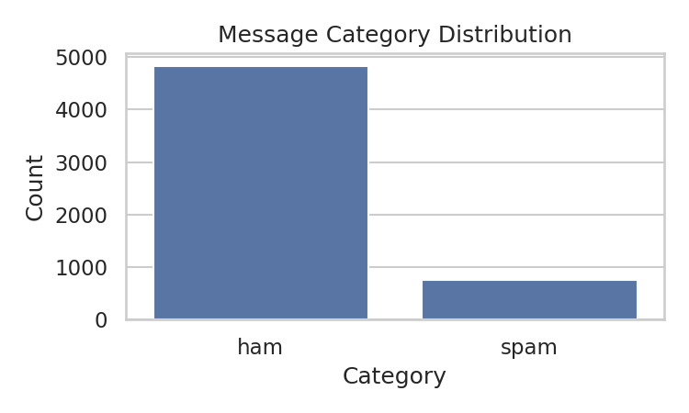
Message Category Distribution

Slide 7
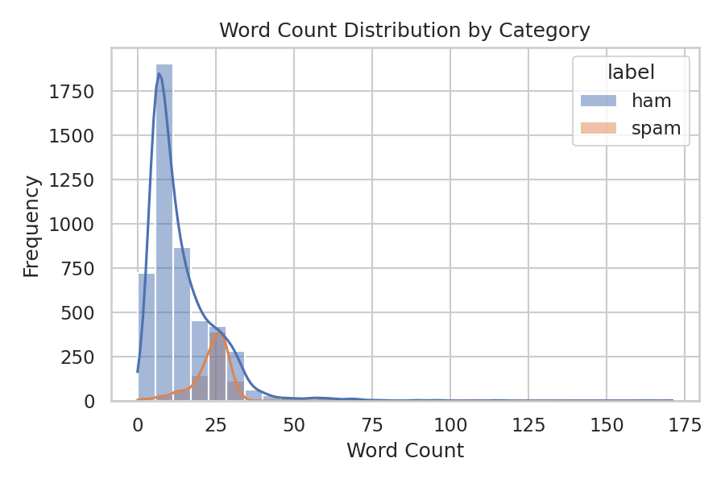
Word Count Distribution by Category

Slide 8
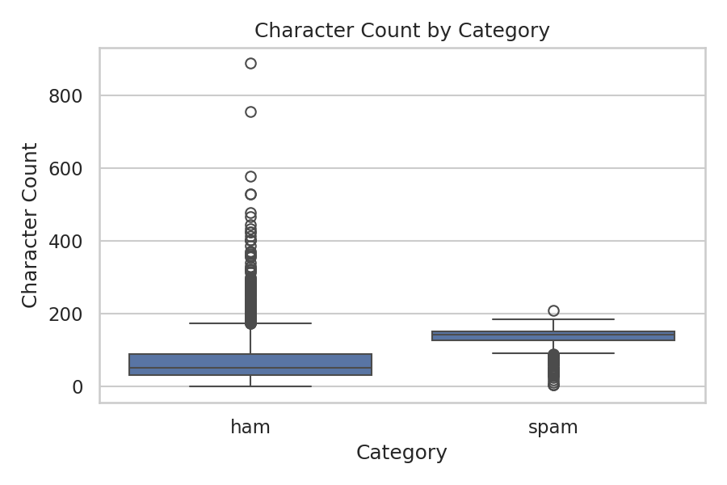
Character Count by Category

Slide 9
Key Findings
- The dataset is imbalanced (only 13% spam).
- Spam messages are consistently longer in both words and characters.
- Ham messages show more variability and conversational tone.
- Length alone provides signal but isn't a perfect classifier.

Slide 10
Next Steps / What Could Be Improved
- Add text features (TF-IDF, keyword frequency, punctuation ratio).
- Train Logistic Regression or SVM models.
- Evaluate precision/recall due to class imbalance.
- Perform error analysis on long ham and short spam messages.

Slide 11
Closing Thoughts
This analysis highlights how even basic data cleaning and visualization can reveal strong patterns in text data.
Prepared by @jhapappu7165 for the Forge Launch Skills Challenge.

