Slide 1
Time series forecast model for inventory management
Author : Dr. P. N. Jha
Presented to : Jet2 Travel Technologies
30-June-2020

Slide 2
Outline
Data preparation
Model approach
Plot data
Model order parameter selection
Applying model
Results

Slide 3
Load and prepare the data
Read excel file.
Rows are items and columns are dates. We switch the axes, so that each column is now one item.
Use a proper date-format and set it as index
Explore the data
Use pandas functions info and describe
Select a few parts to plot. Use decompose to plot seasonality, trends and errors.
Duplicate columns
Take mean if duplicate parts exist – 190 unique parts out of 337 data series

Slide 4
Approach
Time series forecasting
We will use ARIMA-type model (SARIMAX)
This will account for seasonality in the data, along with trend and other variations
Widely used for forecasting problems

Slide 5
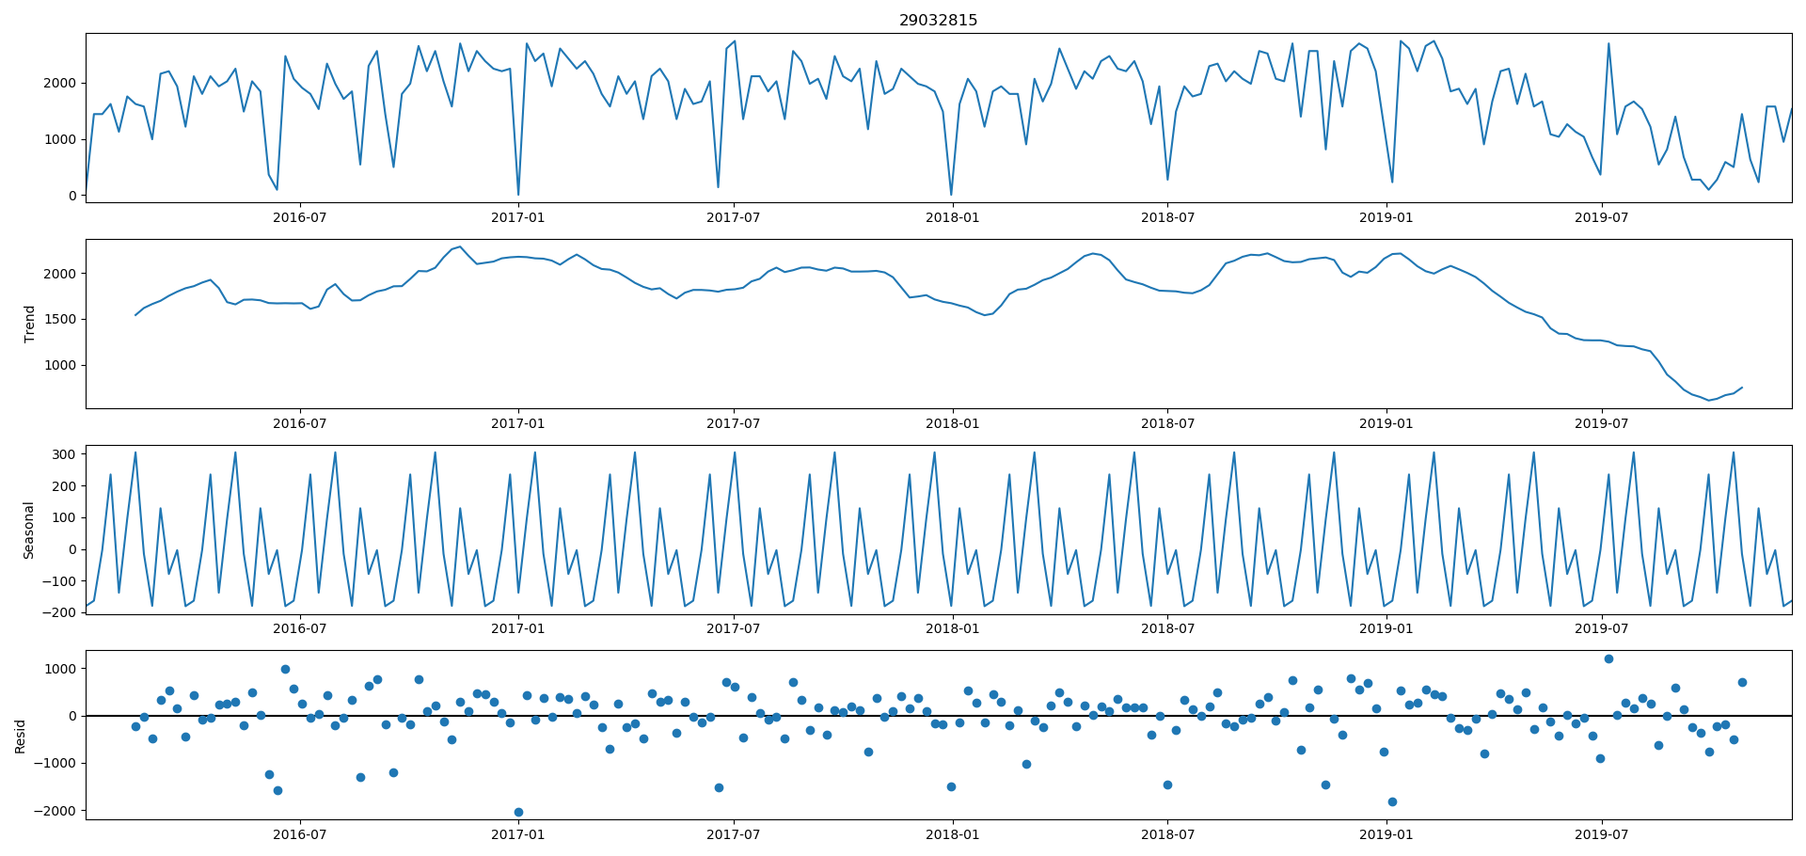
Decomposition
Plots showing data, trend, seasonality (24 periods) and residuals using moving averages
24 periods give low residuals compared to 6 or 12 weeks.
This shows that there is seasonal component to the data

Slide 6
Differencing
We first do differencing to test stationarity
Let us see p-values, using Augmented-Dickey-Fuller (ADF) criteria
Original data = 0.000018
1st difference = 7.824139e-11
Even though the original data has very low p-value, we will still take a 1st order difference.

Slide 7
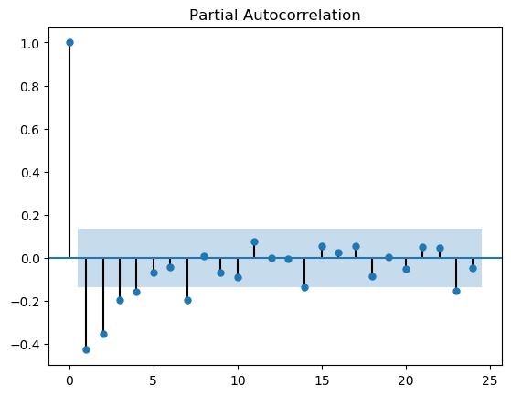
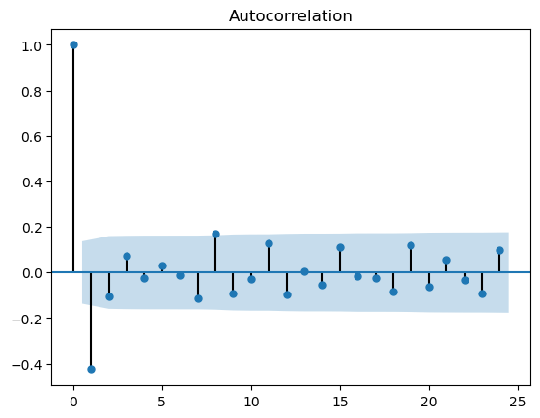
ACF and PACF (of differenced series)
PACF shows important terms = 4, but for simplicity we consider only p = 3
ACF shows a reasonable value for q = 1

Slide 8
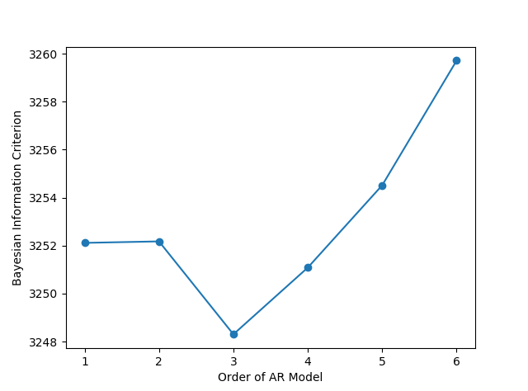
Bayesian information criterion
To remove abmbiguity about the p-order of AR process, we look at the Bayesian information criterion (BIC) of the data
Below plot clearly shows that p = 3 is a good choice (lower BIC is better)

Slide 9
Building SARIMAX model
ARIMA model does not account for seasonality, so we use the SARIMAX model
Order of the model for AR, Differencing and MA models have been estimated, along with order of seasonality component.
We use the same model to forecast inventory for all parts.
The model can be optimized for each part also.

Slide 10
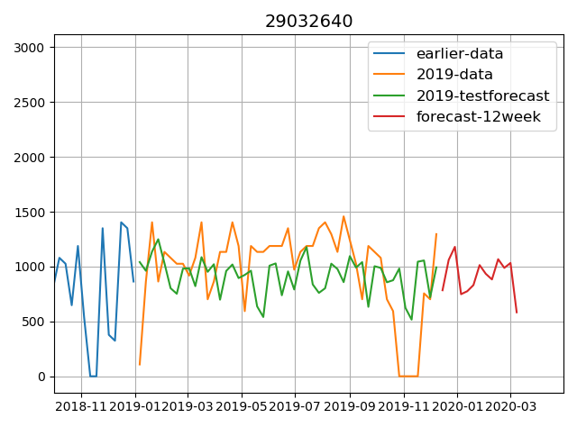
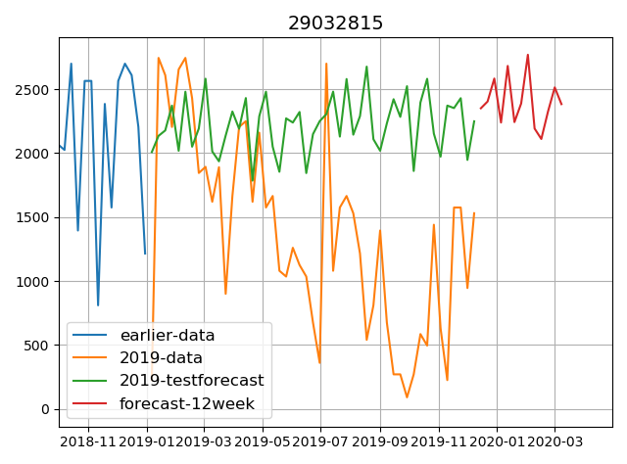
Sample Results
Comments
The same model order is used to predict all parts inventory here, so the results are not optimized
Figure on left gives a good prediction on test data (2019) whereas on the right, the model does not perform very well.
Optimization of order of model and for seasonality can be done to improve results.

Slide 11
Model results statistics for 2019 test data
Part # 29032640
Part # 29032815
Mean squared error = 162188.96
Mean absolute error = 324.56
R^2 value = -0.08
Overall good prediction on 2019 data
Mean squared error = 1377322.04
Mean absolute error= 979.67
R^2 value = -1.43
Poor prediction on 2019 data

Slide 12
Thank you

