Slide 1


Sapient Global Markets | Geneva Solutions
Spotlights 2010
Java - 101
Unix
Notes:
1
Putty location:
http://www.chiark.greenend.org.uk/~sgtatham/putty/download.html
Contact for Unix box:
ISST Service Desk | Sapient Email: isstsupport@sapient.com
. 0124 - 672 - 4778 , ext# 64778 (24X7)
or at portal http://issthelpdesk.sapient.com/otrs/customer.pl
One of the team mates: Rohit Gaur

Slide 2
Getting Started:
Previous exposure to Unix?
Last 2 hours is for hands-on.
You can do assignment OR exercises
Participate in the session
Self-study sections

Slide 3
Agenda
Unix Basics
vi Commands
Shell Programming

Slide 4

Network Communication Utilities

Slide 5
Network Communication Utilities
Question: How can I transfer a file from one computer to another?
ftp Utility
helps to upload and download file from one computer to another computer
ftp utility has its own set of UNIX like commands which allow you to perform tasks such as
Connect and login to a remote host.
Navigate directories.
List directory contents
Put and get files
Transfer files as ascii, ebcdic or binary
To exit from ftp, bye command is used
Syntax
$ftp hostname or ip-address
Would prompt for user Id and password
Ref: http://www.colostate.edu/~pburns/networking/ftplab.html

Slide 6
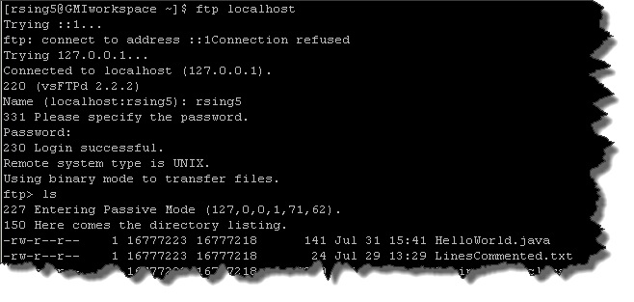
Network Communication Utilities
FTP

Slide 7
Unix Basics

Slide 8
What is Unix?
An operating system which was first developed in the 1960s at AT&T's Bell Labs.
It is a stable, multi-user, multi-tasking system for servers and desktops
UNIX systems also have a graphical user interface (GUI) similar to Microsoft Windows which provides an easy to use environment.
There are various Unix variants available in the market. Solaris Unix, AIX, HP Unix and BSD are few examples. Linux is also a flavor of Unix which is freely available.
Ref : http://snap.nlc.dcccd.edu/learn/idaho/whatis.html

Slide 9
What is Unix? contd.
Unix is flexible and can be installed on many different types of machines, including main-frame computers, supercomputers and micro-computers.
Unix (and Unix flavors like Linux) are typically used as Server Operating system.
Is free open-source operating systems.
Ref: http://linux.about.com/cs/linux101/a/unix_win.htm

Slide 10
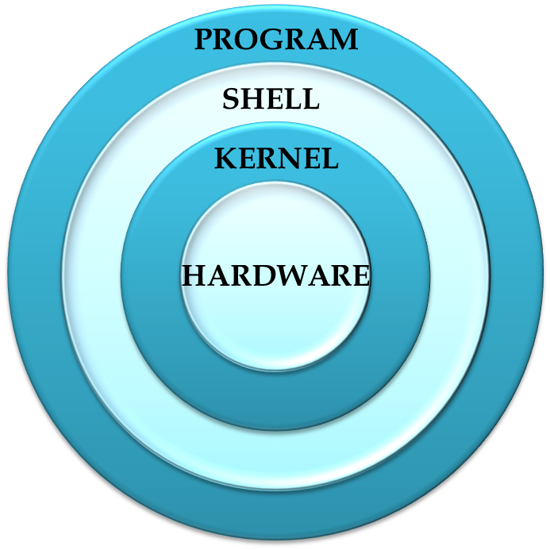
Unix Architecture
UNIX OS is made up of three parts; the kernel, the shell and the programs.
Kernel : The kernel is the heart of the operating system. It interacts with hardware and takes care of the tasks like memory management, scheduling and file management.
Shell : Is an interface between the user and the kernel. It interprets the commands the user types in and arranges for them to be carried out. C Shell, Bourne Shell and Korn Shell are most famous shells.
Program: Commands and Utilities: There are various commands that are used in day to day activities like cp, mv and grep.

Slide 11
MAN Pages

Slide 12
Man Page Help
Before starting on Unix basics, we should know about manual pages.
All the Unix commands come with a number of optional and mandatory options. To view all these options and complete syntax, Unix has help files called as man pages (Manual Pages)
Syntax
$man command
Eg
$man pwd
Command to get complete detail on man pages
$man man
Inside man:
Type ‘q’ to exit from man
Type ‘/’ to search for a text
Type ‘n’ to search next occurrence of the text

Slide 13
Exercise
Use the man command to see the information about the following commands :-
ls
telnet
ftp
ping
ssh
Notes:
Facilitator will tell trainees that these tools are discussed in the self study section

Slide 14
File System and Management

Slide 15
Types of Files
In Unix everything is file, so most of the time is spent on working with files. There are mainly two types of files
Ordinary Files: An ordinary file is a file on the system that contains data, text, or program instructions.
Directories: Directories store both special and ordinary files. Unix directories are equivalent to folders in Windows.
Ref : http://www.tutorialspoint.com/unix/unix-getting-started.htm
http://ph7spot.com/musings/in-unix-everything-is-a-file

Slide 16
Listing Files
Listing Ordinary Files:
$ ls
Long listing ordinary files
The command ls supports the -l option that provides more information about the listed files:
$ ls -l
drwxrwxr-x 3 will finance 4096 Nov 20 10:45 will
-rw-rw-r-- 1 amrood amrood 5341 Dec 25 08:38 uml.jpg
Listing Hidden Files
ls –l command will not list all the files. The files that cannot be viewed are called as hidden files. To view such kind of files ‘–a’ option is used
$ ls -a
All the hidden files in Unix starts from dot (.).

Slide 17
View File
Display content of file
$ cat <filename>
cat stands for concatenate
Eg:
$ cat unixfile.txt
This is unix file....I created it for the first time.....
I'm going to save this content in this file.
$
Display line numbers in the file by using -b option
$ cat unixfile.txt -b
1 This is unix file....I created it for the first time.....
2 I'm going to save this content in this file.
$

Slide 18
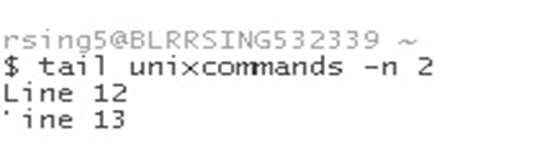
View file contd.
Writes the contents of a file onto the screen, a page at a time
$ less <filename>
Writes the first ten lines of a file to the screen
$ head <filename>
Writes the last ten lines of a file to the screen.
$ tail <filename>
$ tail <filename> –n 100 will list last 100 lines of the file.
$ tail –f <filename>, f stands for follow. It displays the last 10 lines and then update the file as new lines are being added.
tail –f option is used to view log files of running process.
Eg:
Ref: http://www.computerhope.com/unix/utail.htm

Slide 19

Copying and Renaming Files
Copying Files
$ cp <source_file> <destination_file>
cp stands for copy
Renaming Files/Moving Files
$ mv <old_file> <new_file>
mv stands for move
Ref: http://acad.coloradocollege.edu/dept/pc/SciCompLab/UnixTutorial/unix2.html

Slide 20
Deleting Files
Deleting Files
$ rm <filename>
rm stands for remove
rm deletes the file without any confirmation and it cannot be recovered.
rm with –i option, i stands for interactive, will ask for confirmation to delete the file.
Syntax
$ rm -i filename
$

Slide 21
Counting words in a file
To count words in a file
$ wc filename
wc stands for word count
Eg:
$ wc unix.txt
2 19 103 unix.txt
Details of columns displayed:
First Column: represents total number of lines in the file.
Second Column: represents total number of words in the file.
Third Column: represents total number of bytes in the file. This is actual size of the file.
Fourth Column: represents file name.

Slide 22
Counting words in a file contd.
multiple files at a time
$ wc <filename1> <filename2> <filename3>
Ref: http://acad.coloradocollege.edu/dept/pc/SciCompLab/UnixTutorial/unix2.html

Slide 23
Searching in files
Pipes
To connect two commands together so that the output from one program becomes the input of the next program.
A vertical bar (|) on the command line between two commands denotes a pipe.
Searching in file
searches a file or files for lines that have a certain pattern
$ grep <word to search> <filename>
g/re/p stands for "globally search for a regular expression and print all lines containing it."

Slide 24
Searching in files contd.
This will list all the lines of the file example.txt where ‘UNIX’ word is there
Eg:
$ grep UNIX example.txt UNIX operating system UNIX and Linux operating system
Eg:
$ls -l | grep "Aug“
-rw-rw-rw- 1 john doc 11008 Aug 6 14:10 ch02
-rw-rw-rw- 1 john doc 8515 Aug 6 15:30 ch07
use -i option to have case insensitive search
$ grep –i <word to search> <filename>

Slide 25
Searching in files contd.
more command
Incase of long output, to stop the display after each screen full of text.
Eg:
$ls -l | grep "Aug" | more
-rw-rw-rw- 1 john doc 8515 Aug 6 15:30 ch07
-rw-rw-r-- 1 john doc 14827 Aug 9 12:40 ch03
.
-rw-rw-rw- 1 john doc 16867 Aug 6 15:56 ch05
--More--(74%)
To view next page, press ‘space bar’ or type a command at the bottom of the screen i.e near more prompt.
Ref: http://acad.coloradocollege.edu/dept/pc/SciCompLab/UnixTutorial/unix2.html

Slide 26
IO Redirections
Output Redirection:
To write the output of the command into a file.
If the notation > file is appended to any command, the output of that command will be written to file rather than on console.
Eg
$ who > users
The output of the who command will be written to file named users
To append output in a file
If a command has its output redirected to a file and the file already contains some data, that data will be lost
>> operator appends the output in the file.
Eg
$ who >> users

Slide 27
IO Redirections contd.
Input Redirections
To read the input of a command from a file
The less-than character < is used to redirect the input of a command.
Eg:
To count the number of lines in the file by redirecting the standard input of the wc command from the file users:
$ wc < users
Ref: http://www.tutorialspoint.com/unix/unix-getting-started.htm

Slide 28
Exercise
1. Copy the file unix commands.txt from rchau2 directory to your current directory
2. Use the cat command to view the content of the file.
3. Count the word unix in that file.
4. Save the content of the file into new file by your userid_unixcommands.txt
5. Delete the unix_commands.txt file.
6. Display the last two lines of the file userid_unixcommands.txt.
Ref: http://www.tutorialspoint.com/unix/unix-getting-started.htm

Slide 29
Directory Management

Slide 30
Directory Structure
A directory is a file where file names and related information are stored.
Directory Structure
UNIX uses a hierarchical structure for organizing files and directories referred as directory tree.
The tree has a single root node, the slash character ( /)
Below is the sample directory structure. This is specific to Unix flavors.
Ref: http://www.doc.ic.ac.uk/~wjk/UnixIntro/Lecture2.html
/
bin
sbin
home
tmp
lib
usr
var
user1
user2
bin
lib

Slide 31
Directory Structure
Directory | Contents
/ | The "root" directory
/bin | Essential low-level system utilities
/usr/bin | Higher-level system utilities and application programs
/lib | Program libraries (collections of system calls that can be included in programs by a compiler) for low-level system utilities
/usr/lib | Program libraries for higher-level user programs
/tmp | Temporary file storage space (can be used by any user)
/home | User home directories containing personal file space for each user. Each directory is named after the login of the user.
/etc | UNIX system configuration and information files

Slide 32
Directory Structure contd.
Home Directory
The directory in which you find yourself when you first login is called your home directory.
To go to home directory
$cd ~ OR $ cd
~ indicates home directory
cd stands for Change Directory
To go in any other user's home directory
$cd ~username
Absolute/Relative Pathnames:
Directories are arranged in a hierarchy with root (/) at the top. The position of any file within the hierarchy is described by its pathname.

Slide 33
Directory Structure contd.
Absolute
A pathname is absolute if it is described in relation to root, so absolute pathnames always begin with a ‘/’.
Relative
A pathname relative to user home directory
The directories cd. (dot) and cd.. (dot dot)
cd. (dot) represents the current working directory
cd.. (dot dot) represent the directory one level above the current working directory, referred as parent directory.

Slide 34
Directory Structure contd.
Which directory are you in?
To determine where you are within the filesystem hierarchy
$pwd
pwd stands for Print Working Directory
Eg:
$pwd
/user0/home/gmi
$
Listing files in Directories
$ls <dirname>

Slide 35
Directory Structure contd.
Creating Directories
$mkdir <dirname>
mkdir stands for ‘Make Directories’

Slide 36
Directory Structure contd.
Changing Directories
$cd <dirname>
cd stands for “Change Directories”
Eg:
$cd /usr/local/bin
$
Will change the directory to /usr/local/bin

Slide 37
Directory Structure contd.
Renaming Directories
The mv (move) command is also used to rename a directory
$mv <olddir> <newdir>
Removing Directories
$rmdir <dirname>
Stands for “Remove Directories”
Delete multiple directories at a time
$rmdir <dirname1> <dirname2> <dirname3>

Slide 38
Exercise
Create a directory with your userid_unix_training
Go to this directory.
Use pwd command to see the complete directory structure.
Ref: http://www.tutorialspoint.com/unix/unix-getting-started.htm

Slide 39
Permissions

Slide 40
File Permissions
File permission and ownership provides a secure method for storing files. Every file in UNIX has the following attributes:
Owner permissions:
What actions the owner of the file can perform on the file.
Group permissions:
What a member of the group can perform on the file.
Other (world) permissions:
What action all other users can perform on the file.
Ref: http://www.tutorialspoint.com/unix/unix-getting-started.htm

Slide 41
File Permissions contd.
The permissions are broken into groups of threes.
The first three characters (2-4) represent the permissions for the file's owner.
-rwxr-xr-- represents that owner has read (r), write (w) and execute (x) permission.
The second group of three characters (5-7) consists of the permissions for the group to which the file belongs.
-rwxr-xr-- represents that group has read (r) and execute (x) permission but no write
permission.
The last group of three characters (8-10) represents the permissions for everyone else
-rwxr-xr-- represents that other world has read (r) only permission.

Slide 42
File Permissions contd.
Read:
Grants the capability to read i.e. view the contents of the file.
Write:
Grants the capability to modify, or remove the content of the file.
Execute:
Grants the permission to run a file as a program.

Slide 43
Environment

Slide 44
Environment
On login to the system, the shell undergoes a phase called initialization to set up various environment. This is usually a two-step process that involves the shell reading the following files:
(this is environment specific. May differ on different hosts)
/etc/profile
.bash_profile
The process is as follows:
The shell checks to see whether the file /etc/profile exists
If it exists, the shell reads it. Otherwise, this file is skipped. No error message is displayed
The shell checks to see whether the file .bash_profile exists in home directory
If it exists, the shell reads it; otherwise, the shell skips it. No error message is displayed
As soon as both of these files have been read, the shell displays a prompt:
$
.
Ref : http://www.theunixschool.com/2011/07/what-is-profile-file.html

Slide 45
Environment contd.
The .bash_profile File
The file /etc/profile is maintained by the system administrator and contains shell initialization information required by all users on a system and to setup the working environment.
The .bash_profile file can contain any set of Unix commands. The shell reads the file and executes each command in order. The .bash_profile file is the place to
Set an environment variable
Set PATH variable or any other path variables

Slide 46
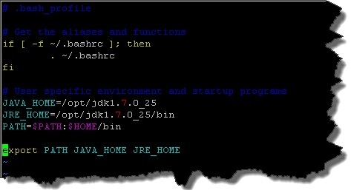
Environment contd.
Eg: .bash_profile file

Slide 47
Setting and Viewing Environment Variable
Environment variables are set using the export command
$ export JAVA_HOME=/opt/jdk1.7.0_25
To view the environment variable
$ echo $ JAVA_HOME
environment variables are set without using $ sign but while accessing them we use $
To show all values of these variables
$ env | less
Setting the PATH
environment variables are set without using $ sign but while accessing them we use $
$export PATH=$PATH:$JAVA_HOME

Slide 48
Setting and Viewing Environment Variable
Setting the CLASSPATH
To set class path
$ export CLASSPATH=$CLASSPATH:/home/rsing5

Slide 49
Exercise
Find the location of Java directory in Unix machine and set the path JAVA_HOME
Navigate till /usr directory and check for the java source and library files
Test the installation by writing a Hello World Program in your local machine and FTP to Unix machine.

Slide 50
Process

Slide 51
Process Control
Whenever a command is issued in UNIX, it creates or starts a new process
Each process submitted to the kernel is given a unique process ID.
Starting a Process
Foreground process
When any command is issued a foreground process is started
$ls starts a foreground process
Background process
A background process is one that does not need manual intervention
The advantage of running a process in the background is that other commands can also be executed; need not to wait until first one completes.
To start a background process is to add an ampersand ( &) at the end of the command
$ls &
Ref: http://www.ee.surrey.ac.uk/Teaching/Unix/

Slide 52
Process Control contd.
Listing Running Process
To see own processes ps (process status) command is used
ps –f ( f for full), creates a full listing
ps –a shows information about all users
ps – e to list all process running on the system, not just associated with current shell
Ref: http://people.ischool.berkeley.edu/~kevin/unix-tutorial/section12.html

Slide 53

Process Control contd.
Eg:
UID: User ID that this process belongs to (the person running it).
PID: Process ID.
PPID: Parent process ID (the ID of the process that started it).
TTY: The controlling terminal for the current process
STIME: Process start time
COMMAND: The command that started this process.

Slide 54
Process Control contd.
Stopping Processes
With CTRL + C keystroke (the default interrupt character) will exit the command. This works when process is running in foreground mode.
OR
Using the kill command with PID (get PID using ps command).
$kill <pid>
Forcefull stopping
If a process ignores a regular kill command, kill -9 followed by the process ID is used
$kill -9 <pid>
Question: How can you catch Kill signal in your Java program?

Slide 55
vi Editor

Slide 56
vi Editor
There are many ways to edit files in Unix and one of the best ways is using screen-oriented text editor vi.
Is usually available on all the flavors of Unix system.
vi has two operation modes
Operation Modes
Command mode
Insert mode
Ref: http://www.tutorialspoint.com/unix/unix-getting-started.htm

Slide 57
Operation Modes
Command Mode
This mode enables to perform administrative tasks such as saving files, executing commands, cutting (yanking) and pasting lines or words, and finding and replacing.
vi always starts in command mode
On pressing Esc twice, vi comes back to command Mode
Insert Mode
This mode enables to insert text into the file.
Everything that's typed in this mode is interpreted as input and is put in the file.
To come in insert mode, type i.
To come out of insert mode, press the Esc key

Slide 58
vi commands
Starting vi Editor
$vi <filename>
Creates a new file if it does not exist, otherwise opens existing file.
$view <filename>
$vi -R filename
Opens an existing file in read only mode
Getting out of vi
The command to quit vi is :q
To quit out of vi without saving is :q!
To save the contents of the editor is :w
Save changes and exit out of vi in command mode is ZZ
Best Practice: On production boxes use ‘view’ command to view the file

Slide 59
vi commands contd.
Moving Cursor in vi
h moves the cursor 1 space left
j moves the cursor 1 space down
k moves the cursor 1 space up
l moves the cursor 1 space right
^ moves the cursor to the start of the line
$ moves the cursor to the end of the line
Copy and Paste Commands
yy : Copies the current line.
yw : Copies the current word from the character the lowercase w cursor is on until the end of the word.
p : Puts the copied text after the cursor
P : Puts the yanked text before the cursor

Slide 60
vi commands contd.
Word and Character Searching
For a string search, the / and ? commands are used
The / command searches forwards (downwards) in the file.
The ? command searches backwards (upwards) in the file.
The n and N commands repeat the previous search command in the same or opposite direction respectively
Deleting Characters in vi
x: Deletes the character under the cursor location.
dw : Deletes from the current cursor location to the next word.
dd : Deletes the line the cursor is on.
Most commands in vi can be prefaced by the number of times the action occur
Eg: 2x deletes two character under the cursor location

Slide 61
Exercise
Create a java program to add two numbers in vi
Run the program and print the output on the console
Redirect the output to a file.

Slide 62
Shell Programming

Slide 63
Need for a Shell script:
A java program needs to run on Unix. Program needs to run 24x7, though needs a quick restart once everyday.
What all is needed to run and maintain this process:
JAVA_HOME needs to be set
Classpath for the program needs to be set
Logic needs to be added to ensure java process has stopped and started successfully
Some special JVM settings like JMX_PORT needs to be set.

Slide 64
What is shell?
The shell provides with an interface to the UNIX system. It gathers input and executes programs based on that input
A shell is an environment in which commands, programs, and shell scripts can run.
Two major types of shells, Bourne and C Shell
subcategories for Bourne Shell are
Bourne shell ( sh)
Korn shell ( ksh)
Bourne Again shell ( bash)
POSIX shell ( sh)
The different C-type shells are
C shell ( csh)
TENEX/TOPS C shell ( tcsh)
Ref: http://www.tutorialspoint.com/unix/unix-getting-started.htm

Slide 65
What is shell? contd.
Shell prompt
The prompt, $, which is called command prompt, is issued by the shell
The shell reads input after Enter is pressed.
For Bourne shell, $ is prompt
For C shell, % is prompt
Shell Scripts
Shell script is a list of commands, which are listed in the order of execution
Shell scripts and functions are both interpreted, not compiled
Shell scripts always starts from hash bang construct
Eg:
#!/bin/bash

Slide 66
What is shell? contd.
Variables
The name of a variable can contain only letters ( a to z or A to Z), numbers ( 0 to 9) or the underscore character ( _).
Unix Shell variables would have their names in UPPERCASE
Ref: http://sc.tamu.edu/help/general/unix/vars.html

Slide 67
What is shell? contd.
Variable Types
Local Variables: A local variable is a variable that is present within the current instance of the shell. It is not available to programs that are started by the shell. They are set at command prompt.
Environment Variables: An environment variable is a variable that is available to any child process of the shell. Some programs need environment variables in order to function correctly. Usually a shell script defines only those environment variables that are needed by the programs that it runs.
Shell Variables: A shell variable is a special variable that is set by the shell. Is equivalent to class variables in java.

Slide 68
Variables
Defining Variables
Variables are defined as follows::
variable_name=variable_value
Eg: VAR1=“GMI”
VAR2=10
Acessing Variables
To access the value stored in a variable, prefix name with the dollar sign ( $)
Eg:
#!/bin/sh
NAME=“GMI“
echo $NAME
Array Variables
Array variables can hold multiple values at the same time.

Slide 69

Basic Operators
Arithmetic Operators.
Relational Operators.
String Operators.
File Test Operators
The Bourne shell didn't originally have any mechanism to perform simple arithmetic but it uses external programs called expr.
Eg: To add two numbers
There must be spaces between operators and expressions for example 2+2 is not correct, where as it should be written as 2 + 2.
Complete expression should be enclosed between ``, called inverted commas.
Notes:
Facilitator need not go through each and every operators rather we should do a simple demo which shows how to solve a particular problem using some operators , (we might use finding the largest of 3 ) , after this we should give one very simple exercise to them for practice and that’s how we should cover operators.

Slide 70
Arithmetic Operators
Shell supports Addition, Subtraction, Multiplication, Division, Modulus, Assignment, Equality and Not Equality
Addition : `expr $a + $b`
Assignment : a=$b would assign value of b into a
Not Equality: [ $a != $b ] would return true/false
Conditional expressions would be put inside square braces with one spaces around them.
All the arithmetical calculations are done using long integers

Slide 71
Relational Operators
Relational operators are specific to numeric values
These operators would not work for string values.
Supports equal, not equal, greater than, greater than equal to , less than, lesser than equal to
-gt : Checks if the value of left operand is greater than the value of right operand; [ $a -gt $b ]
-le : Checks if the value of left operand is less than or equal to the value of right operand; [ $a -le $b ]
Note: All the conditional expressions are put inside square braces with one spaces around them

Slide 72
String Operators
Operators that perform on string values are equal, not equal, size is zero, non zero
Eg: Assume variable a holds "abc" and variable b holds "efg" then
[ $a = = $b ] is not true
[ $a != $b ] is true.
[ -z $a ] is not true. //checks if operand size is zero

Slide 73
Decision Making
Conditional Statements to perform different actions:
The if...else statements
The case...esac statement
The if...else statements:
Unix Shell supports following forms of if..else statement:
If…fi statement
If…else…fi statement
If…elif…else…fi statement
The case...esac Statement:
There is only one form of
case...esac statement

Slide 74
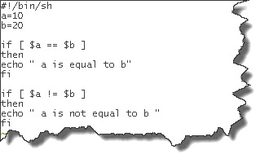

Decision Making contd.
If…else statement
Syntax:
if [ expression ]
then
Statement(s) to be executed if expression is true
fi
Output:

Slide 75
Decision Making contd.
case...esac
case word in
pattern1)
Statement(s) to be executed if pattern1 matches
;;
pattern2)
Statement(s) to be executed if pattern2 matches
;;
esac

Slide 76
Decision Making contd.
Example:
#!/bin/sh
FRUIT="kiwi"
case "$FRUIT" in
"apple")
echo "Apple pie is quite tasty."
;;
"banana")
echo "I like banana nut bread."
;;
"kiwi")
echo "New Zealand is famous for kiwi."
;;
esac

Slide 77
Shell Loops
Loops are a powerful programming tool that enables to execute a set of commands repeatedly.
The while Loop
The for loop
The until loop
The select loop

Slide 78
Loops contd.
while loop
Syntax:
while expression
do
Statement(s) to be executed if command is true
done
Eg:
#!/bin/sh
a=0
while [ $a -lt 10 ]
do
echo $a a=`expr $a + 1`
done

Slide 79
Shell Functions
Function enables to break down the overall functionality of a script into smaller, logical subsections
Recursive Functions are also allowed in Unix.
Creating Functions
Syntax
function_name () {
list of commands
}

Slide 80
Shell functions contd.
Eg:
#!/bin/sh
# Define your function here
Hello () {
echo "Hello World"
}
# Invoke your function
Hello
Execution of script would produce following result:
$./test.sh
Hello World
$

Slide 81
Assignment
Write a java program that creates n number of files with random dates prefixed in a log directory
Now, assume that you have n number of log files in log directory.
Write a shell script that does below mentioned house keeping activity
Find all the log files that have not been modified in last 30 days.
Archive the logs file that are older than 30 days to archive directory.
Inside the archive directory, files which are older than 60 days, should be deleted.
Example Log directory:
MyApplicationLog.2Dec2013.1.log, MyApplicationLog.3Dec2013.2.log …..
Directory where files should be moved:
/log/archive

Slide 82
Before we close:
Need to decide on assignment submission date.
0 evaluation for whole of Unix if assignment not submitted.
Read Self-Study. Assessment will have questions from Self-Study
In order to use Putty from home, install Junos software.
Search ‘Junos’ in PeoplePortal OR
Get it from: https://peopleportal2.sapient.com/Content/IT/Pages/VPN.aspx

Slide 83
Thank You !

