Slide 1
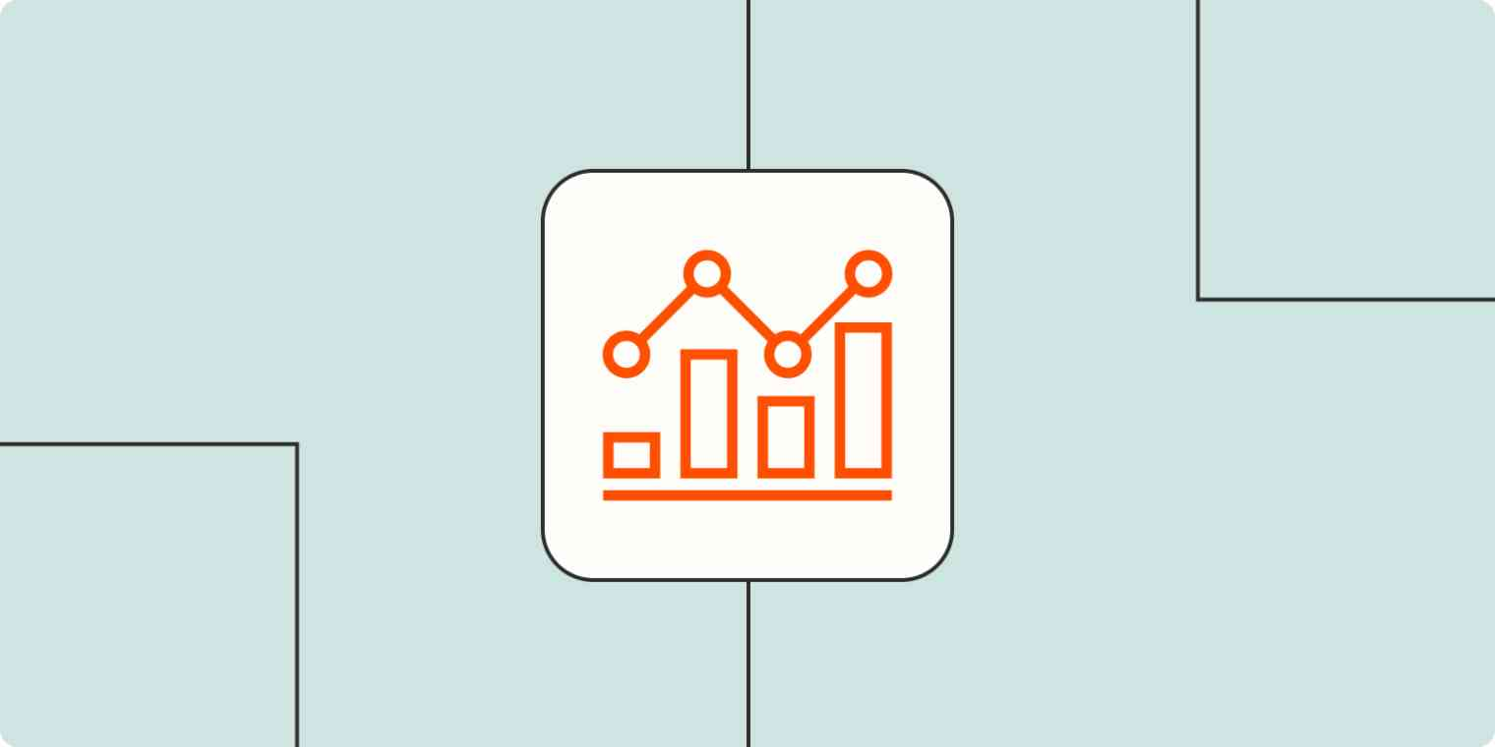
Data Analysis Dashboard

